Slide 1
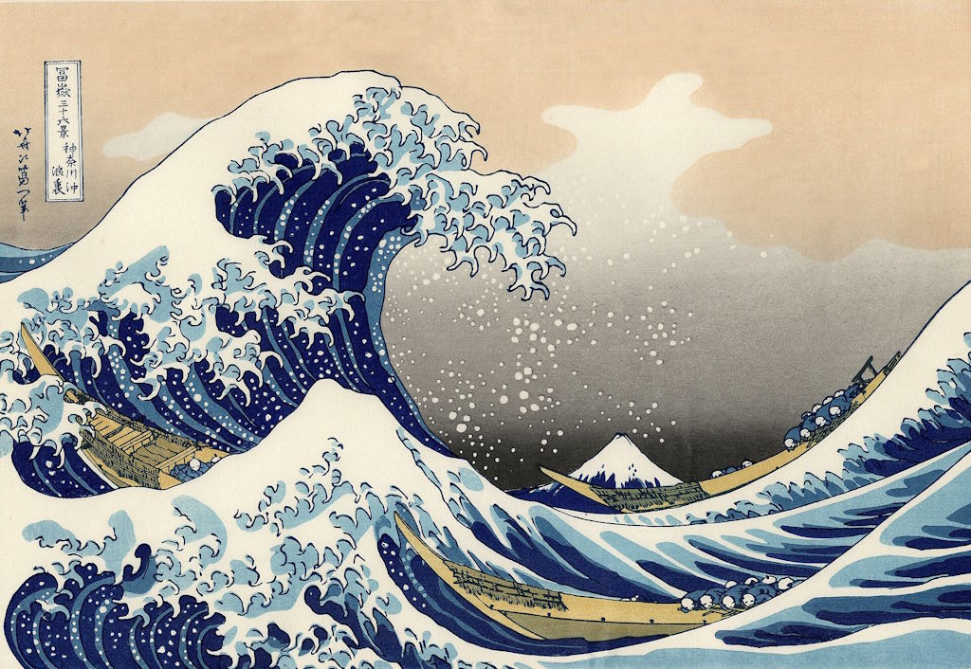
2.2 Waves
CC0
Notes:
The Great Wave off Kanagawa by Hokusai

Slide 2
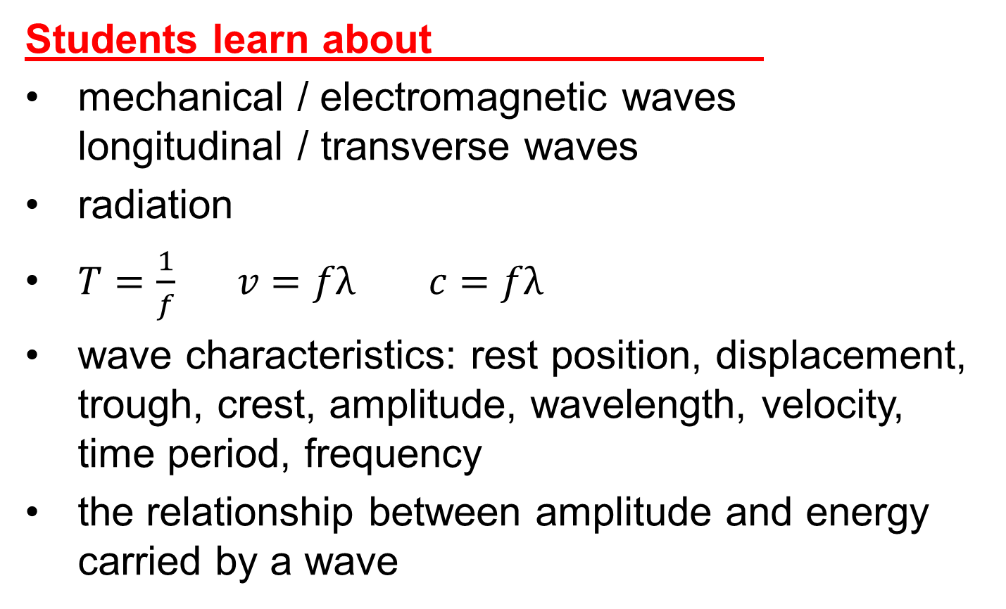
Physics Specification 2.2
2.2 Travelling waves as models of disturbances transferring energy without transferring matter
Students learn about
mechanical / electromagnetic waves
longitudinal / transverse waves
radiation
$T=\frac{1}{f} v=fλ c=fλ$
wave characteristics: rest position, displacement, trough, crest, amplitude, wavelength, velocity, time period, frequency
the relationship between amplitude and energy carried by a wave
Source: LC Physics Specification (2025), ncca.ie, © NCCA

Slide 3
Physics Specification 2.2
2.2 Travelling waves as models of disturbances transferring energy without transferring matter
Students should be able to
model wave motion
Source: LC Physics Specification (2025), ncca.ie, © NCCA

Slide 4
Physics Specification 2.2
2.2 Travelling waves as models of disturbances transferring energy without transferring matter
Students learn about
resonance as the observed phenomenon when driving frequency = the natural frequency of vibration
Students should be able to
investigate resonance in real life situations using secondary sources
Source: LC Physics Specification (2025), ncca.ie, © NCCA

Slide 5
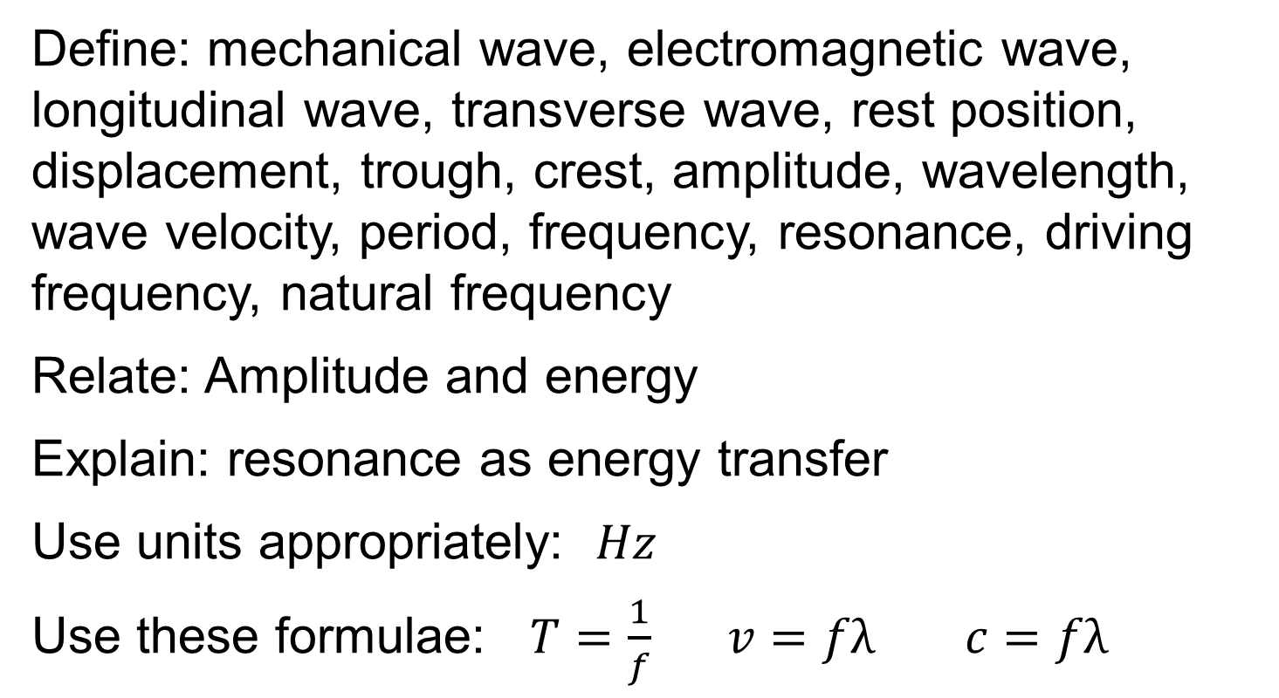
Revision summary
Define: mechanical wave, electromagnetic wave, longitudinal wave, transverse wave, rest position, displacement, trough, crest, amplitude, wavelength, wave velocity, period, frequency, resonance, driving frequency, natural frequency
Relate: Amplitude and energy
Explain: resonance as energy transfer
Use units appropriately: $Hz$
Use these formulae: $T=\frac{1}{f} v=fλ c=fλ$

Slide 6
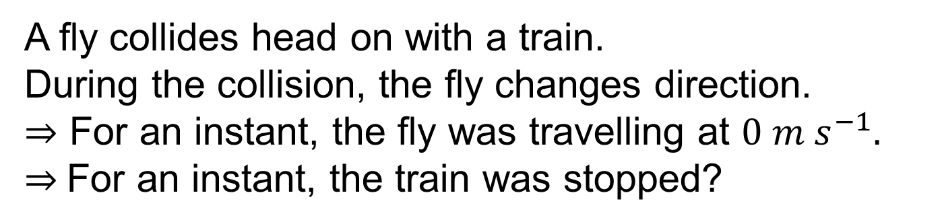


Thought experiment
$$2 m s^{−1}$$
$$20 m s^{−1}$$
A fly collides head on with a train.
During the collision, the fly changes direction.
$⇒$ For an instant, the fly was travelling at $0 m s^{−1}.$
$⇒$For an instant, the train was stopped?
Is this possible?
Describe what actually happens.
Notes:
The impact sends a tiny pressure wave through the train. It starts with a tiny deflection of the window.

Slide 7
What is a wave?
A wave is a disturbance that transfers energy without transferring matter.
LC specification
Wave
Energy
CC0
Definition wording: LC Physics Specification (2025), ncca.ie, © NCCA

Slide 8
What is a travelling wave
A moving disturbance that transfers energy without transferring matter.

Slide 9
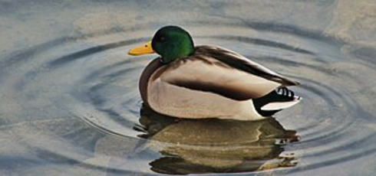
Give examples of travelling waves
Wave on a rope
Waves on water
CC0
Sound waves
Earthquakes

Slide 10
Waves transfer energy
Wave
CC0
But the medium does not travel
Once the wave has passed, the rope is in the same place.
Imagine a Mexican wave at a football match – the wave travels, the people do not

Slide 11
Give examples of
Mechanical and Electromagnetic waves
Water waves
Sound waves
Waves on a rope
Light waves
Infrared waves
Radio waves
X-Rays

Slide 12
What does “oscillate” mean?
A periodic moving back and forth
e.g.
the bob on a pendulum oscillates
a student oscillates between home and school
a branch on a tree oscillates in the wind

Slide 13
What is a mechanical wave?
A disturbance that passes through matter by making the matter particles vibrate.
CC0

Slide 14

What is an electromagnetic wave?
A wave that passes through matter or a vacuum where the disturbance is oscillating electric and magnetic fields.
CC0
gamma rays, x-rays, ultraviolet, visible light, infra-red, microwaves, radio waves.

Slide 15
Do electromagnetic waves need a medium?
No, they can travel in a vacuum.
CC0

Slide 16
What is meant by the Electromagnetic Spectrum?
High frequency
gamma rays
x-rays
ultraviolet light
visible light
infrared
microwaves
radio waves
The full range of electromagnetic waves.
Low frequency

Slide 17
Name another non-mechanical wave?
A gravitational wave
Gravitational waves are created when two black holes collide. The two bodies spiral towards each other and release vast amounts of energy in the form of a variable gravitational field
This is not on the course, these waves were only a theory until the first observation in 2016.

Slide 18
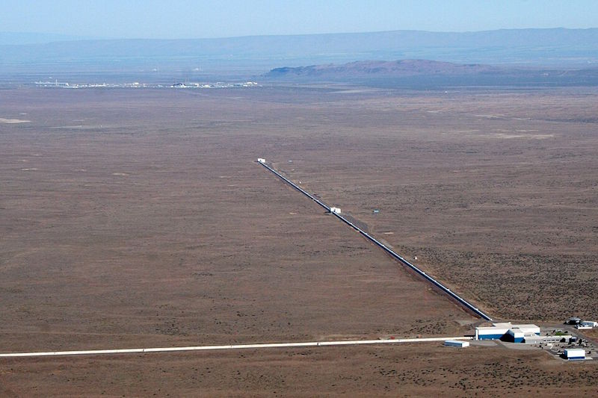
Detecting gravitational waves
The LIGO Hanford Observatory, USA
Notes:
The observatory has two perpendicular tubes 4 km long at right angles to one another. A very high intensity laser is split and sent down each tube and reflected back towards a single light detector. The beams are arranged to be 180 degrees out of phase when they arrive at the light detector. This causes almost total destructive interference. Gravitational waves distort space time and causes the pathlengths of the two light beams to change very slightly thus creating a small but detectable difference in relative phase. The difference in phase causes more light to appear at the detector, allowing measurements to be taken.

Slide 19

Transverse and longitudinal waves
CC0
Animation link
CC0
Animation link

Slide 20
What is a transverse wave?
A wave whose vibrations are perpendicular to the direction of travel HL2025
Direction of travel
CC0
Direction of vibration
the rope vibrates at right angles to the direction of travel
Definition wording per SEC marking schemes at examinations.ie

Slide 21
What is a longitudinal wave?
A wave whose direction of vibration is parallel to the direction of travel.
Direction of vibration
CC0
animation link
Direction of travel
This animation shows single pulses as opposed to a continuous wave.

Slide 22
Longitudinal waves
Direction of travel
Direction of vibration
compression
rarefaction

Slide 23
Wave examples
Transverse waves:
Waves on a rope
Water waves
Electromagnetic waves
Longitudinal waves:
Sound waves
Ultrasonic waves
Compression waves on a spring

Slide 24
What are the peaks and valleys called?
Crests
Troughs

Slide 25
What is the rest position?
The location of the particles when they are not vibrating
Also called the equilibrium position.
Rest position

Slide 26
Wave Characteristics

Slide 27
What is meant by amplitude?
The maximum displacement from the rest position. HL2025
Amplitude (A)
Definition wording per SEC marking schemes at examinations.ie

Slide 28
What is meant by wavelength?
The distance between two adjacent crests.
HL 2016
Wavelength (λ)
Definition wording per SEC marking schemes at examinations.ie

Slide 29
What is a cycle?
One full execution of a repeating motion.
one cycle
also one cycle
E.g. for a pendulum, one swing there and back

Slide 30
What is meant by frequency?
The number of cycles per second.
1 second
3 cycles
e.g. f = 3 cycles per second

Slide 31
What is the SI unit of frequency?
The SI unit of frequency is the hertz (Hz).
1 hertz = 1 cycle per second
1 Hz = 1 s⁻¹

Slide 32
What is the period of a wave?
The time for one cycle.
T
T
T
The letter T is used for time-period

Slide 33
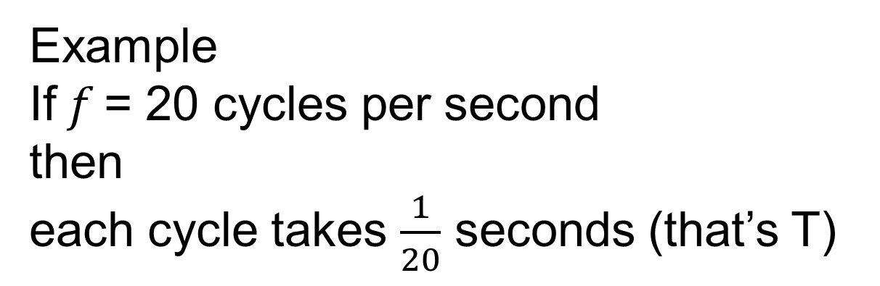
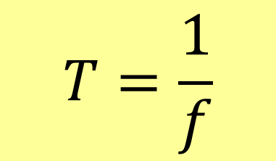
What is the relationship between, frequency (f ) and period (T)?
$$T=\frac{1}{f}$$
T
Example
If 𝑓 = 20 cycles per second
then
each cycle takes $\frac{1}{20}$ seconds (that’s T)

Slide 34
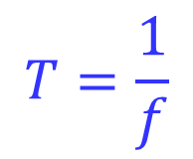


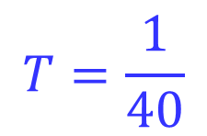
Example 1
A wave has a frequency of 40 Hz, calculate its period.
$$f=40 Hz$$
$$T=\frac{1}{f}$$
$$T=\frac{1}{40}$$
$$T=0.025 seconds$$

Slide 35
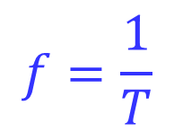
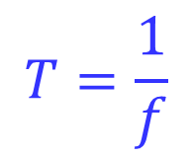
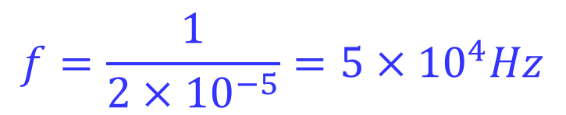
Example 2
A wave has a period of 2 x 10⁻⁵ s. What is its frequency?
$$T=\frac{1}{f}$$
$$f=\frac{1}{T}$$
$$f=\frac{1}{2×{10}^{−5}}=5×{10}^{4}Hz$$

Slide 36

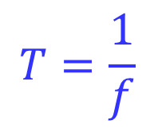
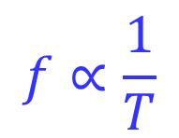
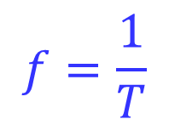
Example 3
If the period of a wave increases by a factor of 4, what happens to the frequency of the wave?
$$T=\frac{1}{f}$$
1. The formula is:
2. Identify the variable you need to find the change in:
$$f$$
$$f=\frac{1}{T}$$
3. Rewrite with 𝒇 as subject
4. Write as a proportional relationship
$$f∝\frac{1}{T}$$
5. If T increased by a factor of 4,
𝒇 must decrease by a factor of 4

Slide 37





Exercise
A wave has a period of 5 milliseconds. What is its frequency?
$$200 Hz$$
A wave has a frequency of 5 MHz. What is its period?
$$2×{10}^{−7} s$$
A wave has a period of 4 μs. What is its frequency?
$$2.5×{10}^{5} Hz$$
$$or 250 kHz$$
A wave has a frequency of 50 Hz. What is its period?
$$20 ms$$

Slide 38



Exercise
A sea wave has a 1.2 metre difference between crest and trough, what is the amplitude of the wave?
$$A= 0.6 m$$
If the frequency of a wave doubled, what would happen to its period?
$$halved$$
A water wave has an amplitude of 3 mm, What is the vertical distance between a crest and a trough.
$$6 mm$$

Slide 39
What is the symbol for speed of a wave?
c
c (wave speed)
c is used instead of v for wave motion
in E=mc² , c is the speed of light

Slide 40
Relate 𝒄, 𝒇 𝐚𝐧𝐝 𝝀 in an equation?
c = f λ
Velocity = Frequency × Wavelength
c
λ

Slide 41
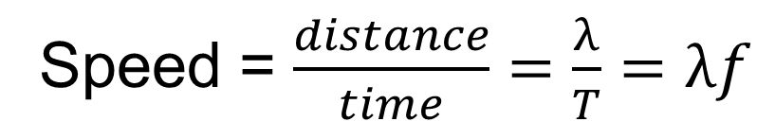
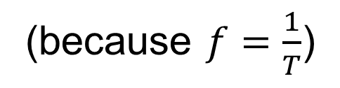
Justify c = f λ
Imagine a wave at an instant of time
One of the crests has been marked
One cycle later the crest has moved λ metres
c
λ
Speed = $\frac{distance}{time}=\frac{λ}{T}$ $=λf$
(because $f=\frac{1}{T}$)

Slide 42
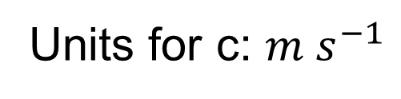
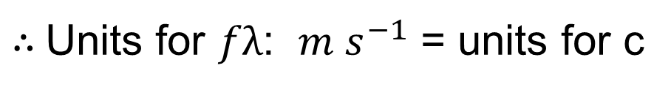
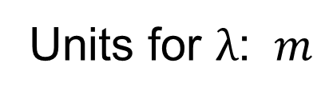
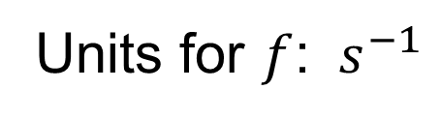
Verify the units for c = f λ
Units for c: $m s^{−1}$
Units for $f$: $s^{−1}$
Units for $λ$: $m$
$∴$Units for $fλ$: $m s^{−1}$ = units for c
c
λ

Slide 43


Example 4
A wave has a frequency of 20 Hz and a wavelength of 5 meters, what is its speed?
c = f λ
$$c= 20×5$$
$$c=100 m s^{−1}$$

Slide 44

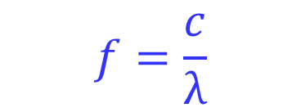

Example 5
The speed of light can be found in the formula book on page 47. Calculate the frequency of a light that has a wavelength of 600 nm.
c = f λ
$$f=\frac{c}{λ}$$
$$f=\frac{2.998×{10}^{8}}{600×{10}^{−9}}$$
$$f=4.997×{10}^{14} Hz$$

Slide 45
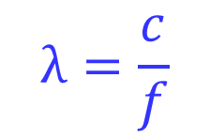


Example 6
When a wave passes from one medium to another, its speed and wavelength change but its frequency stays the same. If the speed increases by a factor of 3, what happens to the wavelength?
1. The formula is:
c = f λ
2. Identify the variable you need to find the change in:
$$λ$$
3. Rearrange with λ as subject
$$λ=\frac{c}{f}$$
4. Write as a proportional relationship
$$λ∝c$$
(f is constant)
5. Answer
If c increases by factor of 3,
λ also increases by a factor of 3

Slide 46
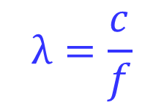

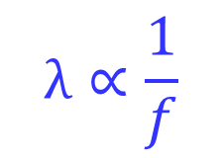
Example 7
If the frequency of a wave is trebled and the speed remains constant, what happens to its wavelength?
1. The formula is:
c = f λ
2. Identify the variable you need to find the change in:
$$λ$$
3. Rearrange with λ as subject:
$$λ=\frac{c}{f}$$
$$λ∝\frac{1}{f}$$
4. Write as a proportional relationship:
(c is constant)
5. Answer
If f increases by factor of 3,
λ reduces by a factor of 3

Slide 47
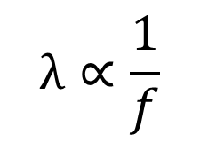
Do I need to learn all the steps?
Your key aim is a simple proportional relationship with the unknown on the left and the known on the right – e.g.
4. Write as a proportional relationship:
$$λ∝\frac{1}{f}$$
The steps are just how to get there.
Use them until you don’t need them.
Questions like this can come up in all topics, not just waves.

Slide 48





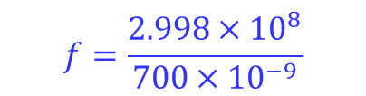

Exercise
A wave has a frequency of 30 Hz and a wavelength of 4 meters, what is its speed?
c = f λ
$$c=30×4$$
$$c=120 m s^{−1}$$
Calculate the frequency of a light that has a wavelength of 700 nm. Speed of light is in the formula book.
$$f=\frac{c}{λ}$$
$$f=\frac{2.998×{10}^{8}}{700×{10}^{−9}}$$
c = f λ
$$f=4.283×{10}^{14} Hz$$
A 440 Hz sound wave is found to have a wavelength of 77 cm, calculate the speed of the sound.
c = f λ
$$c=440×0.77$$
$$c=339 m s^{−1}$$

Slide 49


Exercise
The frequency of a wave is doubled, what happens to its wavelength if the speed remains constant?
c = f λ
$$λ∝\frac{1}{f}$$
λ is halved
When a wave passes from one medium to another, its speed and wavelength change but its frequency stays the same. If the wavelength increased by a factor of 4, what happened to the speed?
c = f λ
$$c∝λ$$
If λ increased by factor of 4,
c increased by a factor of 4

Slide 50
Graphical summary of terms
Cycle
Velocity c
Crest
Amplitude A
Trough
Wavelength λ
Crest
Trough
Cycle
Velocity c
Amplitude
wavelength

Slide 51
Units and symbols used for waves
Quantity | Quantity symbol | Unit | Unit symbol
Wavelength | λ | metre | m
Frequency | f | hertz | Hz
Period | T | second | s
Velocity | c | metres per second | m s⁻¹
Amplitude | A | various | various

Slide 52
How is energy transfer related to wave amplitude?
Greater amplitude = more energy transferred
CC0
Less energy
More energy

Slide 53




Exercise
The energy of a certain wave is given by the formula E=kA² where k is a constant and A is the amplitude of the wave. By how much must the energy change in order to double the amplitude of the wave?
$$E∝A^{2}$$
Energy must increase by a factor of 4
The energy of a wave is proportional to the square of the amplitude of the wave. By how much must the amplitude change in order to double the energy of the wave?
$$E∝A^{2}$$
$$A∝\sqrt{E}$$
Amplitude must increase by a factor of $\sqrt{2}$
Notes:
Students do not need to learn this formula but based on the sample papers, questions quoting an unknown formula can be asked.

Slide 54
Resonance

Slide 55
What is meant by the natural frequency of a body
The natural frequency of a body is the frequency it will freely vibrate at with no external driving force.
If a garden swing is pulled back and let go, it will swing back and forth at its natural frequency

Slide 56
What is meant by driving frequency
Driving frequency is the frequency of an external periodic force applied to a system.
If someone gives the swing a series of pushes, then the frequency of these pushes is the driving frequency.

Slide 57
Explain how a series of small pushes can create high energy oscillations in a garden swing
Each successive push adds its small energy to the system.
If the pushes are timed correctly, the amplitude gets much larger than the energy that any individual push could achieve.

Slide 58
What about energy losses?
As amplitude increases, losses also increase. Higher speed = greater air resistance loss, longer swings = greater force x distance loss at the pivot.

Slide 59
When is maximum amplitude reached?
Maximum amplitude is reached when the input energy per cycle = the energy lost per cycle.
The energy loss is usually through friction or air resistance
If the periodic driving force is removed the friction losses cause the amplitude to slowly decrease until the swing stops

Slide 60
What is resonance?
Resonance is the transfer of energy from one body to another when the driving frequency is the same as the natural frequency of the second body.
HL 2015, 2018, 2020, 2023
Transfer of energy
Driving frequency
= natural frequency
Definition wording per SEC marking schemes at examinations.ie
and LC Physics Specification (2025), ncca.ie, © NCCA

Slide 61
Demonstrate resonance with Barton’s pendulums
A
CC0
Set bob A swinging
Observation the other bob of the same length will swing with greatest amplitude
Conclusion: The other bob is resonating because it has the same natural frequency.
Notes:
These demonstrations are no longer mandatory

Slide 62
Demonstrate resonance with strings
Tune the guitar
Finger on 5th fret of thickest string
Pluck that string
The next string starts to vibrate
Repeat on 4th and 6th fret
The next string does not vibrate
CC0

Slide 63
Demonstrate resonance in a tube
Hold the vibrating fork over the tube and raise the tube slowly.
Observation
At one point a loud sound is heard.
Tuning fork
Resonance tube
Water
graduated cylinder
CC0

Slide 64
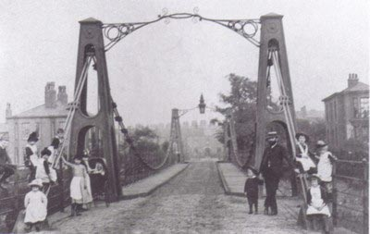
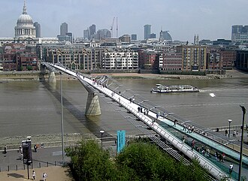
What are the risks for bridges?
Broughton Suspension Bridge, collapsed in 1831 due to soldiers marching in step.
CC0
The Millenium Bridge in London was closed for two years the day after it opened due to a resonance problem.
CC0
Notes:
The famous Tacoma Narrows Bridge collapse is often the attributed to resonance however, expert opinion now favours a similar process called “aeroelastic flutter”

Slide 65
Exercise
In the case of the swing, we saw that the amplitude of the movement is greater than what the energy of one individual push could achieve. Investigate and explain why in the case of resonating guitar strings, the second string does not vibrate with the same or greater amplitude than the first.
In the case of the guitar strings, only a tiny fraction of the driving string’s energy is transferred to the second string. Most of the energy spreads out as sound in the air and only a small fraction reaches the second string.
In the case of the swing, almost all of the push energy is transferred to the swing.
If the second guitar string were to vibrate with greater amplitude, it would mean that it had gained more energy than the first had to give, this contradicts the law of conservation of energy.

Slide 66
Exercise
Investigate a real bridge where oscillations either caused concern or collapse. Using secondary sources: (i) describe what caused the oscillations and what happened to the bridge
(ii) compare the driving frequency and the natural frequency of the bridge.
(iii) describe design features in modern bridges that limit resonance dangers.

Slide 67
Revision summary
Define: mechanical wave, electromagnetic wave, longitudinal wave, transverse wave, rest position, displacement, trough, crest, amplitude, wavelength, wave velocity, period, frequency, resonance, driving frequency, natural frequency
Relate: Amplitude and energy
Explain: resonance as energy transfer
Use units appropriately: $Hz$
Use these formulae: $T=\frac{1}{f} v=fλ c=fλ$

