Slide 1
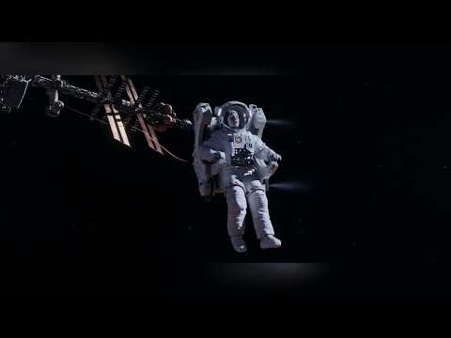
Newton’s Third Law (from the Martian)

Slide 2
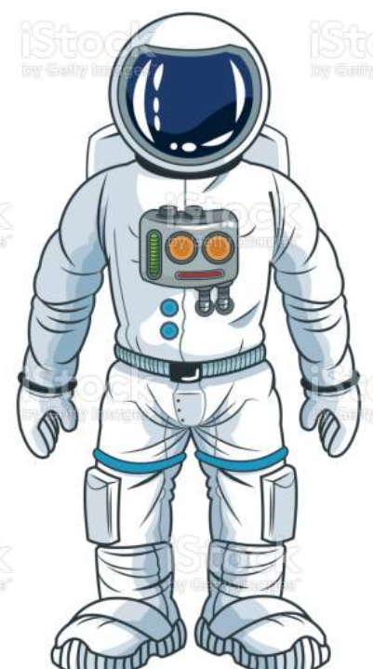
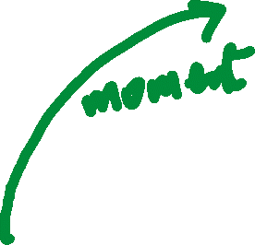
Newton’s Third Law (from the Martian)
Is this plausible?
Arguably.
The air pushed out from the suit would create an equal but opposite force on the astronaut and propel him forwards. But it would be very hard to control.
If the force is not in line with his centre of mass, it would create a turning force (a ‘moment)’ which would cause him to spin around as he moved (even more than the movie suggests)

