Slide 1
Electricity and Magnetism
Problems we can learn from….

Slide 2
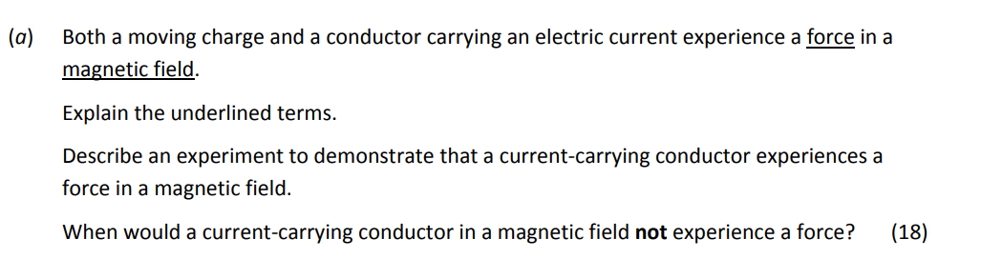
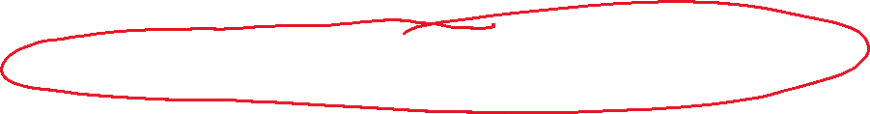
2019 q.9
Explain the underlined terms.
A force is anything causes, or tends to cause, and acceleration.
A magnetic field is that 3D area surrounding a magnet where it creates a force.

Slide 3
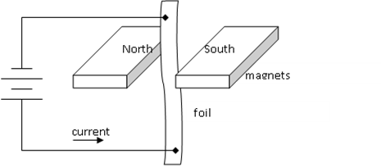
2019 q.9
Describe an experiment to demonstrate that a current carrying conductor experiences a force in a magnetic field.
Method:
Set up a circuit as shown, supporting the foil with a retort stand
Observations / Conclusion:
When the current flows, the strip of foil moves, indicating that a current carrying conductor in a magnetic filed experiences a force.

Slide 4
2019 q.9
When would a current‐carrying conductor in a magnetic field not experience a force?
The conductor would not experience a force in a situation where the current was flowing parallel to the direction of the magnetic field lines.
Additional question (not from exam): how could we demonstrate this in the lab?

Slide 5
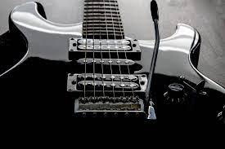
Question….
Electric guitars make use of electromagnetic induction…..
the vibration of the string needs to be converted into a varying electric current…
….but how is this done?
…the pick-ups can hold a coil….
…but the whole string cannot be magnetised….
‘pick-ups’

Slide 6
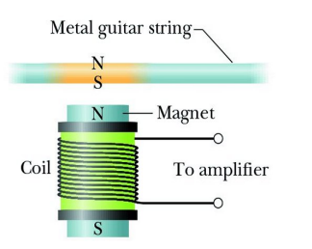
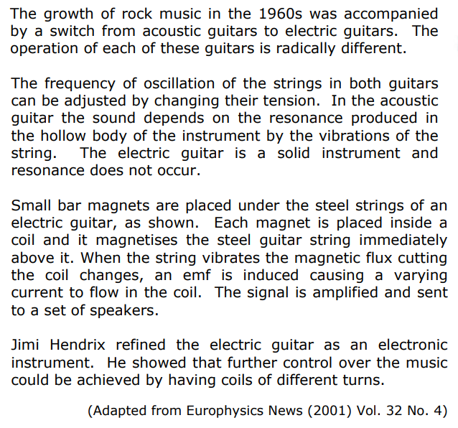

2006 q. 11

Slide 7
2006 q. 11
…
Why must the strings in the electric guitar be made of steel? (7)
Define magnetic flux. (7)
Why does the current produced in a coil of the electric guitar vary? (7)
What is the effect on the sound produced when the number of turns in a coil is increased? (7)
A coil has 5000 turns. What is the emf induced in the coil when the magnetic flux cutting the coil changes by 8 × 10^{–4} Wb in 0.1 s? (7)

Slide 8
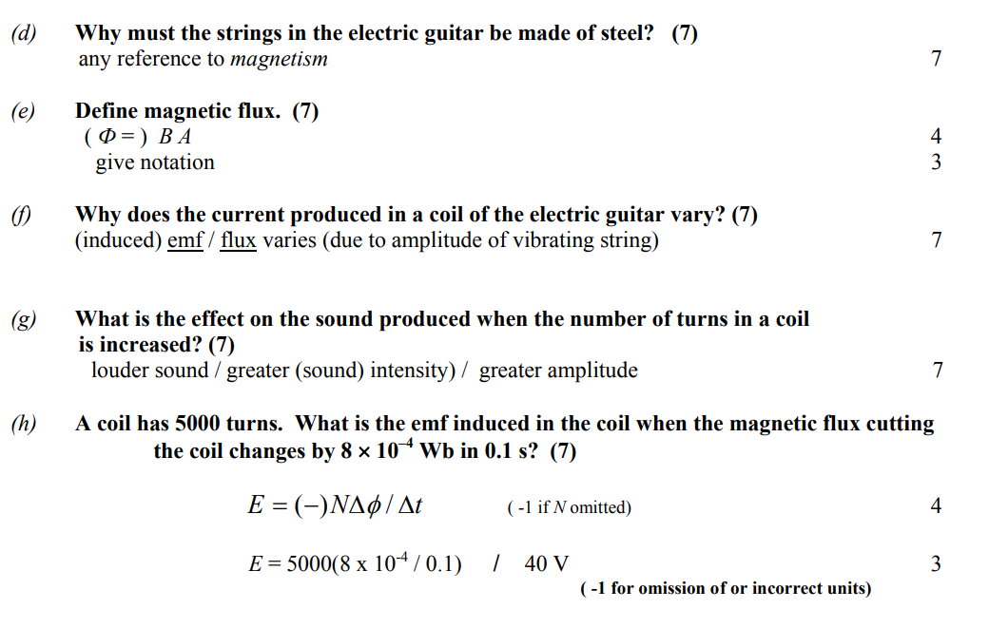
2006 q. 11

Slide 9
2021 q. 10 (extract)
……
The other law of electromagnetic induction is Lenz’s Law
State Lenz’s Law
Explain how Lenz’s Law is a special case of the principle of conservation of energy
Marking scheme….
(vii) State Lenz’s law.
the direction of an induced current (3)
is such as to oppose the change that caused it (3)
(viii) Explain how Lenz’s law….
otherwise energy would be created (5)

Slide 10
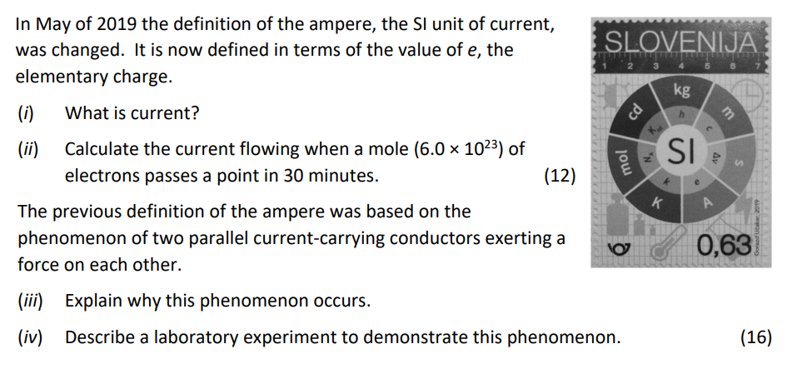
2020 q. 12(d)

Slide 11
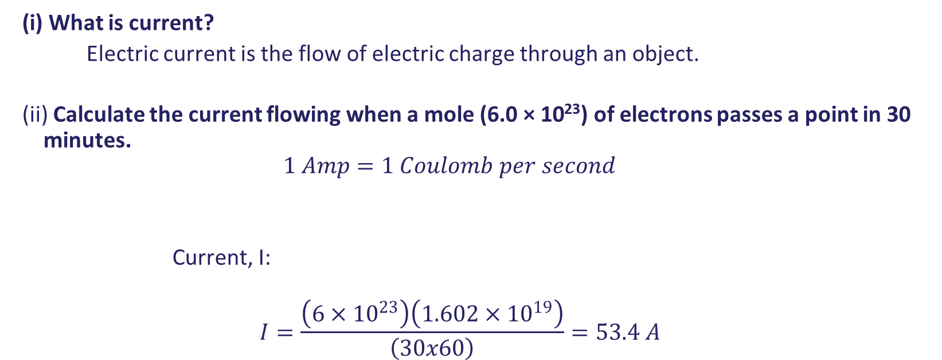
2020 q. 12(d)
(i) What is current?
Electric current is the flow of electric charge through an object.
(ii) Calculate the current flowing when a mole (6.0 × 10²³) of electrons passes a point in 30 minutes.
$$1 Amp=1 Coulomb per second$$
Current, I:
$$I=\frac{\left(6×{10}^{23}\right)\left(1.602×{10}^{19}\right)}{\left(30x60\right)}=53.4 A$$

Slide 12
2020 q 12.(d)
The previous definition of the ampere was based on the phenomenon of two parallel current carrying conductors exerting a force on each other.
(iii) Explain why this phenomenon occurs.
Electricity and magnetism are intertwined.
Every electric current creates a magnetic field. Therefore, if two parallel wires each carry a current, they are each creating a magnetic field, and these fields have an effect on each other, creating magnetic forces on the wires.

Slide 13
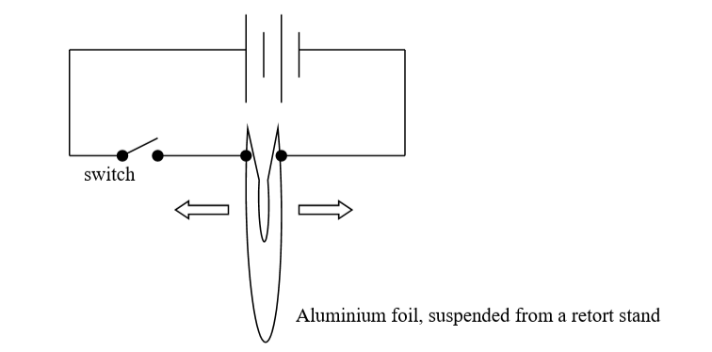
2020 q. 12 (d)
(iv) Describe a laboratory experiment to demonstrate this phenomenon.
Method:
Set up a circuit as shown, supporting the foil with a retort stand.
Switch on the current and observe what happens
Observation / conclusion:
The wires move apart.
This indicates that parallel wires conducting a current will experience a force, the principal on which the definition of the ampere is based.

Slide 14
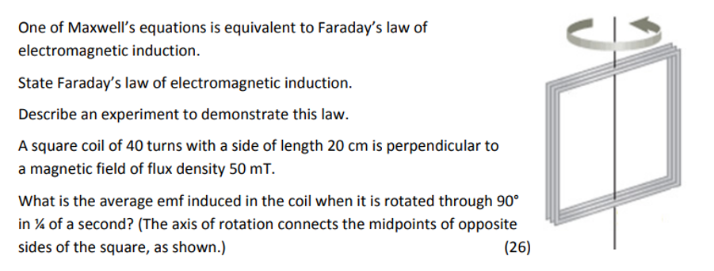
2018 q. 9 (extract)

Slide 15
2018 q. 9
One of Maxwell’s equations is equivalent to Faraday’s law of electromagnetic induction.
State Faraday’s law of electromagnetic induction.
Faraday’s Law states that when there is a change in the magnetic flux linking a coil, an emf is induced in that coil. The strength of the emf is proportional to the rate of change of the flux linking the coil.

Slide 16
2018 q.9
Describe an experiment to demonstrate this (Faraday’s) law.
To demonstrate Farday’s Law
Method:
Set up a circuit as shown here.
Move the magnet towards the coil.
Observations / Conclusion:
When the magnet is moving, a current is shown on the galvanometer.
This indicates that the changing magnetic field is creating an emf.
The faster the magnet moves, the greater the current, as stated in Faraday’s Law.
south north
magnet
galvanometer

Slide 17
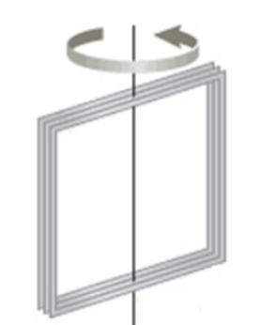
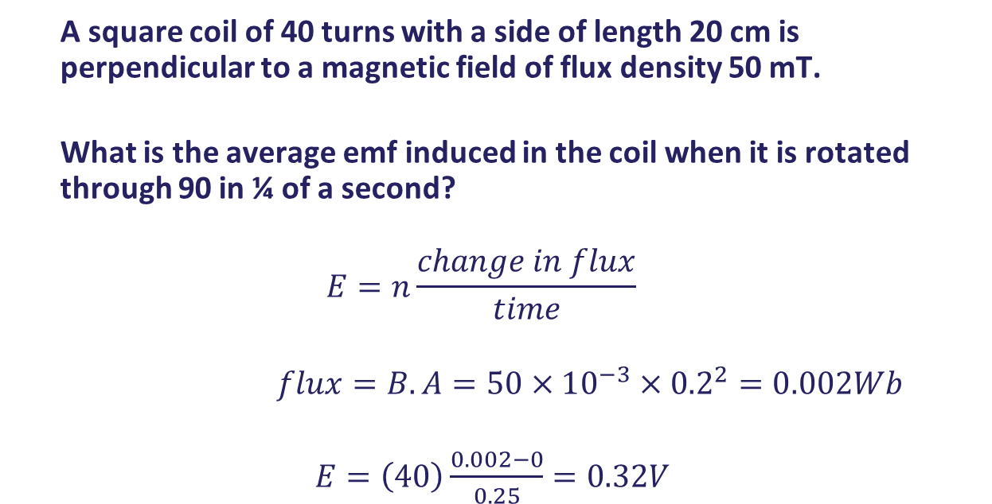
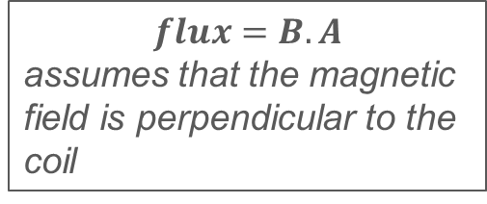
2018 q. 9
A square coil of 40 turns with a side of length 20 cm is perpendicular to a magnetic field of flux density 50 mT.
What is the average emf induced in the coil when it is rotated through 90 in ¼ of a second?
$$E=n\frac{change in flux}{time}$$
$flux=B.A=50×10^{−3}×{0.2}^{2}=0.002Wb$
$E=\left(40\right)\frac{0.002−0}{0.25}=0.32V$
$$flux=B.A$$
assumes that the magnetic field is perpendicular to the coil

