Slide 1
Science Fiction
Newton’s 3rd Law

Slide 2
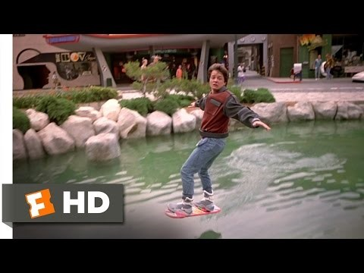
Newton’s Third Law (Back to the Future 2)

Slide 3
Newton’s Third Law (Back to the Future 2)
Is this plausible?
What could hold the hover board of the ground?
A jet of some sort?
But we’d see its effect on the ground, and particularly on the water – so it’s not that
Magnets?
But the whole square would have to be covered with magnets to create repulsion. Unlikely…

Slide 4
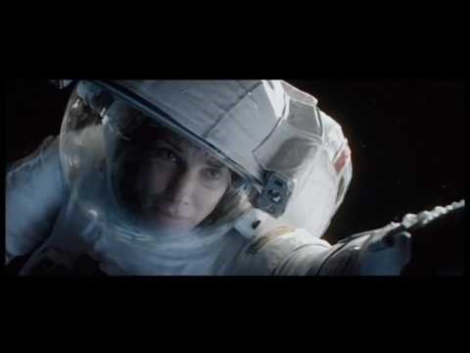
Newton’s First Law? (from Gravity)

Slide 5
Newton’s First Law? (from Gravity)
Is this plausible?
Probably not.
When he lets go of the strap, is there are any force acting on him?
If there is no force, there should be no acceleration. He would remain in place beside the strap, whether or not he was holding on to it.
But, there is some argument about this. If he is still accelerating as he lets go, he would continue to move away (but it should still have been very easy for him to hold on).
Here’s what ‘Gravity’ gets right and wrong about space - The Washington Post

