Slide 1
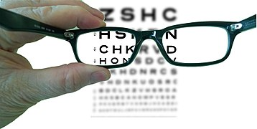

2.3 b Lenses
Version 1.1
Notes:
Changes in version 1.1
Specification text enlarged
Added section header slides
Added a slide o n image descriptions at about slide 21
Added an explanation of 𝑓, F and 2F at about. slide 22
Corrected the use of F and 2F on diagrams
Inserted new example and exercise at about slide 36, 37 to give more practice at calculating f from the formula
On the experiment diagrams change the word “cardboard to “white card”
Formatting changes

Slide 2
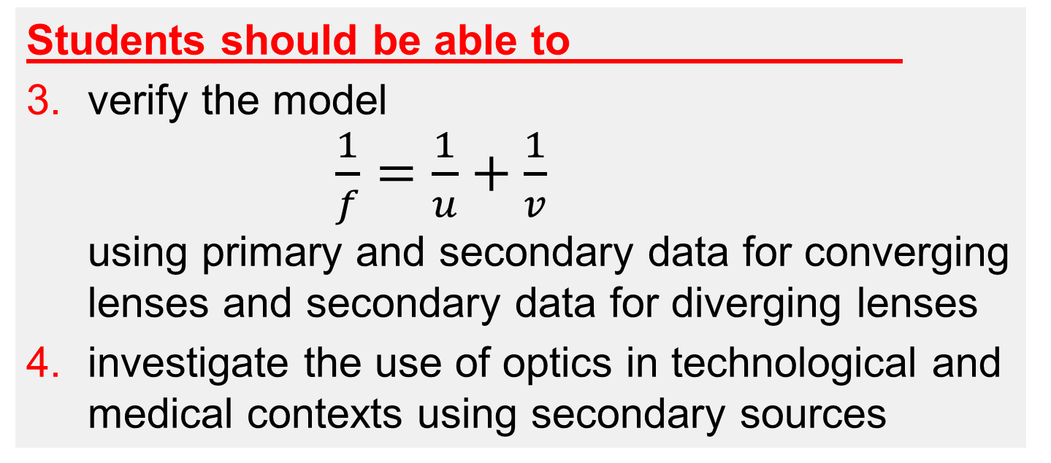
Physics Specification 2.3 (Part b)
2.3. Wave behaviour caused by the interaction of
waves with their environment
Students learn about
converging and diverging lenses
Students should be able to
verify the model
$\frac{1}{f}=\frac{1}{u}+\frac{1}{v}$
using primary and secondary data for converging lenses and secondary data for diverging lenses
investigate the use of optics in technological and medical contexts using secondary sources
Ray Diagrams
Source: LC Physics Specification (2025), ncca.ie, © NCCA
Notes:
Added to new course
Verify model for diverging lenses using secondary data
Use of optics in technological and medical contexts
Gone from old course
Power
Magnification
The Eye

Slide 3
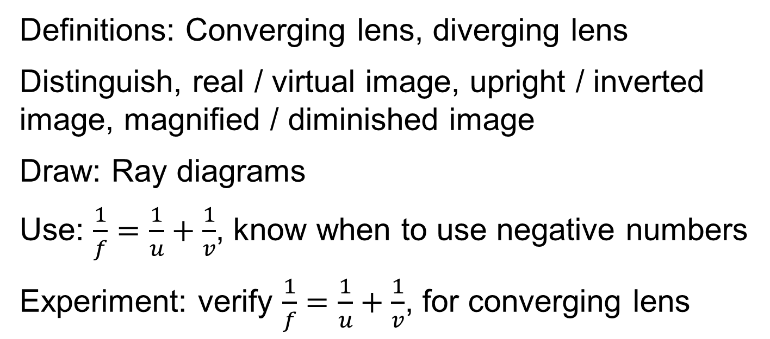
Revision Summary
Definitions: Converging lens, diverging lens
Distinguish, real / virtual image, upright / inverted image, magnified / diminished image
Draw: Ray diagrams
Use: $\frac{1}{f}=\frac{1}{u}+\frac{1}{v}$, know when to use negative numbers
Experiment: verify $\frac{1}{f}=\frac{1}{u}+\frac{1}{v}$, for converging lens
Notes:
V1.1 added
Ray Diagrams and Real virtual upright etc included because of sample paper 1 Q1b

Slide 4
What is a converging lens?
A lens that causes a parallel beam of light to converge
Lens
parallel beam of light
converging beam.
Also called a Convex Lens

Slide 5
What is a diverging lens
A lens that causes a parallel beam of light to diverge
parallel beam of light
Lens
diverging beam.
Also called a Concave lens

Slide 6
Describe a convex and concave Lens
A
B
A Convex Lens is thickest in the centre.
A Concave Lens is thinnest in the centre.
If you exaggerate, it looks like a cave

Slide 7
Label the axis and optic centre
Optic Centre
Axis
The optic centre is the centre of a symmetrical lens
The axis is a normal through the centre.

Slide 8
What is the axis and optic centre of a lens
Axis
The axis is a line perpendicular to the face of the lens and passes through the centre of the lens
Optic centre = geometric centre of a symmetric lens

Slide 9
What is the focus of a lens
the point where all rays parallel to the axis converge after passing through
Rays parallel to axis
Focus
Axis

Slide 10
What is the focal length of a lens?
the distance from the focus to the optic centre of the lens
HL 2022D
Focus
Optic Centre
Focal length
Definition wording per SEC marking schemes at examinations.ie

Slide 11
Ray diagrams: Converging lenses
Ray diagrams appeared in 70% of recent exams!

Slide 12
Why draw an upright arrow here?
Object
It represents the object
It’s clear which is the top and bottom of the object
Its simple

Slide 13
Why is the arrow placed on the axis?
Object
Because the image of it’s base will also be on the axis.
Thus, you only need find the image of the tip.

Slide 14
Ray 1: Draw a ray through the optical centre.
It passes straight through without bending
Object

Slide 15
Ray 2: Draw a ray parallel to the axis.
Where does it go?
Through the focus on far side
Object
F

Slide 16
Can we draw the image now?
Yes, the tip of the image will be at the intersection of the two rays, and the base will be on the axis.
Object
F
Image

Slide 17
Do we need a third ray?
No. But it’s a good test of accuracy to see if it intersects at the same point.
Object
F
Image
F
The third ray passes through the near focus, where should it go after the lens?
It continues parallel to the axis.

Slide 18
What is a real image?
an image formed by the intersection of rays.
OL 2022
Real image
Intersection of rays
Definition wording per SEC marking schemes at examinations.ie

Slide 19
What is a virtual image?
one formed by the apparent intersection of rays. OL 2020, 2022.
Virtual Image
Apparent intersection of rays
Definition wording per SEC marking schemes at examinations.ie

Slide 20
What type of image can form on a screen?
A real image can form on a screen
A virtual image cannot form on a screen

Slide 21
How do we describe images?
Object
Image
Description
/
Diminished / magnified
/
Inverted / upright
/
Real / virtual
virtual image
Same side / Opposite side of lens (as the object)
Remember compare image to object
Notes:
V 1.1 new slide

Slide 22
What do 𝑓, F and 2F stand for?
𝑓 for the focal length (a distance in a formula)
F for the focus (a point on a diagram)
2F for a point twice the distance as F from the optic centre
𝑓
F
2F

Slide 23
Exercise
Complete the ray diagram
2F
F

Slide 24
Exercise
Complete the ray diagram
2F
F
F
2F

Slide 25
What kind of image forms if the object is beyond 2F?
F
2F
2F
F
Object beyond 2F
Real, inverted, diminished, image
Notes:
V 1.1 inverted added to image description

Slide 26
What kind of image forms if the object is at 2F?
F
2F
2F
F
Object at 2F
Real, inverted, same-size image
Notes:
V 1.1 inverted added to image description

Slide 27
What if the object is between 2F and F?
F
2F
2F
F
Object between F and 2F
Real, inverted, magnified image
Notes:
V 1.1 inverted added to image description

Slide 28
What if the object is at F?
Image at infinity
F
2F
2F
2F
Object at F
There is no image, you see a blur.

Slide 29
What if the object is inside F?
Virtual, upright, magnified image
F
2F
2F
F
Object inside F
Notes:
V 1.1 upright added to image description

Slide 30
Exercise
Complete the ray diagram
2F
F
F
2F

Slide 31
Exercise
Complete the ray diagram
2F
F
F
2F

Slide 32
Exercise
Draw a ray diagram to show the formation of an upright image in a magnifying glass. (2019 Q11e)
Source: SEC LC exams at examinations.ie

Slide 33
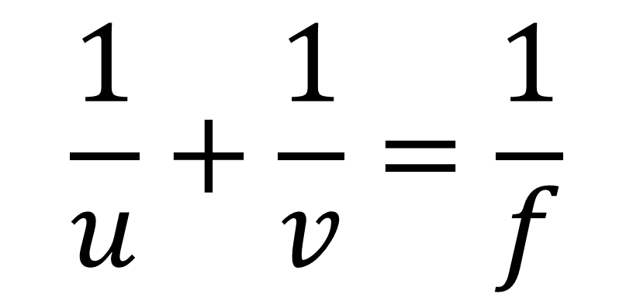
Lens Formula
$$\frac{1}{u}+\frac{1}{v}=\frac{1}{f}$$

Slide 34
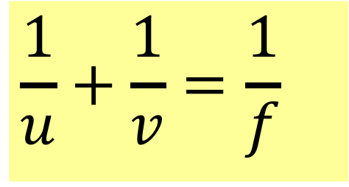


What is the lens formula
$$\frac{1}{u}+\frac{1}{v}=\frac{1}{f}$$
Object
Image
$$u$$
$$v$$
u = distance from object to the optic centre.
v = distance from image to the optic centre.
f = Focal Length of the lens.

Slide 35
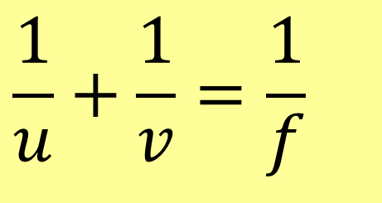
When do you get negatives in the lens formula
$$\frac{1}{u}+\frac{1}{v}=\frac{1}{f}$$
f is positive for a converging lens
f is negative for a diverging lens
v is positive for a real image and
v is negative for a virtual image

Slide 36
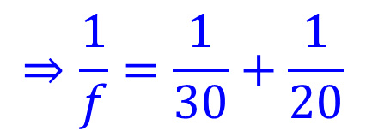
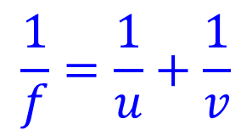
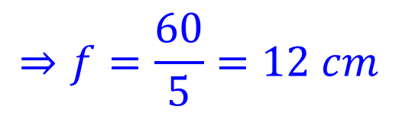
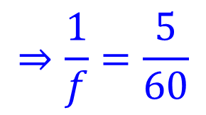
Example 1
An object 30 cm from a converging lens creates a real image 20 cm from the lens. Calculate the focal length of the lens.
$$\frac{1}{f}=\frac{1}{u}+\frac{1}{v}$$
$$⇒\frac{1}{f}=\frac{1}{30}+\frac{1}{20}$$
$$⇒\frac{1}{f}=\frac{5}{60}$$
$$⇒f=\frac{60}{5}=12 cm$$

Slide 37
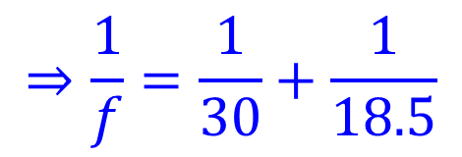
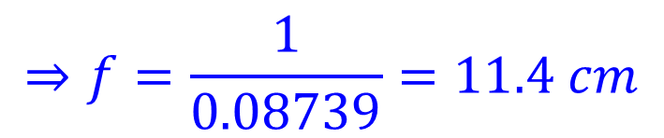
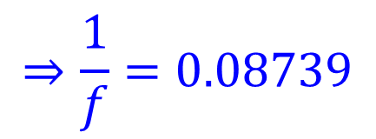
Example 2
An object 30 cm from a converging lens creates a real image 18.5 cm from the lens. Calculate the focal length of the lens to 3 significant figures.
$$\frac{1}{f}=\frac{1}{u}+\frac{1}{v}$$
$$⇒\frac{1}{f}=\frac{1}{30}+\frac{1}{18.5}$$
$$⇒\frac{1}{f}=0.08739$$
$$⇒f=\frac{1}{0.08739}=11.4 cm$$
New V1.1

Slide 38
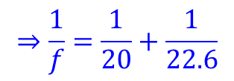
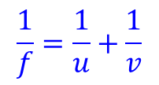
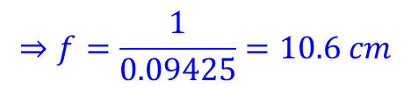
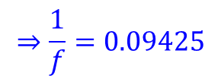
Exercise
An object 20 cm from a converging lens creates a real image 22.6 cm from the lens. Calculate the focal length of the lens to 3 significant figures.
$$\frac{1}{f}=\frac{1}{u}+\frac{1}{v}$$
$$⇒\frac{1}{f}=\frac{1}{20}+\frac{1}{22.6}$$
$$⇒\frac{1}{f}=0.09425$$
$$⇒f=\frac{1}{0.09425}=10.6 cm$$
New V1.1

Slide 39
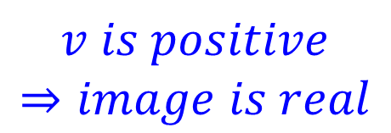
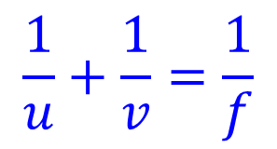

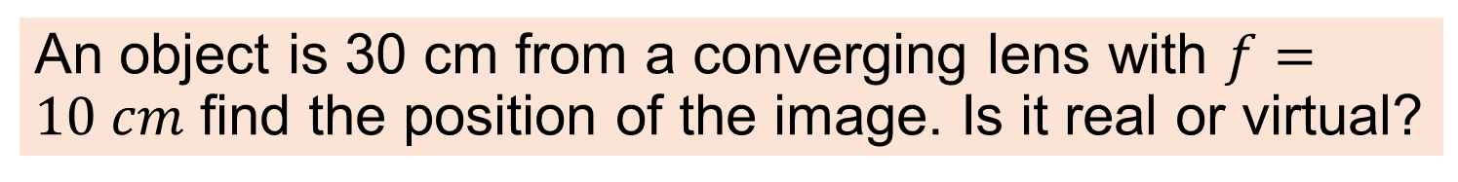
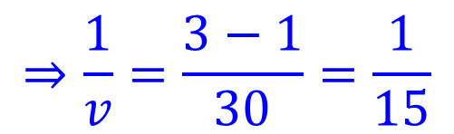
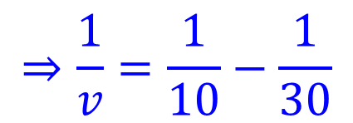
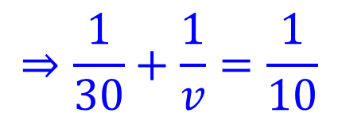
Example 3
An object is 30 cm from a converging lens with $f=10 cm$ find the position of the image. Is it real or virtual?
$$\frac{1}{u}+\frac{1}{v}=\frac{1}{f}$$
$$⇒\frac{1}{30}+\frac{1}{v}=\frac{1}{10}$$
converging lens means f is positive
$$⇒\frac{1}{v}=\frac{1}{10}−\frac{1}{30}$$
$$⇒\frac{1}{v}=\frac{3−1}{30}=\frac{1}{15}$$
$$v is positive$$
$$⇒image is real$$
$$⇒v=15 cm$$

Slide 40
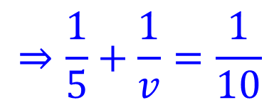
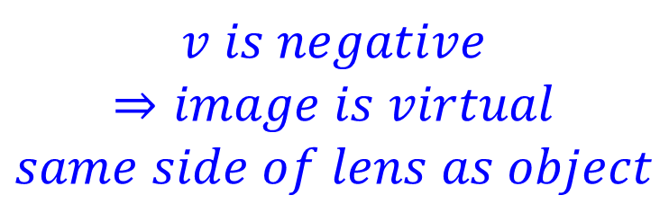
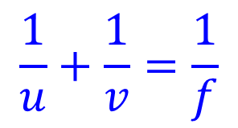

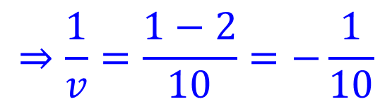
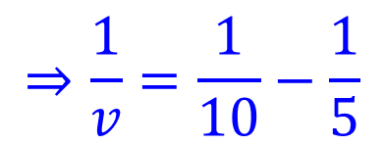
Example 4
Magnifying glasses are converging lenses. In normal use the object is closer to the lens than its Focus. If a lens has a focal length of 10 cm and an object is placed 5 cm from the lens. Will the image be real or virtual?
$$\frac{1}{u}+\frac{1}{v}=\frac{1}{f}$$
$$v is negative$$
$$⇒image is virtual$$
$$same side of lens as object$$
$$⇒\frac{1}{5}+\frac{1}{v}=\frac{1}{10}$$
$$⇒\frac{1}{v}=\frac{1}{10}−\frac{1}{5}$$
$$⇒\frac{1}{v}=\frac{1−2}{10}=−\frac{1}{10}$$
$$⇒v=−10 cm$$

Slide 41
Exercise
A converging lens has a focal length of 20 cm. An object is placed 30 cm from the lens,
calculate how far the image will be from the lens.
Is the image real or virtual.
60 cm
Real image

Slide 42
Exercise
A converging lens has a focal length of 20 cm. An object is placed 15 cm from the lens,
calculate how far the image will be from the lens.
Is the image real or virtual.
-60 cm
Virtual image

Slide 43
Exercise
A converging lens has a focal length of 15 cm. An object is placed 2 m from the lens,
To 4 significant figures, calculate how far the image will be from the lens.
Is the image real or virtual.
16.22 cm
Real image

Slide 44
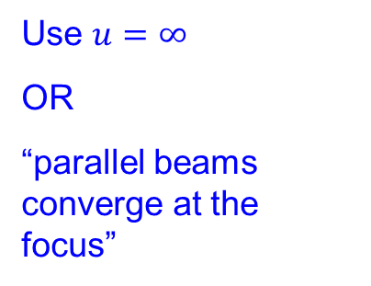
Exercise
A converging lens has a focal length of 20 cm.
How far from the lens will an image of the sun be formed.
Justify your answer
Will this image be real or virtual?
20 cm
Use $u=∞$
OR
“parallel beams converge at the focus”
Real image

Slide 45
Exercise
A projector lens forms an image on a screen 3 meters from the lens. The focal length of the lens is 8 cm. How far is the internal LCD (ie the object) from the lens.
8.22 cm

Slide 46
Exercise
A phone camera lens is 4.4 mm from the sensor. If an object 3 m from the camera is perfectly in focus, what is the focal length of the lens?
Answer to 4 significant figures.
4.394 mm

Slide 47
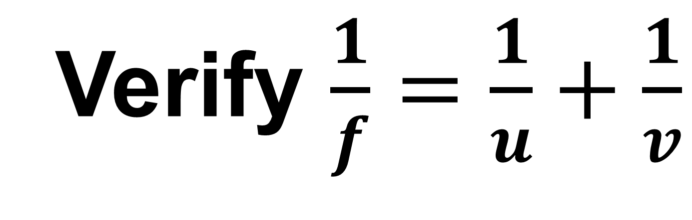
Verify $\frac{1}{f}=\frac{1}{u}+\frac{1}{v}$

Slide 48



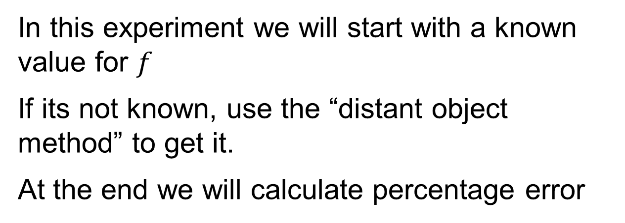
Experiment to Verify $\frac{1}{f}=\frac{1}{u}+\frac{1}{v}$
Object
Image
$$u$$
$$v$$
In this experiment we will start with a known value for $f$
If its not known, use the “distant object method” to get it.
At the end we will calculate percentage error
Notes:
Drew dashed line at centre of lens

Slide 49


find $f$ using a distant object
Image of Tree
Screen
Distant object
Convex Lens
Create an image of a distant object on a screen. Move screen until image is sharp. Measure distance from screen to centre of lens.
$$f$$
Meter stick
Notes:
Drew dashed line at centre of lens

Slide 50
find u and v
Image of cross thread
Screen (white card)
cross thread (object)
Convex Lens
Light
u
v
Meter stick
Edited V1.1
Notes:
Added the word Changed cardboard screen to “Screen (white card)”
Drew dashed line at centre of lens

Slide 51
Alternative setup using a small LED
Image of LED
Convex Lens
LED
u
v
Screen (white card)
Edited V1.1
Notes:
Changed cardboard screen to “Screen (white card)”
Drew dashed line at centre of lens

Slide 52
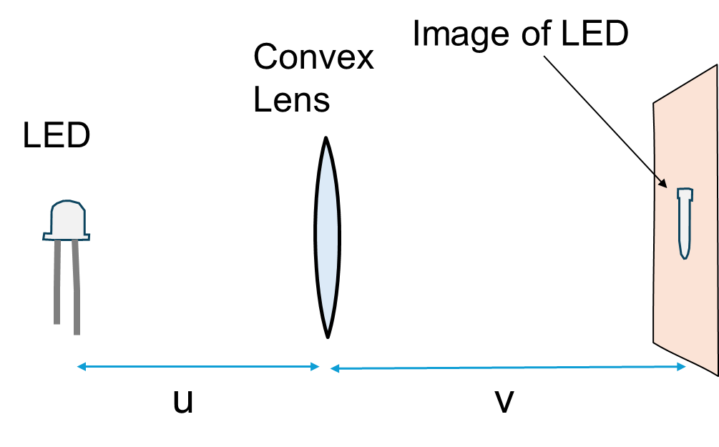
Find u and v
Create an image of a bright object on the screen
Move the screen until image is sharp.
Measure and record u and v
Repeat for different values of u
Note, when we get a sharp image we can say that it is “in focus”. This does NOT mean it is “at the focus” (its not)

Slide 53
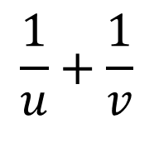
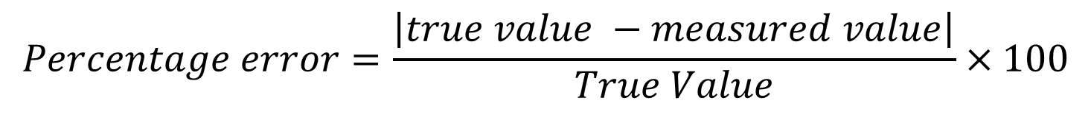


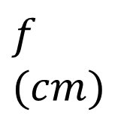
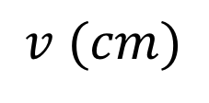
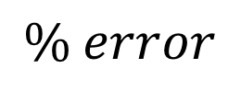
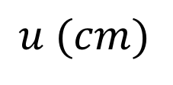

Data and calculations
$$\frac{1}{u}$$
$$\frac{1}{v}$$
$$\frac{1}{u}+\frac{1}{v}$$
$$\frac{1}{f}$$
$$f \\ (cm)$$
$$\% error$$
$$u (cm)$$
$$v (cm)$$
$$Percentage error=\frac{\left|true value −measured value\right|}{True Value}×100$$
If f is not given, use the value that you measured using a distant object as the true value.

Slide 54
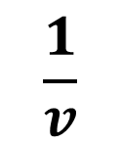
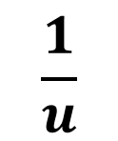
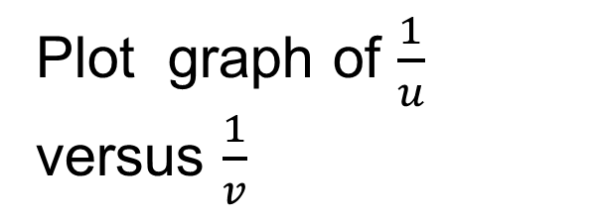
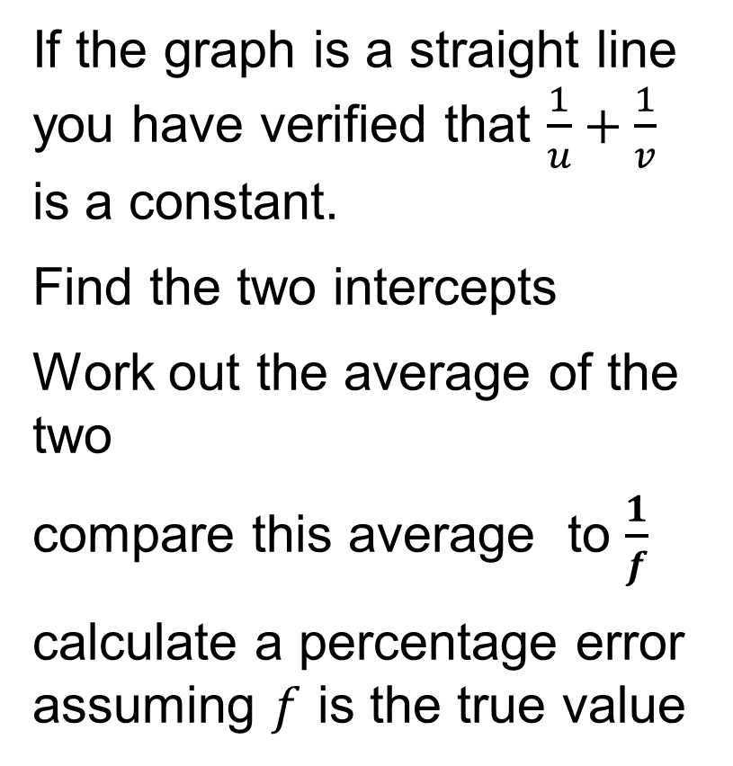
Graph
Plot graph of $\frac{1}{u}$ versus $\frac{1}{v}$
If the graph is a straight line you have verified that $\frac{1}{u}+\frac{1}{v}$ is a constant.
Find the two intercepts
Work out the average of the two
compare this average to $\frac{1}{f}$
calculate a percentage error assuming $f$ is the true value
$$\frac{1}{u}$$
$$\frac{1}{v}$$

Slide 55
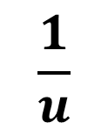
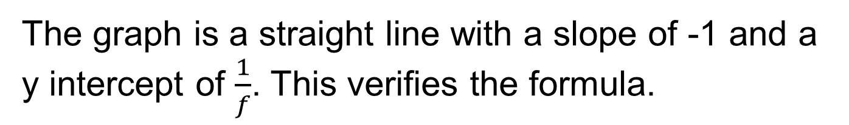
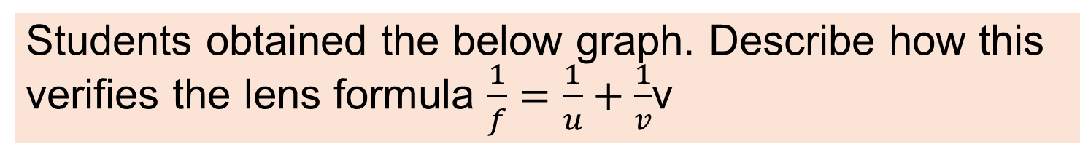
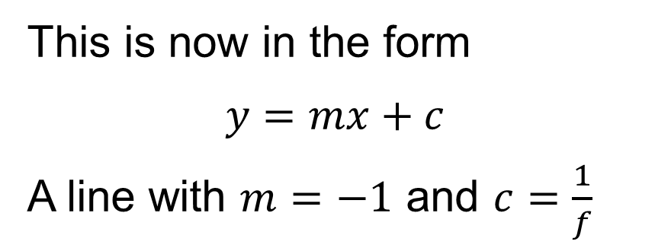
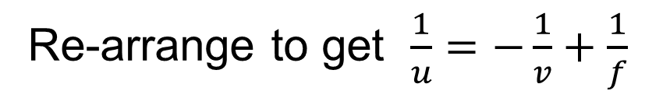
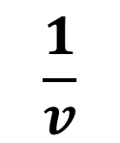
Example 5
Students obtained the below graph. Describe how this verifies the lens formula $\frac{1}{f}=\frac{1}{u}+\frac{1}{v}$v
$$\frac{1}{u}$$
Re-arrange to get $\frac{1}{u}=−\frac{1}{v}+\frac{1}{f}$
This is now in the form
$$y=mx+c$$
A line with $m=−1$ and $c=\frac{1}{f}$
$$\frac{1}{v}$$
The graph is a straight line with a slope of -1 and a y intercept of $\frac{1}{f}$. This verifies the formula.

Slide 56
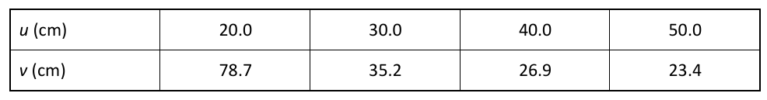


Exercise with secondary data
In an experiment to verify the lens formula students obtained the following data using a lens of focal length 16 cm. Use this data to draw a graph that verifies the formula and state how
the graph verifies the
formula
$$\frac{1}{u}$$
0.05 0.0333 0.025 0.02
$$\frac{1}{v}$$
0.0127 0.0284 0.0372 0.0427

Slide 57
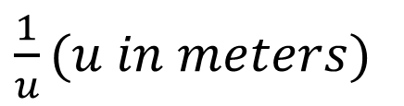


Exercise with secondary data
In an experiment to verify the lens formula $\frac{1}{f}=\frac{1}{u}+\frac{1}{v}$ students obtained the following graph. State how the graph verifies the formula.
$\frac{1}{u}(u in meters)$
6
5
4
3
2
1
1
2
3
4
5
6
$\frac{1}{v}(v in meters)$

Slide 58


Exercise with secondary data
In an experiment to verify the lens formula students obtained the following graph. Using the graph determine the focal length of the lens.
$\frac{1}{u}(u in meters)$
6
5
4
3
2
1
1
2
3
4
5
6
$\frac{1}{v}(v in meters)$

Slide 59



Exercise with secondary data
A student made measurements of u and v for the image of an object in a converging lens with 𝑓 = 15 cm to verify the model $\frac{1}{f}=\frac{1}{u}+\frac{1}{v}.$ Calculate the percentage error of each data point.
u (cm)
20
30
40
v (cm)
56.2
30.3
24.1
$$\frac{1}{u}+\frac{1}{v} ({cm}^{−1})$$
0.0665
0.0678
0.0663
$$\frac{1}{f} (cm^{−1})$$
0.0667
0.0667
0.0667
% error
1.8%
0.6%
0.3%

Slide 60
Ray diagrams: diverging lenses
Object
F
Virtual Image

Slide 61
What type of image do you get with diverging lenses?
Always virtual
Always diminished
Always upright

Slide 62
Ray 1: To the optic centre
Where does it go?
Goes straight on
Object
F

Slide 63
Ray 2: Parallel to axis
Where does it go
As if it came from the focus
Object
F

Slide 64
Do any rays intersect?
No
Extend this ray backwards to where it appears to come from.
What do you do?
Object
F

Slide 65
The image is at the intersection
Object
F
Image

Slide 66
Why do we say the image is virtual?
Because the rays do not actually diverge from points on the image (they only appear to)
Object
F
Image

Slide 67
Diverging lens summary
Object
f
f
Image
The Image is always:
Virtual, Upright and Diminished and on the same side as the object.
Always always always always

Slide 68

Lens formula – diverging lens
$$\frac{1}{u}+\frac{1}{v}=\frac{1}{f}$$
f is negative for a diverging lens
v is negative (virtual image)
u = Object distance v = Image distance

Slide 69

Negatives in the lens formula
1. u is always positive
2. f is negative if the lens is diverging
3. v is negative if it’s a virtual image
The formula in the tables has no negative signs.
$$\frac{1}{u}+\frac{1}{v}=\frac{1}{f}$$
Use the formula in the tables.

Slide 70





Example 6
Diverging lenses are used in doors to allow house occupants see who is outside. A man is standing 1 m away from such a lens. The lens has a focal length of 20 cm, How far from the lens will his image appear?
$$\frac{1}{u}+\frac{1}{v}=\frac{1}{f}$$
$$\frac{1}{100}+\frac{1}{v}=\frac{1}{−20}$$
$$diverging lens means f is negative$$
$$\frac{1}{v}=−\frac{1}{20}−\frac{1}{100}=\frac{−5−1}{100}$$
$$v=−\frac{100}{6}=−16.6 cm$$
$$negative⇒virtual$$

Slide 71
Exercise
A diverging lens has a focal length of 20 cm. An object is placed 15 cm from the lens,
calculate how far the image will be from the lens.
Is the image real or virtual.
Tip: recall that f is negative for diverging lenses
-8.57 cm
Virtual image

Slide 72

Exercise
A diverging lens has a focal length of 20 cm.
What distance from the lens will an image of the moon form.
Justify your answer
-20 cm
Use $u=∞$
OR
“parallel beams appear to diverge from the focus”
Virtual image

Slide 73
Exercise
Complete the ray diagram
2F
F
F
2F

Slide 74
Exercise
Complete the ray diagram
2F
F
F
2F

Slide 75

Exercise
In an experiment to verify the lens formula $\frac{1}{f}=\frac{1}{u}+\frac{1}{v}$ for a diverging lens, u and v were measured for different arrangements (v was determined using the “no parallax” method). Use the data obtained to calculate the focal length of the lens at each data point. Use the calculations to check if the formula has been verified.
u (cm) | 10.0 | 20.0 | 30.0 | 40.0 | 50.0
v (cm) | -6.1 | -8.5 | -10.0 | -11.0 | -11.4
-15.64, -14.78, -15.00, -15.17, -14.77 cm

Slide 76
Summary of expected images
Converging (convex)
Real (u>f) or virtual (u<f)
Upright when virtual
Inverted when Real
Diverging (concave)
Always virtual
Always upright
Always diminished

Slide 77
Use of optics

Slide 78
Phone camera (simplified)
Real inverted image on a screen with millions of photo sensors (3 or 4 per pixel)
Converging lens

Slide 79
Exercise
A phone is to have two cameras, one for normal shots and one is a 3x telephoto (creates an image 3 times the height).
Indicate where the focus is on the telephoto lens.
F
Telephoto Lens
Answer: Where the top ray crosses the axis of the lens

Slide 80
Exercise
Engineers are designing a phone with 5x lens. A prism will help to create the “long lens” needed for telephoto. The below diagram is incorrect. Re-draw the prism correctly so the image will appear on the sensor.
Object
Prism drawn incorrectly
Sensor

Slide 81
Revision Summary
Definitions: Converging lens, diverging lens
Distinguish, real / virtual image, upright / inverted image, magnified / diminished image
Draw: Ray diagrams
Use: $\frac{1}{f}=\frac{1}{u}+\frac{1}{v}$, know when to use negative numbers
Experiment: verify $\frac{1}{f}=\frac{1}{u}+\frac{1}{v}$, for converging lens
Notes:
V1.1 added
Ray Diagrams and Real virtual upright etc included because of sample paper 1 Q1b

Slide 82
Additional Material

Slide 83
The Eye
Ciliary muscle
Cornea
Lens
Retina
Iris
Optic nerve

Slide 84
How is light focused on the retina?
The eye is a double lens consisting of the cornea, and the lens just behind it.
The focal length of the lens can be changed using the ciliary muscle. This allows the eye to focus on near or distant objects.
Ciliary muscle
Cornea
Lens
Retina
Iris
Optic nerve

Slide 85




Long sighted Short sighted
CC0
CC0
CC0
CC0

Slide 86
What does short sighted mean?
A Short-Sighted person can focus on nearby objects but not distant objects.
CC0

Slide 87
What kind of lens can correct short-sightedness?
Short-Sight can be corrected with a Diverging Lens (concave)
Cannot focus on distant objects
A concave lens allows you to focus

Slide 88
What does long sighted mean
A Long-Sighted person cannot see nearby objects clearly.
Some (but not all) can see distant objects clearly.
CC0
CC0

Slide 89
What kind of lens can correct Long-sight?
Long-Sight can be corrected with a converging Lens (convex)
Long sight
Cannot focus on near objects
Focus corrected with convex lens

Slide 90
Exercise
Draw a ray diagram to find the image of the arrow in the plane mirror. Use your diagram to show that the image is the same size as the object.

Slide 91
Exercise
Complete this ray diagram
Focus
F
Axis

Slide 92




Exercise
Plot these results and find f from the graph
u (cm) | 25 | 35 | 50 | 70
v (cm) | 100 | 46.5 | 33.5 | 28
$$\frac{1}{u}(u in metres)$$
$$\frac{1}{u}(u in metres)$$
5
5
4
4
3
3
2
2
1
1
0
0
0
1
2
3
4
5
0
1
2
3
4
5
$$\frac{1}{v}(v in metres)$$
$$\frac{1}{v}(v in metres)$$

Slide 93
Exercise
Complete the ray diagram
2F
F
F
2F
Object
F
2F
F
2F
Image

