Slide 1
2006 q3

Slide 2
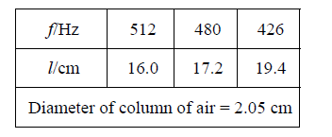
2006 q.3, speed of sound in air
A cylindrical column of air closed at one end and three different tuning forks were used in an experiment to measure the speed of sound in air. A tuning fork of frequency f was set vibrating and held over the column of air.
The length of the column of air was adjusted until it was vibrating at its first harmonic and its length l was then measured. This procedure was repeated for each tuning fork. Finally, the diameter of the column of air was measured.
The following data was recorded.
Describe
(i) how the length of the column of air was adjusted;
(ii) how the frequency of the column of air was measured;
(iii) how the diameter of the column of air was measured. (16)

Slide 3
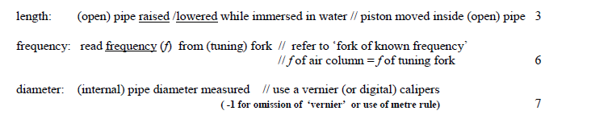
2006 q.3, speed of sound in air
Describe
(i) how the length of the column of air was adjusted;
(ii) how the frequency of the column of air was measured;
(iii) how the diameter of the column of air was measured. (16)
Strike tuning fork and hold it above the resonance tube
Tuning fork
Move the tube up until a clear note is heard
Resonance tube
l
Measure l, as shown
Read the frequency from the tuning fork
Large graduated cylinder
Measure ‘d’ using a vernier callipers
d

Slide 4
2006 q.3, speed of sound in air
How was it known that the air column was vibrating at its first harmonic? (9)
We know the air is vibrating because we can hear it clearly
We know that it is the first harmonic because it is the:
loudest sound heard
The first place resonance is encountered when raising the tube from a short length

Slide 5
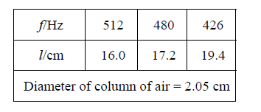
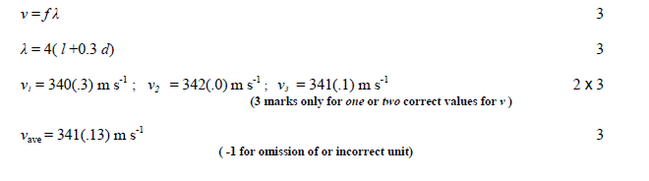
2006 q.3, speed of sound in air
Using all of the data, calculate the speed of sound in air. (15)
l
λ = 4l

