Slide 1
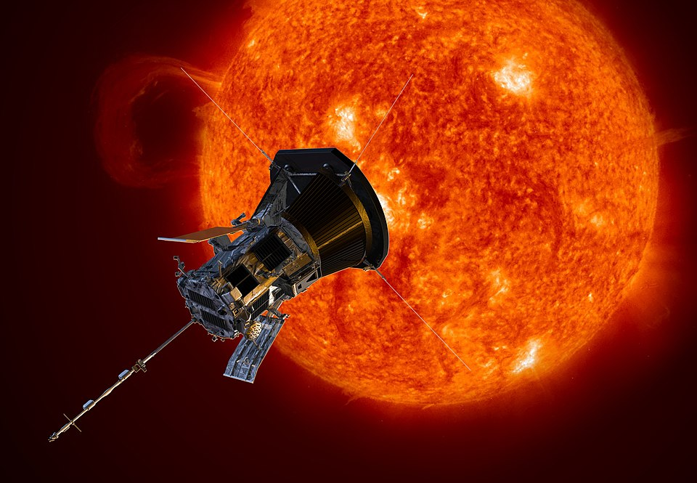
Velocity and Vectors
Parker Solar Probe.
Fastest man-made vehicle
690,000 km/h
CC0
191,000 m/s

Slide 2
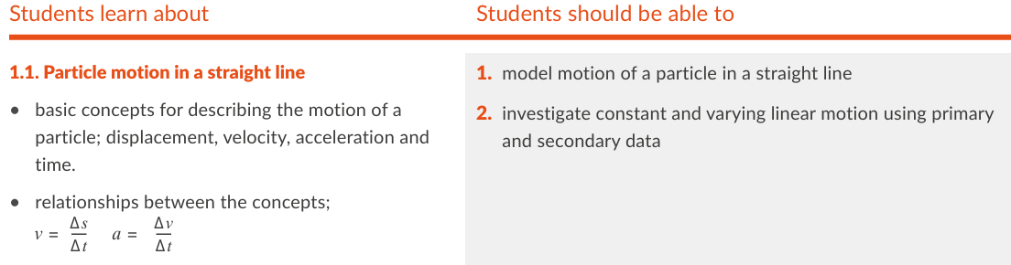
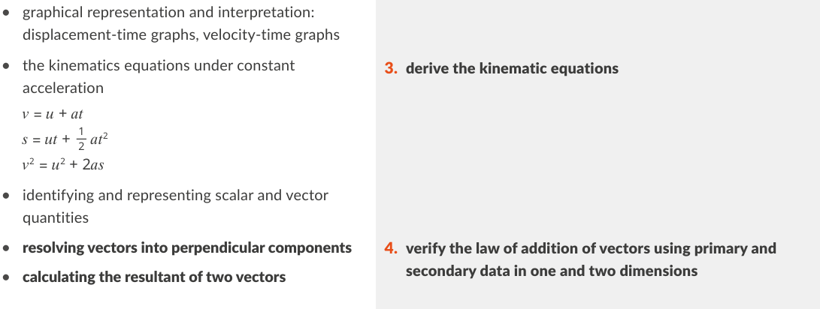
Physics Specification

Slide 3
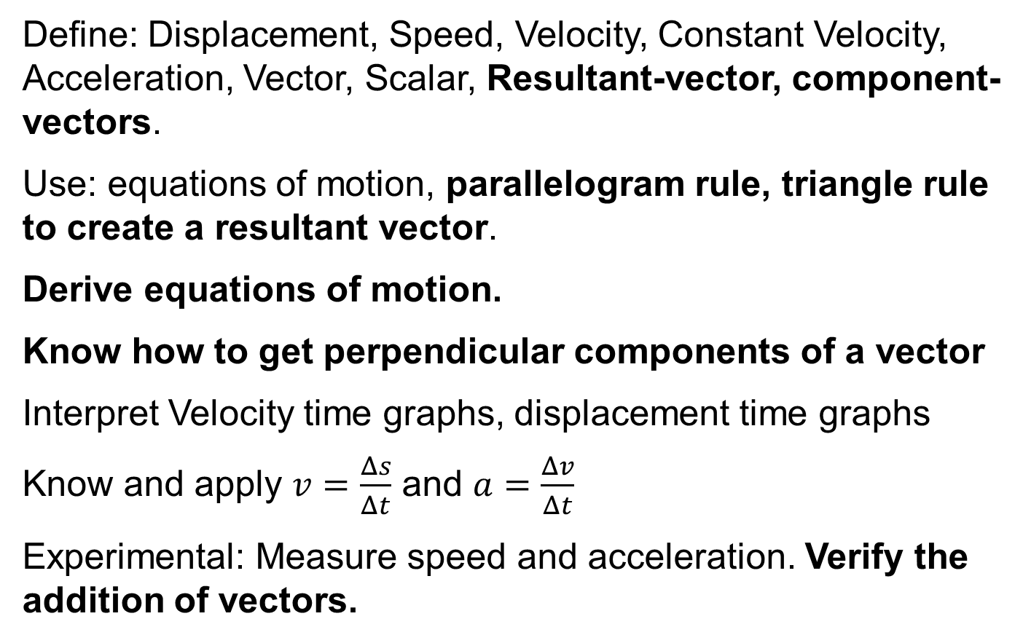
Revision Summary
Define: Displacement, Speed, Velocity, Constant Velocity, Acceleration, Vector, Scalar, Resultant-vector, component-vectors.
Use: equations of motion, parallelogram rule, triangle rule to create a resultant vector.
Derive equations of motion.
Know how to get perpendicular components of a vector
Interpret Velocity time graphs, displacement time graphs
Know and apply $v=\frac{Δs}{Δt}$ and $a=\frac{Δv}{Δt}$
Experimental: Measure speed and acceleration. Verify the addition of vectors.

Slide 4



What is Time?
Progression of events
Measure of change
4th dimension

Slide 5
What is the SI unit of Time?
the second (s).
In physics, convert time to seconds before making calculations.

Slide 6
smaller units of time
1 ms = 1 millisecond = 1 × 10⁻³ seconds
1 μs = 1 microsecond = 1 × 10⁻⁶ seconds
1 ns = 1 nano second = 1 × 10⁻⁹ seconds
In one nano second light will travel 30 cm

Slide 7
How many seconds in an Hour, a Day, a Year?
1 hour = (60)(60) seconds
= 3600 seconds
1 day = (24)(60)(60) seconds
= 86400 seconds
1 year = (365)(24)(60)(60) seconds
= 3.1536 × 10⁷ seconds

Slide 8
What is a Vector?
A quantity with magnitude and direction
HL 2014, 2022, 2022D
e.g. a force or velocity
what is a scalar?
A quantity with magnitude only
HL 2014, 2022
e.g. time or temperature

Slide 9
What is the SI unit of Distance?
the metre (m).
Is distance a vector or scalar?
Scalar

Slide 10

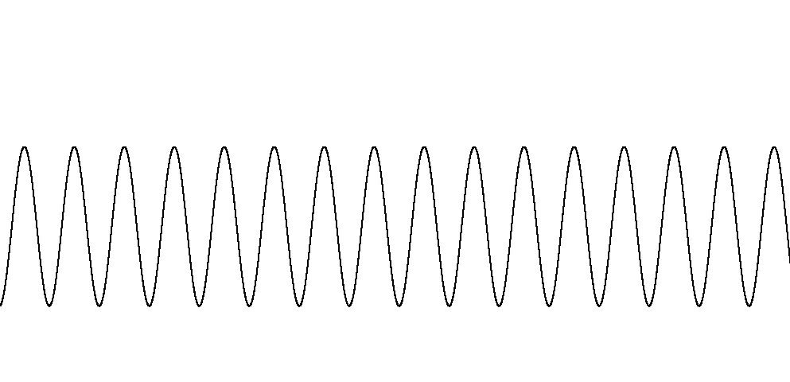
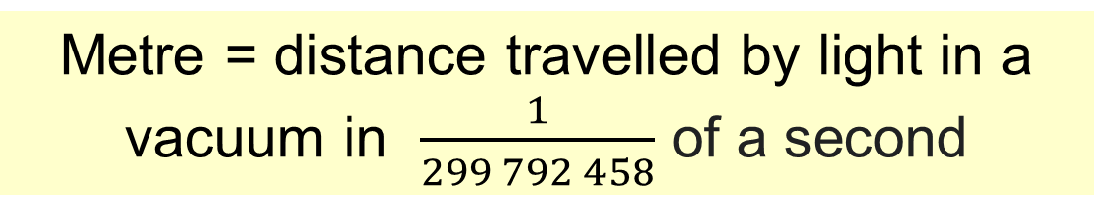
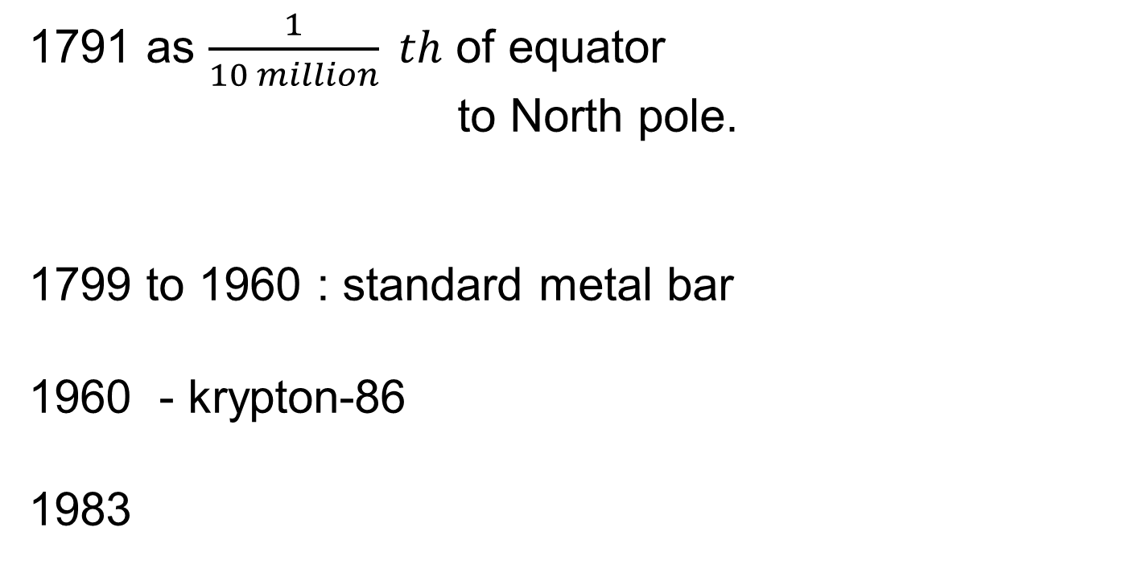
History of the Metre
1791 as $\frac{1}{10 million} th$ of equator
to North pole.
1799 to 1960 : standard metal bar
1960 - krypton-86
1983
CC0
Metre = distance travelled by light in a vacuum in $\frac{1}{299 792 458}$ of a second

Slide 11
Spelling of the Metre
Metre is standard English spelling except in the US
Measuring devices are called meters (voltmeter etc)

Slide 12
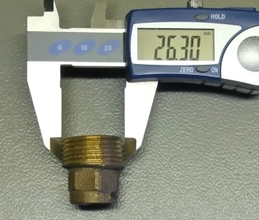
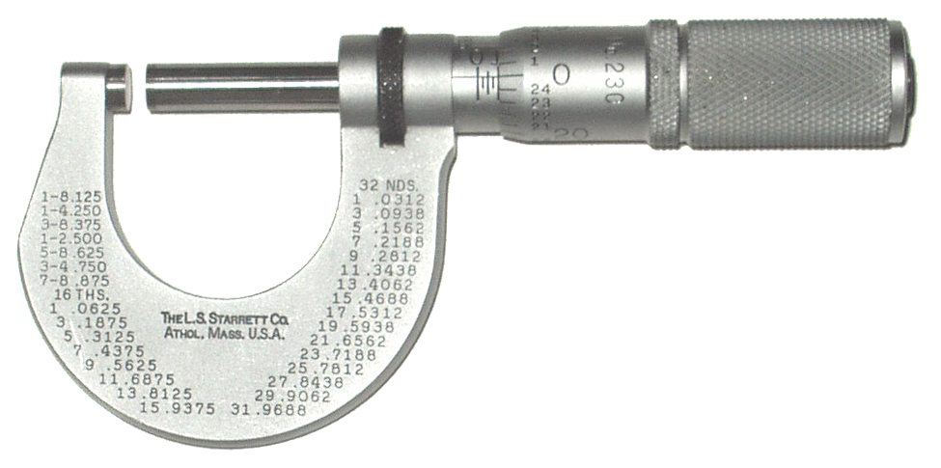
Measuring Distance
10 20 30 40 50 60 70 80 90
A metre stick
CC0
CC0
A micrometer screw gauge
A digital callipers

Slide 13
The vernier scale - Example
0
1 cm
2 cm
0
5
10
Vernier is 0 to 10 but only 9 mm long

Slide 14
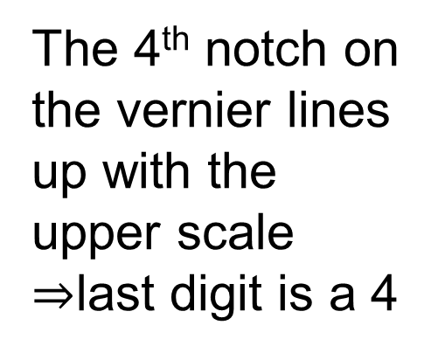
The vernier scale - Example
0
1 cm
2 cm
0
5
10
The 4th notch on the vernier lines up with the upper scale $⇒$last digit is a 4
The instrument is now reading 1.24

Slide 15
The vernier scale - Example
0
1 cm
2 cm
0
5
10
If you don’t “get it”, take your reading opposite the 0 of the vernier

Slide 16
What is Speed?
Speed is the rate of change of distance
Is speed a vector or scalar quantity?
Scalar

Slide 17
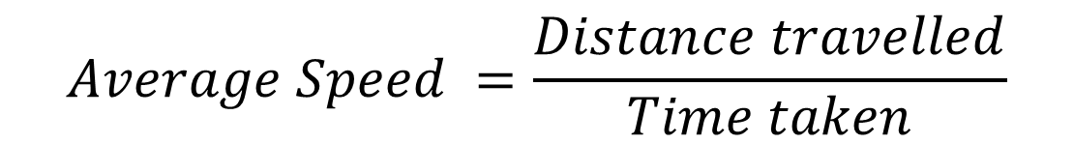
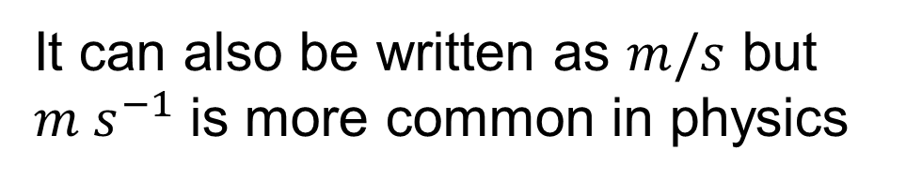
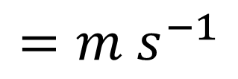
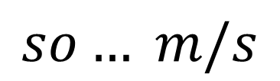
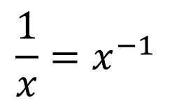
What is the SI unit for speed?
the metre per second (m s⁻¹).
It can also be written as $m/s$ but $m s^{−1}$ is more common in physics
Why m s⁻¹ ?
$$\frac{1}{x}=x^{−1}$$
$$so… m/s$$
$$=m s^{−1}$$
$$Average Speed =\frac{Distance travelled}{Time taken}$$

Slide 18

Example 1
If I run 100 metres in 15 seconds, what is my average speed.
$$6.67 m s^{−1}$$

Slide 19
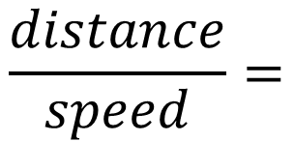

Example 2
how long will it take to go 1 km at a speed of $2.5 m s^{−1}$?
$$\frac{distance}{speed}=$$
$$400 seconds$$

Slide 20
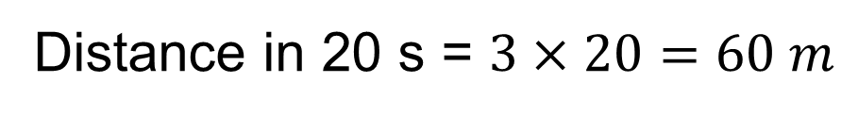

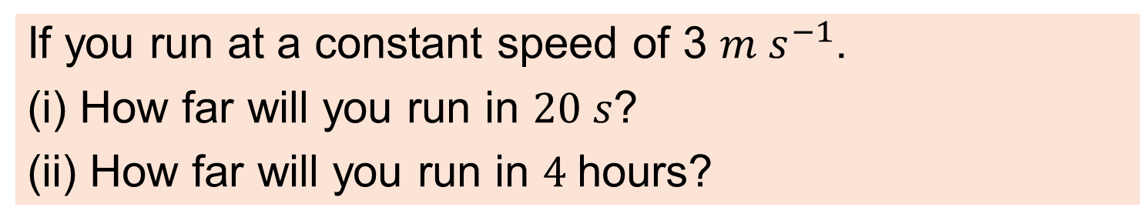
Example 3
If you run at a constant speed of 3 $m s^{−1}$.
(i) How far will you run in $20 s$?
(ii) How far will you run in $4$hours?
Distance in 20 s = $3×20=60 m$
$$4 hours=4×60×60 seconds$$
Distance in 4 hours = $4×60×60×3=43200 m$

Slide 21
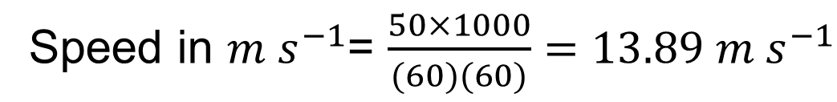

Example 4
A car is going at 50 kmph. Convert this to $m s^{−1}$
$$50 kilometers =50×1000 meters$$
$$1 hour=60×60 seconds$$
Speed in $m s^{−1}$= $\frac{50×1000}{(60)(60)}=13.89 m s^{−1}$

Slide 22

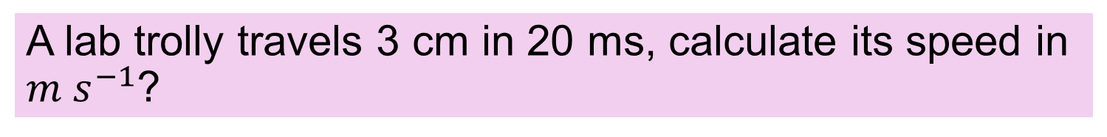
Exercise
A lab trolly travels 3 cm in 20 ms, calculate its speed in $m s^{−1}$?
1.5 $m s^{−1}$

Slide 23
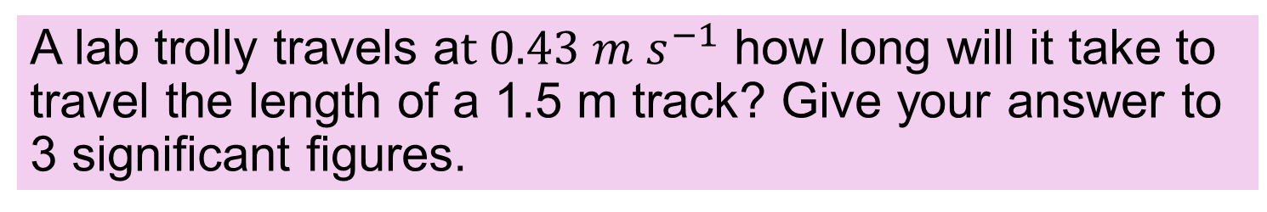
Exercise
A lab trolly travels a$t 0.43 m s^{−1}$ how long will it take to travel the length of a 1.5 m track? Give your answer to 3 significant figures.
3.49 s

Slide 24
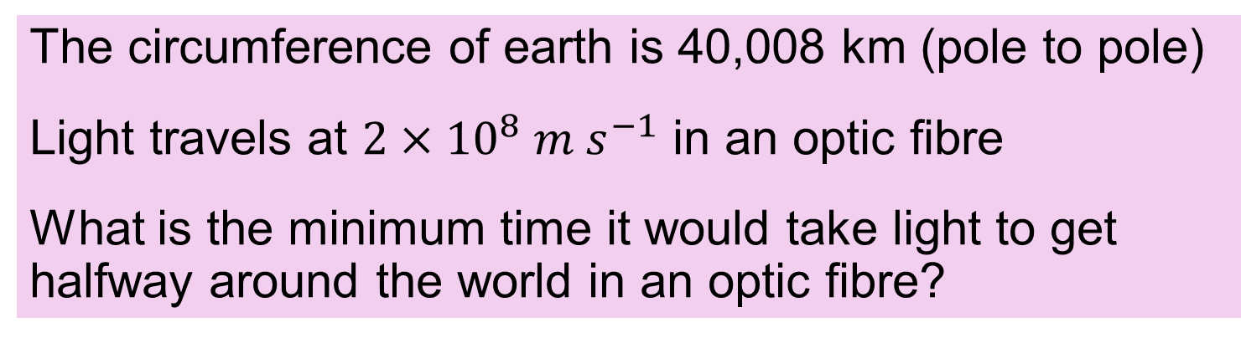
Exercise
The circumference of earth is 40,008 km (pole to pole)
Light travels at $2×{10}^{8} m s^{−1}$ in an optic fibre
What is the minimum time it would take light to get halfway around the world in an optic fibre?
0.2 s

Slide 25

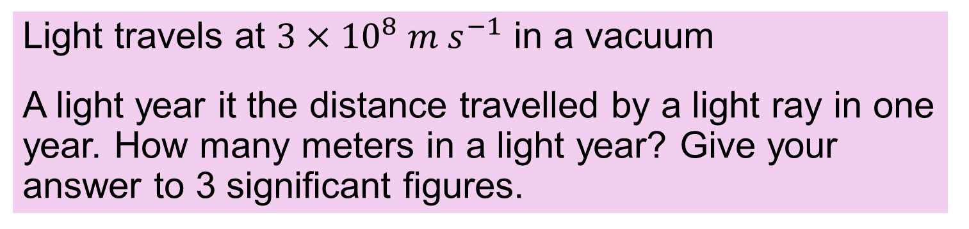
Exercise
Light travels at $3×{10}^{8} m s^{−1}$ in a vacuum
A light year it the distance travelled by a light ray in one year. How many meters in a light year? Give your answer to 3 significant figures.
$9.46× {10}^{15}m$

Slide 26
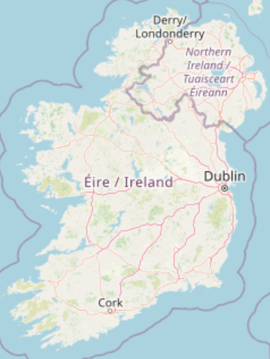
Define displacement?
distance in a direction.
HL 2022D 2023D
Displacement is the straight-line distance + direction

Slide 27
Is displacement a vector or scalar quantity?
Vector.
What is the SI unit of displacement?
the metre (m).
What is the symbol?
s

Slide 28
Give an example of displacement that’s different from distance?
Flight Distance = 18 m
10 m
Displacement = 10 m horizontal

Slide 29
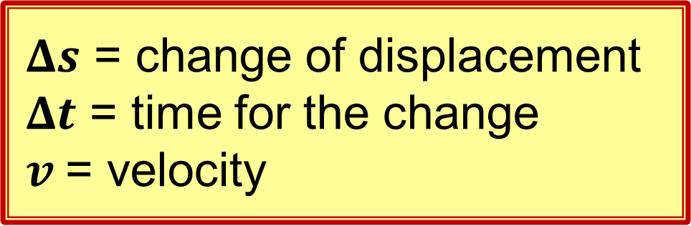
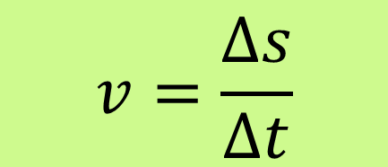
What is Velocity?
The rate of change of displacement.
HL 2022D
$$v=\frac{Δs}{Δt}$$
$Δs$ = change of displacement
$Δt$ = time for the change
$v$= velocity

Slide 30
Is velocity a vector or scalar?
Vector.
Vector nature of velocity
Initial velocity
Final velocity

Slide 31
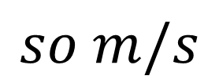
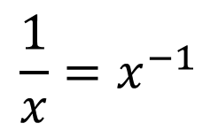
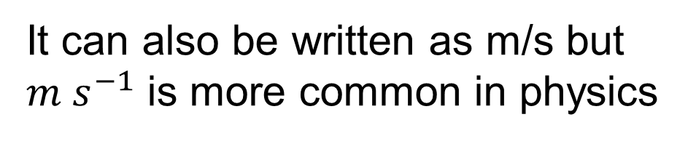
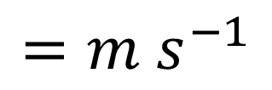
What is the SI unit of velocity?
the metre per second (m s⁻¹).
It can also be written as m/s but $m s^{−1}$ is more common in physics
Why m s⁻¹ ?
$$\frac{1}{x}=x^{−1}$$
$$so m/s$$
$$=m s^{−1}$$

Slide 32
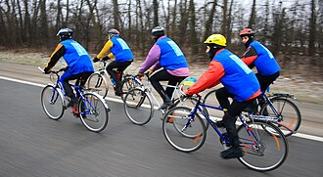
What is Constant Velocity?
When the speed and direction does not change
CC0

Slide 33
Is this Constant Velocity?
No
The ball falls faster and faster.
therefore its not constant velocity.
Video Veritasium
https://www.youtube.com/watch?v=YJbKieEC49M

Slide 34
Is this Constant Velocity?
No
The direction of motion is changing.
Velocity is a vector
therefore it’s not constant velocity.

Slide 35
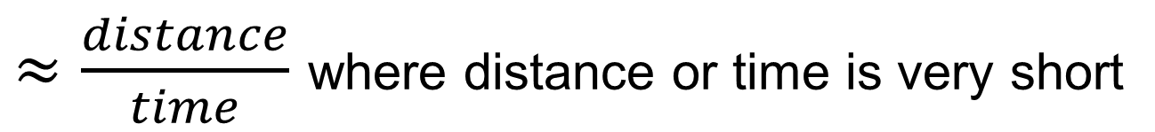
What is instantaneous velocity?
The velocity at an instant in time
$≈\frac{distance}{time}$ where distance or time is very short
The shorter the distance the closer to instantaneous
But… the shorter the distance the less accurate the measurement

Slide 36
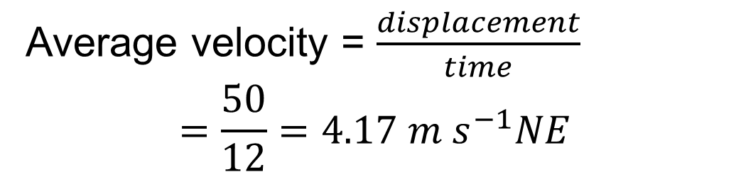
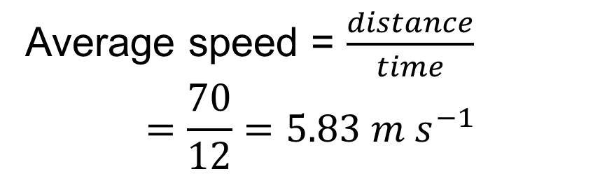
Example 5
A dog runs from A to B by the path in 12 seconds. Calculate his average speed and average velocity.
path
B
Average speed = $\frac{distance}{time}$
$$=\frac{70}{12}=5.83 m s^{−1}$$
70 m
50 m NE
A
Average velocity = $\frac{displacement}{time}$
$$=\frac{50}{12}=4.17 m s^{−1}NE$$

Slide 37
Exercise
A ball is rotating in a circle of radius 1.2 m.
What is its displacement from a point P
After half a revolution
After 1 revolution
P
2.4 m
0 m

Slide 38
How do we measure velocity in the lab?
Measure displacement and time and divide.
Time is measured with:
  Ticker tape
  or
  A light gate and timer
  or
  electrical contacts and timer

Slide 39
Ticker Timer
Vibrating hammer makes
50 dots per second
trolley
paper tape
Ticker Timer
paper tape
dots made by hammer
https://www.youtube.com/watch?v=-xjHLFTQvjo

Slide 40
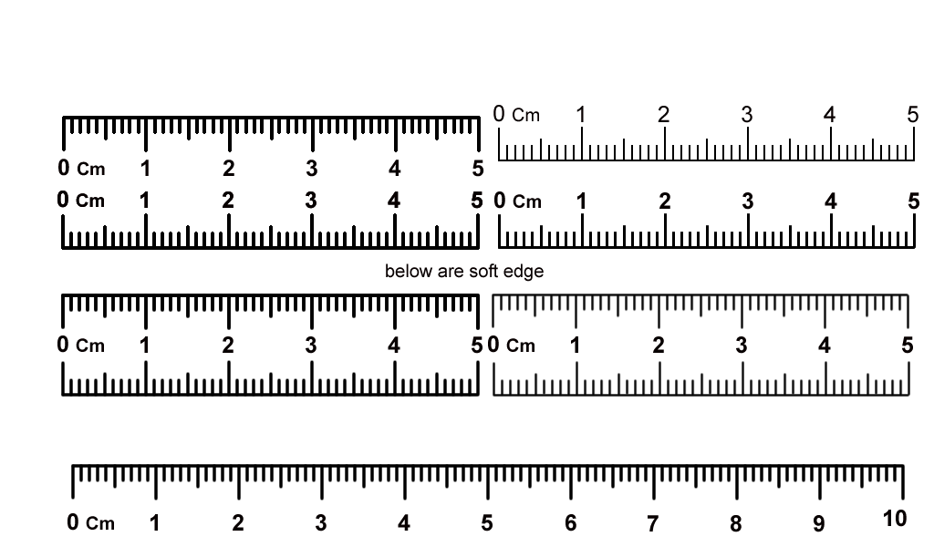
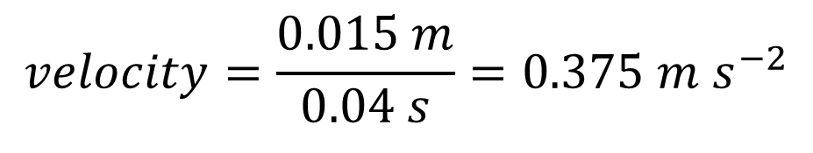
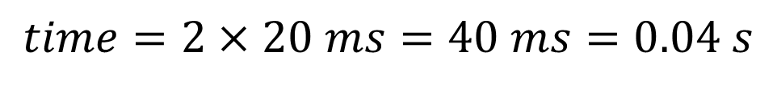
Reading the tape
Measure distance,
count spaces. Time for one space = 20 ms.
1.5 cm, 2 spaces
paper tape
$$time=2×20 ms=40 ms=0.04 s$$
$$velocity=\frac{0.015 m}{0.04 s}=0.375 m s^{−2}$$

Slide 41
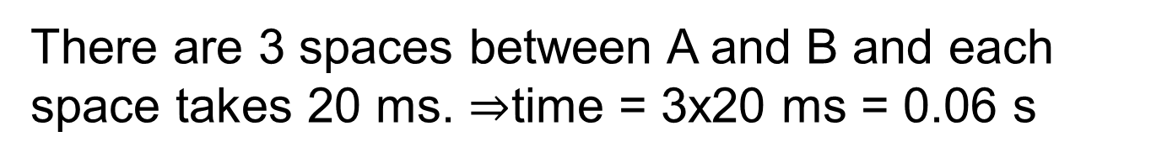
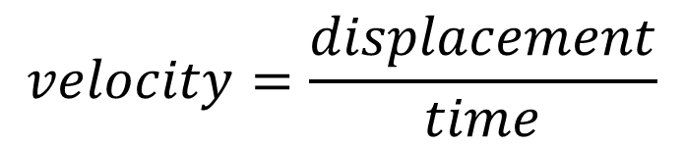
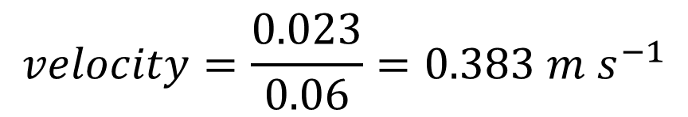
Example 6
Find velocity from this ticker tape
A
B
$$velocity=\frac{displacement}{time}$$
The displacement is from A to B 0.023 m
There are 3 spaces between A and B and each space takes 20 ms. $⇒$time = 3x20 ms = 0.06 s
$$velocity=\frac{0.023}{0.06}=0.383 m s^{−1}$$

Slide 42


Exercise
What is the speed at point A?
What is the speed at point B?
Dot rate = 50 dots per second
B
A
Tip to get the speed at B, measure from one dot to the left to one dot to the right. For A use 2 dots to right and two to left.
A: 0.019/0.080 = 0.24 $m s^{−1}$
B: 0.034/0.040 = 0.85 $m s^{−1}$

Slide 43
What is a Displacement−Time Graph?
Displacement (m)
Displacement on y, time on x
This one shows constant velocity
Time (s)

Slide 44
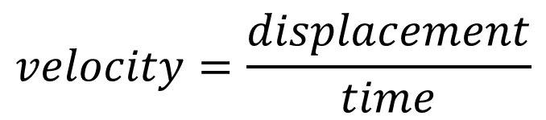
What does the slope of a displacement time graph tell you?
Velocity
Slope = velocity
Displacement (m)
$$velocity=\frac{displacement}{time}$$
Time (s)

Slide 45
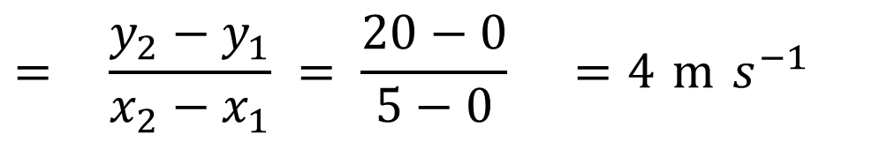
Example
Find the speed using this displacement-time graph.
20
Displacement (m)
5
Time (s)
Speed of Object = Slope of graph
$$= \frac{y_{2}−y_{1}}{x_{2}−x_{1}} = \frac{20−0}{5−0} =4 m s^{−1}$$

Slide 46

Exercise
Find the speed using this displacement-time graph.
30
Displacement (m)
20
10
5
10
Time (s)
3.2 $m s^{−1}$

Slide 47


Exercise
Find the instantaneous velocity at A and B using this displacement-time graph.
40
B
30
Displacement (m)
20
A
10
5
10
Time (s)
A: 5 $m s^{−1}$
B: 10 $m s^{−1}$

Slide 48
Exercise
Describe the motion in each of the below graphs
a
b
c
Displacement
Displacement
Displacement
Time
Time
Time
d
e
f
Displacement
Displacement
Displacement
Time
Time
Time

Slide 49
Exercise
Each of these graphs represent two bodies A and B. Match the graphs to the descriptions.
a
b
c
B
B
Displacement
Displacement
Displacement
B
A
A
A
Time
Time
Time
A and B move towards each other, collide and move off together
A and B move towards each other, collide and bounce back
A and B move towards each other, collide and stop
c, b, a

Slide 50
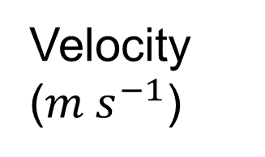
What is a Velocity−Time Graph?
Velocity on y, time on x
This one shows constant velocity
Velocity ($m s^{−1}$)
Time (s)

Slide 51
Exercise
Describe the motion in each case. Identify any case(s) where the direction changes (goes backwards).
a
b
c
Velocity
Velocity
Velocity
Time
Time
Time
d
e
f
Velocity
Velocity
Velocity
Time
Time
Time

Slide 52
Measure velocity with gate and timer
Card to interrupt light gate
Light gate
Displacement: width of card
Time: time that card interrupts the light gate
Low friction track / Air track
Trolly
Velocity: width of card / time that card interrupts the light gate
Metre stick to measure card
Timer

Slide 53
Measure time and distance with ticker timer
Distance: between N dots
Time: 20 ms x (N-1)
Paper tape
Trolly
Ticker timer
Low friction track
Metre stick
20 ms
20 ms

Slide 54
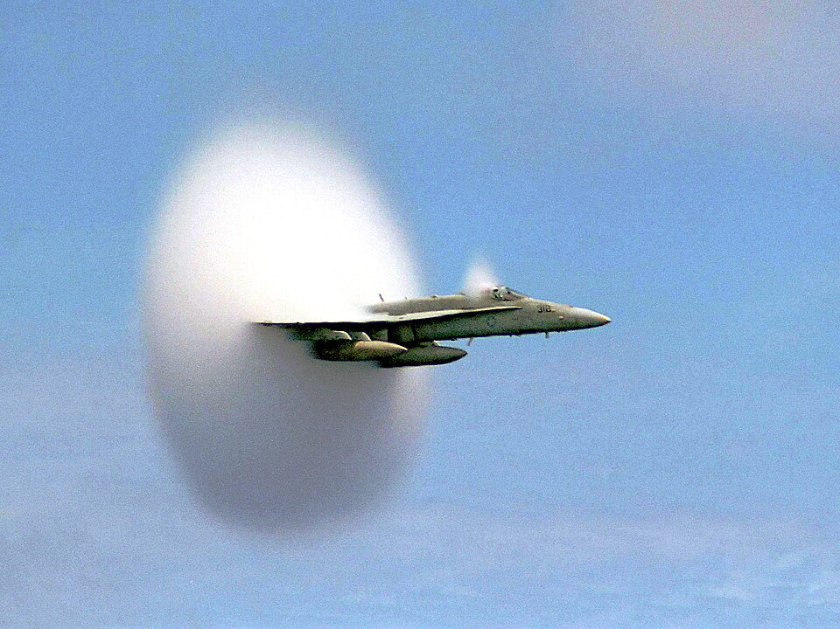
Acceleration
CC0

Slide 55
What is Acceleration?
the rate of change of velocity
2021
Is acceleration a vector or scalar?
Vector.

Slide 56
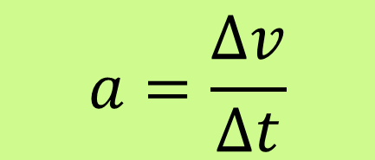
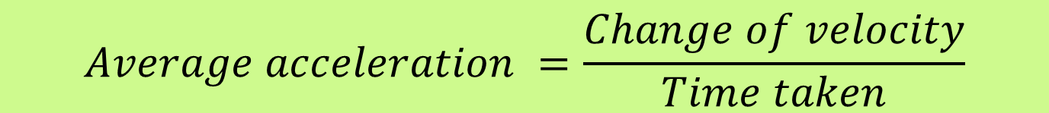
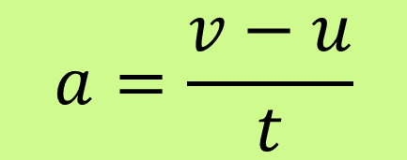
Write a formula for acceleration?
$$Average acceleration =\frac{Change of velocity}{Time taken}$$
or
$$a=\frac{Δv}{Δt}$$
or
$$a=\frac{v−u}{t}$$

Slide 57
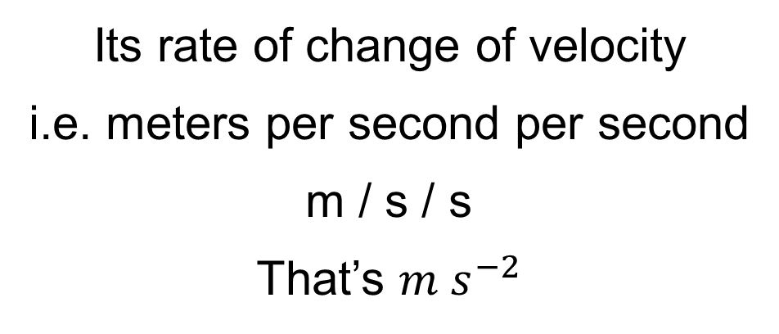
What is the SI unit of acceleration?
the metre per second squared ( m s⁻²).
Its rate of change of velocity
i.e. meters per second per second
m / s / s
That’s $m s^{−2}$

Slide 58
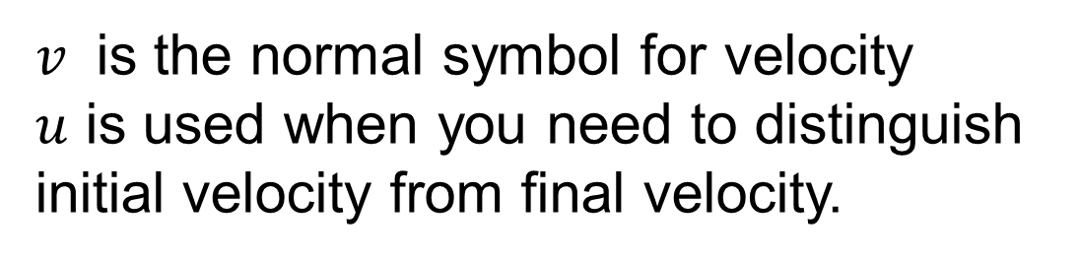
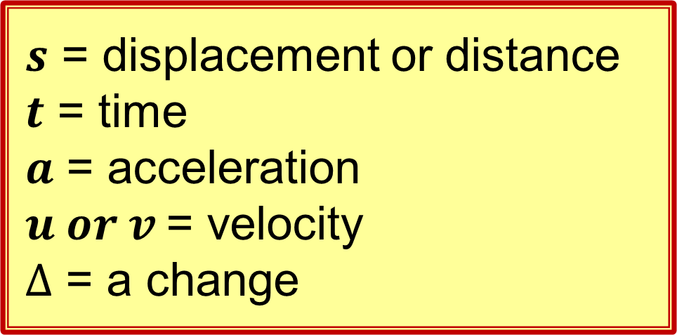
Symbols in equations
$s$ = displacement or distance
$t$ = time
$a$ = acceleration
$u or v$= velocity
$Δ$ = a change
This is different from Junior Cert maths and science.
If you don’t learn them, you will be terribly confused!
$v$ is the normal symbol for velocity
$u$ is used when you need to distinguish initial velocity from final velocity.

Slide 59


Why $u and v$?
$v$ is the normal symbol for velocity
$u$ is used when you need to distinguish initial velocity from final velocity.

Slide 60




Example
A car increases its velocity from $10 m s^{−1}$ to $15 m s^{−1}$ in 2 seconds. Calculate its average acceleration in the 2 seconds.
$$a=\frac{Δv}{Δt}$$
$$⇒ a=\frac{15−10}{2}$$
$$=\frac{5}{2}=2.5 m s^{−2}$$

Slide 61


Exercise
A train increases its velocity from rest to $30 m s^{−1}$ in $96 seconds$. Calculate its average acceleration.
0.313 $m s^{−1}$

Slide 62

Exercise
A accelerates from rest with an acceleration of $0.47 m s^{−2}$, how long will it take to reach 120 km per hour.
Don’t forget to convert to SI units
70.9 s

Slide 63
Name 3 ways an object can accelerate
Speeding up
Slowing down
Changing direction
combination.

Slide 64


Give examples of constant acceleration
A falling object has a constant acceleration of 9.8 $m s^{−2}$ ignoring air resistance.
Similarly, a trolly rolling down a straight inclined track will have almost constant acceleration.

Slide 65

Give and example of acceleration with zero velocity
If an object is thrown straight up it will have zero velocity when it gets to maximum height, but the acceleration will be 9.8 $m s^{−2}$ even at this moment.
Zero velocity, non-zero acceleration

Slide 66




Example 1
A body’s velocity changes from 8 $m s^{−1} East$ to
18 $m s^{−1} East$ in 4 seconds. Calculate its average acceleration.
$$a=\frac{v−u}{t}$$
Formula for average acceleration
$$=\frac{18−8}{4}$$
$$=2.5 m s^{−2} East$$

Slide 67




Example 2
A train on a straight track reduces speed from 30 $m s^{−1}$ North to 20 $m s^{−1}$ North in 20 seconds find the average acceleration.
$$a=\frac{v−u}{t}$$
Formula for average acceleration
$$=\frac{20−30}{20}$$
$$=−0.5 m s^{−2}$$
The answer is negative – opposite direction to the velocity
$=0.5 m s^{−2}$ South

Slide 68


Exercise
A body’s velocity changes from 3 $m s^{−1} South$ to
7 $m s^{−1} South$ in 4 seconds. Calculate its average acceleration.
1 $m s^{−2}$

Slide 69


Exercise
A trolly travels 35 mm in 80 ms, 320 ms later it travels 46 mm in 40 ms, calculate its average acceleration.
Tip, calculate two velocities then use $a=\frac{v−u}{t}$ to calculate the acceleration
u = 0.4375
v = 1.15
a = 2.23 $m s^{−2}$

Slide 70
Give examples of:
1
Constant acceleration
2
Variable acceleration
Object falling in a vacuum
Runner
Rocket
Sky-diver
A constant force on a fixed mass results in constant acceleration.
For Leaving Certificate we only do calculations where acceleration is constant.

Slide 71




Write the 3 equations of motion
If acceleration is constant, then..
$$v=u+at$$
$s$ = displacement
$t$ = time
$u$= initial velocity
$v$= final velocity
$a$ = acceleration
$$s=ut+\frac{1}{2}at^{2}$$
$$v^{2}= u^{2}+2as$$
Also called kinematic equations
Also called “suvat” (from the symbols )

Slide 72
Derive the 3 equations of motion
(Higher Level)

Slide 73





Derive $v=u+at$
Hint: use $a=\frac{v−u}{t}$
$$a=\frac{v−u}{t}$$
(definition of acceleration)
$$⇒at=v−u$$
$$⇒v=u+at$$

Slide 74







Derive $s=ut+\frac{1}{2}at^{2}$
Hint, use $\frac{u+v}{2}$ and $v=u+at$
$$Average velocity=\frac{u+v}{2}$$
For constant acceleration:
$$⇒displacement s=\frac{u+v}{2}t$$
(displacement = vt)
$$⇒s=\frac{u+(u+at)}{2}t$$
(because v= u+at)
$$⇒s=\frac{2u+at}{2}t$$
$$⇒s=ut+\frac{1}{2}at^{2}$$

Slide 75







Derive $v^{2}=u^{2}+2as$
Hint: use previous 2 equations Square the first, then isolate the $s=ut+\frac{1}{2}at^{2}$ term
$$v=u+at$$
$$⇒v^{2}=u^{2}+2aut+a^{2}t^{2}$$
$$⇒v^{2}=u^{2}+2a(ut+\frac{1}{2}at^{2})$$
$$but s=ut+\frac{1}{2}at^{2}$$
$$⇒v^{2}=u^{2}+2as$$

Slide 76







Example 3
$$v=u+at$$
$$s=ut+\text{½}at^{2}$$
$$v^{2}=u^{2}+2as$$
What is the velocity of a projectile if it is given an acceleration of 1000 $m s^{−2}$ for 80 milliseconds
Assume it starts from rest and the acceleration is constant
$$v=u+at$$
$$=0+1000(0.08)$$
(u = 0 when it starts from rest)
$$=80 m s^{−1}$$

Slide 77


Exercise
$$v=u+at$$
$$s=ut+\text{½}at^{2}$$
$$v^{2}=u^{2}+2as$$
What is the velocity of a projectile if it is given an acceleration of 500 $m s^{−2}$ for 160 milliseconds
$$80 m s^{−1}$$

Slide 78









Example 4
$$v=u+at$$
$$s=ut+\text{½}at^{2}$$
$$v^{2}=u^{2}+2as$$
A train accelerates from rest at 0.4 $m s^{−2}$. (i) After how many seconds is its velocity 140 kilometres per hour?
(ii) how far did it travel in that time?
140 kmph= $\frac{140×1000}{3600}=38.89 m s^{−1}$
Use 4 significant figures in intermediate calculations
(i)
$$v=u+at$$
$$⇒t=\frac{v−u}{a}$$
(ii)
$$s=ut+\text{½}at^{2}$$
$$=\frac{38.89−0}{0.4}$$
$$=0+\text{½}(0.4)({97.2}^{2})$$
$$=1890 m$$
$$=97.2 s$$

Slide 79


Exercise
$$v=u+at$$
$$s=ut+\text{½}at^{2}$$
$$v^{2}=u^{2}+2as$$
A train accelerates from rest at 0.55 $m s^{−2}$. (i) After how many seconds is its velocity 120 kilometres per hour?
(ii) how far did it travel in that time?
v=33.33 m/s
(i) 60.61 s
(ii) 1010 m

Slide 80










Example 5
$$v=u+at$$
$$s=ut+\text{½}at^{2}$$
$$v^{2}=u^{2}+2as$$
A trolly travels $40 cm$ while its velocity changes from 0.3 $m s^{−1}$ to 0.75 $m s^{−1}$. Calculate its acceleration.
No good, we don’t know t.
$a=\frac{v−u}{t}$ ?
40 cm
$$v^{2}=u^{2}+2as$$
$${0.75}^{2}={0.3}^{2}+2a(0.4)$$
if you cannot measure time between the lightgates, you use the distance and
$v^{2}=u^{2}+2as$.
$$⇒a=\frac{{{0.75}^{2}−0.3}^{2}}{2(0.4)}$$
$$=0.591 m s^{−2}$$

Slide 81


Exercise
$$v=u+at$$
$$s=ut+\text{½}at^{2}$$
$$v^{2}=u^{2}+2as$$
A trolly travels $60 cm$ while its velocity changes from 0.2 $m s^{−1}$ to 0.8 $m s^{−1}$. Calculate its acceleration.
50 cm
$$0.5 m s^{−2}$$

Slide 82







Example 5
$$v=u+at$$
$$s=ut+\text{½}at^{2}$$
$$v^{2}=u^{2}+2as$$
A trolly travelling with a velocity of 0.2 $m s^{−1}$is accelerating at $0.6 m s^{−2}$. How far does it travel before its velocity reaches 1 $m s^{−1}$ ?
$$v^{2}=u^{2}+2as$$
$$1^{2}={0.2}^{2}+2\left(0.6\right)s$$
$$1=0.04+1.2s$$
$$0.96=1.2s$$
$$s=\frac{0.96}{1.2}$$
$$=0.8 m$$

Slide 83


Exercise
$$v=u+at$$
$$s=ut+\text{½}at^{2}$$
$$v^{2}=u^{2}+2as$$
A bicycle travelling with a velocity of 2 $m s^{−1}$is accelerating at $1.1 m s^{−2}$. How far does it travel before its velocity reaches 5 $m s^{−1}$ ?
$$9.55 m$$

Slide 84





Example 6
$$v=u+at$$
$$s=ut+\text{½}at^{2}$$
$$v^{2}=u^{2}+2as$$
A trolly is released from rest and takes 2.2 seconds to roll down a 1.5 m sloped ramp, find its acceleration.
$$s=ut+\text{½}at^{2}$$
$$1.5=0\left(2.2\right)+\text{½}a({2.2}^{2})$$
$$1.5=0+2.42a$$
$$a=\frac{1.5}{2.42}$$
$$=0.62 m s^{−2}$$

Slide 85

What is a Velocity−Time Graph?
Recap
Velocity on y, time on x
This one shows constant acceleration
Velocity ($m s^{−1}$)
Time (s)

Slide 86
What is the slope of a Velocity−Time Graph?
Slope = Acceleration
High Acceleration
no acceleration (constant velocity)
low acceleration
Velocity (m s⁻¹)
Time (s)

Slide 87
How do you get distance?
Distance = area under the graph
= Velocity x time
Velocity ($m s^{−1}$)
Time (s)

Slide 88
What about distance in this case?
Still it’s the area
Velocity ($m s^{−1}$)
Distance = area
Time (s)

Slide 89
Example
find the distance travelled
= Area 1 + Area 2
= (5)(6) + ½(6)(10)
= 30 + 30 = 60 m
15
Velocity (m s⁻¹)
Area 2
10
5
Area 1
Time (s)
6

Slide 90

Example
Determine the acceleration
= Slope
$$=\frac{y_{2}−y_{1}}{x_{2}−x_{1}}$$
$$=\frac{15−5}{6−0}$$
$$\frac{10}{6}$$
$$=1.667 m s^{−2}$$
15
Velocity (m s⁻¹)
10
5
Time (s)
6

Slide 91


Exam Question 2016 Q5b
This is a short question and so should take 3 minutes

Slide 92
Measuring Acceleration with a Ticker Timer and Ticker Tape
Ticker Timer
trolley
paper tape

Slide 93







Example Acceleration calculation
Calculate the velocity at A and B ($u and v)$ and the acceleration between A and B
B
A
8cm, 0.04s
3cm, 0.04s
$$v=\frac{0.08}{0.04}=2 m s^{−1}$$
$$u=\frac{0.03}{0.04}=0.75 m s^{−1}$$
To calculate the time $t_{AB}$ count the spaces and multiply by 0.02 s. That’s $t_{AB}=7×0.02$ seconds
$$a=\frac{v−u}{t}=$$
$$\frac{2−0.75}{7×0.02}$$
$$=\frac{1.25}{0.14}=8.9 m s^{−2}$$

Slide 94
Exercise
What is the speed at point A and B and what is the acceleration?
B
A
Dot rate = 50 dots per second

Slide 95


Measure Acceleration with gates and timer
Measure time in each gate and time between gates.
Calculate $u$ and $v$ then calculate $a=\frac{v−u}{t}$
Card to interrupt light gate
Light gates
$$s$$
Low friction track
Trolly
Metre stick to measure card
Timer

Slide 96
Data collection

Slide 97
Vectors

Slide 98
What is a Vector Quantity?
A quantity that has both Magnitude and Direction
HL 2014 2022 2022D

Slide 99
Give 3 examples of Vector Quantities
Displacement
Velocity
Acceleration
We will meet a few more during the course, the most important being Force

Slide 100
What is a Scalar Quantity?
A quantity that has magnitude only
HL 2014
Scalars have no direction

Slide 101
Give Examples of Scalar Quantities
Time
Temperature
Mass
Volume
Distance

Slide 102
How do you draw a Vector
An arrow
Length = Magnitude.
Arrow point = Direction

Slide 103




Describe these 3 vectors in words.
N
$$1.8 m s^{−1}$$
W
E
A velocity of $1.8 m s^{−1}$ to the right
5 N
S
A force of 5 N North-East
7 m s⁻¹
${20}^{o}$
A velocity of $7 m s^{−1}$ at an angle of ${20}^{o}$ to the horizontal

Slide 104
What is the Resultant of two Vectors?
A single vector that has the same effect as the original two vectors.
Vector A
Resultant
Has the same effect as the combination of A and B
Vector B

Slide 105
Example of resultant
A person walks 20 m north then 20 m east, what is the resultant displacement?
20 m
20 m
28.3 m North east
How was the magnitude calculated?
Pythagoras

Slide 106
Example of resultant
Two forces A and B act on the top of a pole, sketch the resultant.
B
A
Resultant
We will learn how to do this more accurately

Slide 107
Adding co-Linear Vectors
Co linear means along the same line e.g.

Slide 108






Finding the Resultant:
Vectors in same direction
$$1.8 m s^{−1}$$
$$1.2 m s^{−1}$$
displacement
Resultant = $3 m s^{−1}$
$$1 N$$
force
$$2 N$$
Resultant =$3 N$

Slide 109






Finding the Resultant:
Vectors in the opposite direction
$$20 m s^{−1}$$
…subtract….
$$12 m s^{−1}$$
direction of the bigger.
Resultant = $8 m s^{−1}$
…subtract….
$$5 N$$
$$8 N$$
direction of the bigger.
Resultant = $3 N$

Slide 110
non-collinear vectors
Vectors that are not parallel

Slide 111
Find the resultant using the triangle rule
Vector A
Vector B
Resultant
Draw the vectors head to tail
Complete the triangle
This method is often used with displacement vectors.

Slide 112
Find the resultant using the parallelogram rule
Vector A
Resultant
Vector B
Complete the parallelogram
Draw the diagonal
This method is often used with forces.

Slide 113







Example 1
A ball travels 4 m East, bounces and travels 3 m North? What is its overall displacement.
end
s
$s^{2}=4^{2}+3^{2}$
3 m
$$s=\sqrt{4^{2}+3^{2}}$$
$$θ$$
$$s=5 m$$
start
4 m
$$\tan{θ}=\frac{3}{4}$$
$θ=\tan^{−1}\left(\frac{3}{4}\right)={36.9}^{0}$
Answer: 5 m at ${36.9}^{o}$ North of East

Slide 114




Example 2
A fly is walking across a piece of paper at $0.2 m s^{−1}$. The paper is being pulled at $0.15 m s^{−1}$ at right angles. Determine the resultant velocity of the fly using a scale drawing of the vectors.
Paper
Fly
$$0.2 m s^{−1}$$
$$0.15 m s^{−1}$$
Make this scale drawing and measure accurately.
$${53}^{o}$$
$$v=0.25 m s^{−1} at {53}^{o} to the direction of the paper$$

Slide 115






Exercise
Calculate and draw the resultant in each case
a.
$$3 N$$
$$2 N$$
b.
$$3 N$$
$$2 N$$
c.
$$3 m$$
$$3 m$$

Slide 116




Exercise
Calculate and draw the resultant in each case
d.
$$3 N$$
$$1 N$$
e.
$$2 N$$
$$3 N$$

Slide 117
Exercise
draw the resultant in each case
a.
b.
c.
d.

Slide 118



Describe an experiment to Verify the addition of vectors. (new spec)
Paper
Thread
$$F_{3}$$
Adjust the direction and force on each balance. Ensure the knot is at rest.
Note the values of, ​F​₁ ​, ​F​₂​ and ​F​₃​.
$$F_{1}$$
Newton balances
$$F_{2}$$
Trace 3 vectors in the direction of the 3 balances and with lengths proportional to the forces.
Use the parallelogram method to add two of the vectors.
This should be equal and opposite to the other vector.

Slide 119
Describe an experiment to find the resultant of 2 vectors. (old spec)
Paper
Thread
$$F_{3}$$
Adjust the direction and force on each balance. Ensure the knot is at rest.
Note the values of, ​F​₁ ​, ​F​₂​ and ​F​₃​.
$$F_{1}$$
Newton balances
$$F_{2}$$
Trace 3 vectors in the direction of the 3 balances and with lengths proportional to the forces.
Draw a vector equal and opposite to one vector.
Observe that this is = resultant of the other two using the parallelogram rule.

Slide 120
How did the student determine…
The resultant by experiment
Paper
Thread
Newton balances
The resultant by the vector addition laws

Slide 121

2022 deferred Q7

Slide 122
Vector Components
Making two vectors from one

Slide 123
Resolving a Vector into Components
This is the opposite to finding a resultant.
We want two vectors that add to make vector x
Component b
Vector x
Component a
We have the correct answer if it all fits in a parallelogram (or rectangle)

Slide 124
Resolving a Vector into Components
There are an infinite number of answers.
Vector x
The green vectors are components of x
The red vectors are also components of x
For the Leaving Certificate you will only be asked to create components at right angles to each other (like the green ones)

Slide 125
Recap
Resultant
Composition
Or
addition
Component
Resolving
Component
only Perpendicular Components.

Slide 126













Recap on Trigonometry
h
o
$$θ$$
a
$$\frac{o}{h}$$
$$\sin^{−1}{\frac{o}{h}}$$
$$\sin{θ= }$$
$$θ=$$
$$\frac{a}{h}$$
$$\cos^{−1}{\frac{a}{h}}$$
$$\cos{θ= }$$
$$θ=$$
$$\frac{o}{a}$$
$$\tan^{−1}{\frac{o}{a}}$$
$$\tan{θ= }$$
$$θ=$$

Slide 127


Set your calculator to degrees
Most calculators have 3 modes of angles Degrees, Radians and Gradians. Test by typing $\sin\left({90}^{o}\right)$ if the answer is 1 you are in degrees, if not, change it.
Cassio
Press Shift > Setup > 2 > 1
Sharp
Press 2ndF then the decimal point • and watch the screen

Slide 128






Example
Find $x$
We only know one side so cannot use Pythagoras. We need to use sin, cos or tan.
$$\sin{{60}^{o}=\frac{o}{h}=\frac{x}{5}}$$
5 m
$$x$$
$$\frac{x}{5}=\sin{{60}^{o}}$$
$$60⁰$$
$$x=5sin{{60}^{o}}$$
$$x=4.33 m$$

Slide 129






exercises
Find the unknowns
7 m
$$x$$
v
200 N
50 N
v
$$65⁰$$
$$70⁰$$
$$60⁰$$
h
h
$$y$$
v
40 N
30 m/s
$$40⁰$$
30 N
h

Slide 130










Calculating Perpendicular Components
Find the vertical and horizontal components of v:
v
$$θ$$
1. draw components x and y using the parallelogram rule
v
$$y$$
$$θ$$
2. Use trigonometry
$$x$$
$$cos⁡θ =\frac{x}{v}$$
$$sin⁡θ =\frac{y}{v}$$
$$⇒x=$$
$$v cosθ$$
$$⇒y=$$
$$v sinθ$$

Slide 131


Example
Find the vertical and horizontal components of a 40 N force acting at ${70}^{o}$ to the horizontal.
Horizontal component:
h = 40 cos 70º
= 13.7 N
Vertical component:
V = 40 sin 70º
= 37.6 N
40 N
v
$$70⁰$$
h

Slide 132






Exercise
A cart is pulled with a force of 200 N at an angle of 22° with the horizontal. Find the vertical and horizontal components of the force.
vertical component
200 N
22⁰
horizontal component
vertical component
horizontal component
$$F_{v}=$$
$$200\sin{{22}^{0}}$$
$$F_{h}=$$
$$200\cos{{22}^{0}}$$
$$=74.9 N$$
$$=185.4 N$$

Slide 133





Example
A ball is hit with a velocity of 30 $m s^{−1}$ at an angle of ${30}^{0}$ to the horizontal.
Calculate the vertical and horizontal components of the initial velocity
30 m s⁻¹
vertical velocity $u_{v}$
30⁰
horizontal
velocity $u_{h}$
$$u_{v}=30\sin{30=15 m s^{−1}}$$
$$u_{h}=30\cos{30=26.0 m s^{−1}}$$

Slide 134



Exercise
A ball is kicked with a velocity of 10 $m s^{−1}$ at an angle of ${25}^{0}$ to the horizontal.
Calculate the vertical and horizontal components of the initial velocity.
$$u_{v}=4.23 m s^{−1}$$
$$u_{h}=9.06 m s^{−1}$$

Slide 135

Question 14 part a 2022

Slide 136

Example
A simple pendulum is ${15}^{o}$ from vertical. The bob weighs 5N. Find the components of the 5N in line with and perpendicular to the string.
15⁰
Component in line with string
Perpendicular component
= 5 Sin 15⁰
= 5 Cos 15⁰
= 1.29 N
= 4.83 N
5 N

Slide 137
Revision Summary
Define: Displacement, Speed, Velocity, Constant Velocity, Acceleration, Vector, Scalar, Resultant-vector, component-vectors.
Use: equations of motion, parallelogram rule, triangle rule to create a resultant vector.
Derive equations of motion.
Know how to get perpendicular components of a vector
Interpret Velocity time graphs, displacement time graphs
Know and apply $v=\frac{Δs}{Δt}$ and $a=\frac{Δv}{Δt}$
Experimental: Measure speed and acceleration. Verify the addition of vectors.

Slide 138
0.9
0.8
0.7
0.6
0.5
0.4
0.3
0.2
10 cm
10 cm
0.1
A
B
C
D
E
F
G
H
I
J
K
L
M
Notes:
Background for taking a video of ballistic flight of small ball

