Slide 1

Reflection and Refraction
CC0

Slide 2
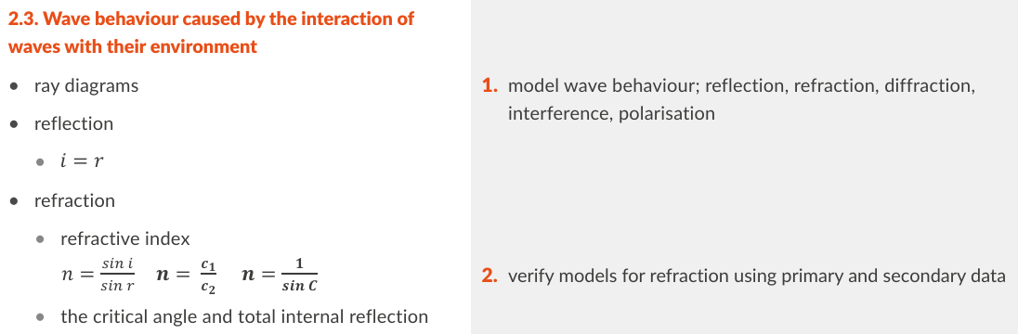
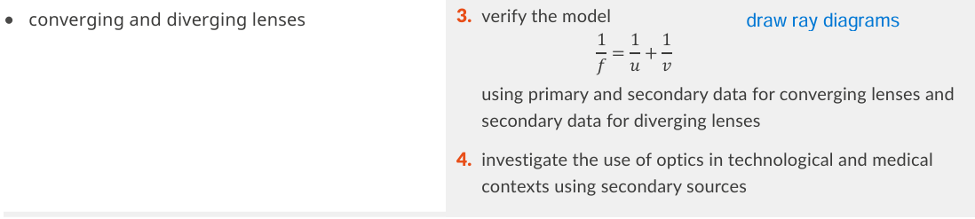
Gone:
Real and apparent depth
Spherical mirrors
Refractive index of liquid experiment
Mirages
Probably gone:
Method of no parallax

Slide 3
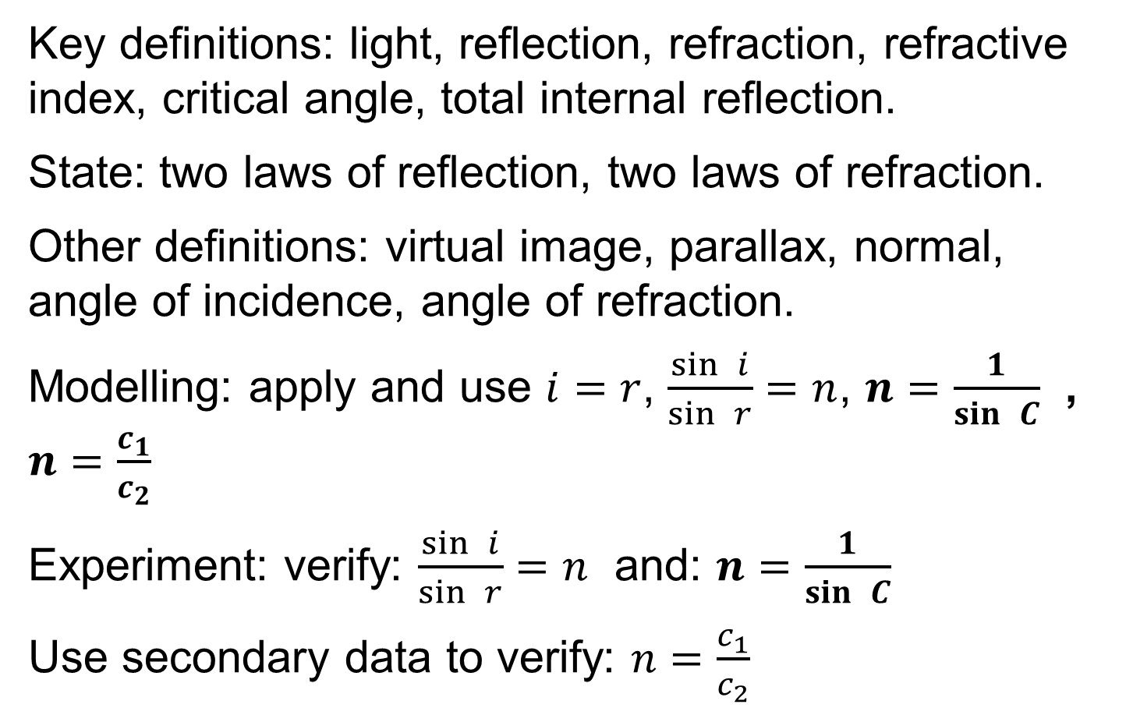
Revision summary
Key definitions: light, reflection, refraction, refractive index, critical angle, total internal reflection.
State: two laws of reflection, two laws of refraction.
Other definitions: virtual image, parallax, normal, angle of incidence, angle of refraction.
Modelling: apply and use $i=r$, $\frac{\sin{ }i}{\sin{ }r}=n$, $n=\frac{1}{\sin{ }C}$ , $n=\frac{c_{1}}{c_{2}}$
Experiment: verify: $\frac{\sin{ }i}{\sin{ }r}=n$ and: $n=\frac{1}{\sin{ }C}$
Use secondary data to verify: $n=\frac{c_{1}}{c_{2}}$

Slide 4
What is Light?
Light is Electromagnetic energy and travels as a wave through a vacuum and some transparent materials

Slide 5
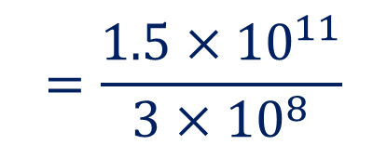




Example
The Sun is 1.5 x 10¹¹ m from earth
How long does it take light to get from the sun to the earth.
Speed of light = 3 x 10⁸ m s⁻¹
$$time=\frac{distance}{speed}$$
$$=\frac{{1.5×10}^{11}}{3×{10}^{8}}$$
$$=5 ×{10}^{2}$$
$$=500 s$$
$$≈8 minutes$$

Slide 6





Exercise
How far will light travel in 1 millisecond?
Speed of light = 3 x 10⁸ m s⁻¹
$$distance=time×speed$$
$$=0.001×3×{10}^{8}$$
$$=3×{10}^{8−3}$$
$$=3×{10}^{5}m$$
$$=300 km$$

Slide 7




Exercise
How far will light travel in 1 nano second?
Speed of light = 3 x 10⁸ m s⁻¹
$$distance=time×speed$$
$$={10}^{−9}×3×{10}^{8}$$
$$=3×{10}^{8−9}$$
$$=3×{10}^{−1}m$$
$$=30 cm$$

Slide 8






Distinguish between luminous and non luminous objects
You can see both luminous and non-luminous objects
Luminous
makes its own light
Non- luminous
Reflects light

Slide 9
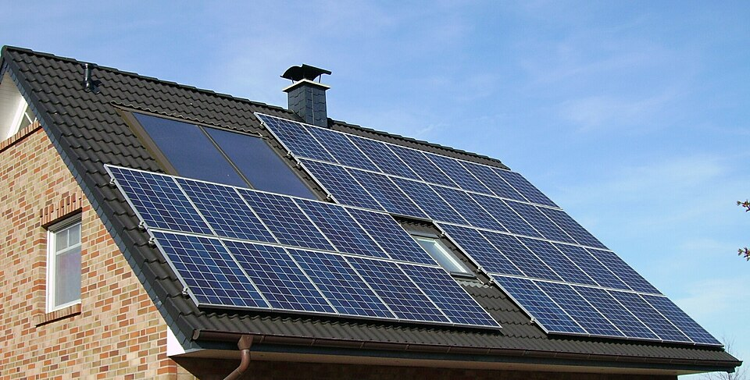
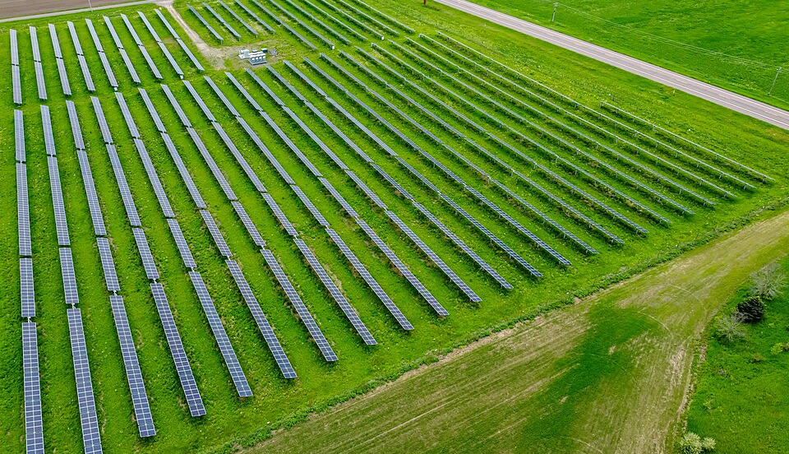
Converting Light Energy to Electrical Energy
CC0
CC0

Slide 10
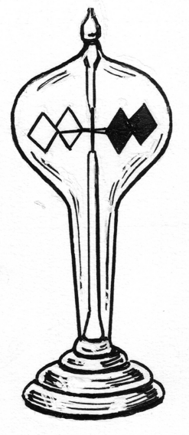
How do you prove that light is energy?
Crooke’s Radiometer
converts Light Energy into Kinetic Energy.
Or
use a solar panel.
CC0

Slide 11
How can you prove that light travels in straight lines?
1
Thread pulled tight
Light
2
View through holes

Slide 12
What word do we use for light travelling in straight lines
Rectilinear propagation of light.
This allows us draw diagrams with light represented by straight lines called “rays”
These are called “Ray Diagrams”

Slide 13
Drawing light rays
Laser
Point source
Each of the lines is called a ray
Lines are straight until they hit something

Slide 14
Purpose of Ray Diagrams
Ray diagrams help you understand and make predictions about optical systems
This ray diagram shows the formation of an image with a lens. We will study this later.

Slide 15
What is Reflection of Light?
Light bouncing off a surface.
HL 2014 2017
CC0

Slide 16
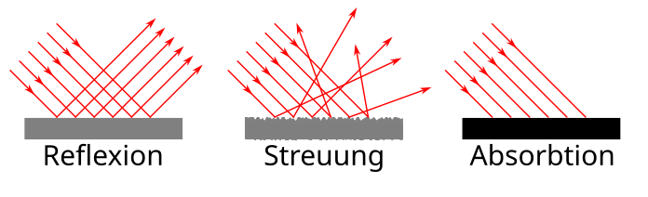
Name the two types of reflection
Regular reflection
(mirror)
CC0
Diffuse reflection
(paper)
CC0

Slide 17
How do you draw a plane mirror?
Reflective surface
Non Reflective side
Plane mirror
(ie flat mirror)

Slide 18


Key words
NB all angles are measured from the Normal
Normal at point of incidence
Angle of incidence
Angle of reflection
Incident ray
Reflected ray
$$i$$
$$r$$
Point of incidence
Plane mirror
Regular reflection

Slide 19
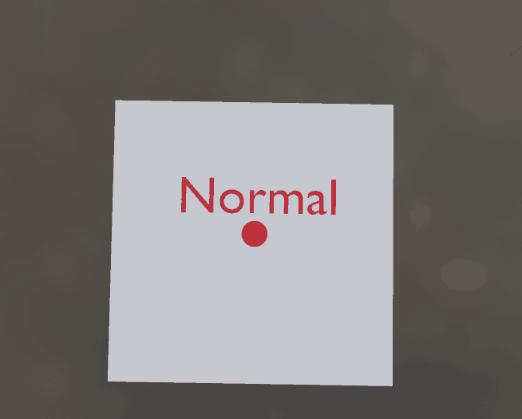
What is a “normal”?
A line or vector perpendicular to a surface

Slide 20
Exercise
Label parts a, b and c
Which is the angle of incidence
Which is the angle of reflection
w, x, y or z
w, x, y or z
b:
a:
c:
x
y
(2 words)
w
z

Slide 21
State the Laws of Reflection of Light
First: The incident ray, the normal at the point of incidence and the reflected ray are all in the same plane.
Second: The angle of incidence is equal to the angle of reflection. i = r
.

Slide 22
First law
The incident ray, the normal at the point of incidence and the reflected ray are in the same plane.
Normal at point of incidence
Reflected ray
Incident ray
Common plane
Mirror

Slide 23


State the second law of reflection
Angle of Incidence = Angle of Reflection.
i = r
Incident ray
Angle of incidence
Angle of reflection
Reflected ray
$$i$$
$$r$$
Plane mirror

Slide 24
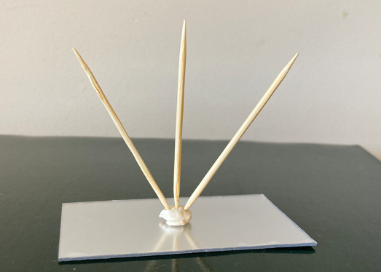
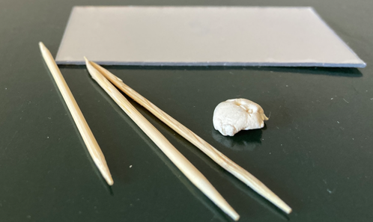
Activity: Model of the laws of reflection

Slide 25
Experiments:
Demonstrate the laws of reflection
See next two slides

Slide 26


Demonstrate the 2nd Law of Reflection
Trace the path
of the ray.
Mark the position
of the mirror.
Draw in the
normal at the
point of incidence.
Measure the angle of incidence (i) and the angle of reflection (r) with a protractor.
Repeat for different values of i.
Observation: angle of incidence = the angle of reflection.
Normal
Sheet of paper
Ray box
Angle of incidence
Angle of reflection
Incident ray
Reflected ray
$$i$$
$$r$$
Point of incidence
Regular reflection
Plane mirror

Slide 27
Demonstrate the 1st Law of Reflection
Same setup
Observation: the incident ray and reflected ray and the normal are all in the plane of the paper sheet – thus all are in the same plane.
Might be more obvious if a laser is used.
Normal
Sheet of paper
Ray box
Incident ray
Reflected ray
Regular reflection
Plane mirror

Slide 28

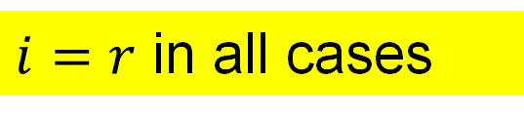

Draw a ray diagram for the image in a plane mirror
Object
Image
Virtual image
$$i$$
$i=r$ in all cases
$$r$$
All of the reflected rays appear to come from the image

Slide 29
Exercise
Draw a ray diagram to determine if A can see B
A
B

Slide 30
Exercise
Draw a ray diagram to determine if A can see B
A
B

Slide 31
Exercise
Draw a ray diagram to determine if A can see B
A
B

Slide 32
Exercise
Draw a ray diagram to determine if A can see C
A
C

Slide 33
Exercise
Draw a ray diagram showing how the image of a point A is formed in a plane mirror.
A

Slide 34
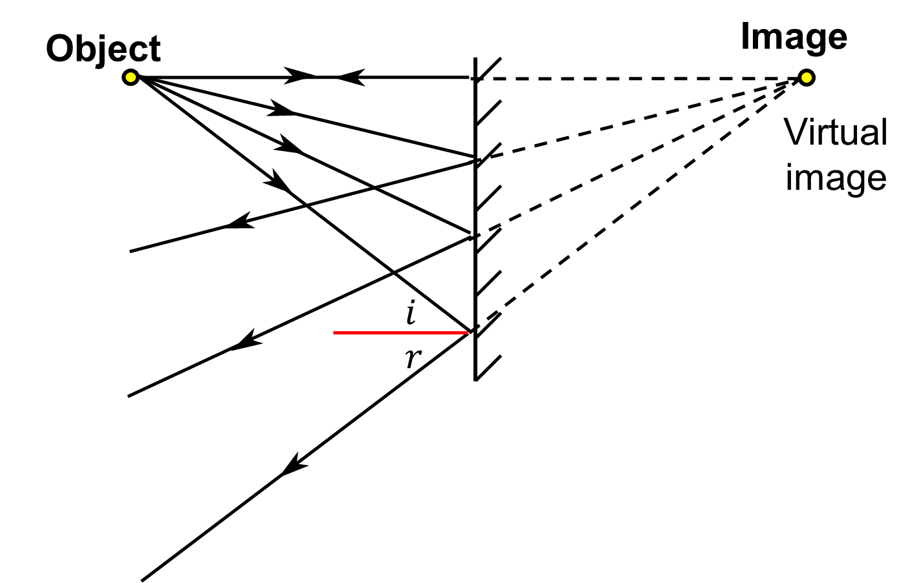
What is a virtual image?
an image formed by the apparent intersection of rays. OL 2020, 2022
The rays only intersect at the object but to the observer they appear to come from the image

Slide 35
How far from the mirror is the image?
Same distance as the object is from the mirror.

Slide 36

What is Parallax?
The apparent change of position of something caused by the movement of the observer.
CC0
link

Slide 37



Give an example of Parallax?
the bird is in line with the soccer ball
A
Microsoft icon
Microsoft icon
B
Microsoft icon
the bird is in line with the rugby ball

Slide 38
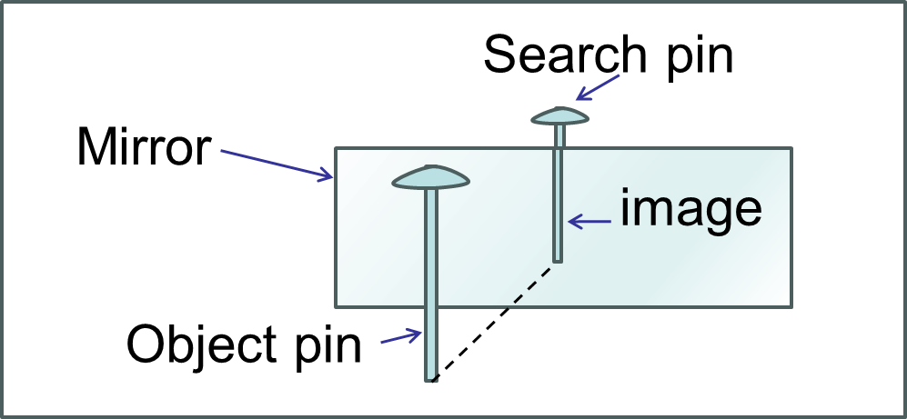
When is parallax helpful and when is it not?
Helpful:
finding the position of a virtual image using the “Method of no parallax”
Not helpful:
When it leads to errors in measurement

Slide 39
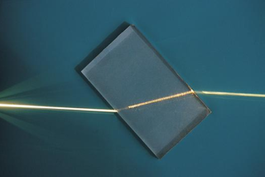

Refraction
Refraction
CC0

Slide 40
What is Refraction of Light?
Refraction is the bending of light when it goes from one medium to another.
byjus.com
sciencelearn.org.nz
Refraction occurs in all wave motion for example sound can be refracted when It passes from an area of cold air to an area of warm air.

Slide 41

What causes the light to bend?
The difference in speed in the two media
Slower
CC0
Faster
Animation link

Slide 42
What is the fastest way to run from A to B
A
full speed
Half speed
full speed
B

Slide 43
Which way does the light bend?
rarer to denser… bends towards the normal.
Air
Glass
denser to rarer … bends away from the normal.
Glass
Air

Slide 44
Does the light always bend?
Light source
Light source
Ray of light
Ray of light
Glass block
Glass block
bending
No bending

Slide 45
Key word check
light
What is this line called?
The normal at the point of incidence
A
B
Which is the angle of incidence, A or B?
A
Remember the normal is a very important line in optics. Angle of incidence, angle of reflection and angle of refraction are all the angle with the normal.

Slide 46
Key word check
light
What is this ray called?
A
The incident ray
B
What is this ray called?
The refracted ray

Slide 47
Key word check
Which is the angle of incidence? _______
light
A
A
Air
B
Glass
D
Which is the angle of refraction? ______
C
C

Slide 48


Key words for Refraction
Normal at the point of incidence
Incident Ray
$$i$$
point of incidence
Angle of incidence
$$r$$
Refracted ray
Angle of refraction
Emergent Ray

Slide 49
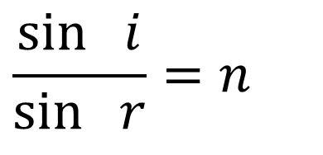
State the 2 Laws of Refraction of Light
1​^{st​} Law: The incident ray, the normal at the point of incidence and the refracted ray are in the same plane.
HL 2016
2^{​nd​} Law: The ratio of the sine of the angle of incidence to the sine of the angle of refraction is a constant.
HL 2016, 2022D
$$\frac{\sin{ }i}{\sin{ }r}=n$$
i.e.
Where n is a constant

Slide 50
1​^{st​} Law of Refraction diagram:
Normal at point of incidence
Incident ray
Common plane
Refracted ray

Slide 51

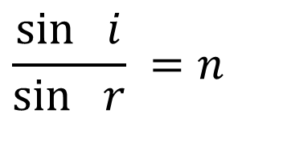

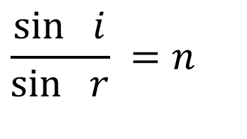

The second law of refraction
$$i$$
$$i$$
air
air
glass
glass
$$r$$
$$r$$
$$\frac{\sin{ }i}{\sin{ }r} =n$$
$$\frac{\sin{ }i}{\sin{ }r} =n$$
The ratio is the same regardless of the angles
The ratio is called the refractive index

Slide 52
Exercise
When does no bending occur?
When the angle of incidence is 0⁰
Glass block

Slide 53
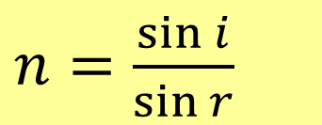
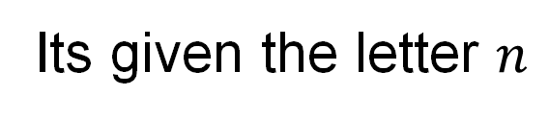
What is meant by the Refractive Index of a material?
ratio of sine of the angle of incidence [3] to sine of the angle of refraction [3] when light goes from a vacuum into the material HL 2024
Its given the letter $n$
Vacuum
Material
$n=$ $\frac{\sin{i}}{\sin{r}}$

Slide 54
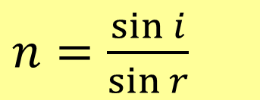
Can you use air instead of a vacuum when measuring refractive index?
Air
Material
$n=$ $\frac{\sin{i}}{\sin{r}}$
Yes when 2 or 3 significant figure accuracy is sufficient. This is because light travels at almost the same speed in air as in a vacuum (0.9997 times slower)

Slide 55
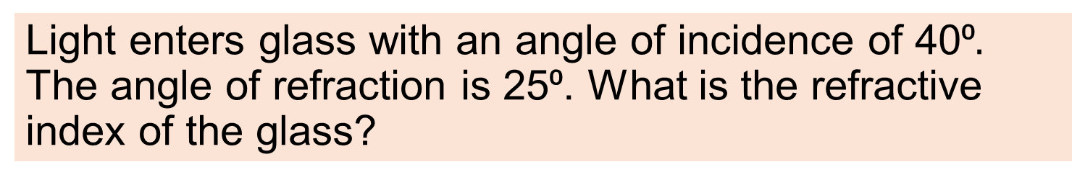
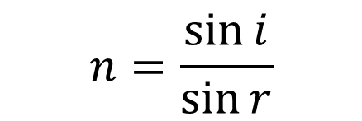
Example
Light enters glass with an angle of incidence of 40⁰$.$ The angle of refraction is 25⁰. What is the refractive index of the glass?
$$n=\frac{\sin{i}}{\sin{r}}$$
=1.52

Slide 56
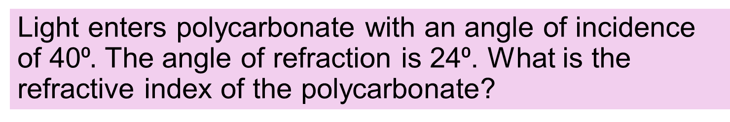
Exercise
Light enters polycarbonate with an angle of incidence of 40⁰$.$ The angle of refraction is 24⁰. What is the refractive index of the polycarbonate?
$$n=\frac{\sin{i}}{\sin{r}}$$
=1.58

Slide 57
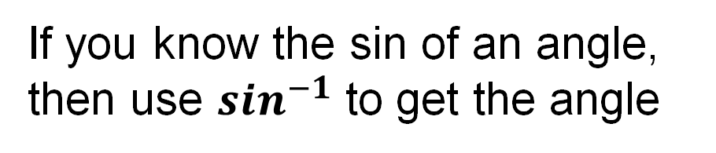


Recap on $sin^{−1}$
If you know the sin of an angle, then use $sin^{−1}$ to get the angle
Example $sin⁡θ$ = 0.24
$$θ$$
$$θ=\sin^{−1}{0.24}$$
$$θ={13.89}^{o}$$

Slide 58
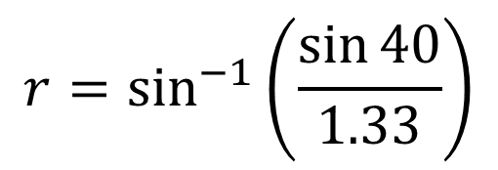
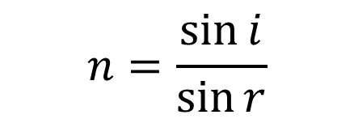
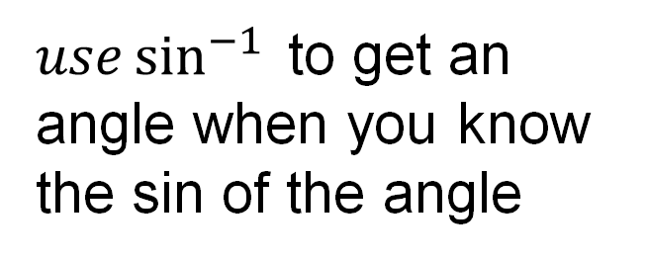
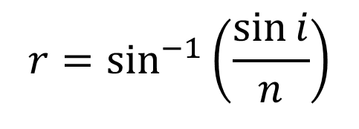
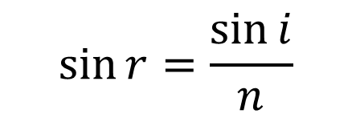
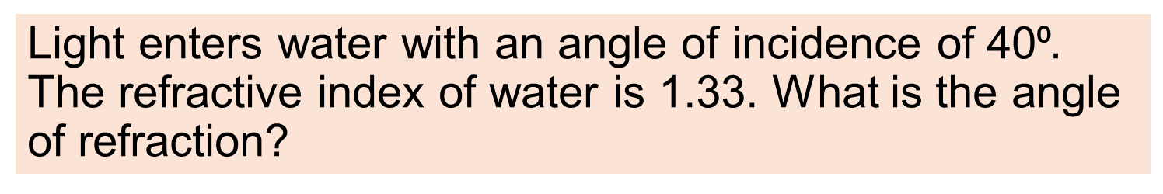

Example
Light enters water with an angle of incidence of 40⁰$.$ The refractive index of water is 1.33. What is the angle of refraction?
$$n=\frac{\sin{i}}{\sin{r}}$$
$$\sin{r}=\frac{\sin{i}}{n}$$
$$r=\sin^{−1}\left(\frac{\sin{i}}{n}\right)$$
$use\sin^{−1}{ }$to get an angle when you know the sin of the angle
$$r=\sin^{−1}\left(\frac{\sin{40}}{1.33}\right)$$
$$r={28.9}^{0}$$

Slide 59
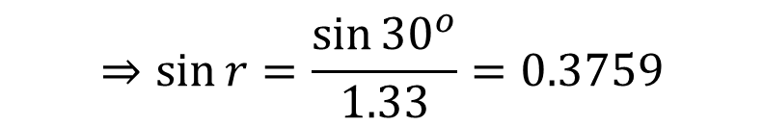
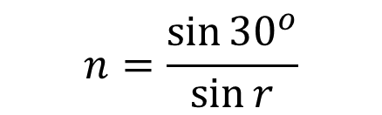
Exercise
A light ray enters water with an angle of incidence of 30⁰ find the angle of refraction.
The refractive index of water is 1.33.
$$n=\frac{\sin{{30}^{o}}}{\sin{r}}$$
=1.33
$$⇒sin{r}=\frac{\sin{{30}^{o}}}{1.33}=0.3759$$
$$⇒{r}=\sin^{−1}{0.3759={22.1}^{o}}$$

Slide 60
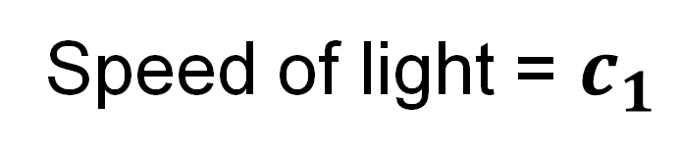
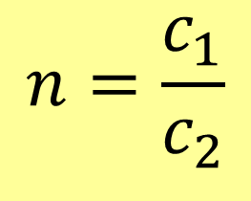
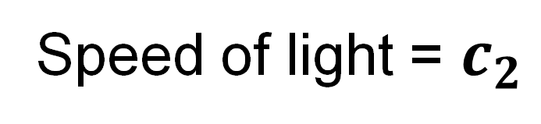
Write Refractive Index in terms of wave Speed
$$n=\frac{c_{1}}{c_{2}}$$
Tables page 59
Speed of light = $c_{1}$
Speed of light = $c_{2}$
Recall refraction is caused by the difference in speed

Slide 61
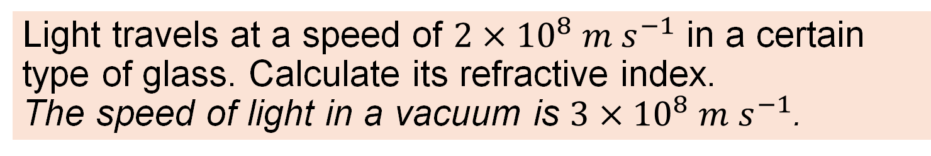
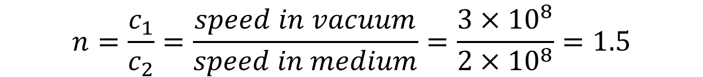
Example
Light travels at a speed of $2×{10}^{8} m s^{−1}$ in a certain type of glass. Calculate its refractive index.
The speed of light in a vacuum is $3×{10}^{8} m s^{−1}$.
$$n=\frac{c_{1}}{c_{2}}=\frac{speed in vacuum}{speed in medium}=\frac{3×{10}^{8}}{2×{10}^{8}}=1.5$$

Slide 62
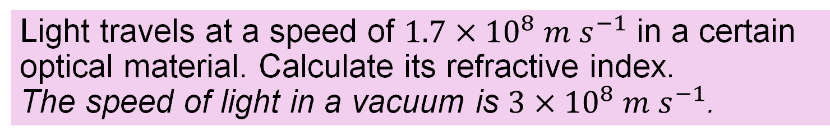
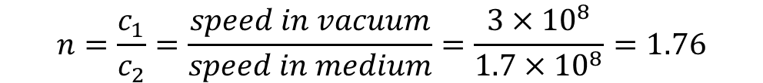
Exercise
Light travels at a speed of $1.7×{10}^{8} m s^{−1}$ in a certain optical material. Calculate its refractive index.
The speed of light in a vacuum is $3×{10}^{8} m s^{−1}$.
$$n=\frac{c_{1}}{c_{2}}=\frac{speed in vacuum}{speed in medium}=\frac{3×{10}^{8}}{1.7×{10}^{8}}=1.76$$

Slide 63


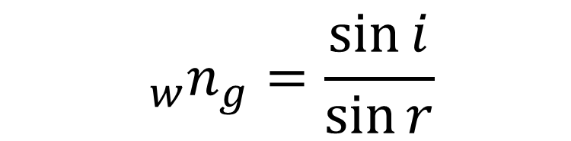

What is meant by the Refractive Index between 2 media?
It’s the ratio $\frac{\sin{i}}{\sin{r}}$ when light goes from one to the other
$$i$$
Water
Glass
The w and g refer to water and glass
$$r$$
$${ _{w}n}_{g}=\frac{\sin{i}}{\sin{r}}$$

Slide 64
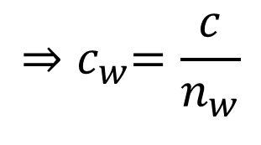
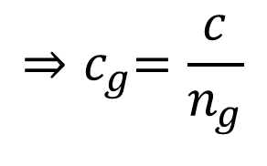
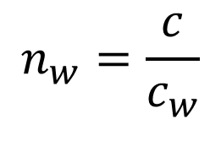
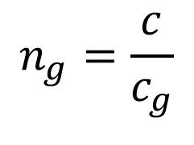

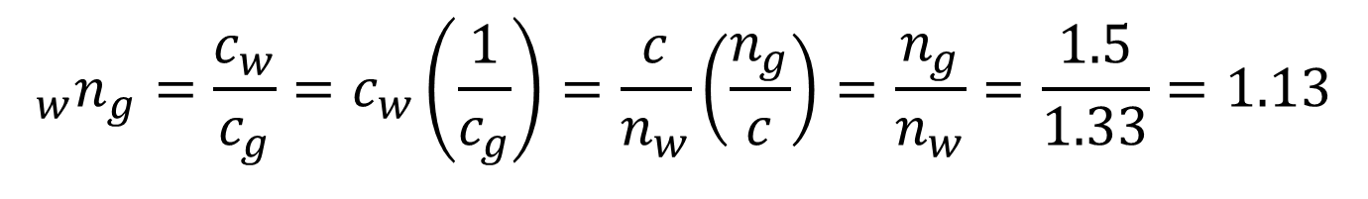
Calculate the refractive index from water n=1.33 to glass n=1.5
$$c=speed of light, c_{g} and c_{w}=speed in glass and water$$
$$n_{g}=\frac{c}{c_{g}}$$
$$n_{w}=\frac{c}{c_{w}}$$
$$i$$
Water
$${⇒c}_{g}=\frac{c}{n_{g}}$$
$${⇒c}_{w}=\frac{c}{n_{w}}$$
Glass
$$r$$
$${ _{w}n}_{g}=refractive index from water to glass$$
$${ _{w}n}_{g}=\frac{c_{w}}{c_{g}}=c_{w}\left(\frac{1}{c_{g}}\right)=\frac{c}{n_{w}}\left(\frac{n_{g}}{c}\right)=\frac{n_{g}}{n_{w}}=\frac{1.5}{1.33}=1.13$$

Slide 65




Reversing the direction
$$i$$
Water
Refractive index Water to Glass
n
= 1.13
Glass
w
g
$$r$$
What is the refractive index from Glass to Water?
1
1
n
=
=
=
0.88
n
g
w
1.13
$$r$$
w
g
Water
Glass
$$i$$

Slide 66
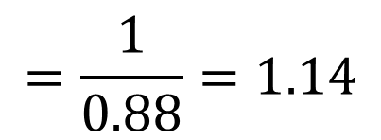
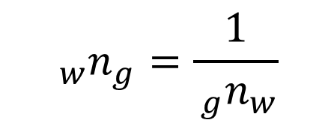
Example
The refractive index between glass and water is 0.88. What is the refractive index between water and glass?
$${ _{w}n}_{g}=\frac{1}{{ _{g}n}_{w}}$$
$$=\frac{1}{0.88}=1.14$$
Note the discrepancy with the previous slide.
This has been caused by an accumulation of rounding differences and highlights the need to round to one extra digit during calculations.

Slide 67
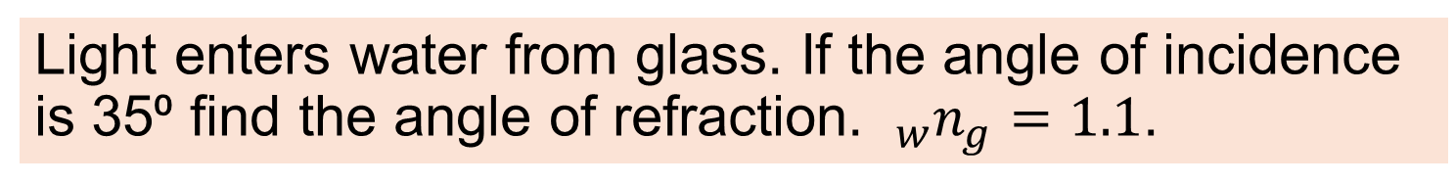






Example
Light enters water from glass. If the angle of incidence is 35⁰ find the angle of refraction. $_{w}n_{g}=1.1$.
$$_{w}n_{g}=1.1{{ ⇒ }_{g}n}_{w}=0.909$$
$${35}^{∘}$$
Glass
$${{ ⇒ }_{g}n}_{w}=0.909=\frac{{\sin{35}}^{∘}}{\sin{r}}$$
Water
$$r$$
$$⇒\sin{r=\frac{sin{35}^{0}}{0.909}=0.6226}$$
$$⇒r=\sin^{−1}\left(0.6226\right)={38.5}^{o}$$

Slide 68
Exercise
The refractive index between water and a certain type of glass is 1.15, what is the refractive index between that glass and water?
0.87

Slide 69
Exercise
A ray of light enters air from a plastic. The angle of incidence is 37⁰ and the angle of refraction is 66⁰ calculate the refractive index of the plastic.
1.52

Slide 70
Exercise HL
Plastic A and Plastic B are in contact. Their refractive indices are 1.44 and 1.47. What is the refractive index for light going from A to B?
A n=1.44
B n=1.47
1.021

Slide 71
Exercise
Which Ray Diagram is correct?
A
B
air
air
air
air
glass
glass
A

Slide 72


Which speed goes on top?
$$n=\frac{c_{1}}{c_{2}}$$
e.g. Glass and vacuum…
Consider...
Refractive index of any material is greater than 1
Thus… highest number goes on top
Light travels fastest in a vacuum
Thus… Speed of light in vacuum goes on top
$$⇒n = \frac{speed of light in vacuum}{Speed of light in glass}$$

Slide 73




Example
The refractive index of diamond = 2.42 and the speed of light in air = $3×{10}^{8} m s^{−1}$. Calculate the speed of light in diamond.
$$n=\frac{c_{1}}{c_{2}}=\frac{speed in air}{speed in diamond}=2.42$$
$$⇒speed in diamond=\frac{speed in air}{2.42}$$
$$=\frac{3×{10}^{8}}{2.42}=1.24×{10}^{8} m s^{−1}$$

Slide 74


Example
The refractive index of Water = 1.33 and the speed of light in a vacuum = $3×{10}^{8} m s^{−1}$. Calculate the speed of light in water.
$$2.26×{10}^{8} m s^{−1}$$

Slide 75


What is the Critical Angle?
The angle of incidence when the angle of refraction is 90⁰.
2019, 2021
Angle of refraction = ${90}^{o}$
Refracted ray
$$C$$
Angle of incidence = Critical angle

Slide 76

Alternative definition: Critical Angle
the angle of incidence in a denser medium greater than which total internal reflection occurs
2019, 2021
Refracted ray
$$C$$
Critical angle
Any bigger and total internal reflection occurs

Slide 77

What is Total Internal Reflection?
Occurs when the angle of incidence > critical angle and all light is reflected.
HL 2019
Angle of incidence greater than Critical angle
Reflected ray
$$C$$
Critical angle

Slide 78



How do you demonstrate Total Internal Reflection
$$r$$
Move the ray box to the left slowly until the angle of refraction is ${90}^{o}$.
(next slide)
$$i$$
Semicircular glass block
Ray box or Laser

Slide 79
How do you demonstrate Total Internal Reflection
$$r$$
Keep going
(next slide)
$$i$$
Partial internal reflection
Ray box or Laser

Slide 80



When you reach the critical angle,
you will see the refraction at ${90}^{o}$ and also a partial reflection.
$$r={90}^{o}$$
$$C$$
Partial internal reflection
Ray box or Laser

Slide 81

When you exceed the critical angle,
you will see total internal reflection.
$$i>C$$
Total internal reflection
Ray box or Laser

Slide 82

How do you calculate the refractive index from the Critical Angle?
$$n=\frac{1}{\sin{ }C}$$
Pg 60
C is the critical angle

Slide 83

Example
The critical angle of a type of plastic is 40⁰. Find the refractive index.
$$n=\frac{1}{\sin{C}}=\frac{1}{\sin{{40}^{o}}}=1.56$$

Slide 84


Example
Saphire ($Al_{2}O_{3})$ has interesting optical properties including a high refractive index of 1.77. What is the critical angle for Saphire?
$$n=\frac{1}{\sin{C}}⇒\sin{C}=\frac{1}{n}=\frac{1}{1.77}=0.565$$
$$⇒C=\sin^{−1}{0.565}={34.4}^{o}$$

Slide 85








Example
What is the smallest value the refractive index that allows total internal reflection in the below prism ?
For total internal reflection:
$$i>C$$
$${⇒45}^{o}>C$$
$$⇒C<{45}^{o}$$
$${45}^{o}$$
$${45}^{o}$$
$${45}^{o}$$
$$n=\frac{1}{\sin{C}}$$
$${45}^{o}$$
now
$$if C={45}^{o}, then n=\frac{1}{\sin{{45}^{o}}}=1.414$$
$⇒$The refractive index must be > 1.414

Slide 86






Example
An architect is designing a circular pool of water with a 2-metre radius which has a light under the water in the centre. What is the minimum depth of the light that will allow light to exit from all points on the surface of the water. ($n_{water}=1.33$).
$$n=1.33=\frac{1}{\sin{C}}$$
2 m
$$⇒\sin{C}=\frac{1}{n}=\frac{1}{1.33}=0. 752$$
d
C
$$⇒C=\sin^{−1}{0.752={48.76}^{0}}$$
C
$$\tan{C=\frac{2}{d}}$$
light
$$⇒d=\frac{2}{tan C}{=1.75 m}$$
If the light were any less deep, no light would escape near the edge of the pool.

Slide 87

Exercise
Pure silicon is opaque to visible light but transparent at infra red frequencies. Its refractive index is 3.4. Calculate the critical angle.
$${17.1}^{o}$$

Slide 88

Exercise
The critical angle of a type of plastic is 44⁰. Find the refractive index.
$$1.44$$

Slide 89
Exercise HL
Plastic A and Plastic B are in contact. Their refractive indices are 1.44 and 1.47 respectively. What is the Critical angle going from B to A?
A n=1.44
B n=1.47
78.4⁰

Slide 90
exercise
Which medium has the highest refractive index?
Medium 1
Medium 2
Total internal reflection

Slide 91
Exercise
How can you turn a ray of light through 180º with a prism?
A
B
C

Slide 92
Example: Prism reflectors
Light that is internally reflected in a 90⁰ prism will always reflect back to where it came from.
This principle is used in bicycle reflectors, in road signs and in reflective strips on clothing.
These prisms use a corner reflector arrangement so as to work in 3 dimensions. Hundreds or thousands of tiny prisms are used in road signs.
Prism based
retroreflectors

Slide 93

Retro reflectors on the moon
There are 7 retro-reflectors on the moon.
5 were placed there on the Apollo missions and have a prism design.
They allow very precise measurements to be made of the moon’s position relative to earth.
CC0

Slide 94

Diver
When a diver looks up, he or she sees a disk of light. The darker surrounding area is where no light comes in and you only see a reflection of the underwater darkness.
CC0

Slide 95


What is an Optical Fibre
A very thin transparent fibre of glass or plastic through which light can pass.

Slide 96

Use of Optical Fibres
Optic fibres are used in communication networks for transmitting data or video signals.

Slide 97
How do Optical Fibres transmit information?
The information is sent as a pulsating laser beam. The angle of incidence is always greater than the critical angle. Total internal reflection keeps the beam inside the fibre.

Slide 98
What is cladding on an optic fibre?
Inner core
Cladding
Many optic fibres are constructed with an inner core which carries the light signal and a thin outer “cladding” made of a similar material but with a lower refractive index.

Slide 99
Where does the total internal reflection occur?
Inner core
Cladding
Total internal reflection occurs at the boundary between the two materials

Slide 100
Exercise
The inner core and outer cladding of an optic fibre have refractive indices of 1.42 and 1.47 respectively. What is the Critical angle for light travelling in the core?
Inner core
Cladding
75.01º

Slide 101

Verify $n=\frac{sin\left(i\right)}{sin\left(r\right)}$
Setup equipment as shown with a sheet of paper under the block.
Trace out the block and the rays
Remove the block and draw the refracted ray and the normal
measure the angles i and r
Repeat with different angles
Ray box
Normal at the point of incidence
$$i$$
Incident Ray
Point of incidence
Protractor
$$r$$
Refracted ray
Glass block
Point of emergence
Paper
Emergent ray

Slide 102
Data and calculations
i | r | sin i | sin r | sin i / sin r

Slide 103






Draw a Suitable graph
$$\frac{\sin{ }i}{\sin{ }r}=n$$
$$sin i$$
$$n=slope$$
$$⇒\sin{i=n\sin{r}}$$
$$y=mx+c$$
$$sin r$$

Slide 104



How does your graph verify the model
$$sin i$$
$$sin r$$
The Graph is a Straight Line through the Origin.
This verifies that: sin i ∝ sin r i.e. $\frac{\sin{i}}{\sin{r}} is constant$

Slide 105

Alternative 1: Search pins
Pins
Normal at the point of incidence
Place sheet of paper under the block.
Line up the pins as viewed through the block
Trace out the block and the rays
Remove the block and draw the refracted ray and the normal
measure the angles i and r
Repeat with different angles
$$i$$
Incident Ray
Protractor
$$r$$
Refracted ray
Glass block
Pins
Emergent ray
Paper
Observer

Slide 106

3d drawing of pin arrangement
2-D drawing is sufficient in an exam.
Line up the pins
Draw incident ray
Draw Refracted ray
Draw Normal at point of incidence
Measure $i$ and $r$ with protractor

Slide 107
Alternative 2: semicircular block
Place sheet of paper under the block.
Trace the block
Mark the centre of the straight edge.
Remove the block and draw the normal
Replace the block
Shine a ray towards the centre of the straight edge
trace the incident and refracted ray
Remove the block and measure i and r.
Repeat for different angles
Normal at the point of incidence
Angle of incidence i
Ray Box
r
Semicircular block of glass
Protractor

Slide 108



Verify $n=\frac{1}{sin C}$
Normal at the point of incidence
Angle of refraction = ${90}^{o}$
Place sheet of paper under semi-circular block.
Trace out the block and mark the centre of the straight edge
Arrange the light box so that rays point at the centre of the straight edge and the angle of refraction is ${90}^{o}$
Remove block
Draw Normal
Draw Incident ray
Measure C
Calculate $\frac{1}{sinC}$ and check that it is the same as n
C
Semicircular block of glass
Ray Box
Protractor

Slide 109
Phet simulations of refraction
Bending Light - Snell's Law | Refraction | Reflection - PhET Interactive Simulations

Slide 110
Revision summary
Key definitions: light, reflection, refraction, refractive index, critical angle, total internal reflection.
State: two laws of reflection, two laws of refraction.
Other definitions: virtual image, parallax, normal, angle of incidence, angle of refraction.
Modelling: apply and use $i=r$, $\frac{\sin{ }i}{\sin{ }r}=n$, $n=\frac{1}{\sin{ }C}$ , $n=\frac{c_{1}}{c_{2}}$
Experiment: verify: $\frac{\sin{ }i}{\sin{ }r}=n$ and: $n=\frac{1}{\sin{ }C}$
Use secondary data to verify: $n=\frac{c_{1}}{c_{2}}$

Slide 111
Additional material

Slide 112
Change log
Log of significant changes e.g. added / moved material, revised definitions
8 Sept 25: Definition of virtual image changed in line with marking schemes

