Slide 1
2017 question 6
Mechanics, bungee jump

Slide 2
In a bungee jump, Henry falls while attached to an elastic cord. When the cord stops Henry’s fall, he then oscillates up and down.
During the bungee jump, gravitational potential energy is converted into kinetic energy and then into elastic potential energy.
State the principle of conservation of energy.
The Principle of conservation energy states that energy can neither be created nor destroyed, but that it can be converted from one form into another.

Slide 3



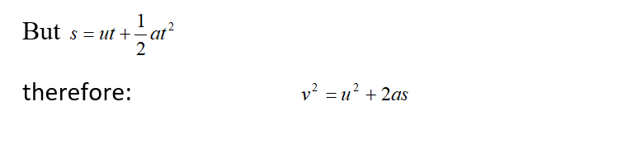
Derive the expression v²=u²+2as for uniform accelerated motion.

Slide 4
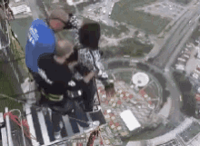

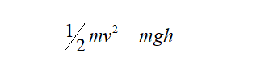
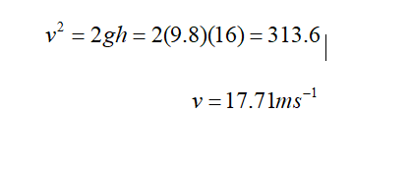
The cord is 32 m long and Henry, of mass 60 kg, falls from rest while attached. Calculate his speed when he has fallen 16 m. (21)

Slide 5
A stretched elastic cord obeys Hooke’s law and the weight attached to the cord oscillates with simple harmonic motion.
State Hooke’s law. What is meant by simple harmonic motion?
Hooke's Law states the restoring force on a spring is proportional to the extension of the spring
Simple harmonic motion: Any motion where the acceleration (a) of a particle is proportional to its distance (s) from an equilibrium position is simple harmonic motion:
a ∝ -s

Slide 6
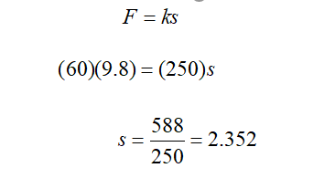
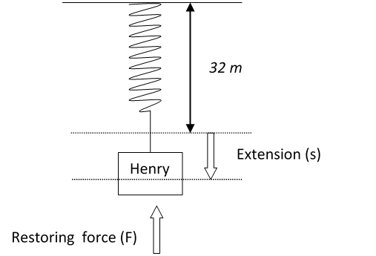

The elastic constant of the cord is 250 N m^{–1}. Calculate the length the cord would have if Henry was suspended at rest. (15)

Slide 7

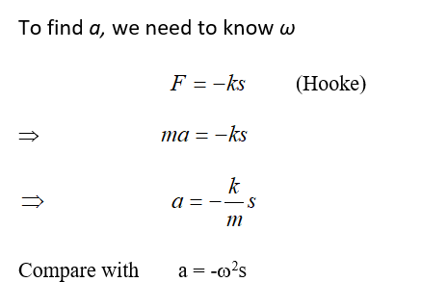
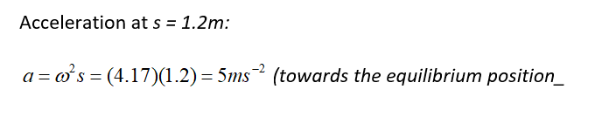
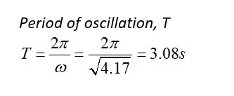

After the end of the fall, Henry oscillates with simple harmonic motion.
The maximum displacement from his rest position is 1.2 metres.
Calculate (i) his maximum acceleration as he oscillates and (ii) his period of oscillation

Slide 8
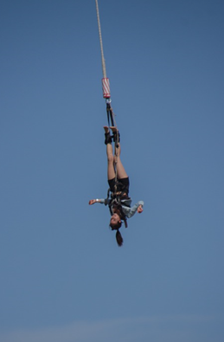

Draw a diagram to show the forces acting on Henry when he is at his lowest point. (20)
Restoring force is greater than the weight.

