Slide 1
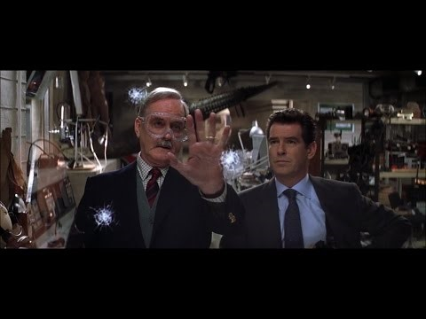
Resonance (from Bond: Die Another Day)

Slide 2
Resonance (from Bond: Die Another Day)
Is this plausible?
Using resonance to break glass:
Plausible. But creating a sound wave with sufficient energy to break the glass from such a small device (and presumably a small battery) would be very unlikely
The invisibility:
Not plausible with available technology, nor likely to be plausible for many, many years

