Slide 1
Spiderman
And Hooke’s Law

Slide 2
Hooke’s Law (from Spiderman)

Slide 3
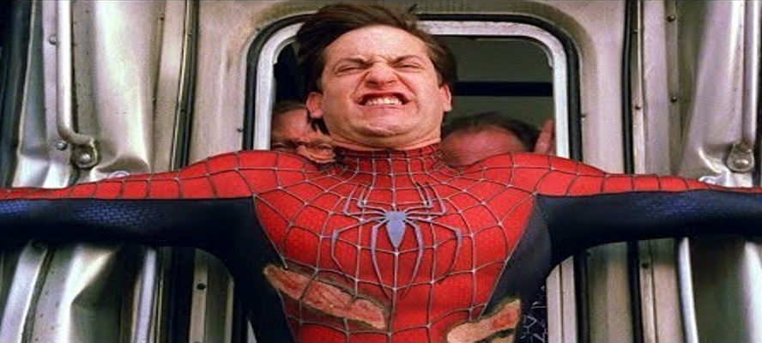
Is this plausible?
A human becoming a superhero after being bitten by a radioactive spider?
No
Large scale spider’s webs creating forces large enough to stop a train?
Possibly…..

Slide 4
To determine if the scene is plausible, we need to make a few assumptions…..
Speed of train…..140 km/hr (mentioned in the movie)
Mass of train….155,000 kg (a typical value)
Stopping time…..50 seconds (from timing the movie)

Slide 5
We also need to ask ourselves a specific question….
If we take the web to be equivalent to a spring, calculate a value for the spring constant based on what we see in the movie.
Is this similar to the actual values for a spider’s web?
If the answer to the second question is ‘yes’, then the scene is (sort of) plausible

Slide 6
How much kinetic energy does the train have at the beginning?
Mass of train = 155, 000 kg
Velocity = 140 km/hr

Slide 7
How much work is done in stopping the train?

Slide 8
If work = (average force)(distance), what force is required to stop the train?

Slide 9
Following Hooke’s Law, find a value for the spring constant (k)

Slide 10
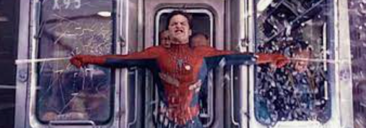
Following Hooke’s Law, find a value for the spring constant (k)

Slide 11
Typical value for the Spring Value of a spider’s web (scaled up the size of web produced by Spiderman) would range from…
100 Nm⁻¹ to 25,000 Nm⁻¹
Our value is 120 Nm⁻¹
…so (if we accept that being bitten by a radioactive spider can turn you into a superhero with the ability to manufacture spider’s webs on a large scale) the scene is plausible….

