Slide 1
The Physics of Time Travel

Slide 2
Hands up….
Give your first impression. Don’t look at others or ask what they think….
Will time travel ever be possible?

Slide 3
If time travel was possible…
Would you choose to go to the …..
Future?
Past?

Slide 4
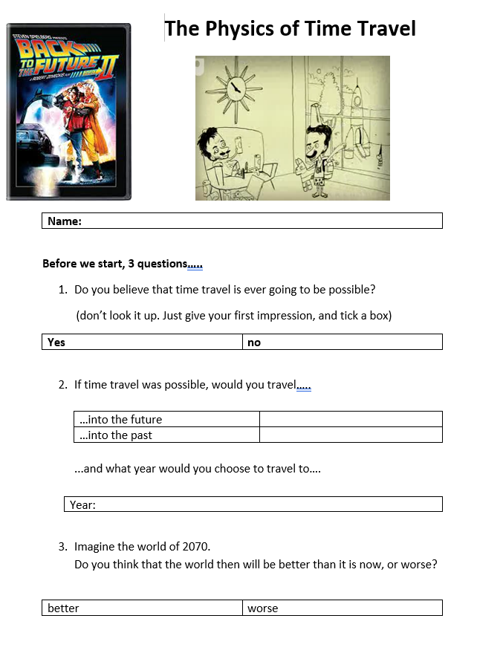
Fill in page 1
Choose a specific year…
In 2070, will the world be…
…better than today?
…worse than today?

Slide 5
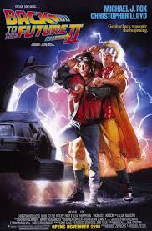
Predicting the Future….
Made in 1989
Based in 1985, following people who travel forward …
…to 2015
So, this is how they imagined the modern world would look…
How close were they?

Slide 6
Predicting the Future….
Their vision of a town centre…
What did they get wrong?
What did they get right?

Slide 7
Predicting the Future….
Their vision of skateboarding
Is this possible? How?
If its possible, why doesn’t it happen?

Slide 8
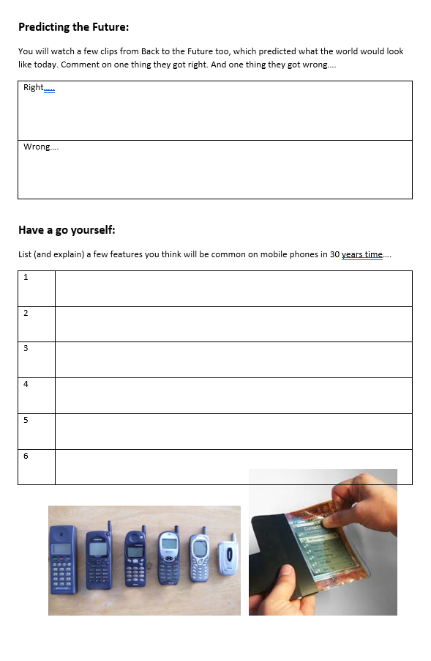
Predicting the Future: you try it….
Imagine the world 30 years from now…
What will mobile phones look like?
List a few features in your booklet…

Slide 9
Predicting the Future….
This is one vision of where phones might go…

Slide 10
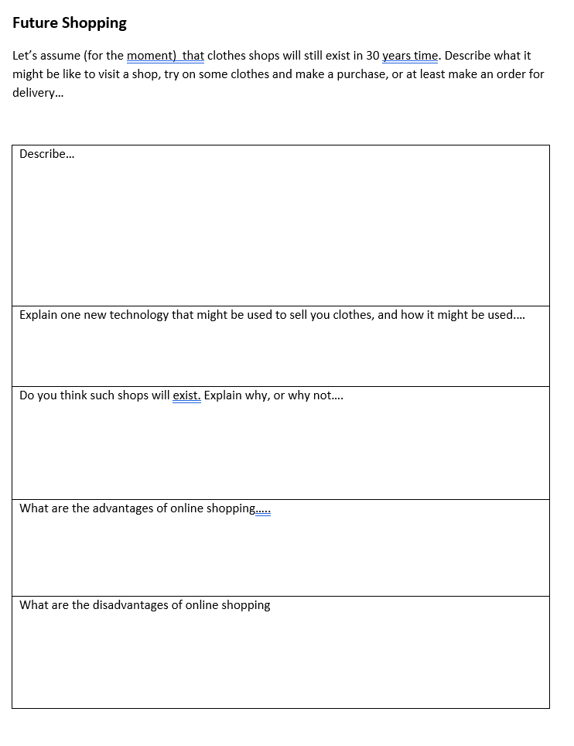
Predicting the Future….
imagine it is 30 years in the future, and you’re shopping for clothes…
…describe the experience

Slide 11
Predicting the Future….
Let’s not forget the effect of technology on climate change…
Climate change is real
Climate change is overwhelmingly caused by human activity
Climate change will affect our futures
Lets look at some graphs that tell us how we know this……

Slide 12
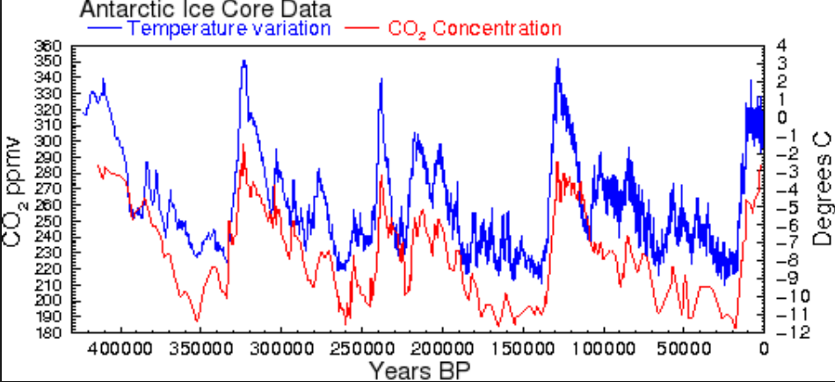
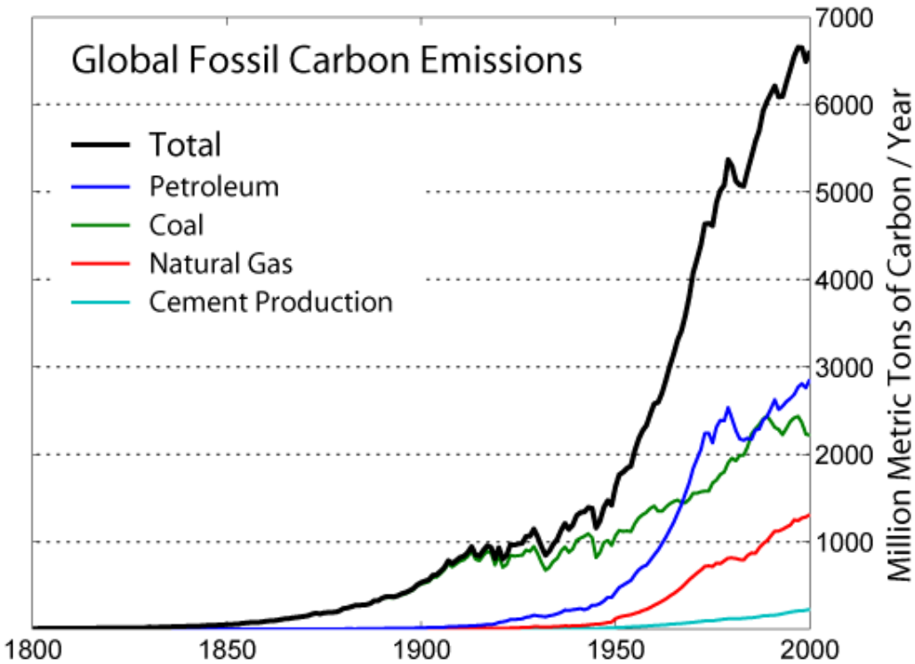
Let’s not forget about climate change
Facts:
Carbon dioxide does affect average temperatures…
We are still burning too many fossil fuels…

Slide 13
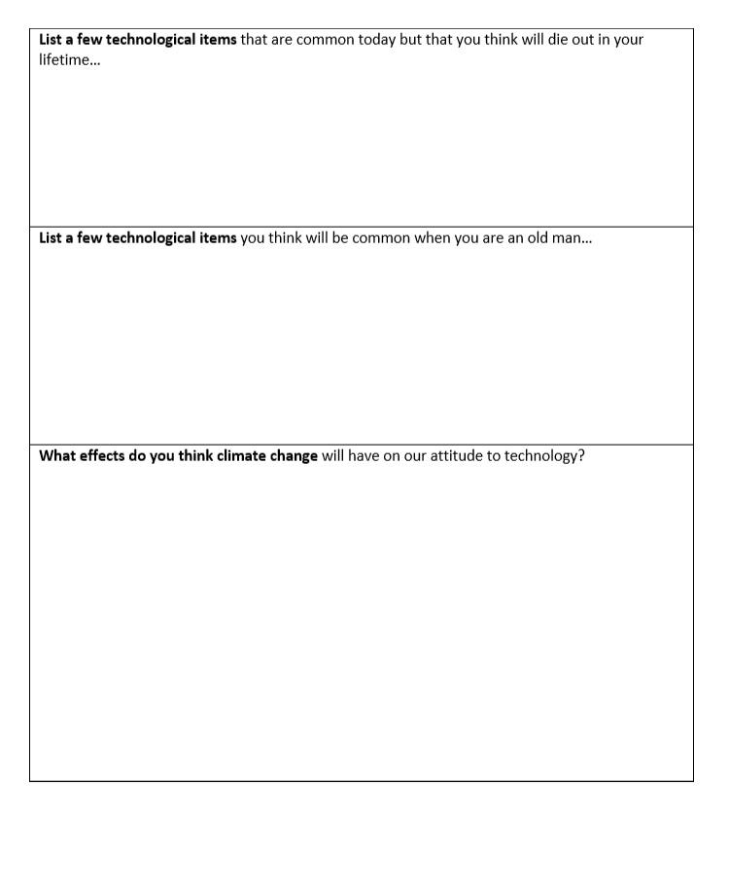
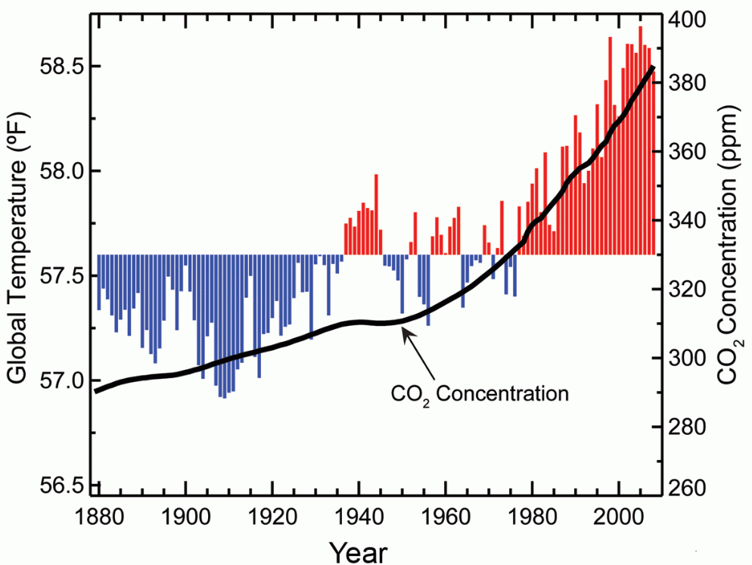
Let’s not forget about climate change
The effects are already being felt
This is a problem that we can’t ignore when we think about future technologies and how we use them
Complete this page, with that in mind

Slide 14
Is time travel possible?
Einstein’s work in the early 1900s suggest that it might be, in 2 ways…..
Wormholes (from his Theory of General Relativity)
Time Dilation (from his Theory of Special Relativity)

Slide 15
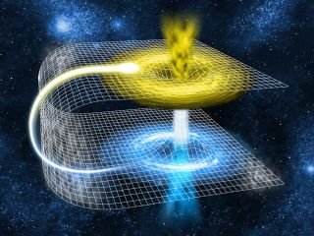
Is time travel possible?
Wormholes are similar to black holes except …
…anything entering one side would emerge from the other, arriving at another point in space and time
…we have never found a wormhole
May or may not exist
We’re definitely not close to one
Time travel via a wormhole is not happening anytime soon

Slide 16
Is time travel possible?
Time Dilation means that the faster we travel through space…, the slower we travel through time
This is a real and provable phenomenon
It happens all the time
But the effects are usually too small to notice

Slide 17
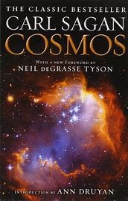
time dilation: video explanations
From 1980, with dated special effects but a great explanation of time dilation
A more recent cartoon explanation….

Slide 18
time dilation and relativity
How does it work?
Remember that
… there won’t be a test on this
…you don’t have to follow every line
Just try to get the basic idea…

Slide 19
time dilation and relativity
How do we see a ticking clock?
Light reflects from the clock and enters your eye
We can see the second hand moving

Slide 20
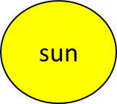
time dilation and relativity
But if you move backwards at the speed of light…..
……. the light ray never catches up
If you don’t see the clock move, has time stood still?

Slide 21
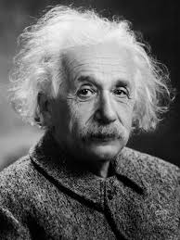
time dilation and relativity
Einstein based his work on two ideas:
the speed of light is constant
the laws of physics are the same whether or not you’re moving

Slide 22
What is relativity?
A car is travelling at 30 m/s (100 km/hr)

Slide 23
What is relativity?
A car is travelling at 30 m/s (100 km/hr)
If it meets another car travelling at 30 m/s…
They would each measure the other car’s speed as
60 m/s… (30 +30)
…relative to themselves
That’s ordinary relativity

Slide 24
A car is travelling at 30 m/s (100 km/hr)
It meets a light travelling at 300, 000, 000 m/s
It measures the speed of the passing light as….
300,000,030 m/s?
or….
300,000,000 m/s?
i.e. the speed of light is constant.
This is the basis of special relativity

Slide 25
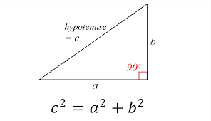
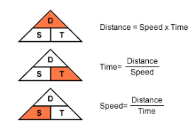
What is relativity?
To follow Einstein’s maths, you need to remember…..
…both from Junior Cert Maths + Science

Slide 26
What is relativity?
Imagine you’re in the car, using a pulse of light as a clock…..
Each second the pulse moves from top to bottom of the clock

Slide 27
What is relativity?
Imagine you’re watching this car pass by, using the same clock
Each second the pulse moves from top to bottom of the clock
It follows a zig-zig path

Slide 28
What is relativity?
Distance = (speed) (time)
cT
cT’
c = speed of light
v = speed of the car
T’ = time measured in the moving car
T = time measured by people outside the car
vT

Slide 29
What is relativity?
From Pythagoras…
$${(cT^{′})}^{2}+{(vT)}^{2}={(cT)}^{2}$$
$${(cT^{′})}^{2}={(cT)}^{2}−{(vT)}^{2}$$
$${c^{2}T^{′}}^{2}={c^{2}T}^{2}−{v^{2}T}^{2}$$
$${T^{′}}^{2}=T^{2}−{\frac{v^{2}}{c^{2}}T}^{2}$$
$${T^{′}}^{2}=T^{2}(1−{\frac{v^{2}}{c^{2}})}^{}$$
$$T^{′}=T\sqrt{1−\frac{v^{2}}{c^{2}}}$$
cT
cT’
vT
c = speed of light
v = speed of the car
T’ = time measured in the moving car
T = time measured by people outside the car

Slide 30
What is relativity?
$$T^{′}=T\sqrt{1−\frac{v^{2}}{c^{2}}}$$
This tells us that time passes differently depending on how fast you are travelling
If you leave the earth and travel at (extremely) high speed for a few hours, you could return to earth and find that decades have passed.
Lets look at a few examples….

Slide 31
Time Dilation: if a rocket travels at 30 m/s
Time on the space craft…
Time on earth
remember that c = 300,000,000 m/s
T’= T $\sqrt{\text{(1 −} \frac{v^{2}}{c^{2}})}$
T’= T $\sqrt{\text{(1 −} \frac{{30}^{2}}{{300000000}^{2}})}$
T’= T (the difference is tiny)
365 days on earth = 365 days on the spacecraft

Slide 32
Time Dilation: if a rocket travels at 30,000 m/s
Time on the space craft…
Time on earth
remember that c = 300,000,000 m/s
T’= T $\sqrt{\text{(1 −} \frac{v^{2}}{c^{2}})}$
T’= T $\sqrt{\text{(1 −} \frac{{30,000}^{2}}{{300000000}^{2}})}$
T’= T (the difference is small)
365 days on earth = 363 days in the spacecraft

Slide 33
Time Dilation: if a rocket travels at 297,000, 000 m/s
Time on the space craft…
Time on earth
remember that c = 300,000,000 m/s
T’= T $\sqrt{\text{(1 −} \frac{v^{2}}{c^{2}})}$
T’= T $\sqrt{\text{(1 −} \frac{{297,000,000}^{2}}{{300000000}^{2}})}$
T’= 0.14 T
365 days on earth = 51 days in space

Slide 34
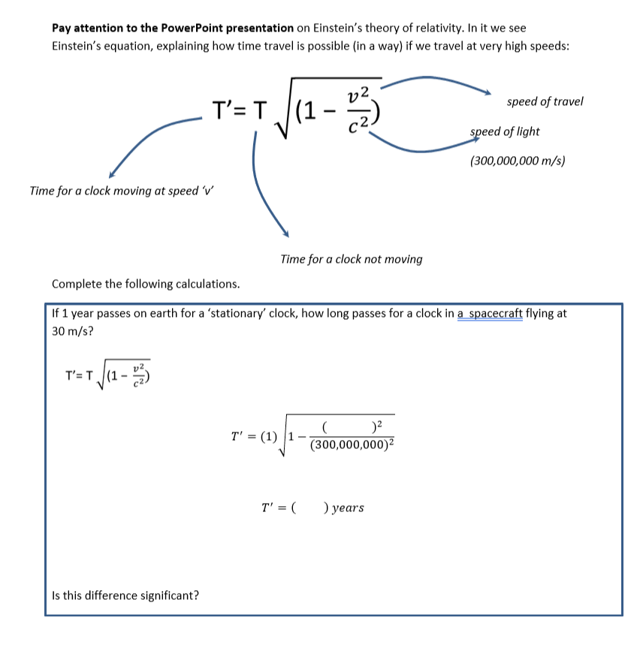
Time Dilation: if a rocket travels at 99.99999 % the speed of light
Time on the space craft…
Time on earth
remember that c = 300,000,000 m/s
T’= T $\sqrt{\text{(1 −} \frac{v^{2}}{c^{2}})}$
T’= T $\sqrt{\text{(1 −}0.99999992)}$
Try these questions…
T’= 0.00045 T
50 years on earth = 4 hours in space

Slide 35
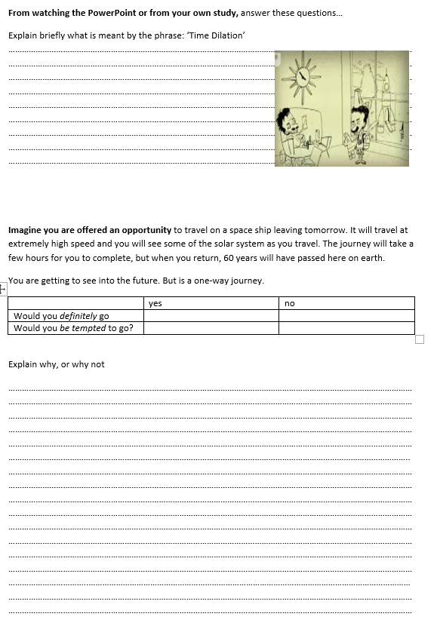
Time Dilation: if a rocket travels at 99.99999 % the speed of light
50 years on earth = 4 hours in space
Imagine that…..
you have the chance to travel for 4 hours in space knowing that when you come back to earth, 50 years have passed
This is time travel:
You get to see the future, but….
…it’s a one way journey. You can’t ever come back to the resent time
Would you go?

Slide 36
Hands up….
Give your first impression. Don’t look at others or ask what they think….
Is there life elsewhere in the Universe?
If so, will we ever communicate with aliens?

Slide 37
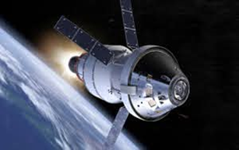
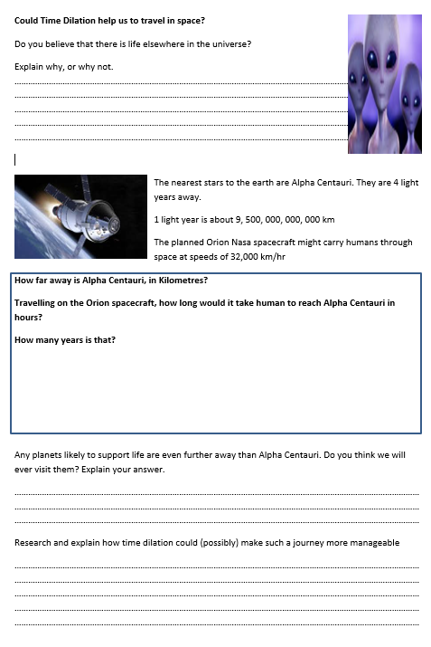
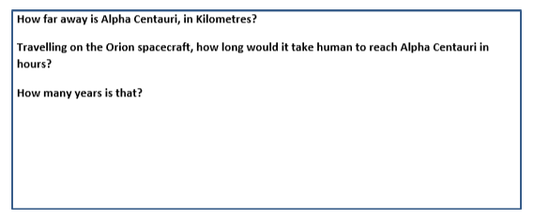
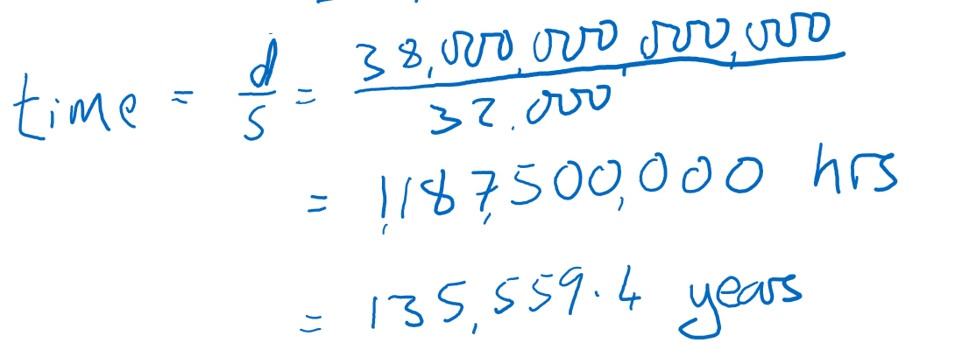
In your booklet….
The nearest stars to the earth are Alpha Centauri. They are 4 light years away.
1 light year is about 9, 500, 000, 000, 000 km
The planned Orion Nasa spacecraft might carry humans through space at speeds of 32,000 km/hr

Slide 38
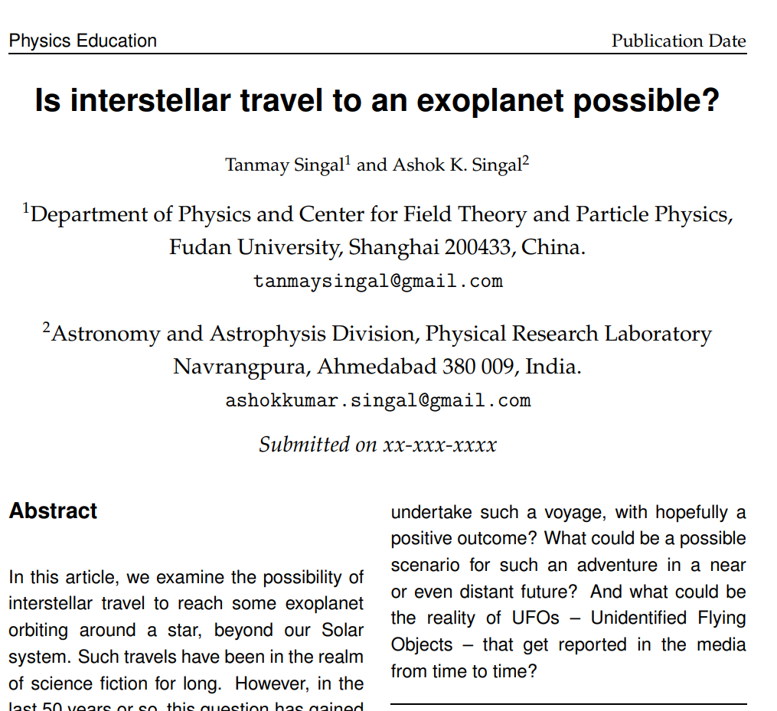
Could time dilation make a journey to other planets possible?
A spaceship accelerating continuously with a convenient value of g, that is the acceleration that we are used to on the surface of the Earth, could travel to the most distant parts of the universe within a human lifetime, without violating the speed-limit of c, the speed of light. In principle, interstellar travel may thus appear possible.
In summary: it’s possible….but still unlikely….

