Slide 3
Electricity and Magnetism
Self Induction
Eddy Currents

Slide 4
A strong magnet is above a copper sheet as shown
Remember that copper is not a magnetic material….
…but when the copper sheet is pulled to he left, considerable force is required to do so.
What would that be?

Slide 5
N
S
attracts
When the copper moves, a voltage (and current) is induced in the sheet (Faraday). This is called an eddy current
This current creates a magnetic field, which opposes the change (Lenz)
The faster the change the greater the effect. When plate stops movement, effect disappears

Slide 6
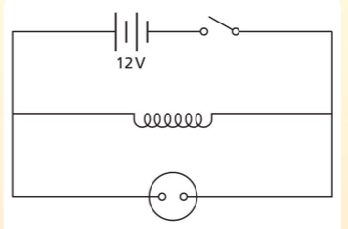

Self Induction
Bulb requires 100 V to light
Close switch and noting happens
Open switch and the bulb flashes…
…due to self induction
I/A
t/s
Quickly changing current creates a quickly changing magnetic field in the coil…
…as the coil is inside a quickly changing magnetic field, a voltage is induced…
…which is enough to light the bulb briefly.

Slide 8
2014 q12d
Electromagnetic Induction
Faraday’s and Lenz’s Law
Eddy Currents

Slide 9
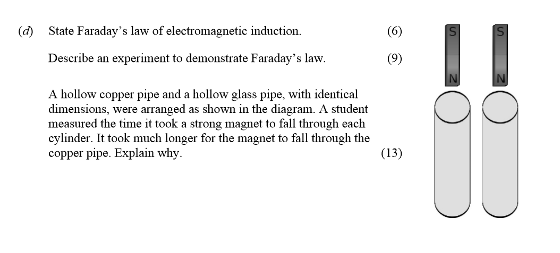

Slide 10
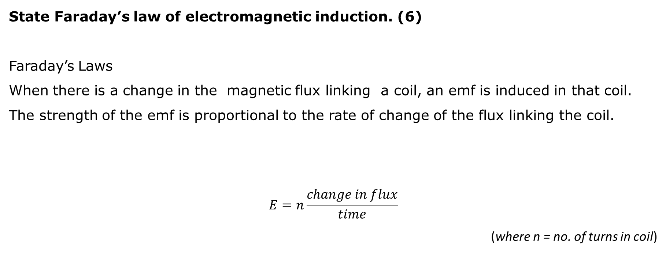
State Faraday’s law of electromagnetic induction. (6)
Faraday’s Laws
When there is a change in the magnetic flux linking a coil, an emf is induced in that coil. The strength of the emf is proportional to the rate of change of the flux linking the coil.
$$E=n\frac{change in flux}{time}$$
(where n = no. of turns in coil)

Slide 11
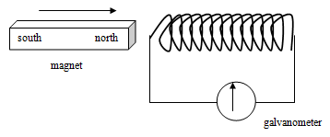
Describe an experiment to demonstrate Faraday’s law. (9)
Method: Set up a circuit as shown here. Move the magnet towards the coil.
Observations / Conclusion: When the magnet is moving, a current is shown on the galvanometer, indicating that the changing magnetic field is creating an emf, as stated in Faraday’s Law.
The faster the magnet moves, the greater the current.

Slide 12
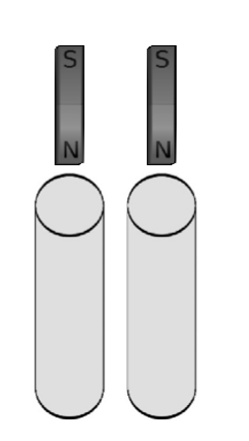
A hollow copper pipe and a hollow glass pipe, with identical dimensions, were arranged as shown in the diagram.
A student measured the time it took a strong magnet to fall through each cylinder. It took much longer for the magnet to fall through the copper pipe. Explain why. (13)
Obviously the glass is unaffected by the magnet, and the magnet falls under gravity. Copper is non-magnetic, and does not generally respond to the presence of a magnet. In this arrangement, however, there is an effect:
the falling magnet creates a changing magnetic field.
The changing magnetic field induces electrical currents to flow in the copper(known as eddy currents)
The electric currents themselves create a magnetic field, which – according to Lenz’s Law – oppose the change. In this instance this means that they create an upward force, falling of the magnet is slowed down.
force

