Slide 1
derivations
Leaving Cert Physics
Electricity

Slide 2
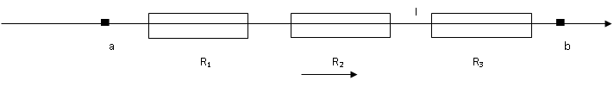
Derivations: resistors in series
Consider a set of 3 resistors in series

Slide 3
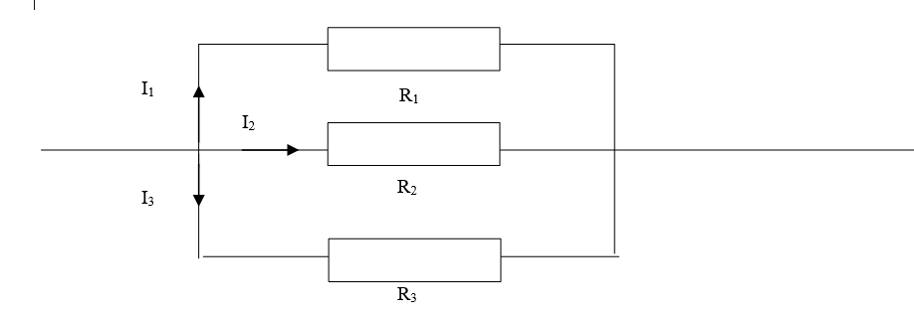
Derivations: resistors in parallel

Slide 4


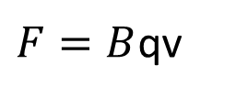
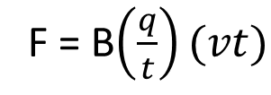
Derivations: F = Bqv
north
current-carrying conductor in a magnetic field:
$$F=BIl$$
l
south
For a charge, q, with velocity , t, in a magnetic field:
north
$$F=BIl$$
+
q v
F = B$\left(\frac{q}{t}\right)(vt)$
south
$F=B$qv

