Slide 1
2007 q8

Slide 2
2007 q.8
Define electric field strength and give its unit of measurement.
Electric field strength is the force (F) per unit charge (Q) at a point in the field
It is measured in N/C

Slide 3
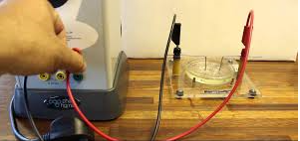
2007 q.8
Describe how an electric field pattern may be demonstrated in the laboratory.
3kV
Set up circuit as shown
Close switch
The semolina lines up, demonstrating the shape of the electric field pattern
Petri dish, containing oil and semolina

Slide 4
A dome is charged. The dome has a diameter of 30 cm and its charge is 4 C.
A 5 μC point charge is placed 7 cm from the surface of the dome.
Calculate:
(i) the electric field strength at a point 7 cm from the dome
(ii) the electrostatic force exerted on the 5 μC point charge. (15)
4C
0.15
0.07
(i)
0.22
See marking scheme

Slide 5
A dome is charged. The dome has a diameter of 30 cm and its charge is 4 C.
A 5 μC point charge is placed 7 cm from the surface of the dome.
Calculate:
(i) the electric field strength at a point 7 cm from the dome
(ii) the electrostatic force exerted on the 5 μC point charge. (15)
4C
0.15
0.07
(i)
0.22
(ii)

