Slide 1
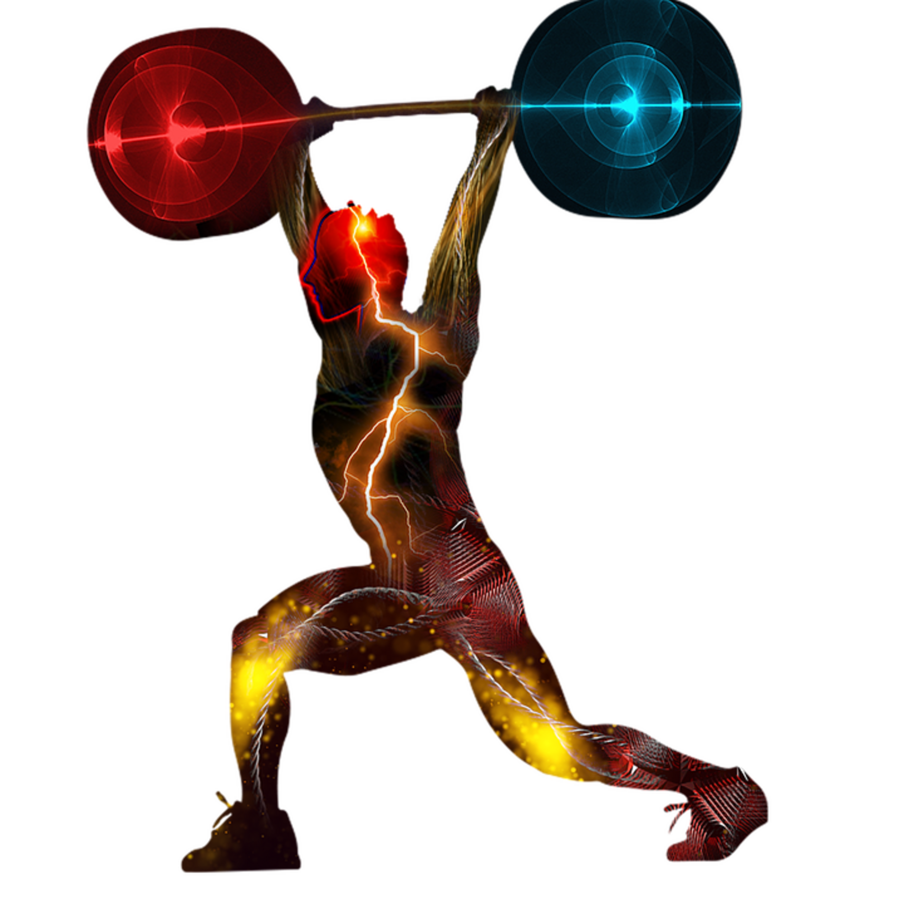
Work, Energy and Power
CC0

Slide 2
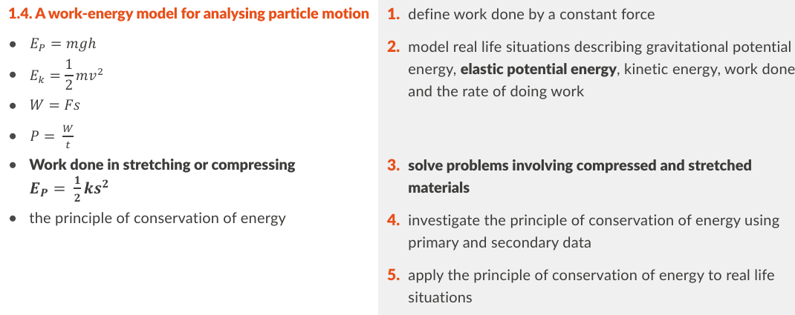
Physics Specification 1.4
Efficiency is in 2.1 but introduced here
New to the course
Energy conservation experiments
Elastic potential energy (higher)

Slide 3
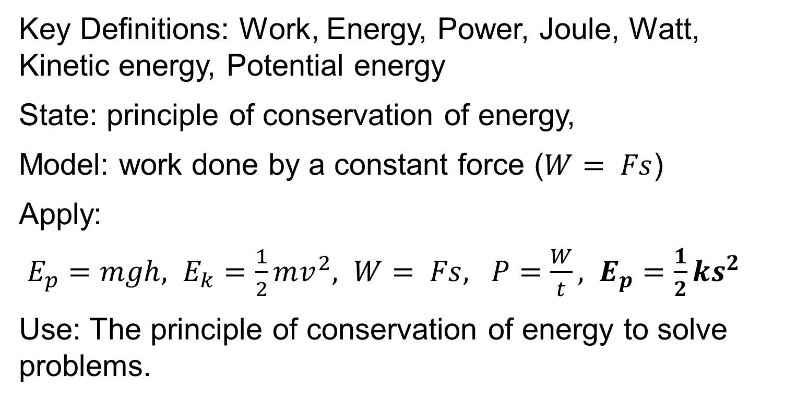
Revision Summary
Key Definitions: Work, Energy, Power, Joule, Watt, Kinetic energy, Potential energy
State: principle of conservation of energy,
Model: work done by a constant force ($W= Fs$)
Apply:
$E_{p}=mgh, E_{k}=\frac{1}{2}mv^{2}, W= Fs, P=\frac{W}{t}, E_{p}=\frac{1}{2}ks^{2}$
Use: The principle of conservation of energy to solve problems.

Slide 4
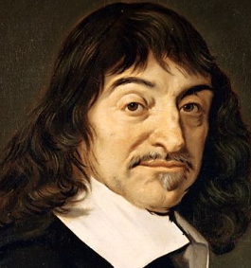
Work
“Lifting 100 lb one foot twice over is the same as lifting 200 lb one foot, or 100 lb two feet.”
— René Descartes 1637,
Letter to Huygens

Slide 5
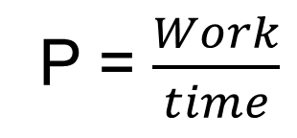
Work Energy Power Summary
Work = Force x displacement
W=Fs (joules)
Energy = ability to do Work
E = W (joules)
Power = rate of doing work
P = $\frac{Work}{time}$
(watts)
Don’t get energy and power mixed up!
Batteries store energy
Motors do work
High power motors do more work per second

Slide 6
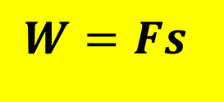
What is Work?
Work = force multiplied by distance moved in the direction of the force.
Work = force × displacement
$$W=Fs$$
Equation and Notation
F
s

Slide 7
What is the SI Unit of Work?
The joule (J)
What is the symbol?
W
Vector or scalar?
Scalar

Slide 8
Define the joule.
One joule is the amount of work done when a force of 1 newton acts for 1 metre in the direction of the force.
i.e. 1 J = 1 N m
1 joule of Work:
F= 1 N
s = 1 m

Slide 9
Example
A rock is dragged 4 metres with a force of 200 N calculate the work done.
200 N
4 m
Work done = W = F s = (200)(4) = 800 J

Slide 10
Recap: How do you calculate weight from mass?
W = mg
1 kg
9.8 N
On Earth,
Weight = mass x 9.8
1 kg

Slide 11
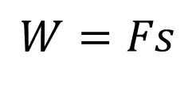
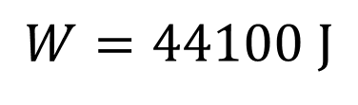
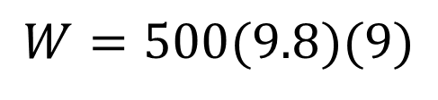
Example
A lift of mass 500 kg travels upwards 9 metres, how much work is done?
$$W=Fs$$
R Downey
$$W=500(9.8)(9)$$
$$W=44100 J$$
9 m
R Downey

Slide 12
Exercise
A rock is dragged 15 metres with a force of 300 N calculate the work done.
300 N
15 m
4500 J or 4.5 kJ

Slide 13

Exercise
A 300 g mass is raised 90 cm how much work is done?
$$W=2.646 J$$

Slide 14

Exercise
A crane lifts a 400 kg mass 30 meters off the ground. How much work is done?
$$W=117600 J$$

Slide 15
What is energy?
Energy is the ability to do work.
If a battery can store 1000 J then it can do 1000 J of work.
Energy and work are often interchangeable in formulae, and they have the same unit.

Slide 16
What is the SI Unit of Energy?
The joule (J).

Slide 17
Name different types of energy.
Kinetic energy
Gravitational potential energy
Elastic potential energy
Electric potential energy a charge in an electric field
Electromagnetic energy (Light, microwave, x-ray…)
Heat
Sound
Chemical
Electrical
Nuclear

Slide 18
State the principle of
Conservation of Energy.
energy cannot be created or destroyed it can be changed from one form to another. HL 2016 2017 2018 2019 2021 2024

Slide 19
Describe the energy conversions in a waterfall.
Gravitational Potential Energy
Kinetic Energy
Sound and heat energy
R Downey

Slide 20
What is Potential Energy?
Potential energy is stored energy due to position in a force field. OL 2023
Gravitational Potential Energy
Magnetic potential energy

Slide 21
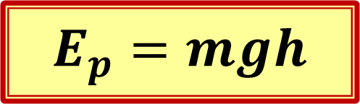
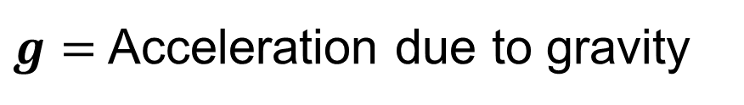
Write an equation for
Gravitational Potential Energy
m
m
$$E_{p}=mgh$$
h
$g=$Acceleration due to gravity

Slide 22


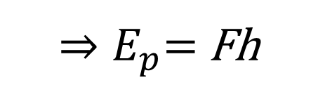
Derive the Potential Energy equation
Work = force x distance
m
${⇒E}_{p}=$ Fh
m
$$and F=mg$$
h
$$⇒$$
Ep = m g h

Slide 23
Exercise
How much energy does it take to raise a lift with a mass of 3 000 kg to a height 50 m?
Hint: E_{p} = m g h
R Downey
50 m
R Downey
1.47 MJ

Slide 24

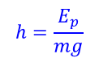

Exercise
How high must a 1 kg mass be lifted to give it a potential energy of 1 joule.
E_{p} = m g h
$$h=\frac{E_{p}}{mg}$$
$$h=\frac{1}{9.8}$$
$$h=0.102 m$$

Slide 25
Exercise
Which 2 of these 3 movements involve the same amount of work on a 1 kg mass?
A
B
C
5 m
14 m
5 m
5 m
A and C

Slide 26

What is Kinetic Energy?
Kinetic Energy is the energy associated with movement.

Slide 27
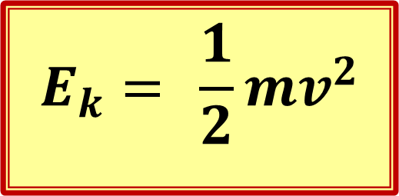
Write a formula for Kinetic Energy?
$$E_{k}= \frac{1}{2}mv^{2}$$
m = mass
v = velocity
E_{k} = Kinetic Energy
A most useful formula

Slide 28

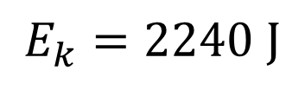
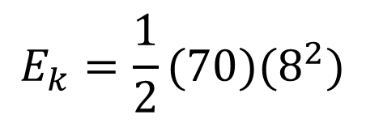
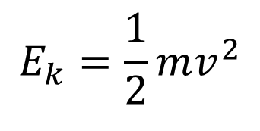
Example of kinetic energy
A cyclist and bike of total mass 70 kg is moving with a velocity of 8 m s⁻¹. Calculate the kinetic energy.
$$E_{k}=\frac{1}{2}mv^{2}$$
70 kg
$$E_{k}=\frac{1}{2}(70)(8^{2})$$
$$8 m s^{−1}$$
$$E_{k}=2240 J$$

Slide 29

Exercise
A trolley of mass 700 g has a velocity of 2 m s⁻¹. Calculate the kinetic energy.
$$E_{k}=1.4 J$$

Slide 30
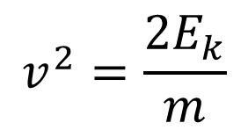
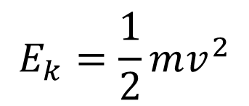

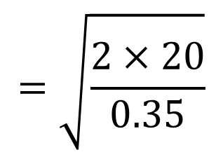
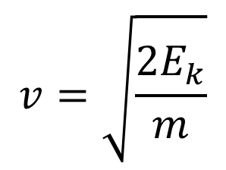
Example
A 350 g trolley is given a kinetic energy of 20 J calculate its velocity.
$$E_{k}=\frac{1}{2}mv^{2}$$
$$v^{2}=\frac{{2E}_{k}}{m}$$
$$v=\sqrt{\frac{{2E}_{k}}{m}}$$
$$=\sqrt{\frac{2×20}{0.35}}$$
$$=10.69 m s^{−1}$$

Slide 31





Exercise
A 100 g rider on an air track is given an injection of 5 J of energy from a spring, calculate its velocity.
$$E_{k}=\frac{1}{2}mv^{2}$$
$$v^{2}=\frac{{2E}_{k}}{m}$$
$$v=\sqrt{\frac{{2E}_{k}}{m}}$$
$$=\sqrt{\frac{2×5}{0.1}}$$
$$=10 m s^{−1}$$

Slide 32
Give an example of work as a transfer of energy.
When work is done energy is transferred. For example if you lift a mass, you are doing work. Energy is transferred into the mass. It now has potential energy equal to the work that you did.

Slide 33
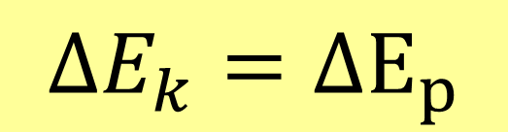

Write a formula for Conservation of Energy
If we can neglect friction, we have:
loss of potential energy
gain in kinetic energy
=
$$ΔE_{k}=ΔE_{p}$$
Or vice versa
The Greek letter $Δ$(delta) means “change in”

Slide 34
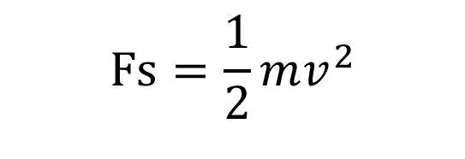
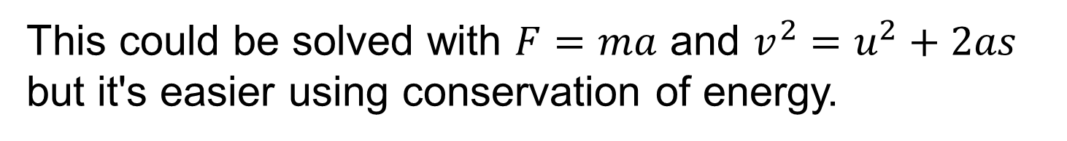


example
A car of mass 1200kg hits a wall at a velocity
of 5 m s⁻¹. The front crumples and the car is 0.4 m shorter when it comes to rest. Calculate the average force on the car as it crumples.
This could be solved with $F=ma$ and $v^{2}=u^{2}+2as$ but it's easier using conservation of energy.
Work done = kinetic energy lost
$$Fs=\frac{1}{2}mv^{2}$$
$$F=\frac{mv^{2}}{2s}$$
$$F=37.5 kN$$

Slide 35

Exercise
A golf ball of mass 45 g is struck by a club. The ball and club are in contact for a distance of 1.2 cm and the ball flies off with a velocity of 40 m s⁻¹, calculate the average force exerted on the ball by the club.
Hint 1: the input energy = force by distance
Hint 2: the input energy = the kinetic energy
$$F=3,000 N$$

Slide 36
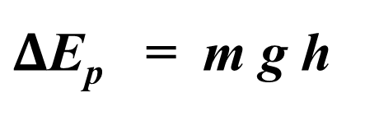
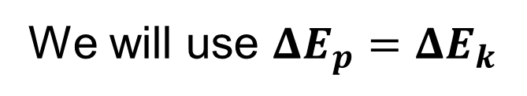



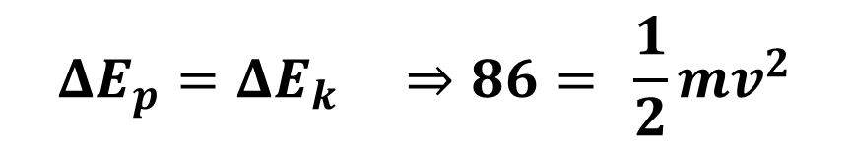
Example
A football of mass 440 g is kicked straight up to a height of 20 m. Using conservation of energy calculate its initial velocity.
We will use ${{ΔE}_{p}=ΔE}_{k}$
$Δ$E_{p} = m g h
$$=86 J$$
v
$${{ΔE}_{p}=ΔE}_{k} ⇒86= \frac{1}{2}mv^{2}$$
$$⇒v=\sqrt{\frac{2(86)}{m}}=\sqrt{\frac{2(86)}{0.44}}$$
$$⇒v=19.8 m{ s}^{−1}$$

Slide 37

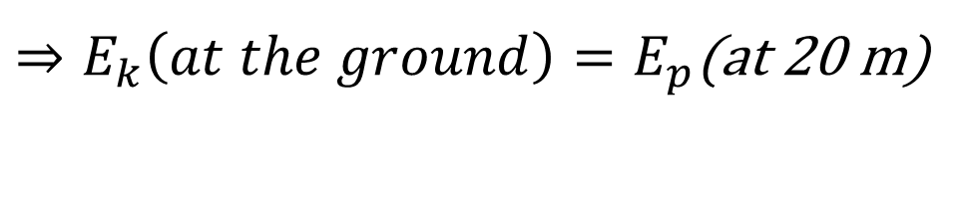
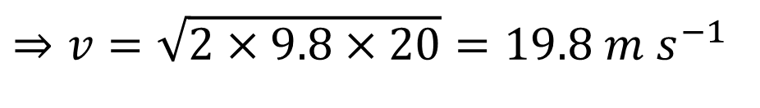
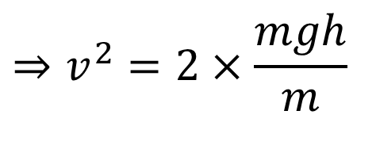
Example
A mass falls from 20 m, calculate its velocity just before it hits the ground.
$⇒E_{k}\left(at the ground\right)=E_{p}$(at 20 m)
$$⇒\frac{1}{2}mv^{2}=mgh$$
$$⇒v^{2}=2×\frac{mgh}{m}$$
$$⇒v=\sqrt{2×9.8×20}=19.8 m s^{−1}$$

Slide 38

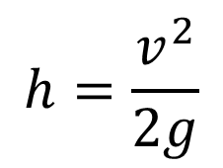
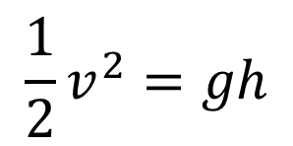
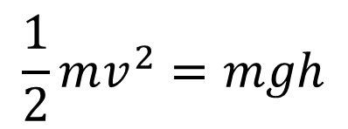
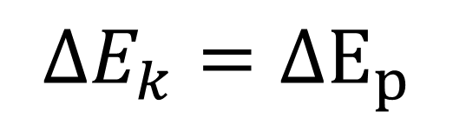
Example
A tennis ball is struck upwards with a velocity of
15 m s⁻¹ find the greatest height.
$$ΔE_{k}=ΔE_{p}$$
At maximum height, v=0 and all the energy is potential.
$$\frac{1}{2}mv^{2}=mgh$$
$$\frac{1}{2}v^{2}=gh$$
$$h=\frac{v^{2}}{2g}$$
$h=11.5 m$

Slide 39
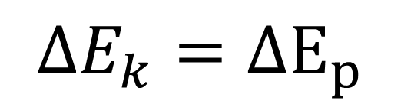

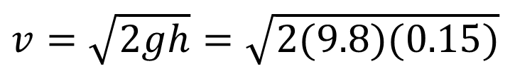
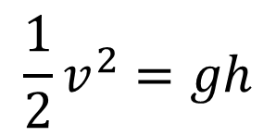
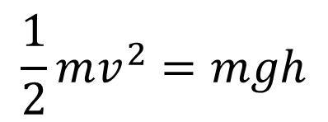
Example
A ball on a string is released 15 cm above the lowest point it can swing to. Calculate its maximum velocity.
$$ΔE_{k}=ΔE_{p}$$
$$\frac{1}{2}mv^{2}=mgh$$
15 cm
$$\frac{1}{2}v^{2}=gh$$
v
$v=\sqrt{2gh}$ $=\sqrt{2(9.8)(0.15)}$
$v=1.71 m s^{−1}$
Note the speed does not depend on the mass or the angle, just the height.

Slide 40
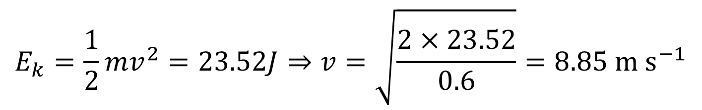
Example
A trolley of mass 600 g rolls down this slope.
What was its potential energy at the top?
Assuming all of this energy is converted to kinetic energy, What will its velocity be at the end of the slope?
600 g
12 m
4 m
$$Ep=mgh=0.6\left(9.8\right)\left(4\right)=23.52J$$
$$E_{k}=\frac{1}{2}mv^{2}=23.52J⇒v=\sqrt{\frac{2×23.52}{0.6}}=8.85 m s^{−1}$$

Slide 41
Exercise
A ball is projected upwards with a velocity of 3 m s⁻¹. Calculate the maximum height it reaches.
0.46 m

Slide 42
Exercise
A jet of water is directed upwards with a velocity of 10 m s⁻¹. Calculate the maximum height it reaches.
5.1 m

Slide 43
Exercise
Calculate the speed this cart would have at the bottom of the ramp if it released from rest.
20 cm
1.98 m s⁻¹

Slide 44
Exercise
Calculate the calculate the velocity this ball bearing will have after falling 20 cm if it released from rest.
20 cm
1.98 m s⁻¹

Slide 45
Exercise
Calculate the maximum velocity this pendulum bob will reach if it released from rest.
20 cm
v
1.98 m s⁻¹

Slide 46
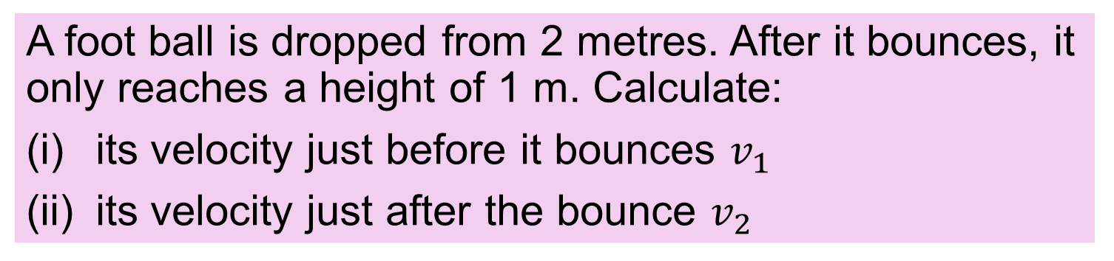
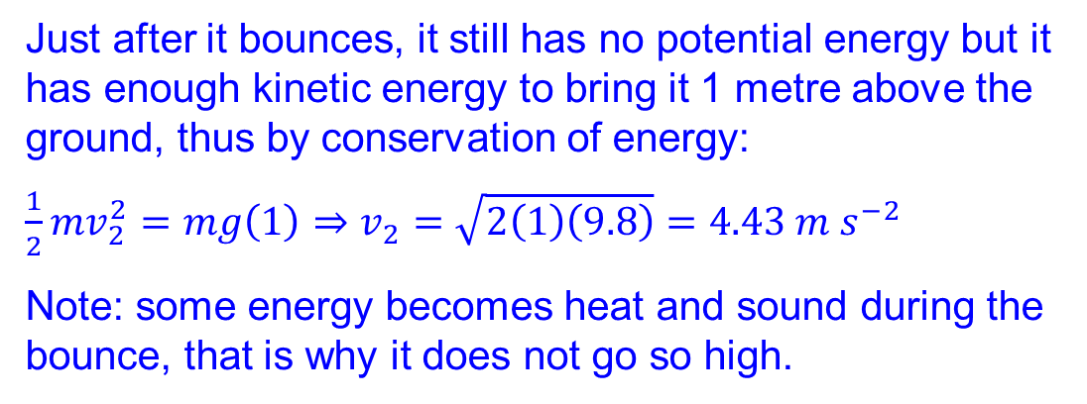
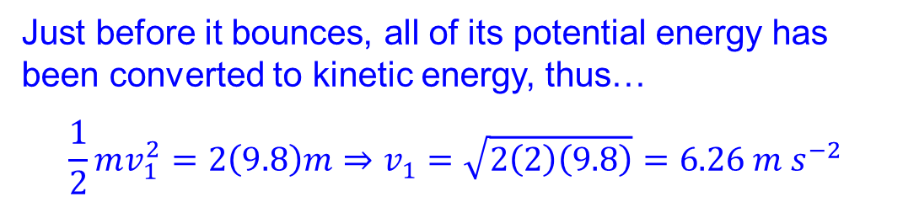
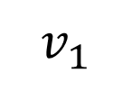
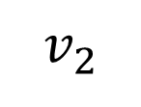
Exercise
A foot ball is dropped from 2 metres. After it bounces, it only reaches a height of 1 m. Calculate:
its velocity just before it bounces $v_{1}$
its velocity just after the bounce $v_{2}$
The ball starts from rest and has a potential energy of mgh = 2(9.8)m (m = mass of ball)
Just before it bounces, all of its potential energy has been converted to kinetic energy, thus…
$$\frac{1}{2}mv_{1}^{2}=2\left(9.8\right)m⇒v_{1}=\sqrt{2\left(2\right)\left(9.8\right)}=6.26 m s^{−2}$$
Just after it bounces, it still has no potential energy but it has enough kinetic energy to bring it 1 metre above the ground, thus by conservation of energy:
$\frac{1}{2}mv_{2}^{2}=mg\left(1\right)⇒v_{2}=$ $\sqrt{2\left(1\right)\left(9.8\right)}=4.43 m s^{−2}$
Note: some energy becomes heat and sound during the bounce, that is why it does not go so high.
$$v_{1}$$
$$v_{2}$$

Slide 47
Exercise
A foot ball is dropped from 2 metres. After it bounces, it only reaches a height of 1 m. Which velocity time graph represents this motion? (up = positive velocity)
A
B
Velocity
Velocity
time
time
A: stopped at start, constant negative acceleration until bounce. High positive acceleration during bounce. Positive (up) velocity after bounce. Velocity becomes negative after the 1 m high point.
Velocity
C
$$v_{1}$$
$$v_{2}$$
time

Slide 48
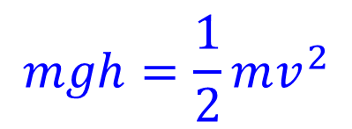


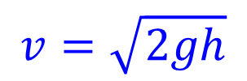
Example
Calculate h and use this to calculate the maximum velocity of the bob if released from B.
8 m
8 cos(30)
$${30}^{o}$$
h= 8 - 8 cos(30)
h= 1.0718
$$mgh=\frac{1}{2}mv^{2}$$
B
$$v=\sqrt{2gh}$$
h
$$=4.58 m s^{−1}$$
A

Slide 49
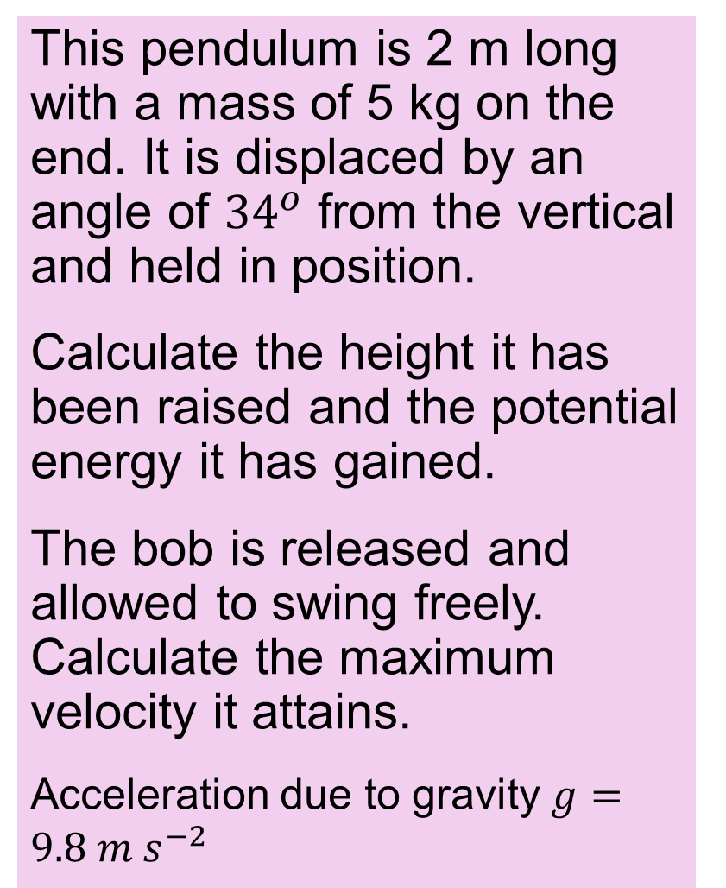




Exercise
This pendulum is 2 m long with a mass of 5 kg on the end. It is displaced by an angle of ${34}^{o}$ from the vertical and held in position.
Calculate the height it has been raised and the potential energy it has gained.
The bob is released and allowed to swing freely. Calculate the maximum velocity it attains.
Acceleration due to gravity $g=9.8 m s^{−2}$
$${34}^{o}$$
2 m
B
$$h=0.3419 m$$
A
$$E_{p}=mgh=16.75 J$$
$$v=\sqrt{2gh}=2.59 ms^{−2}$$

Slide 50


Slide 51

Elastic and in-elastic collisions
Elastic collisions
R Downey
Momentum conserved
Kinetic energy conserved
In-elastic collisions
Momentum conserved
Kinetic energy NOT conserved
Some energy is lost as heat and sound
Pixabay user 30363
NB: Momentum always conserved

Slide 52




Example
A 350 g trolley travelling at 1.5 m s⁻¹ collides and sticks to a 250 g trolley (at rest) find the velocity after the interaction AND the loss in energy.
This is in-elastic $⇒$you cannot use conservation of energy to calculate velocity. Use conservation of momentum.
$$momentum before=momentum after$$
$$\left(0.35\right)\left(1.5\right)+0\left(.25\right)=\left(0.35+0.25\right)v$$
$$v=\frac{0.525}{0.6}=0.875 m s^{−1}$$
$$E_{k}\left(before\right)=\frac{1}{2}mv^{2}=\frac{{\left(0.35\right)\left(1.5\right)}^{2}}{2}=0.394 J$$
$$E_{k}\left(after\right)=\frac{1}{2}mv^{2}=\frac{{0.6×0.875}^{2}}{2}=0.230 J$$
Loss of kinetic energy = 0.394-0.230 = 0.164 J (as heat + sound)

Slide 53
Exercise
A 440 g foot ball is dropped from 2 metres and bounces back to a height of 1 metre. Calculate the loss in kinetic energy.
4.3 J

Slide 54


Investigate the principle of conservation of energy
$\frac{1}{2}mv^{2}=mgh$
Get mass of trolley (optional)
Place trolley
Measure vertical height to be lost
Reset timer
release trolley
Record time in gate and calculate speed
Verify $\frac{1}{2}mv^{2}=mgh$
trolley and card
Light gate
h = vertical height
Timer
Metre stick

Slide 55

Investigate the principle of conservation of energy
$\frac{1}{2}mv^{2}=mgh$
Get mass of trolley (optional)
Place trolley
Measure vertical height to be lost
Reset timer
release trolley
calculate speed from tape
Verify $\frac{1}{2}mv^{2}=mgh$
Ticker timer
trolley
h = vertical height
Metre stick

Slide 56

Investigate the principle of conservation of energy
$\frac{1}{2}mv^{2}=mgh$
mass release
Record the mass dropping from rest using the motion sensor.
Record velocity (v) and corresponding drop height (h) at several points during the drop.
Use data to confirm that $\frac{1}{2}mv^{2}=mgh$
Mass dropped from rest
Mesh basket
Motion sensor

Slide 57


Exercise
A student used a motion sensor to obtain distance and velocity data for a falling object. Use the data at 0.3 seconds to verify the principle of conservation of energy.
time | Height | Velocity
0 | 0.71 | 0
0.05 | 0.71 | 0
0.1 | 0.71 | 0
0.15 | 0.71 | 0
0.2 | 0.70 | 0.49
0.25 | 0.66 | 0.98
0.3 | 0.60 | 1.47
0.35 | 0.51 | 1.96
0.4 | 0.40 | 2.45
0.45 | 0.41 | -0.56
0.5 | 0.39 | 0.01
Mass dropped from rest
$$ΔE_{p}=mgh$$
$$=m\left(9.8\right)\left(0.71−0.60\right)$$
$$=1.078m$$
Mesh basket
$$ΔE_{k}=\frac{1}{2}{mv}^{2}=1.080m$$
Motion sensor
The change in kinetic energy is approximately equal to the change in potential energy

Slide 58



Exercise
In an experiment to verify the conservation of energy a 300 g trolley was released from rest and allowed to roll down an incline as shown. At point A the trolley travelled 65 mm in 40 ms. Analyse if the data verifies the law of conservation of energy.
Velocity and energy at A:
$$v=\frac{0.065}{0.040}=1.625 m s^{−1}$$
A
$$E_{k}=\frac{1}{2}mv^{2}=\frac{1}{2}0.3{\left(1.625\right)}^{2}=0.396 J$$
150 mm
$E_{p}=mgh=0.3×9.8×0.15=0.441$ J
There is an 11 % discrepancy between the two energy calculations. This can be explained by the friction losses on the track.

Slide 59
Exercise
A student used a motion sensor as shown to plot a distance time graph of a falling mass. Use this graph to verify the principle of conservation of energy.
200
Mass dropped from rest
Displacement (mm)
100
Mesh basket
Motion sensor
100
200
Time (ms)

Slide 60





Exercise
A student used a motion sensor as shown to plot a distance time graph of a falling mass. Use this graph to verify the principle of conservation of energy.
200
Velocity at A = slope
$$v=\frac{180−82}{80−162}=1.20 m s^{−1}$$
A
$$ΔE_{k}=\frac{1}{2}mv^{2}$$
$E_{k}=\frac{m{\left(1.2\right)}^{2}}{2}$=0.72m
Displacement (mm)
100
$$Height dropped to A:$$
$$=200−125=75 mm$$
$$ΔE_{p}=mgh$$
$=m\left(9.8\right)(0.075)$=0.735m
100
200
Time (ms)
$$ΔE_{k}≈ΔE_{p}$$

Slide 61
Power

Slide 62


What is Power?
the rate of doing work. (work per second)
$$Power=\frac{Work}{Time}$$
$$Power=\frac{Energy }{time}$$
What is the unit of power?
The watt, (W)
1 watt is 1 joule per second

Slide 63


Example
A rock is dragged 4 metres with a force of 200 N in
5 seconds calculate the average power.
200 N
4 m
$$Power=\frac{Work}{time}=\frac{Fs}{t}$$
$$P=\frac{200\left(4\right)}{5}=160 W$$

Slide 64

Exercise
A cyclist and bike have a mass of 80 kg and on a hill are gaining an altitude of 1 metre every 3 seconds. Calculate the power.
$$P=\frac{W}{t}=\frac{mgh}{t}=\frac{80\left(9.8\right)\left(1\right)}{3}=261 W$$

Slide 65

Exercise
A crane lifts a 250 kg mass at a rate of 1.2 m s⁻¹. Calculate the power.
1.2 m s⁻¹
$$P=\frac{W}{t}=\frac{mgh}{t}=\frac{250\left(9.8\right)\left(1.2\right)}{1}=2940 W$$

Slide 66


How is efficiency calculated?
$$= \frac{P_{o}}{P_{i}}×100$$
Percentage Efficiency
$$P_{o}=\left(useful\right)output power$$
$$P_{i}=input power$$
Note Efficiency is also covered in Section 2.1

Slide 67
Example
Input power = 1800 W, Output power = 1600 Watts, calculate percentage efficiency.
1800 W
1600 W
Percentage Efficiency = $\frac{P_{o}}{P_{i}}×100$ = $\frac{1600}{1800}×100=88.9\%$

Slide 68

Exercise
Input power = 300 mW, Output power = 200 mW, calculate the percentage efficiency.
300 mW
200 mW
$$66.7\%$$

Slide 69



Exercise
The motor an electric bike is rated at 250 W. This is the mechanical output power. If the motor has an efficiency of 87%, calculate the maximum power drawn from the battery.
Percentage Efficiency = $\frac{P_{o}}{P_{i}}×100$
$$87=\frac{P_{o}}{P_{i}}×100$$
$$P_{i}=\frac{P_{o}}{87}×100=287 W$$

Slide 70
Example
An LED is 25% efficient, it consumes 9 W. The unwanted output energy is heat. Calculate how much heat energy is lost in an hour.
Hint: get 75% of total power
Heat is produced at a rate of 0.75 x 9 = 6.75 W
1 hour = 3600 seconds
Heat = 6.75 x 3600 = 24300 J

Slide 71
Units recap
From the unifying strand

Slide 72
Recap
What are the SI Base units?
Meter, kilogram, second, ampere, kelvin, mole, candela.
There are only 7
all the rest (e.g. the Newton) are derived
units such as the Newton and the Joule are called derived units.

Slide 73




Example Unit conversion
Convert newtons (N) to base units.
$$F=ma$$
So the units for newtons (N) are the units of $ma$
$$m$$
$$a$$
$$1 N=1 kg m s^{−2}$$

Slide 74





Example Joule
Convert Joules (J) to base units.
Joule is work, $W=Fs$and $F=ma$so $W=mas$
So the units for work (J) are the units of ($mas$)
$$m$$
$$a$$
$$s$$
$$1 J =1 kg m s^{−2} m$$
$$=1 kg m^{2} s^{−2}$$

Slide 75



Exercise
Convert Watts (W) to base units.
In the previous example we got
$$J =kg m^{2} s^{−2}$$
Watts are joules per second
$$W=kg m^{2} s^{−2} s^{−1}$$
$$=kg m^{2} s^{−3}$$

Slide 76



Conversion of Units Exam question 2021 q13
The Planck constant relates energy and frequency. Its value is $6.6×{10}^{−34}J s$.
Express this unit in terms of metres, kilograms and seconds.
(7)
tip: its the J s you need to convert
Joule is work, $W=Fs$and $F=ma$so $W=mas$
So the units for work (J) are the units of $mas$
$$J =kg m s^{−2} m$$
$$⇒J s =kg m s^{−2} m s=kg m^{2}{ s}^{−1}$$

Slide 77
Elastic energy
(Higher Physics)

Slide 78


What is the formula for the energy stored in a spring?
$$E_{P}=\frac{1}{2}ks^{2}$$
$E_{P}$= Potential energy stored in the spring
$k$ = Spring constant ($N m^{−1})$
$s$ = displacement from natural length
This applies to both compressed and stretched strings

Slide 79



Justify $E_{P}=\frac{1}{2}ks^{2}$
Force
Hooke’s law $⇒$straight line graph
displacement
Energy = force x displacement
Energy = area under graph
Energy = $\frac{1}{2}Fs=\frac{1}{2}\left(ks\right)s=\frac{1}{2}ks^{2}$

Slide 80



Example
The springs in the suspension of a car have an elastic constant of 80 kN m⁻¹. Calculate the energy stored in one of these springs when it is displaced by 20 cm.
$$E_{p}=\frac{1}{2}ks^{2}$$
$$E_{p}=\frac{1}{2}(80 000){(0.2)}^{2}$$
$$E_{p}=1600 J$$

Slide 81

Exercise
A spring with a spring constant of 120 N m⁻¹ is compressed by 15 cm. Calculate the energy used.
Energy used = potential energy
$$E_{p}=\frac{1}{2}ks^{2}=1.35 J$$

Slide 82




Example
How far must a spring with a spring constant of 100 N m⁻¹ be compressed in order to project a 90 g ball 3 meters in the air.
$$E_{p}=\frac{1}{2}ks^{2}=E_{pg}=mgh$$
$$⇒ks^{2}=2mgh$$
$$⇒s=\sqrt{\frac{2mgh}{k}}$$
$$⇒s=.188 m=18.8 cm$$

Slide 83

Exercise
How far must a spring with a spring constant of
300 N m⁻¹ be compressed in order to project a 250 g ball 3.5 meters in the air.
$$s=0.239 m=23.9 cm$$

Slide 84
Conservation of Energy experiments with springs
Notes
At present these experiments are un-tested.
The experiments assume that you have a trolley with a built-in or compatible compression spring.
It may be possible to adapt the design for use with a spring (or elastic) that only works in tension.

Slide 85
Measure spring constant of trolley spring
Preparatory work
Pull trolley until spring just touches stopper.
Record distance
Pull Newton balance to compress spring.
Record new distance and the force
Repeat for different forces.
Graph F vs s
Calculate k from slope
Newton balance
string wrapped around the trolley.
Track with distance scale engraved
stopper
spring
Paper pointer to allow more precise readings of displacement

Slide 86




Investigate the principle of conservation of energy 2
$\frac{1}{2}ks^{2}=\frac{1}{2}mv^{2}$
Get mass of trolley
Measure spring constant.
Measure s
Release the spring to set the trolley in motion.
Record time in gate and calculate speed
Verify $\frac{1}{2}ks^{2}=\frac{1}{2}mv^{2}$
Card to interrupt light gate
Light gate
$$s$$
Low friction track
Spring
trolley
Timer
Metre stick to measure card
Mass Scale
$$m$$

Slide 87


Investigate the principle of conservation of energy 3
$\frac{1}{2}ks^{2}=mgh$
Get mass of trolley
Measure spring constant.
Compress spring and measure s.
Release the spring to set the trolley in motion.
Measure vertical height gained
Verify $\frac{1}{2}ks^{2}=mgh$
Measure displacement s of spring
trolley
h = vertical height gained
Spring
Metre stick to measure s and h
Mass Scale
$$m$$

Slide 88
Improving the experiments
How can you compensate for friction
How can you measure h more accurately
How can you ensure no energy is gained or lost when the spring is released
There may be no answers to some of these given the equipment at hand in which case suggestions for new equipment can be made.

Slide 89



Exercise
In an experiment to verify the conservation of energy a 330 g trolley was propelled from rest by a compressed spring. Immediately after the spring expanded, the trolley travelled 19 mm in 80 ms. Analyse if the data verifies the law of conservation of energy.
Spring constant: 50 N m⁻¹, spring compression 2 cm.
$E_{p}=\frac{1}{2}ks^{2}=\frac{50×{0.02}^{2}}{2}=0.01$ J
$v=\frac{0.019}{.08}=0.2375 m s^{−1}$
$E_{k}=\frac{1}{2}mv^{2}=\frac{0.33×{0.2375}^{2}}{2}=0.0093$ J
The two energies agree within 7%
The velocity should have been measured over a longer time

Slide 90
Revision Summary
Key Definitions: Work, Energy, Power, Joule, Watt, Kinetic energy, Potential energy
State: principle of conservation of energy,
Model: work done by a constant force ($W= Fs$)
Apply:
$E_{p}=mgh, E_{k}=\frac{1}{2}mv^{2}, W= Fs, P=\frac{W}{t}, E_{p}=\frac{1}{2}ks^{2}$
Use: The principle of conservation of energy to solve problems.

