Slide 1
2017 q 12d
Particle physics

Slide 2
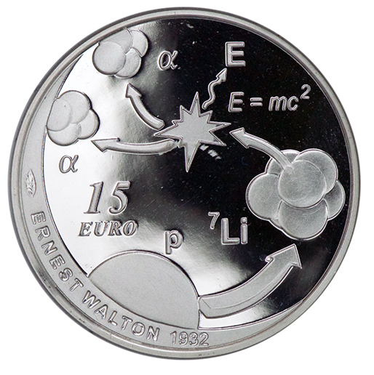
In the Cockcroft and Walton experiment, accelerated protons collided with lithium nuclei.
In each collision a proton collided with a lithium nucleus to produce two alpha-particles, as shown in this commemorative coin.
Explain
how the protons were produced,
The protons were essentially the nuclei of hydrogen atoms, ionised in a strong electric field. They can also be ionised by heat
how the protons were accelerated and
The protons have a positive charge and they were accelerated by the application of a very large voltage (up to 700 kV).
how the alpha-particles were detected.
They were detected by giving small flashes of light on a Zinc-Sulphide screen

Slide 3
In the Cockcroft and Walton experiment, accelerated protons collided with lithium nuclei.
In each collision a proton collided with a lithium nucleus to produce two alpha-particles, as shown in this commemorative coin.
Write the nuclear equation for this reaction. (13)
For this reaction, calculate the loss in mass and hence the energy released (in MeV). (12)
Using masses listed in the tables:

