Slide 1
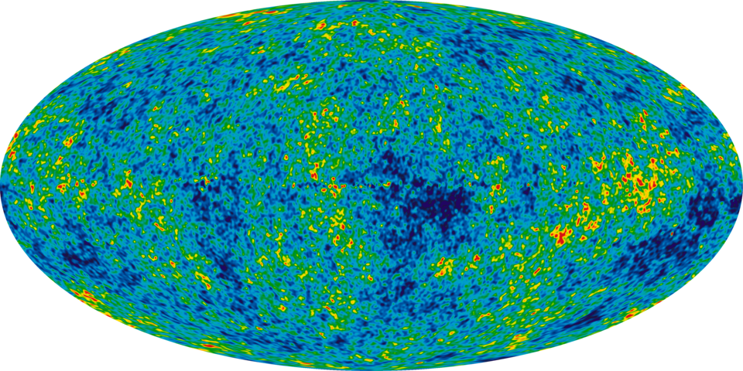
2.1 Heat and Temperature
CC0
Cosmic Background Radiation: 2.7 K
Notes:
CBR is key evidence for the current Big Bang theory
A black body in intergalactic space will cool to this temperature of 2.7 K and remain at this temperature. If the body was colder, it would heat up to 2.7 K.

Slide 2
Physics specification 2.1
2.1. The transfer of heat energy and temperature change
Students learn about
A definition of temperature
thermometric properties of materials
thermometer as a device
the Kelvin and Celsius temperature scales
Temperature and Thermometers
Students should be able to
1. analyse the suitability of materials for use as thermometers using primary and secondary data

Slide 3
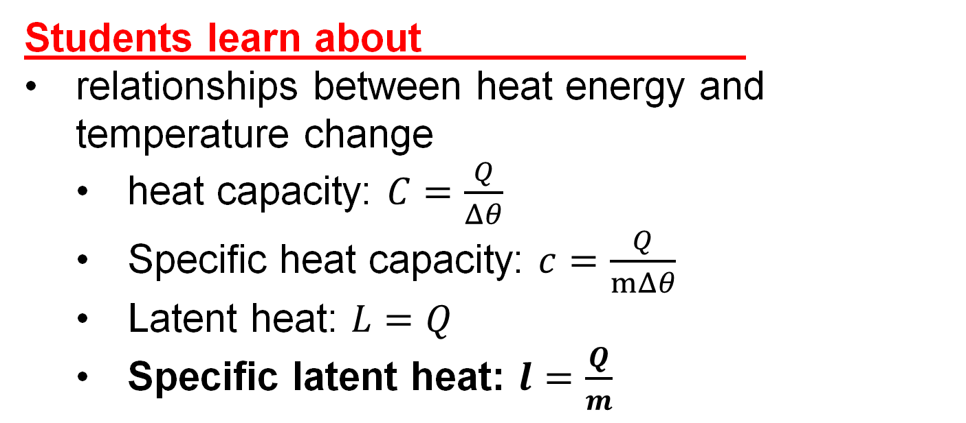
Physics specification 2.1
2.1. The transfer of heat energy and temperature change
Students learn about
relationships between heat energy and temperature change
  heat capacity: $C=\frac{Q}{Δθ}$
  Specific heat capacity: $c=\frac{Q}{mΔθ}$
  Latent heat: $L=Q$
  Specific latent heat: $l=\frac{Q}{m}$
Heat Models

Slide 4
Physics specification 2.1
2.1. The transfer of heat energy and temperature change
Students should be able to
2. determine specific heat capacity using primary data (solid or liquid) and secondary data (solid and liquid)
3. determine the specific latent heat using primary data (vaporisation of steam or fusion of ice) and secondary data (vaporisation of steam and fusion of ice)
4. verify mathematical models of heat energy, latent heat and temperature change using secondary data
5. solve real life problems involving heat transfer, change of state and improving efficiency
Heat Models

Slide 5
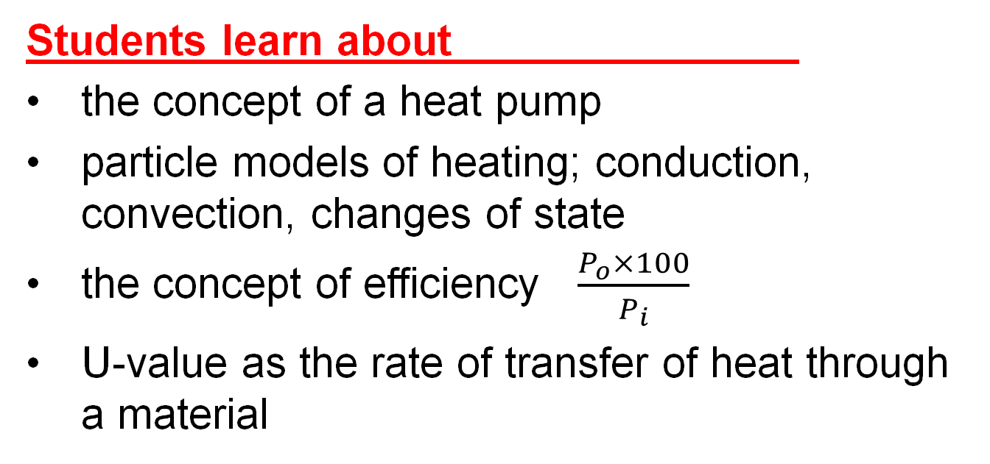
Physics specification 2.1
2.1. The transfer of heat energy and temperature change
Students learn about
the concept of a heat pump
particle models of heating; conduction, convection, changes of state
the concept of efficiency $\frac{P_{o}×100}{P_{i}}$
U-value as the rate of transfer of heat through a material
Heat transfer and Efficiency

Slide 6
Physics specification 2.1
2.1. The transfer of heat energy and temperature change
Students should be able to
5. solve real life problems involving heat transfer, change of state and improving efficiency
6. investigate the impact of insulation on energy consumption and sustainability using secondary sources
Heat transfer and Efficiency

Slide 7
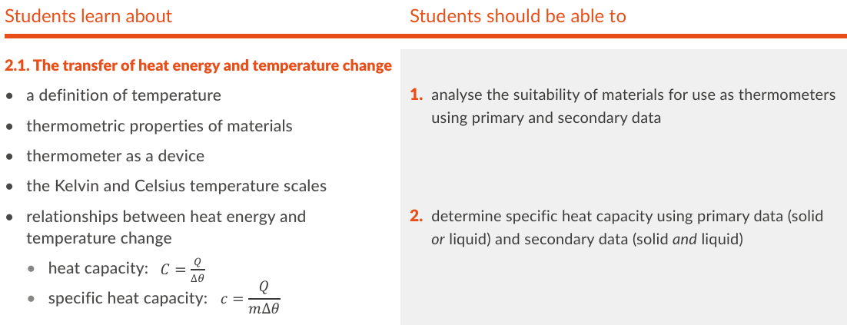
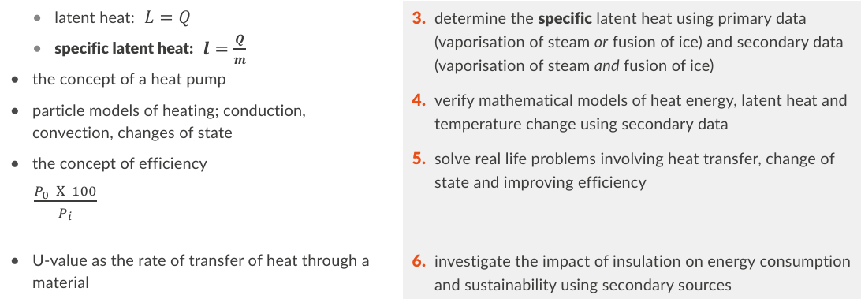
Physics specification 2.1
Removed from course: gas thermometers? and graduation
Added to course: suitability of materials for use as thermometers, Particle models, experiments to verify as opposed to determine

Slide 8
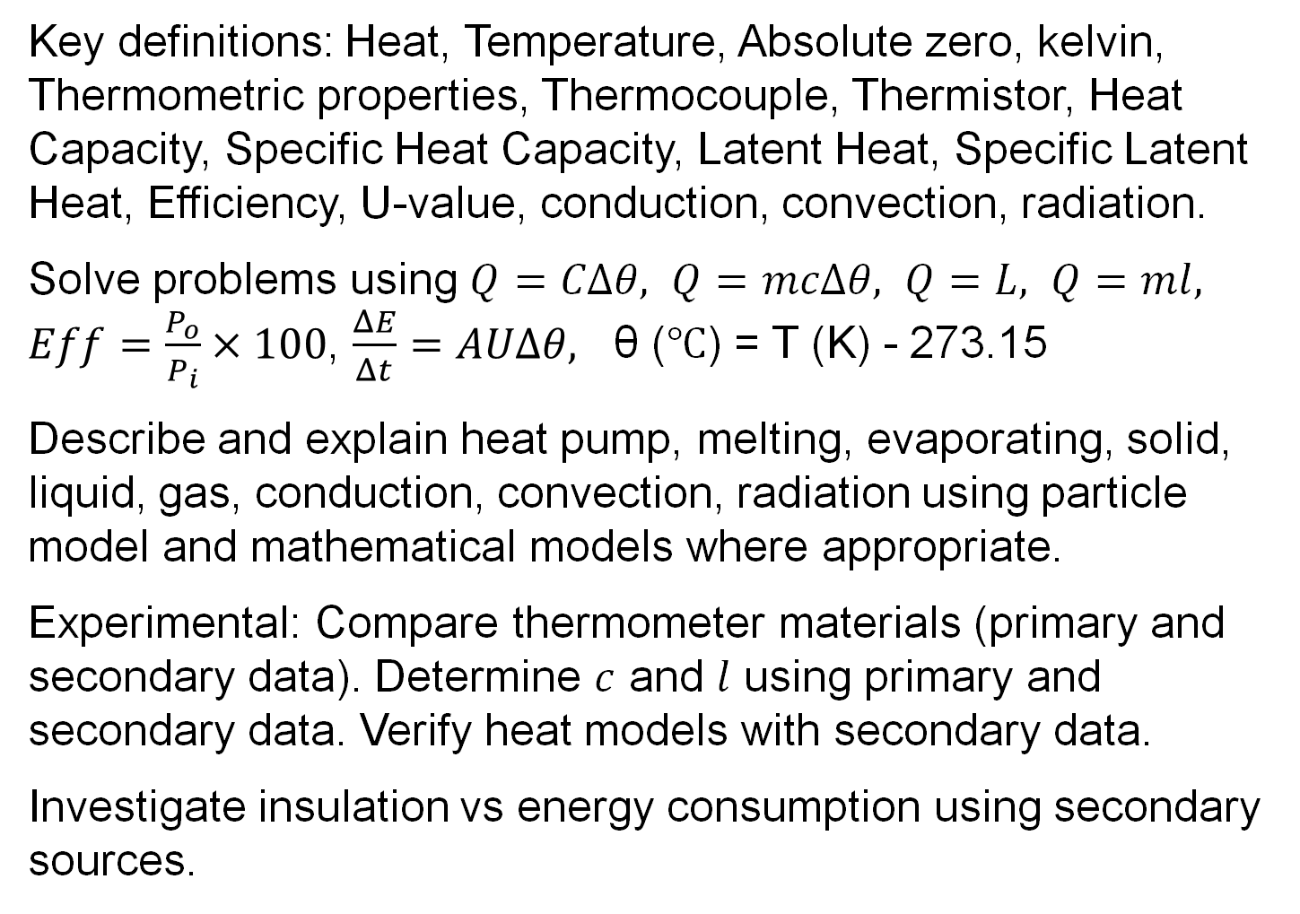
Revision summary
Key definitions: Heat, Temperature, Absolute zero, kelvin, Thermometric properties, Thermocouple, Thermistor, Heat Capacity, Specific Heat Capacity, Latent Heat, Specific Latent Heat, Efficiency, U-value, conduction, convection, radiation.
Solve problems using $Q=CΔθ, Q=mcΔθ, Q=L, Q=ml, Eff=\frac{P_{o}}{P_{i}}×100$, $\frac{ΔE}{Δt}=AUΔθ,$ θ (℃) = T (K) - 273.15
Describe and explain heat pump, melting, evaporating, solid, liquid, gas, conduction, convection, radiation using particle model and mathematical models where appropriate.
Experimental: Compare thermometer materials (primary and secondary data). Determine $c$ and $l$ using primary and secondary data. Verify heat models with secondary data.
Investigate insulation vs energy consumption using secondary sources.

Slide 9
What is meant by Temperature?
Temperature is a measure of hotness or coldness. 2016

Slide 10
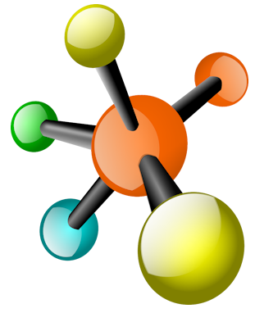

Describe the particle model of heat.
Particle = atom or molecule.
Heat gives energy to the particles.
Temperature is due to the kinetic energy of the particles.
Changes in potential energy (e.g. during melting) do not contribute to temperature.
Vibrating molecule
In solids, the particles vibrate, in liquids and gases they move and collide.

Slide 11
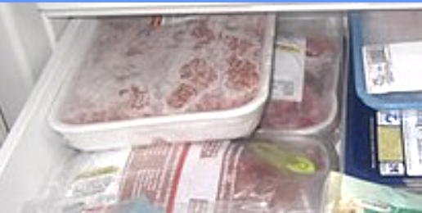
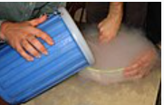
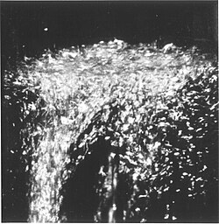
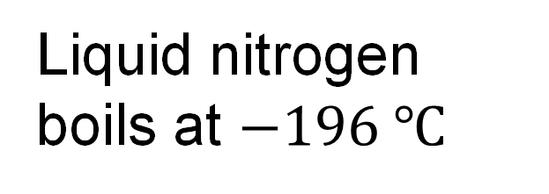
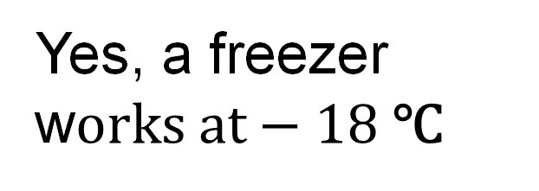
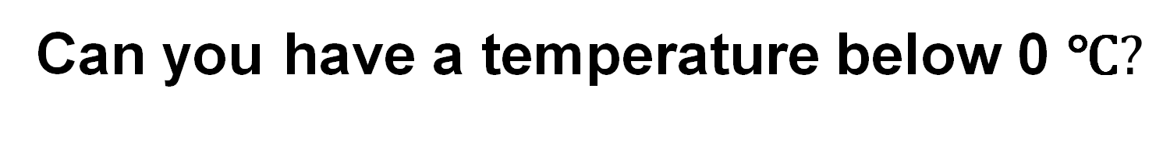
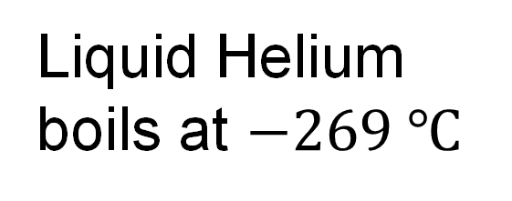
Can you have a temperature below 0 ℃$?$
0℃
Yes, a freezer w$orks at−18 \text{℃}$
CC0
-100℃
Liquid nitrogen boils at $−196 ℃$
CC0
-200℃
Liquid Helium boils at $−269 ℃$
CC0

Slide 12
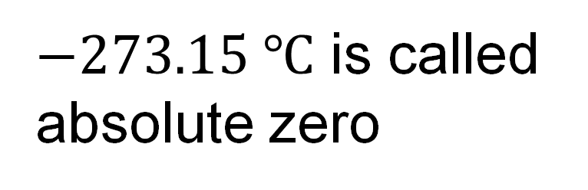
Is there a “lowest temperature”?
0℃
Yes
The lowest temperature possible is −273.15 ℃
-100℃
$−273.15 ℃$ is called absolute zero
-200℃
If we could reach absolute zero, atoms would stop vibrating
-273℃

Slide 13

What temperature scale starts at absolute zero?
0℃
The kelvin scale
-100℃
$$0 K=−273.15 ℃$$
-200℃
-273℃
0 K

Slide 14
What is the SI Unit of temperature?
The kelvin (K)
Vector or Scalar?
Scalar

Slide 15

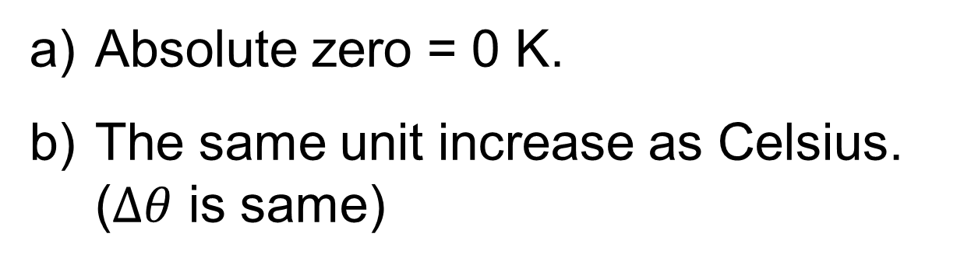
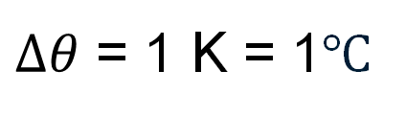
What is the kelvin scale based on?
Absolute zero = 0 K.
The same unit increase as Celsius. ($Δθ$ is same)
274.15 K = 1℃
$Δθ$ = 1 K = 1℃
273.15 K = 0℃
0 K = -273.15℃

Slide 16
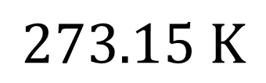
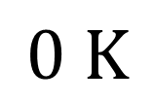
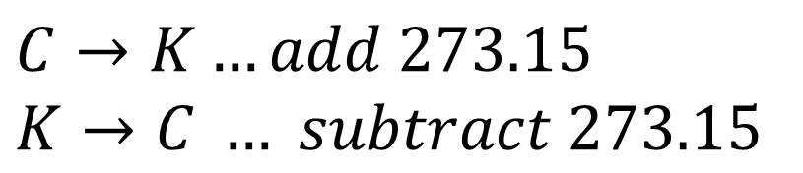
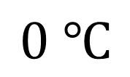
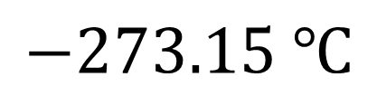
What is the relationship between Celsius and Kelvin?
θ (℃) = T (K) - 273.15
Formula book p 58
$$C→K…add 273.15$$
$$K→C … subtract 273.15$$
$$0 ℃$$
$$273.15 K$$
$$−273.15 ℃$$
$$0 K$$

Slide 17
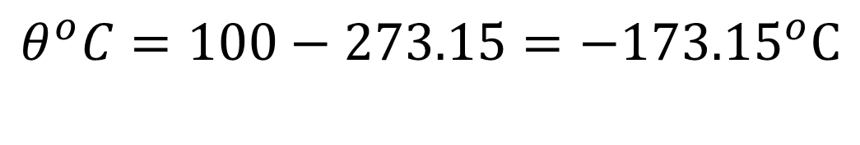
Example 1: Temperature conversion
Convert 100 K to degrees Celsius
θ (℃) = T (K) - 273.15
Formula book p 58
a drawing helps avoid mistakes:
K
0
100 K
273.15
^{o​}C
-273.15
0
Must be about –170℃
$$θ^{o}C=100−273.15={−173.15}^{o}C$$

Slide 18
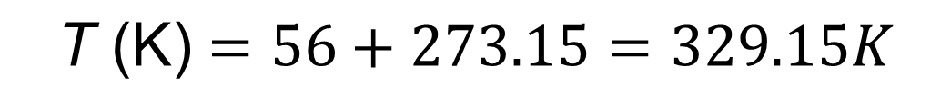
Example 2: Temperature conversion
Convert 56℃ to kelvin
Must be more than 273 K
drawing:
K
0
273.15
^{o​}C
-273.15
0
56℃
θ (℃) = T (K) - 273.15
Formula book p 58
⇒T (K) = θ (℃) + 273.15
$$\text{T}\text{ (}\text{K}\text{)}=56+273.15=329.15K$$

Slide 19
Exercise Temperature conversions
Convert 700℃ to kelvin
Convert 700 K to ℃
700℃ = 973.15 K
700 K = 426.85℃

Slide 20
What is the difference between heat and temperature?
Heat is a form of energy. HL 2016
Temperature is a measure of hotness.
HL 2016

Slide 21
Thermometers

Slide 22

How do you measure temperature?
We measure temperature indirectly through its effects.
For example, the expansion or contraction of a liquid.
Liquid expands into the capillary tube

Slide 23
What is a Thermometric Property?
A property that changes measurably with temperature. HL 2015
Example:
length of liquid

Slide 24
What is the thermometric property of a liquid-in-glass thermometer?
Length of a column of liquid.
A liquid-in-glass thermometer has a very thin tube into which the liquid can expand. This is called a capillary tube.
Thermometric property = length of the column of liquid.

Slide 25
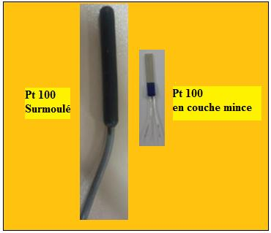
What is a Resistance Thermometer?
A thermometer whose sensor is made from thin metal.
The most common metals are
Platinum
Copper
Nickel
CC0
Platinum resistance thermometers
Top: wire wound
Lower: Thin film

Slide 26
Miniature Resistance devices
2 mm
Thin film (nanometres) of platinum, nickel or copper
Example:
a Pt100 device has a resistance of 100 Ω at 0℃ and 135 Ω at 100℃

Slide 27

What is the thermometric property of a Resistance Thermometer?
thermometric property = Resistance
Ohmmeter
$$Ω$$
The resistance of a metal increases approximately linearly with temperature.
Platinum has the biggest temperature range and is the most stable over time. It is also the most expensive.
Thin metal wire or film
Heat

Slide 28
What is a Thermistor?
a semiconductor with 2 connecting wires.
resistance (ohms) changes with temperature.
used in electronic thermometers and thermostats.

Slide 29

What is the thermometric property of a Thermistor?
thermometric property = resistance
Resistance can be measured with an ohm-meter.
Resistance of a thermistor usually decreases with temperature.
Ohmmeter
$$Ω$$
Thermistor
Heat

Slide 30
What is a Thermocouple?
Two different metals joined together in a circuit. If there is a difference in temperature in the circuit, a small voltage will be generated
Voltmeter
Copper wire
The size of the voltage varies with the temperature difference.
V
Steel wire
Cold
Hot

Slide 31
What is the thermometric property of a Thermocouple?
thermometric property = voltage (emf)
Copper wire
V
Steel wire
Voltage can be measured with a voltmeter set to milli-volts
Heat
Ice
Water
R Downey

Slide 32
What is the thermometric property of this gas thermometer.
Test tube with air
Coloured liquid
R Downey
thermometric property = volume of the gas at constant pressure
Mass is fixed (air cannot escape).
Pressure is constant (Atmospheric pressure).
If the temperature changes the volume changes and liquid moves.

Slide 33
Analyse the suitability of materials for use as thermometers
Key features of a thermometer:
Repeatability, stability and accuracy
Sensitivity (e.g. ohms per ℃)
Response time
Heat capacity
Temperature range
Size

Slide 34
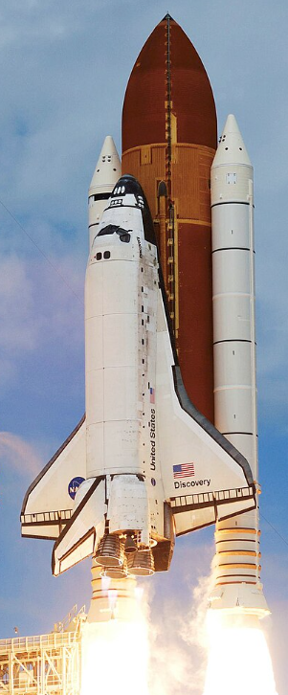
Thermocouples vs platinum resistance thermometer in the Space Shuttle
The space shuttle was the first spacecraft to use a re-usable rocket engine.
In the original design, platinum resistance thermometers monitored engine temperature.
After several flights, the thermometers began to fail. They were subject to too many cycles between extremely low and extremely high temperatures.
They were replaced by thermocouples, not for accuracy but for robustness.
CC0

Slide 35

Plot Resistance vs Temperature for a copper wire.
Standard Thermometer
Ohm-meter
Set the multimeter to 200Ω
setting
Gradually heat the water.
Note the temperature and the resistance at different points
Plot a R vs T
2000
Ω 200
Long Thin Copper wire
Water
Experiment notes below $↓$
Heat
Notes:
If you have a pre-constructed metal resistance thermometer, then use it to save trouble.
Alternatively use for example 10 meters of laminated copper wire with a diameter of about 0.13 mm (quite thin). This will give about 10 ohms resistance. Wind the wire about something insulating and non soluble (e.g. test tube or pvc pipe). Use insulating tape to hold it in place. The lamination will ensure that the wire does not short circuit and reduce the effective length however a neat coil is recommended as a further precaution against shorting.
Be sure the scrape the lamination off both ends of the wire for attaching to the ohmmeter. Most ohm-meters have a resolution of 0.1 ohm, hence the need get a resistance of about 10 ohms of wire. This needs to be prepared and tested before class as it is fiddley and time consuming. Try to make something you can re-use.
Nichrome wire is problematic as its resistance does not change that much with temperature.
Some recommend glycerol instead of water because of the lower electrical conductivity of glycerol, however the difference is negligible and unlikely to alter any readings in a school lab. Water is shown in a partially drawn diagram in the Ordinary Level Sample paper 1 issued for the new specification.

Slide 36
Plot Resistance vs Temperature for metal
Resistance
Temperature (℃)
resistance increases with temperature.
very linear within the measurement range – particularly for platinum.
Bureau International des Poids et Mesures use Platinum resistance thermometers to make standard thermometers.

Slide 37
Plot the Resistance Temperature curve of a thermistor
Standard Thermometer
Ohm-meter
Set the multimeter to 20kΩ setting.
Gradually heat the water.
Note the temperature and the resistance at different points
Plot R vs T
Thermistor
Water
Heat
Notes:
Some people recommend glycerol instead of water because of the lower electrical conductivity of glycerol, however the difference it makes is tiny. Some say it makes better thermal contact however, international calibration protocols recommend a liquid bath of water, oil or salt and do not mention glycerol. Water is shown in a partially drawn diagram in the Ordinary Level Sample paper 1 issued for the new specification.

Slide 38
Temperature vs Resistance – Thermistor
Resistance
Temperature (℃)
resistance decreases with temperature (mostly).
non-linear.
Very sensitive
A microprocessor can calculate the correct temperature.

Slide 39


Compare resistance temperature curves for two metals
Standard Thermometer
Ohm-meters
Measure resistance and temperature for platinum and nickel RTDs and plot the resistance temperature curves
OR use copper and nichrome wires instead of RTDs
$$Ω$$
$$Ω$$
RTDs
Water
Heat
Notes:
RTDs are low-cost temperature sensors and can be purchased as a component. Platinum is the most common type but Nickle versions are sometimes available. Nickle has greater heat sensitivity which should give a nice comparison.

Slide 40
Recap
Accuracy: Closeness to true value
Resolution: The smallest detectable change
Precision: repeatability
Example
0.5℃
Accuracy: 0.5℃ error
Ice bath with stirring rod
Resolution: 0.1℃
Precision: If it reads 0.5℃ every time we measure, then we have good precision.
Notes:
A stirred ice bath with plenty of crushed ice in water is a simple and accurate temperature reference for checking thermometers. Boiling point is much more problematic. Apart from scalding risks, variations in air pressure and temperature variations within the boiling liquid make it unreliable.

Slide 41
Example 3
Compare these resistance-temperature curves. State which material you would choose for measuring body temperature and justify your choice.
Resistance
thin copper wire
thin nichrome wire
Manganese oxide thermistor
37℃
Temperature (℃)
Answer A: the thermistor because of smaller size and greater sensitivity to temperature change
Answer B: copper because of linear relationship and adequate sensitivity

Slide 42
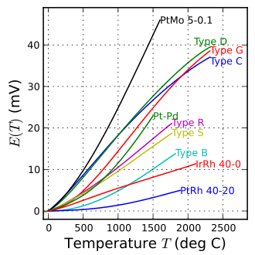
Exercise
Which thermocouple would work best for temperatures below 100℃ when used with a multimeter with 0.1 mV resolution? Justify your answer.
Type C, D or Pt Mo 5-0.1 are best because they have the steepest curves below 100℃. The slope is approximately 10 mV over 500℃ so the meter will be able to detect a temperature change every 5℃. However, this is not particularly good and another means of measuring the voltage is desirable.
PtMo are specially suited for nuclear reactors as they are less affected by radiation
CC0

Slide 43
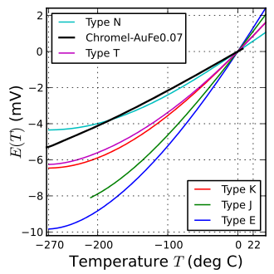
Exercise
Which thermocouple would you choose for work at temperatures ranging from 1 K to 20 K. Justify.
Conversion:
20 K = -253℃
Chromel-AuFe0.07 is most linear and has the greatest slope making it the most sensitive in the range.
CC0

Slide 44
Exercise
For a given temperature, a thermistor’s resistance can drift over time due to aging effects (e.g. chemical changes in the material).
A thermistor-based thermometer which used to consistently read 0.0℃ in an ice bath now reads -0.4℃ every time it is immersed in an ice bath.
What has changed – its accuracy or its precision or both?
The accuracy has reduced, the precision has not changed

Slide 45
Exercise
A platinum and a nickel resistance thermometer are compared on the graph below. Both have the same resistance at 0℃. Platinum is generally chosen because of its stability over time. Suggest a reason based on the graph why a manufacturer might base a thermometer design on nickel.
Nickel
Platinum
Resistance
Temperature (℃)
The nickel thermometer has greater sensitivity, ie its resistance changes by a greater amount for a given change in temperature, this makes it easier to detect small temperature changes.

Slide 46

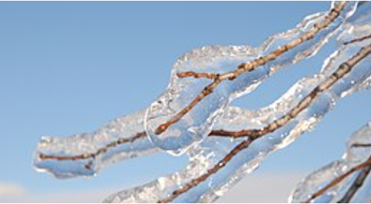

Heat
CC0

Slide 47
What is Heat?
Heat is a form of Energy. HL 2016

Slide 48
What is Heat Capacity?
The energy needed to change the temperature of a body by 1 K.
HL 2022
What is the Symbol?
C (big C)

Slide 49
How long does it take to boil a kettle?
Full kettle – about 6 minutes
Half full kettle – about 3 minutes
The full kettle needs more energy to raise the temperature by the same amount.
We say the full kettle has more Heat Capacity

Slide 50
What is the
SI Unit of Heat Capacity?
The joule per kelvin (J K⁻¹​​).

Slide 51
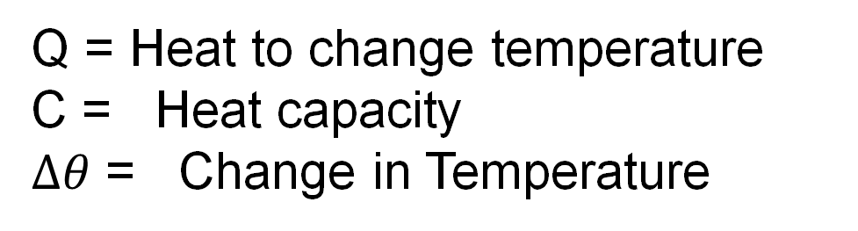


Write the equation for
Heat Capacity. (big C)
$$Q=CΔθ$$
Q = Heat to change temperature
C = Heat capacity
$Δθ$ = Change in Temperature
U$nits: J K^{−1}$
Big C applies to an object rather than a substance this piece of copper rather than copper

Slide 52
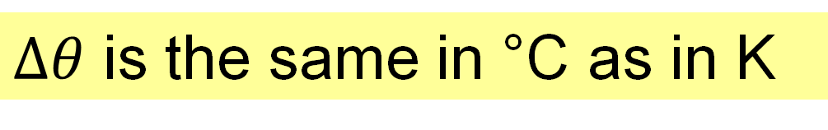
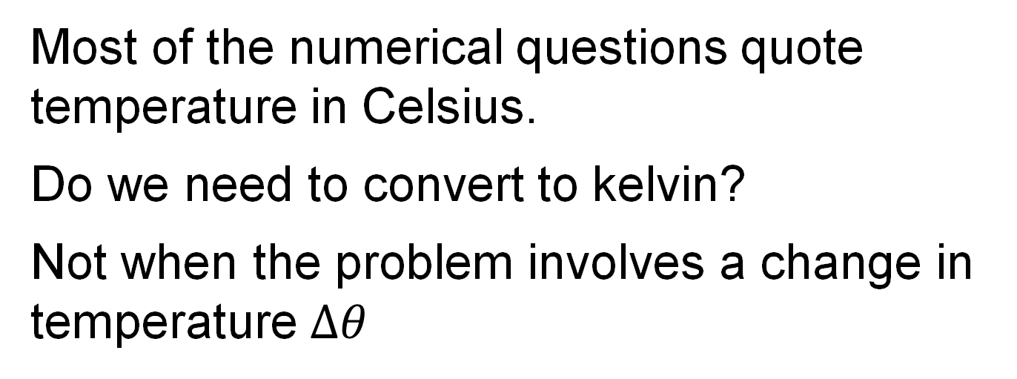
Temperature units in heat problems
Most of the numerical questions quote temperature in Celsius.
Do we need to convert to kelvin?
Not when the problem involves a change in temperature $Δθ$
$Δθ$ is the same in °C as in K

Slide 53
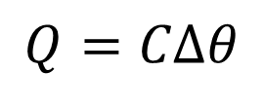
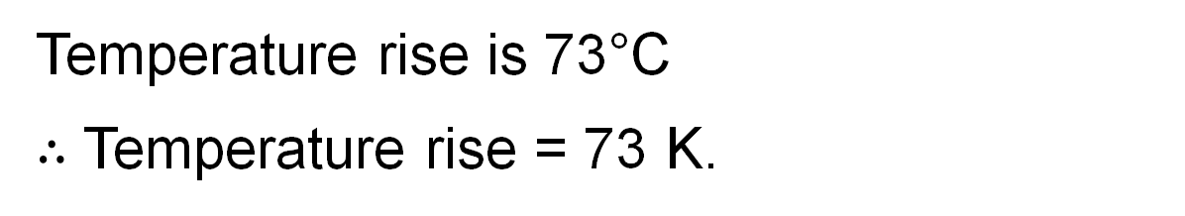
Example 4
Every object has a heat capacity. A piece of metal with a heat capacity of 500 J K⁻¹ is heated from -3°C to +70°C. How much heat was used?
Temperature rise is 73°C
$∴$ Temperature rise = 73 K.
$$Q=CΔθ$$
C = heat capacity
Q =73×500 = 36500 J

Slide 54
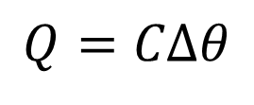

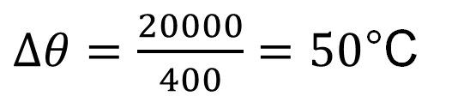
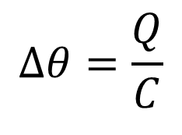
Example 5
A piece of metal at 20°C with a heat capacity of 400 J K⁻¹ is heated with 20 000 J. What temperature will it reach?
$$Q=CΔθ$$
C = heat capacity
$$Δθ=\frac{Q}{C}$$
$Δθ=\frac{20000}{400}=50$°C
$∴$ New Temperature = 70°C.

Slide 55
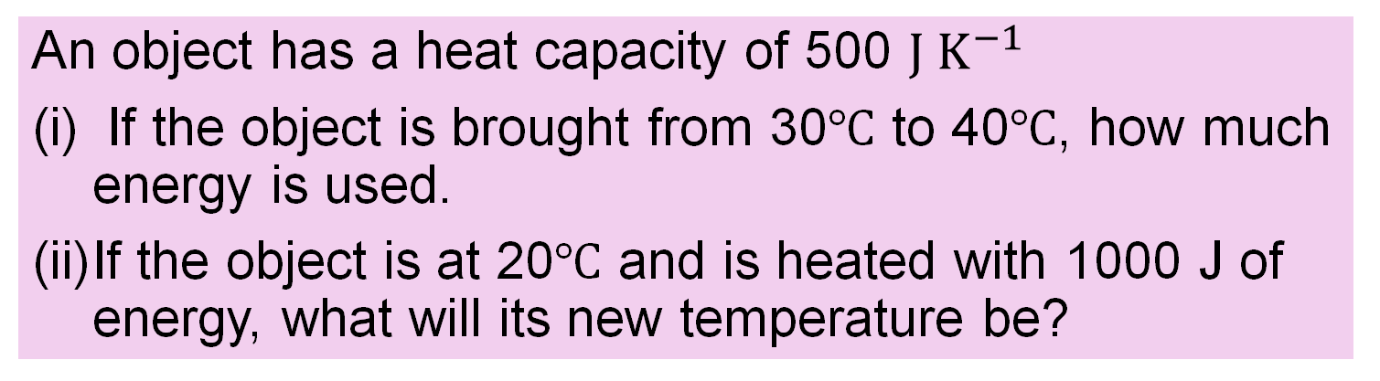

Exercise with $Q=CΔθ$
An object has a heat capacity of 500 $J K^{−1}$
If the object is brought from 30℃ to 40℃, how much energy is used.
If the object is at 20℃ and is heated with 1000 J of energy, what will its new temperature be?
5000 J
22℃

Slide 56
What is Specific Heat Capacity?
The energy to change the temperature of one kilogram of a substance by one kelvin.
HL 2018, 2021, 2022
What is the Symbol?
c (small c)

Slide 57
Cooking oil vs water
It takes almost twice as much energy to heat a kg of water to the same temperature as it does a kg of cooking oil.
Water
Oil
1kg
1kg
Water has a higher Specific heat capacity.
Specific heat capacity is a property of a substance.

Slide 58
What is the SI Unit of Specific Heat Capacity?
The joule per kilogram per kelvin
(J kg⁻¹ K⁻¹).

Slide 59
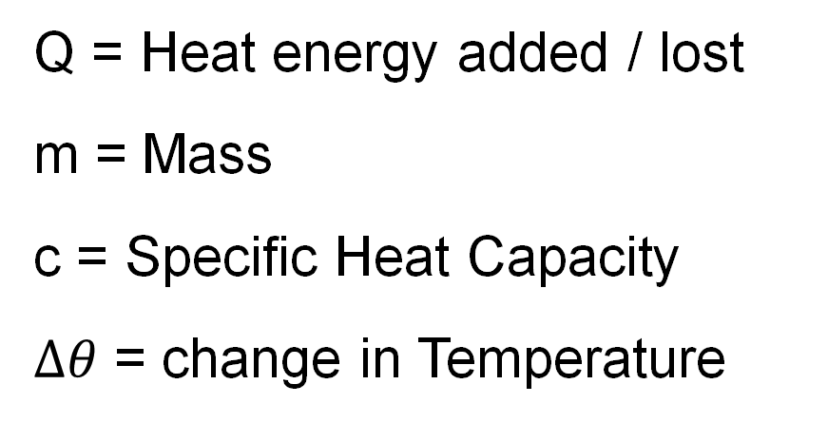

Write the equation for
Specific Heat Capacity. (small c)
$$Q=mcΔθ$$
Provided No Change of State
Q = Heat energy added / lost
m = Mass
c = Specific Heat Capacity
$Δθ$ = change in Temperature

Slide 60
Example 6
Specific heat capacity refers to a substance rather than an object. 500 g of copper is heated from -18°C to 50°C. Calculate the heat used.
The specific heat capacity of copper is 385 J kg⁻¹ K⁻¹.
Temperature difference is 18+50 = 68°C = 68 K.
This problem involves “little c” i.e. specific heat capacity
Q = mcΔθ = 0.5×385×68 = 13 090 J

Slide 61

Exercise with $Q=mcΔθ$
Copper has a specific heat capacity of 385 J kg⁻¹ K⁻¹
(i) If 2 kg of copper is brought from 30℃ to 40℃, how much energy is used?
(ii) If 500 grams of copper is at 20℃ and is heated with 1000 J of energy, what will its new temperature be?
7700
25.2℃

Slide 62
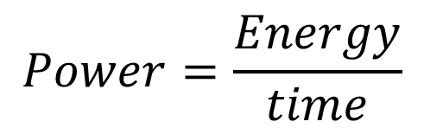

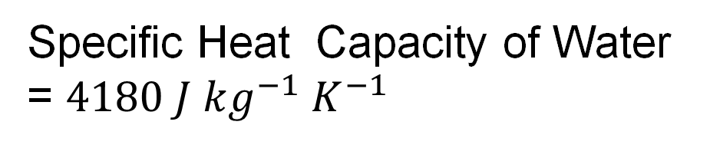
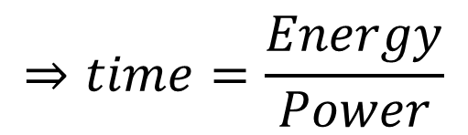
Example 7
A 2 kW electric kettle raises the temperature of 1 kg of water from 18°C to 60°C. How long will it take assuming no heat loss?
Specific Heat Capacity of Water = $4180 J kg^{−1} K^{−1}$
$$Q=mcΔθ$$
= 175,560 J
$$Power=\frac{Energy}{time}$$
$$⇒time=\frac{Energy}{Power}$$
= 87.78 s

Slide 63
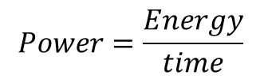

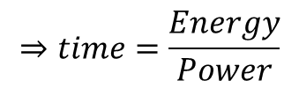
Exercise
What is the minimum time it will take to bring 8 kg of water from 18°C to 100°C in an electric boiler rated at 2 kW?
Specific Heat Capacity of Water = $4180 J kg^{−1} K^{−1}$
$$Q=mcΔθ$$
= 2742 kJ
$$Power=\frac{Energy}{time}$$
$$⇒time=\frac{Energy}{Power}$$
= 1371 s
= 22.9 mins

Slide 64
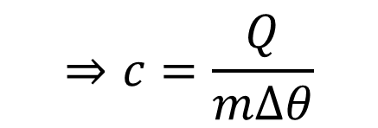

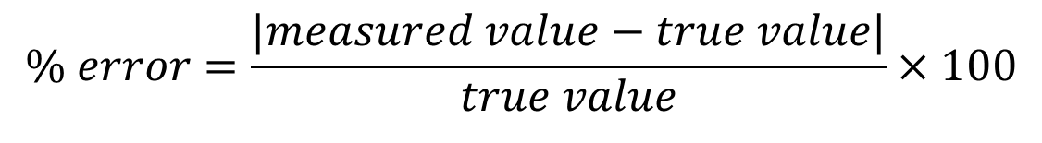
Example 8
To determine the specific heat capacity of a substance, we measure how much energy it takes to raise the temperature of a known mass.
32665 J of energy were used to heat 1.2 kg of aluminium from 5°C to 35°C. Calculate the specific heat of the aluminium.
$$⇒c=\frac{Q}{mΔθ}$$
$$Q=mcΔθ$$
c = 907 J per kg per K
The correct answer for aluminium is 897 J kg⁻¹ K⁻¹, calculate the percentage error.
$$\% error=\frac{|measured value−true value|}{true value}×100$$
= 1.1%

Slide 65
Exercise
Calculate the specific heat capacity of cooking oil if it took 2 mins 20 seconds to heat 50 g from 17°C to 22°C using an electric heater which output a constant 4 W of heat. Ignore any heat lost.
2240 J kg⁻¹ K⁻¹

Slide 66
More complex calculations
Heat calculations frequently involve:
Heating two items together to the same temperature
Heat transfer between two objects starting at different temperatures

Slide 67
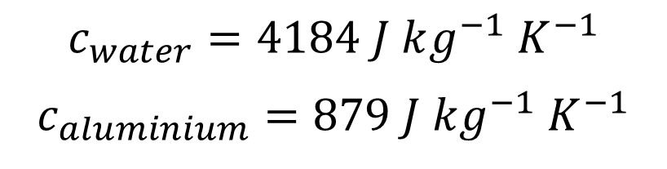
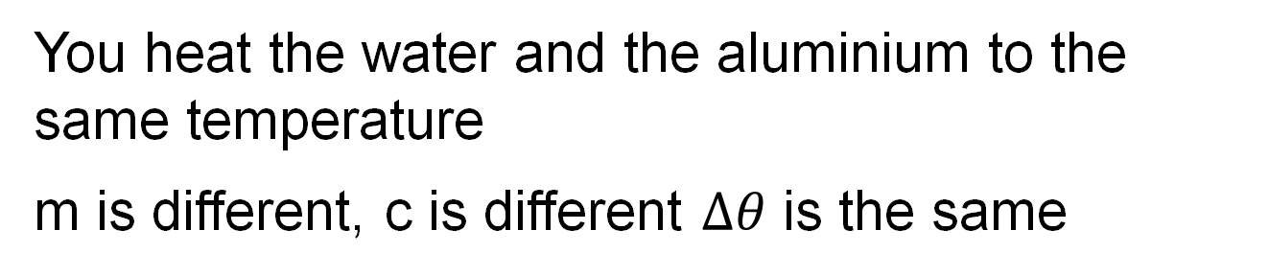
Heating two items together
Example: heating 1.2 kg or water in a 0.5 kg aluminium container to raise the temperature by 7°C
$$c_{water}=4184 J kg^{−1}{ K}^{−1}$$
$$c_{aluminium}=879 J kg^{−1}{ K}^{−1}$$
You heat the water and the aluminium to the same temperature
m is different, c is different $Δθ$ is the same
$Q=m_{water}c_{water}Δθ+$ $m_{aluminium}c_{aluminium}Δθ$
$Q=1.2\left(4184\right)\left(7\right)+0.5\left(879\right)\left(7\right)=38222 J$

Slide 68
Heat transfer
100°C
Example: 1.2 kg water at 100°C added to a 0.5 kg aluminium container at 20°C
20°C
Result:
Container heats up
Water cools down
An equilibrium temperature is reached
equilibrium temperature
100°C
Water
Aluminium
20°C

Slide 69
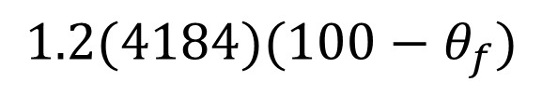
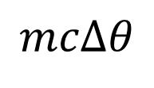








Calculate final temperature
Water
Aluminium
100°C
Heat lost
=
Heat gained
$$mcΔθ$$
=
$$mcΔθ$$
20°C
$m, c, and Δθ$ are different for water and the aluminium
$$m_{w}c_{w}Δθ_{w}$$
=
$$m_{a}c_{a}Δθ_{a}$$
100°C
Water
$$1.2(4184)Δθ_{w}$$
=
$$0.5(879)Δθ_{a}$$
$θ_{f}$
aluminium
Trick: Let $θ_{f}$= final temperature,
20°C
$$1.2(4184)(100−θ_{f})$$
=
$$0.5(879)(θ_{f}−20)$$

Slide 70






Complete the calculation
$$θ_{f}$$
$$1.2(4184)(100−θ_{f})$$
=
$$0.5(879)(θ_{f}−20)$$
$$502080−5021θ_{f}=439.5θ_{f}−8790$$
$$510870=5460.5θ_{f}$$
$$θ_{f}=\frac{510870}{5460.5}={93.6}^{o}C$$

Slide 71


About subscripts
m is the symbol for mass. To avoid confusion, we use a small letter after each m to distinguish if it refers to water or to aluminium.
This is called a subscript.
$$m_{w}c_{w}Δθ_{w}$$
$$m_{a}c_{a}Δθ_{a}$$
=
Subscripts to indicate water
subscripts to indicate aluminium

Slide 72







Example 9 (heating together)
If water is heated in a metal container, the container will also be heated. 60 g of water in a 35 g copper container is brought from 15°C to 24°C. Calculate the heat energy supplied.
$c_{water}$= 4184 $J {kg}^{−1} K^{−1}$
$c_{copper}$= 385 $J {kg}^{−1} K^{−1}$
$$m_{w}=mass of water$$
$$m_{c}=mass of copper$$
$$c_{w}=c of water$$
$$c_{c}=c of copper$$
$$Q=mcΔθ$$
$$⇒Q=m_{w}c_{w}Δθ_{w}+m_{c}c_{c}Δθ_{c}$$
Q=0.06(4184)(9)+0.035(385)(9)
Q=2259.4 + 121.3 = 2381 J

Slide 73











Example 10 (heat transfer)
70 g of water at $5^{o}C$ is heated by adding 50 g of copper pellets which were heated to 75℃. Calculate the final temperature of the mixture assuming no heat loss.
$$θ_{f}=final temerature$$
$$c_{water}=4182 J kg^{−1}K^{−1}$$
$$Q=mcΔθ$$
$$c_{copper}=385 J kg^{−1}K^{−1}$$
$$m_{w}=mass of water$$
$$m_{c}=mass of copper$$
Heat gained by water = heat lost by copper
$$⇒m_{w}c_{w}Δθ_{w}=m_{c}c_{c}Δθ_{c}$$
Note, two $Δθs$
$$⇒0.07\left(4182\right){(θ}_{f}−5)=0.05(385)(75−θ_{f})$$
$$⇒292.7 θ_{f}−1464=1444−19.25{ θ}_{f}$$
$$⇒311.95θ_{f}=2908$$
$⇒θ_{f}={9.3}^{o}$ $C$

Slide 74







Exercise
20 ball bearings with a heat capacity of 75 J K⁻¹ each at a temperature of 90℃ are immersed in 200 g of water which is initially at a temperature of 15℃ in an insulated container. Ignoring the heat capacity of the container, what temperature will the water rise to.
Specific heat capacity of water = 4180 J kg⁻¹ K⁻¹
$$m_{w}=mass of water$$
$$c_{w}=c of water$$
$$θ_{f}=final temerature$$
Heat gained by water = heat lost by metal
$$⇒m_{w}c_{w}Δθ_{w}=CΔθ_{m}$$
$$⇒0.2\left(4189\right){(θ}_{f}−15)=20(75)(90−θ_{f})$$
$$⇒836 θ_{f}−12540=135000−1500{ θ}_{f}$$
$$⇒135000=2336{ θ}_{f}$$
$⇒θ_{f}={63.2}^{o}$ $C$

Slide 75







Exercise
50g of copper pellets at 90°C is added to 120 g of water at 16°C in an insulated container. Find the final temperature of the mixture.
Specific Heat Capacity: Water = $4180 J kg^{−1} K^{−1}$
Copper = $390 J kg^{−1} K^{−1}$
Let $θ$= final temperature
Heat Lost = Heat gained
0.05(390)($90−θ$)=0.12(4180)($θ$-16)
1755-1$9.5θ$ = 5$01.6θ$-8025.6
1755+8025.6 = 5$01.6θ+$1$9.5θ$
9780.6 = 5$21.1θ$
$$θ=\frac{9780}{521.1}=18.7\text{7}\text{o}\text{C}$$

Slide 76



Exercise
A teapot is made of 520 g of steal. The teapot is at 20°C before 0.8 litres of water at 100°C are poured in. The teapot and water come to an equilibrium temperature a few seconds later. Calculate this temperature assuming no heat loss to the surrounds.
Density of water = 1 gramme per cubic cm
Specific Heat Capacity: Water = $4180 J kg^{−1} K^{−1}$
Steel = $490 J kg^{−1} K^{−1}$
$${m_{w}c_{w}\left(100−θ_{f}\right)=m}_{s}c_{s}(θ_{f}−20)$$
$θ_{f}=\frac{{m_{w}c}_{w}\left(100\right)+m_{s}c_{s}(20)}{m_{s}c_{s}+m_{w}c_{w}}=94.3$ °C

Slide 77







Example 11 (experiment)
60 g of water was heated in a 35 g copper container and brought from 15°C to 24°C. The heat energy supplied was 2400 J. Calculate the specific heat capacity of water.
$c_{copper}$= 385 $J {kg}^{−1} K^{−1}$
$$m_{w}=mass of water$$
$$m_{c}=mass of copper$$
$$Q=mcΔθ$$
$$c_{w}=c of water$$
$$c_{c}=c of copper$$
$$⇒Q=m_{w}c_{w}Δθ_{w}+m_{c}c_{c}Δθ_{c}$$
$$2400=0.06 (9)c_{w}+0.035(385)(9)$$
$$0.06 \left(9\right)c_{w}+0.035(385)(9)=2400$$
$$0.06 \left(9\right)c_{w}=2400−0.035(385)(9)$$
$c_{w}=\frac{2400−0.035\left(385\right)\left(9\right)}{0.06(9)}=4219$ $J {kg}^{−1} K^{−1}$

Slide 78
Measure the Specific Heat Capacity of water by an Electrical Method
Using voltmeter and ammeter
Thermometer
A
DC power
V
Insulated Lid
Calorimeter
Timer
Water
Lagging
Mass Scales
Heating Coil

Slide 79
Method
Record the mass of the calorimeter with and without water. Use cool water about 5 K below room temperature. Record temperature.
Switch on the power and the timer.
Ensure constant current.
Stir or agitate.
Record I and V once a minute.
When the temperature reaches about 5 K above room temp, stop and note the time and temperature.
Timer
A
V
Timer

Slide 80
Measurements
Mass of copper calorimeter
Mass of cold water
Start temperature
End temperature
Current
Voltage
Time

Slide 81


Calculation
Electrical Energy = Heat gained by copper and water
$$IVt=m_{c}c_{c}Δθ+m_{w}c_{w}Δθ$$
Re-arrange
$$c_{w}=\frac{IVt−m_{c}c_{c}Δθ}{m_{w}Δθ}$$

Slide 82




Sample results
Results:
Mass of calorimeter | 65 g
Mass of calorimeter + Water | 158 g
Start temperature | 17.4
Final Temperature | 23.5
Time taken | 6 mins
Current | 1.2 A
Voltage | 5.7 V
$$c_{c}=390 J kg^{−1} K^{−1}$$
$$c_{w}=\frac{IVt−m_{c}c_{c}Δθ}{m_{w}Δθ}$$
$$c_{w}=$$
4068 $J kg^{−1}K^{−1}$

Slide 83
Using a paper cup instead of a copper calorimeter
Copper Calorimeter
Paper cup
The paper cup version results in simpler calculations because the cup has a very low heat capacity C and thus you can ignore the heat that goes into the cup.
This simplification introduces a systematic error, but it is of a similar magnitude to errors caused by the calorimeter heat behaviour.
Notes:
The assumption with the calorimeter is that it all reaches the temperature of the water. The top portion will not fully reach the water temperature and so the term $m_{c}c_{c}Δθ$ will have an error. In addition, the top portion will radiate more heat than the top portion of the paper cup version because it will reach a higher temperature than the un-imersed paper. In the past expanded polystyrene cups were used but these have been banned because they cannot be recycled, they produce microplastics and animals mistake them for food.
The paper cup calculations are easier to understand and may be a better place to start.

Slide 84


Paper Cup Version
Assumption: The heat transferred to the paper cup is negligible.
Paper cup
Simplified Calculation
Electrical Energy supplied= Heat gained by water
$$IVt=m_{w}c_{w}Δθ$$
Re-arrange
$$c_{w}=\frac{IVt}{m_{w}Δθ}$$

Slide 85
Measure the Specific Heat Capacity of copper
Digital thermometer
Boiling water
Paper cup
Lagging
Water
Copper pellets
Mass balance
Heat

Slide 86
Method
Measure the mass of about 30 g of copper pellets and transfer to a boiling tube
Heat pellets to 100°C in the tube immersed in boiling water (heat for about 5 minutes to ensure the pellets have reached 100°C).
Pour cold tap water (about 30 g) into a small insulated paper cup. Record its mass.
Insert a digital thermometer into the water and note the temperature.
Pour the hot copper pellets into the water, stir and record the maximum temperature.
Paper cup

Slide 87







Results and calculations (paper cup)
$$c_{water}=4184 J kg^{−1}K^{−1}$$
 | Sample results
Mass of copper | 32 g
Mass of Water | 35 g
Start temperature | 17.4°C
Final Temperature | 23.5°C
$$m_{c}$$
$$m_{w}$$
$$θ_{1}$$
$$θ_{2}$$
Heat in = Heat out
Result:
$$m_{c}c_{c}\left(100−θ_{2}\right)=m_{w}c_{w}(θ_{2}−θ_{1})$$
$$c_{c}=\frac{m_{w}c_{w}\left(θ_{2}−θ_{1}\right)}{m_{c}\left(100−θ_{2}\right)}$$
365 J kg⁻¹ K⁻¹

Slide 88

Latent heat
(hidden heat)
CC0
Notes:
Water at boiling point thrown into very cold air. The hot water has very low surface tension thus it splits into tiny droplets so small that they freeze on contact with the cold air. This demonstrates two things:
the lowering of surface tension due to heating is a manifestation of the greater potential energy of the molecules (bonds between molecules are weaker)
2. The increased surface area (thousands of tiny droplets) allowing for faster heat transfer so it has time to freeze while still in the air. This is not on the course, but it’s interesting and you can find a few nice videos on YouTube.

Slide 89
The States of Matter
Heat energy added
Gas
Evaporating or vaporising
Condensing
Liquid
Solidifying or freezing
Melting
We do not study the plasma state.
Solid
Heat energy removed

Slide 90
Draw a graph of Temperature vs added energy as a substance changes state.
Boiling point
Latent heat of vaporisation
Temperature remains constant for a period
Temperature (°C)
Melting point
Latent heat of fusion
Energy supplied (J)

Slide 91
Particle model of states of matter
Heat increases the energy of molecules
Solid: intermolecular forces hold molecules in a ridged structure. Particles vibrate.
Liquid: Heat energy partially overcomes intermolecular force. Particles are still bound but can move around.
Gas: energy fully overcomes intermolecular force and molecules spread out.

Slide 92
Particle model for melting
Heat weakens the bonds
Particles gain enough energy to move away from their equilibrium positions in the structure.
This allows them to move about freely.
Heat during melting increases their potential energy, not their kinetic energy.
Thus, the temperature of the material does not rise during melting.

Slide 93
Particle model for evaporation
Heat breaks some bonds
At any given temperature there is a distribution of velocities among the molecules of any object.
Even below the boiling point, some molecules have sufficient kinetic energy in the right direction to break free from the surface.
When these leave, the average kinetic energy of the remaining particles is lower, and this is observed as a lowering of the temperature.

Slide 94
Particle model for boiling
Heat breaks the bonds
Molecules gain enough energy to break the bonds with their neighbours.
Once again, this is a change in potential energy rather than kinetic energy
The temperature remains constant during the boiling process.

Slide 95
What is Latent Heat?
The energy required to change the state of of an object with no change in temperature.
Based on HL 2014, 2025
SI Unit = the joule (J).

Slide 96
What is Specific Latent Heat?
The energy required to change the state of 1 kg of a substance with no change in temperature.
HL 2014, 2024
The SI Unit = joule per kilogram (J ​kg​⁻¹​).

Slide 97

What is Specific Latent Heat of Fusion?
The energy required to melt 1 kg of a substance with no change in temperature.
Based on HL 2014, 2025
CC0
Or … the amount of energy given off when it freezes.
Note the process occurs at the melting point temperature

Slide 98

What is Specific Latent Heat of Vaporisation?
The heat needed to evaporate 1 kg of a substance with no change in temperature.
Based on HL 2014, 2025
CC0
Or … the amount of energy given off when it condenses

Slide 99


Write the equation for
Specific Latent Heat.
$$Q=ml$$
$Q$ = Heat to change the state
$m$ = Mass
$l$= Specific Latent Heat

Slide 100
Summary C c L and l
 | An object | A substance
Change Temperature | Heat Capacity C Q=CΔθ | Specific Heat Capacity c Q=mcΔθ
Change state | Latent Heat L Q=L | Specific Latent Heat l Q=ml

Slide 101



Example 12
It takes a huge amount of energy to convert water to steam. Calculate how much energy it takes to bring 30 g of water at 20°C to 100°C and then how much energy it takes to convert to steam.
$$Specific heat capacity of water c_{w}=4180 J {kg}^{−1} K^{−1}$$
Latent heat of vaporisation of water (l) = 2.3x10⁶ J kg⁻¹
Heat water to $100^{o}C$
Boil the water
$$Q=mcΔθ$$
$$=0.03(4180)(100−20)$$
$$Q=ml$$
$$=0.03(2.3×{10}^{6})$$
= 10 032 J
= 69 000 J

Slide 102











Example 13
20 g of ice at -18°C are added to 250 g of water at 26°C. Calculate the final temperature of the water and melted ice.
Specific heat capacity of ice: 2100 J Kg⁻¹ K⁻¹
20 g of ice at -18℃
Specific heat capacity of Water: 4200 J Kg⁻¹ K⁻¹
Latent Heat of Fusion Ice: 3.3 × 10⁵ J Kg⁻¹
250 g of water 26℃
Let $T$= final temperature
Heat gained (20 g Ice):
Heat the ice
$$m_{i}c_{i}Δθ_{1}=$$
$0.02(2100)$(18) = 756
Melt the ice
$$m_{i}l=$$
$0.02(330000)$ = 6600
Heat melted ice
$$m_{i}c_{w}Δθ_{2}=$$
$0.02\left(4200\right)\left(T\right)=$84T
= Heat Lost (250 g Water) =
$$m_{w}c_{w}Δθ_{3}=$$
$$0.25(4200)(26−T)$$
756+6600+84T =
27300-1050T
$⇒T=\frac{27300−7356}{84+1050}={17.6}^{o}C$
Note the 3 $Δθs$

Slide 103

Exercise
How much heat energy is needed to melt 32 g of ice at 0°C without raising its temperature?
Latent heat of fusion of ice: l = 3.34x10⁵ J kg⁻¹
Q = ml = 0.032x3.34x10⁵ = 1.069x10⁴. J

Slide 104





Exercise
40 g of ice at -18°C are added to 300 g of water at 25°C. Calculate the final temperature of the water and melted ice.
Specific heat capacity of ice: 2100 J Kg⁻¹ K⁻¹
40 g of ice at -18℃
Specific heat capacity of Water: 4200 J Kg⁻¹ K⁻¹
Latent Heat of Fusion Ice: 3.3 × 10⁵ J Kg⁻¹
300 g of water 26℃
Let $T$= final temperature
Heat gained (40 g Ice):
Heat the ice
$$m_{i}c_{i}Δθ_{1}=$$
$0.04(2100)$(18) = 1512
Melt the ice
$$m_{i}l=$$
$0.04(330000)$ = 13200
Heat melted ice
$$m_{i}c_{w}Δθ_{2}=$$
$0.04\left(4200\right)\left(T\right)=$168T
= Heat Lost (250 g Water) =
$$m_{w}c_{w}Δθ_{3}=$$
$$0.3(4200)(25−T)$$
14712+168T =
31500-1260T
$⇒T=\frac{31500−14712}{168+1260}={11.8}^{o}C$
Note the 3 $Δθs$

Slide 105
Verify mathematical models of heat energy, latent heat and temperature change using secondary data

Slide 106


Exercise
Which model does the below graph verify, state how it verifies the model and calculate the heat capacity of the object.
$$Q=CΔθ$$
40
x
The graph is a straight line which verifies the formula $Q=CΔθ$
Temperature (°C)
30
20
x
Slope=20/1800. C=1800/20 = 90 J K⁻¹
1
2
Heat kJ

Slide 107

Exercise
What step to ensure fairness has the student likely omitted. What is your best estimate of the heat capacity?
40
Temperature (°C)
Adequate insulation / allowing too high a temperature
Best estimate is close to room temperature where heat loss is least significant
Steepest slope: $\frac{11K}{600J}$
$$C=\frac{600}{11}=55 J K^{−1}$$
30
x
20
x
1
2
Heat kJ

Slide 108
Practical examples of Latent Heat

Slide 109

Perspiration
Perspiration evaporates on your skin and takes the Latent Heat of vaporisation from your body. This brings your temperature down.
The specific latent heat of vaporisation of water is very high – hence this is a very effective process.
CC0

Slide 110

Ice Pack
An Ice pack will keep things cold much longer than the same amount of a cold liquid.
It is the latent heat required to melt the frozen liquid that accounts for this difference.
CC0

Slide 111
Heat Pumps and Fridges
Normally heat flows from hot to cold
A heat pump artificially reverses the direction.
Heat pumped from cold to warm region
A refrigerator uses a heat pump to remove heat from the interior

Slide 112
Heat Pumps for home heating
Heat pumped from cold exterior to provide home heating
Consumes about one third the electricity of an electric resistance heater.

Slide 113
Describe a Heat Pump
Cold side
Hot side
Compressor
vapour
vapour
Heat in
Heat out
Liquid
Liquid
Expansion Valve
Low pressure liquid evaporates and takes in latent heat.
High pressure gas condenses and gives out latent heat
refrigerator on the left and a heater on the right

Slide 114
Demonstrate the effects of low pressure on boiling point
Pull
syringe
Low pressure
Water at 40°C
End blocked by finger or Blu Tack
Observation:
Water boils and cools
blocked
Notes:
Not a mandatory demo. Helps appreciate the heat pump. It would be even better if you could monitor the water temperature.

Slide 115
What are the properties of the refrigerant in a heat pump?
The refrigerant is the fluid that flows in the pipes.
1.
low boiling point e.g. in a freezer it must be able to boil at a temperature of less than -18° C (at a low pressure).
Freon boils at -26 ° C
2.
high specific latent heat of vaporisation This makes the heat pump more effective.

Slide 116
HL 2016
In a heat pump, a fluid is used to transfer energy from a cold body to a warmer body.
Describe the operation of a heat pump and explain how a heat pump can be used to reduce the temperature of a cold region, for example the interior of a refrigerator. (12)
pipe containing a fluid (3)
fluid changes state on passing through a valve/compressor (3)
latent heat associated with fluid changing from liquid to gas (3)
loss of temperature/heat in surroundings associated with fluid changing from liquid to gas (3)

Slide 117
HL 2016
State two desirable physical properties of the fluid used in a heat pump.
high (specific) latent heat of vaporisation (3)
low boiling point / volatile / low molecular mass / little intermolecular forces (3)

Slide 118
HL 2021
(v) Draw a labelled diagram of a heat pump.
compressor indicated (3)
(expansion) valve indicated (3)
correct arrangement of liquid/vapour indicated (3)
(vi) Explain how a heat pump works.
heat taken in by liquid evaporating (3)
heat given out by vapour condensing (3)

Slide 119



Exercise
A student placed 4 kg of water at 12°C in a small fridge. The fridge had an electrical energy consumption meter attached. After 20 minutes the water is removed and these readings are taken:
Electrical energy consumed: 60 kJ,
Final temperature of water: 6°C.
Calculate the coefficient of performance (COP) of the fridge where $COP=\frac{heat energy transferred}{electrical energy supplied}$.
$$Specific heat capacity of water c_{w}=4180 J {kg}^{−1} K^{−1}$$
Heat transferred from water = $mcΔθ= 4kg×4180×\left(12−6\right)=100 320 J$
E$lectrical energy supplied=60 000 J$
$COP=\frac{100320}{60000}=1.7$
Note the COP of a heat pump is not a fixed figure, it depends on the temperatures on both sides of the heat pump

Slide 120
Measure the Latent Heat and Specific Latent Heat of Fusion of Ice
Stirrer
Thermometer
Insulated lid
Calorimeter
Cloth to dry the ice
Crushed ice
Water
Insulation
Mass balance

Slide 121




Method and results
Subtractions:
Mass of calorimeter $m_{c}$ ________
Add warm water
(~35° C, half full),
Combined mass $m_{c}+m_{w}$ ________
Place in insulation
Crush ice,
When it starts to melt, dry it
Take temperature of the warm water $θ_{1}$ ______
Add ice to increase the volume in the
calorimeter by about 20%
Stir until ice melted
Take final temperature $θ_{2}$ _______
Take final mass $m_{c}+m_{w}+m_{ice}$ _______
$$Δθ=_________$$
$m_{w}=$______
$m_{ice}=$_____

Slide 122







Calculation of L (OL&HL) and l (HL):
Heat lost = heat gained
Heat lost by water | + | Heat lost by calorimeter | = | Latent heat gained by ice | + | Heat to bring melted ice to final temp $θ_{2}$
$$m_{w}c_{w}Δθ$$
$${+m}_{c}c_{c}Δθ$$
$$=$$
$$L$$
$${+m}_{ice}c_{w}θ_{2}$$
$$L_{ice}=m_{w}c_{w}Δθ+m_{c}c_{c}Δθ−m_{ice}c_{w}θ_{2}$$
$$l_{ice}=\frac{L_{ice}}{m_{ice}}$$
ice
Heat
Practice the method, don’t try to learn the equation because it can change.
Water

Slide 123







Exercise on Sample Results
Calculate $L$and $l$ for the ice using this data:
62.1 g
Mass of calorimeter $m_{c}$ ____________
Combined mass $m_{c}+m_{w}$ ____________
temperature of water $θ_{1}$ __________
final temperature $θ_{2}$ _______
Final mass $m_{c}+m_{w}+m_{ice}$ _______
97.3 g
31.7°C
9.7°C
106.5 g
Subtractions:
$c_{copper}$= 385 $J {kg}^{−1} K^{−1}$
$c_{water}$ = $4180 J kg^{−1} K^{−1}$
$$Δθ=_________$$
$$L_{ice}=m_{w}c_{w}Δθ+m_{c}c_{c}Δθ−m_{ice}c_{w}θ_{2}$$
$m_{w}=$______
=2919 J
$m_{ice}=$_____
$$l_{ice}=\frac{L_{ice}}{m_{ice}}=317000 J kg^{−1}$$

Slide 124
HL 2019 2024
Why did the student crush the ice?
To ensure that it would have an even temperature – ie temperature in the middle of a particle of ice = temperature on the surface.
To expose more surface area so that it will all melt more quickly.
Why did the student dry the ice?
To ensure that when he calculated the mass of the ice (by subtraction) that he got an accurate figure. If there was water mixed in, then he would not get the true mass of ice.

Slide 125
HL 2017
How did the student prevent heat loss?
Insulated the container
Used an insulated lid
Give two characteristics of the thermometer (2017, 2024)
Measures in steps of 0.1 ℃
Low specific heat
Fast reacting

Slide 126

Specific latent heat of vaporisation
Secondary Data
Measure:
Mass of calorimeter
Mass of water before and after steam
Temperature before and after steam
Dry Steam
$$θ$$
Thermometer
Insulated lid
Calorimeter
Insulation
Water
Mass balance
Notes:
The vaporisation experiment is only partially described here and is not recommended. The latent heat of fusion (ice) experiment is more fully described. It is much safer and on its own meets the requirements for collecting primary data for latent heat. Students are only required to collect primary data for one type of latent heat experiment. Risks associated with the vaporisation experiment include stoppers ejected at speed from flasks under the pressure of the steam, connections breaking under pressure and hot steam ejected in an unexpected direction, burn and fire risk from bunsen or hot plate. Precautions can be taken but they can also be forgotten.

Slide 127
Key points
Start with water cooler than room temperature (e.g. add ice)
Dry the steam (steam trap)
Don’t over-heat the water (30 seconds for small calorimeter)
Write a conservation of energy equation.

Slide 128





Write an equation
Start with conservation of energy
Heat lost = heat gained
By what?
Heat lost by steam = heat gained by water and copper
Be more specific.
Latent heat lost by steam
Heat lost by condensed steam as it drops to the final temperature
Heat gained by water
Heat gained by copper
+
=
+
$$m_{s}l_{s}$$
$$+$$
$$m_{s}c_{w}({100−θ}_{2})$$
$${= m}_{w}c_{w}({θ_{2}−θ}_{1})$$
$${+m}_{c}c_{c}({θ_{2}−θ}_{1})$$

Slide 129














Equation continued
$$m_{s}l_{s}$$
$$+$$
$$m_{s}c_{w}({100−θ}_{2})$$
$${= m}_{w}c_{w}({θ_{2}−θ}_{1})$$
$${+m}_{c}c_{c}({θ_{2}−θ}_{1})$$
$$m_{s}l_{s}$$
$${= m}_{w}c_{w}({θ_{2}−θ}_{1})$$
$${−m}_{s}c_{w}({100−θ}_{2})$$
$${+m}_{c}c_{c}({θ_{2}−θ}_{1})$$
$$l_{s}$$
$${= m}_{w}c_{w}({θ_{2}−θ}_{1})$$
$${−m}_{s}c_{w}({100−θ}_{2})$$
$${+m}_{c}c_{c}({θ_{2}−θ}_{1})$$
$$m_{s}$$
Learning this equation is a bad strategy you can be asked a variation.

Slide 130


Exercise (steam)
Calculate the latent heat and the specific latent heat of the steam (HL 2010)
Mass of calorimeter: 34.6 g
Mass of calorimeter + water: 96.4 g
Mass of calorimeter + water + steam: 97.6 g
Temperature before adding steam: 8.2
Temperature after adding steam: 20.0
L=$2.81×{10}^{3} J$
$$l=2.34×{10}^{6} J {kg}^{−1}$$

Slide 131
How and Why did the student dry the steam?
How?
Use a steam trap
Why?
If there was water mixed with the steam, it would add to the final mass but would not contribute any latent heat.
Steam traps collect droplets of condensed steam

Slide 132

How and why did the student cool the water?
How?
Cool in fridge / melt some ice in it
Why?
Minimise heat loss errors…
Heat gained from surroundings at start $≈$ heat lost to surroundings at end.
lower temperature gradients = lower heat loss

Slide 133
If there was un-melted ice in the calorimeter when you introduced the steam how would it affect the result?
Some of the added heat would be used in melting the ice (latent heat of fusion). This heat would not contribute to a rise in temperature. Thus, the final temperature would be too low.

Slide 134


Heat Transfer
Convection
Conduction
Radiation

Slide 135
What is Convection?
Heat transfer by means of circulation of a fluid. HL 2018, 2024
Remember a fluid is a liquid or a gas
Heat

Slide 136
Demonstrate Convection in a Liquid
Carefully add a drop of food colouring to the bottom of a beaker of cold water with a plastic pipette.
Heat.
Observation
The water and coloured dye circulates showing convection currents.
Food colouring
Heat

Slide 137
Explain Why Convection Occurs
Heated liquid expands and becomes less dense.
It rises to float on denser cool liquid.
Thus, the cooler liquid sinks and gets heated.
This movement is called a Convection Current.
Heat

Slide 138
Particle model simulation: Convection
Link :
Convection - Javalab
Objective: observe the general flow of the gas
Observe the back-and-forth motion of the particles

Slide 139
What is meant by Conduction of heat?
Conduction is transfer of heat by vibration from particle to particle with no net movement of the medium. HL 2018, 2024

Slide 140
Particle model simulation:
Conduction of heat
Objective:
Observe how vibrations propagate from particle to particle.
Observe how heat flows without any net movement of the substance.
Link:
Particle Simulation of Thermal Conduction - Javalab

Slide 141
Demonstrate how different solids conduct heat at different rates
Use rods of the same size.
Stick identical weights on the end of each rod with wax.
Pour in hot water.
Observation
Weights fall off
Aluminium first then
steel then wood.
Steel
Aluminium
Hot water
Weights stuck on with wax
wood
Conclusion: aluminium is the best conductor of heat

Slide 142
Demonstrate that water is a poor conductor of heat
Apparatus see diagram.
Method Heat top of water
weight
Observation
Ice takes a long time to melt.
Ice
Conclusion Water is a poor conductor of heat.

Slide 143

What is Radiation of Heat?
Radiation is the transfer of heat energy by means of electromagnetic waves. It will pass through a vacuum. HL 2018
CC0

Slide 144
What is the Solar Constant?
The amount of solar energy falling normally on the earth per second per square meter. HL 2023
Its value is about
1.36 kW ​m​⁻²​.
also called the Solar Irradiance.
Watts
per square metre
1 m²

Slide 145
Example 14
The solar constant is 1.36 kW m⁻². How much energy falls on a 0.9 m x 1.5 m solar panel in one minute? Round your answer to 4 significant figures.
Energy = Solar constant x area x time
$$=1360\left(0.9\right)\left(1.5\right)\left(60\right)=110200 J$$
Note, using 6 significant figures does not make sense here because the solar constant is only given with 3 significant figures

Slide 146

Exercise
The solar constant is 1.36 kW m⁻². How much power can be obtained from 6 solar panels measuring 0.9 m by 1.3 m if the system efficiency is 21%?
$$1360(6)(0.9)(1.3)(0.21)$$
$$=2004 W$$
$$≈2 kW$$

Slide 147
Demonstrate that dark colours radiate heat better
Apparatus: see diagram
Thermometers
Method: fill cans with hot water and monitor the temperature
Observation:
The temperature of the water in the black can falls quicker.
Cans filled with hot water, one shiny the other painted matt black
Notes:
Not mentioned in the spec but part of transfer of heat and insulation

Slide 148

Demonstrate that dark coloured objects absorb heat better than bright or shiny ones
Sunlight
Cold water & direct sunlight.
Observation the darker can will heat up at a faster rate.
Thermometers
video:
INFRA-RED RADIATION - Science GCSE Physics Required Practical
Cans with cold water

Slide 149
What is meant by the U-Value of a material?
The rate of energy transfer through 1 m² of a surface when there is a temperature difference of 1 K across the surface. HL 2022D
1 K colder
Heat
1 m²
What is the SI unit:
The SI Unit of U-value is W m⁻² K⁻¹

Slide 150



Where is U-value in the formula book?
Page 58 under heat and temperature
What is $\frac{ΔE}{Δt}$?
$$\frac{change of energy}{time interval}$$
= heat conducted per second
(measured in watts)

Slide 151





Use the formula to recall the definition of U-value
$$\frac{ΔE}{Δt}=AUΔθ$$
Page 58
re-arrange:
$$⇒U=\frac{ΔE}{ΔtAΔθ}$$
Heat energy
per second
per $m^{2}$
per Kelvin
$$⇒$$
Energy per second per $m^{2}$ per K

Slide 152
Which is the better insulator:
high or low U-value?
U = Watts per square meter per K
High U-Value = More watts = Bad Insulator
Low U-Value = Less watts = Good Insulator
Heat
1 m²
W m⁻² K⁻¹

Slide 153




Leaving Cert 2014
The U-value of the material in a double-glazed window is 2.8 W m⁻² K⁻¹. The window has an area of 3.0 m². How much energy is lost through the window in one hour if the temperature inside is 20℃ and the outside temperature is 11℃?
$$\text{Rate} \left(watts\right)=\frac{ΔE}{Δt}=AUΔθ$$
Page 58
Rate $\left(watts\right)=3×2.8×9^{o}C=75.6 W$
$$1 hour=3600 seconds$$
Heat loss $\left(jules\right)=75.6×3600=272160 J$

Slide 154

Leaving Cert 2022 deferred
marking scheme:

Slide 155

Example 15 Impact of insulation
A home-owner is considering replacing windows.
Old U value 3.2 W m⁻² K⁻¹
New U-value 1.2 W m⁻² K⁻¹
Total window area 20 m².
Calculate the reduction in power consumption in watts when the indoor temperature is 20℃ and the outside temperature is 7℃.
$$\frac{ΔE}{Δt}=AUΔθ$$
Old windows:
New windows:
20(3.2)(13)
=832 Watts
20(1.2)(13)
=312 Watts
Saving: 832-312=520 W

Slide 156

Exercise
Calculate the difference in heat loss between an old window measuring 2 m x 1.5 m with a U-value 5 W m⁻² K⁻¹ and a new window of the same size with a U-value of 1.3 W m⁻² K⁻¹ when the temperature difference between inside and outside is 15℃
$$\frac{ΔE}{Δt}=AUΔθ$$
Old window:
New window:
2(1.5)(5)(15)
=225 Watts
2(1.5)(1.3)(15)
=58.5 Watts
Difference: 225-58.5 = 166.5 W

Slide 157



Exercise (part 1)
A student filled a cup with hot water and measured the temperature of the water every 4 minutes. Plot a graph temperature difference (Δθ) between the inside and outside of the cup vs time. Room temperature = 20 ℃
Time (mins): 0 4 8 12 16 20
Temperature (℃): 80.2 70.9 63.7 58.0 53.8 49.8
$Δθ$(K)
60.2 50.9 43.7 38.0 33.8 29.8
60
$Δθ$(K)
40
20
0
0
10
20
Time (min)

Slide 158


Exercise (part 2)
The student expanded the centre part of the graph. Use this to determine the temperature drop per second when the temperature difference is 40℃.
$Δθ$(K)
Slope at 40℃:
Use two equidistant points:
Slope
$$=\frac{41.3−38.7}{11.6−9.6}$$
$$=1.3 K /min$$
Temperature drop per second
$$=0.0217 K/s$$
45
X
40
X
35
8
9
10
11
12
Time (min)
Notes:
See SEC sample paper 2 Q7 where the student was asked to find the slope of a magnified portion of a non-linear graph. The magnified portion was approximately linear similar to his portion of the graph.

Slide 159

Exercise (part 3)
If the mass of water was 100 g, determine the heat loss in joules per second when the temperature difference is 40℃.
$$Specific heat capacity of water c_{w}=4180 J {kg}^{−1} K^{−1}$$
T$emperature drop per second= 0.0217 K/s$
$$Heat lost=mcΔθ_{1}$$
$$Heat lost per second=mc\left(0.0217\right)$$
$$=0.1\left(4180\right)\left(0.0217\right)$$
$$9.07 J s^{−1}$$

Slide 160



Exercise (part 4)
If the surface area of the cup in contact with the water was 95 cm², calculate a U-value for the plastic of the cup using the value you calculated for heat loss per second in the previous question.
The formula for U-value is $\frac{ΔE}{Δt}=AUΔθ$
$$U=\frac{ΔE}{Δt}×\frac{1}{AΔθ}$$
$$U=9.07×\frac{1}{0.0095(40)}$$
= 24 W m⁻² K⁻¹
Note: At higher temperatures, a lot of heat is lost due to evaporation rather than through the sides of the cup. This creates a systematic error.

Slide 161


Impact of insulation on efficiency and sustainability
$$\frac{ΔE}{Δt}=AUΔθ$$
i.e. heat loss is proportional to
Surface area, U-value, Temperature difference
So, we should live in spherical dwellings built from thick insulating material and keep the indoor temperature as low as bearable.
CC0
Research question: write a piece on the pros and cons of igloos. Reference your sources.

Slide 162
Example 16
Describe the mechanisms by which heat escapes from this container.
Heat is circulated inside by convection.
And heat is radiated towards the walls by radiation.
Inside surface gets hot.
Air
Heat source
Heat is transferred through the walls by conduction making the outside surface hotter than the surroundings.
Heat leaves the outside walls by convection and radiation.

Slide 163
Efficiency

Slide 164


How is percentage efficiency calculated?
$$= \frac{P_{o}}{P_{i}}×100$$
Percentage efficiency
$$P_{o}=\left(useful\right)output power$$
$$P_{i}=input power$$
Note Efficiency is also covered in Section 1.4

Slide 165


Can you use energy instead of power?
Yes
$$= \frac{E_{o}}{E_{i}}×100$$
Percentage efficiency
$$E_{o}=\left(useful\right)energy out$$
$$E_{i}=input energy$$

Slide 166
Give examples of Improving efficiency
Heat pumps that consume less power for a given output
Lights and motors that consume less power for a given useful output
Energy storage devices (e.g. batteries) that consume less power for a given output
A kettle that uses less power to heat the same mount of water.

Slide 167


Exercise
A 2-kW kettle takes 6 minutes to bring 1.8 kg of water from 18°C to 100°C, calculate the efficiency.
Specific heat capacity of water = 4184 J kg⁻¹ K⁻¹
$$\%efficiency =\frac{energy gained by water}{input energy}×100$$
$$=\frac{1.8(82)(4184)}{2000(6)(60)}×100$$
= 86%

Slide 168

Revision summary
Key definitions: Heat, Temperature, Absolute zero, kelvin, Thermometric properties, Thermocouple, Thermistor, Heat Capacity, Specific Heat Capacity, Latent Heat, Specific Latent Heat, Efficiency, U-value, conduction, convection, radiation.
Solve problems using $Q=CΔθ, Q=mcΔθ, Q=L, Q=ml, Eff=\frac{P_{o}}{P_{i}}×100$, $\frac{ΔE}{Δt}=AUΔθ, \text{θ}\text{ (}\text{o}\text{​}\text{C}\text{) = }\text{T}\text{ (}\text{K}\text{) − 273.15}$
Describe and explain heat pump, melting, evaporating, solid, liquid, gas, conduction, convection, radiation using particle model and mathematical models where appropriate.
Experimental: Compare thermometer materials (primary and secondary data). Determine $c$ and $l$ using primary and secondary data. Verify heat models with secondary data.
Investigate insulation vs energy consumption using secondary sources.

