Slide 1
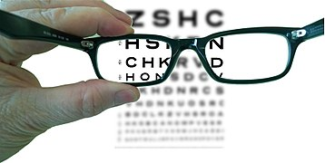

Lenses

Slide 2
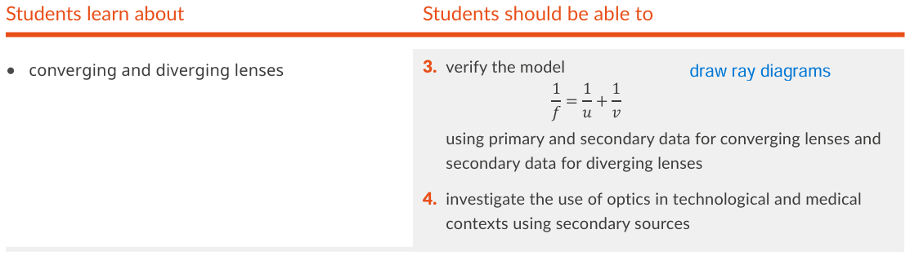
Physics Specification
Added
Verify model for diverging lenses using secondary data
Use of optics in technological and medical contexts
Gone
Power
Magnification

Slide 3
What is a converging lens?
A lens that causes a parallel beam to converge
Lens
parallel beam of light
Focus
converging beam.
Also called a Convex Lens

Slide 4
What is a Diverging Lens
A lens that causes a parallel beam to diverge
diverging beam.
parallel beam of light
Lens
Focus
Also called a Concave lens

Slide 5
Describe a Convex and concave Lens
A Convex Lens is thickest in the centre.
A Concave Lens is thinnest in the centre.
If you exaggerate, it looks like a cave

Slide 6

Label the axis and optic centre
Optic Centre
Axis
The optic centre is the centre of a symmetrical lens
The axis is a normal through the centre.

Slide 7
What is the axis and optic centre of a lens
Axis
The axis is a line perpendicular to the face of the lens and passes through the centre of the lens
Optic centre = geometric centre of a symmetric lens

Slide 8
What is the focus of a lens
Focus
F
Axis
the point where all rays parallel to the axis converge after passing through

Slide 9
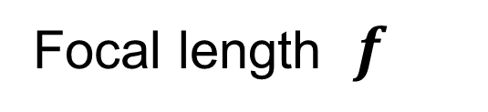
What is the focal length of a lens?
F
Axis
Focal length $f$
the distance from the focus to the optic centre of the lens
HL 2022D

Slide 10
Ray Diagrams for converging lenses
Ray diagrams appeared in 70% of recent exams!

Slide 11
Why draw an arrow here?
Object
It represents the object
It’s clear which is the top and bottom of the object
Its simple

Slide 12
Why is the arrow placed on the axis?
Object
Because the image of it’s base will also be on the axis.
Thus, you only need find the image of the tip.

Slide 13
Ray 1: Draw a ray through the optical centre.
It passes straight through without bending
Object

Slide 14
Ray 2: Draw a ray parallel to the axis.
Where does it go?
Through the focus on far side
Object
F

Slide 15
Can we draw the image now?
Yes, the tip of the image will be at the intersection of the two rays, and the base will be on the axis.
Object
F
Image

Slide 16
Do we need a third ray?
No. But it’s a good test of accuracy to see if it intersects at the same point.
Object
F
Image
F
The third ray passes through the near focus, where should it go after the lens?
It continues parallel to the axis.

Slide 17
What is a Real Image?
an image formed by the intersection of rays.
OL 2022
A real image can be formed on a screen.
Image
Object
Intersection of rays

Slide 18
What is a Virtual Image?
one formed by the apparent intersection of rays. OL 2020, 2022.
Backward extension of rays
(rays appear to come from here)
Virtual image
Object

Slide 19
Exercise
Complete the Ray Diagram
2F
F

Slide 20
Exercise
Complete the Ray Diagram
2F
F
F
2F

Slide 21
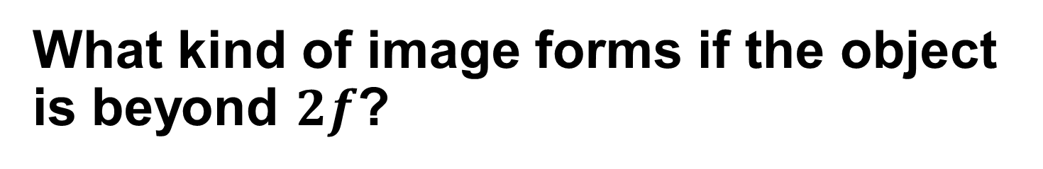




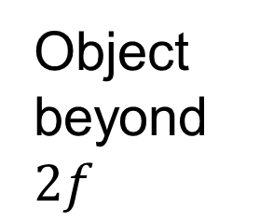
What kind of image forms if the object is beyond $2f$?
$$f$$
$$2f$$
$$2f$$
$$f$$
Object beyond $2f$
Real Diminished image

Slide 22


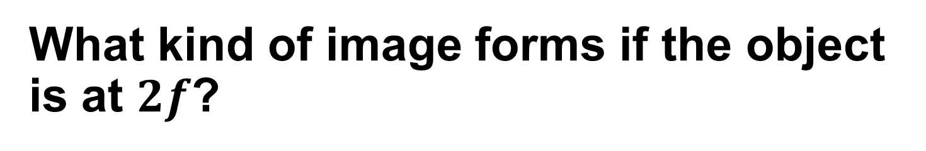



What kind of image forms if the object is at $2f$?
$$f$$
$$2f$$
$$2f$$
$$f$$
Object at $2f$
Real Same size image

Slide 23
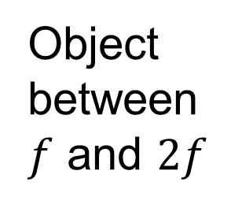




What if the object is between 2f and f?
$$f$$
$$2f$$
$$2f$$
$$f$$
Object between $f$ and $2f$
Real Magnified image

Slide 24
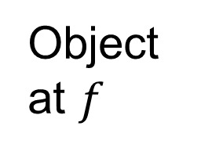




What if the object is at f?
Image at infinity
$$f$$
$$2f$$
$$2f$$
$$f$$
Object at $f$
There is no image, you see a blur.

Slide 25
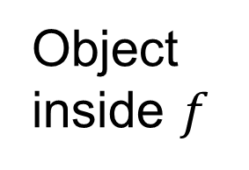




What if the object is inside F?
Virtual magnified image
$$f$$
$$2f$$
$$2f$$
$$f$$
Object inside $f$

Slide 26
Exercise
Complete the Ray Diagram
2F
F
F
2F

Slide 27
Exercise
Complete the Ray Diagram
2F
F
F
2F

Slide 28
2019 Q11e
Draw a ray diagram to show the formation of an upright image in a magnifying glass.

Slide 29
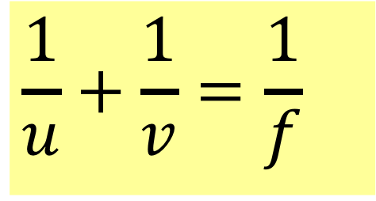


What is the Lens Formula
$$\frac{1}{u}+\frac{1}{v}=\frac{1}{f}$$
Object
Image
$$u$$
$$v$$
u = distance from object to the optic centre.
v = distance from image to the optic centre.
f = Focal Length of the lens.

Slide 30
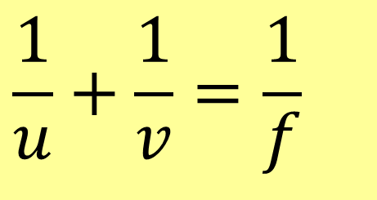
When do you get negatives in the Lens Formula
$$\frac{1}{u}+\frac{1}{v}=\frac{1}{f}$$
f is positive for a converging lens
f is negative for a diverging lens
v is positive for a real image and
v is negative for a virtual image

Slide 31
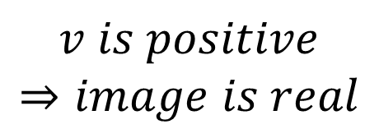
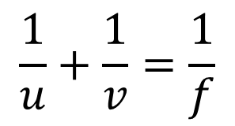

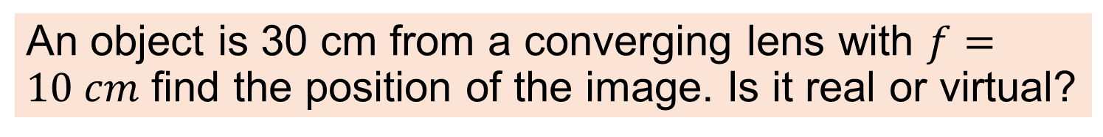
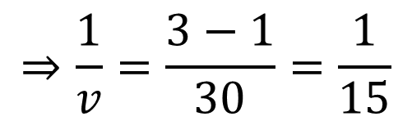
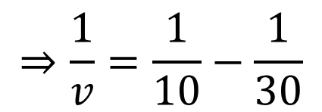
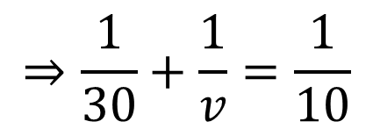
Example
An object is 30 cm from a converging lens with $f=10 cm$ find the position of the image. Is it real or virtual?
$$\frac{1}{u}+\frac{1}{v}=\frac{1}{f}$$
$$⇒\frac{1}{30}+\frac{1}{v}=\frac{1}{10}$$
converging lens means f is positive
$$⇒\frac{1}{v}=\frac{1}{10}−\frac{1}{30}$$
$$⇒\frac{1}{v}=\frac{3−1}{30}=\frac{1}{15}$$
$$v is positive$$
$$⇒image is real$$
$$⇒v=15 cm$$

Slide 32
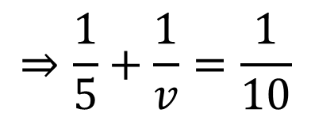
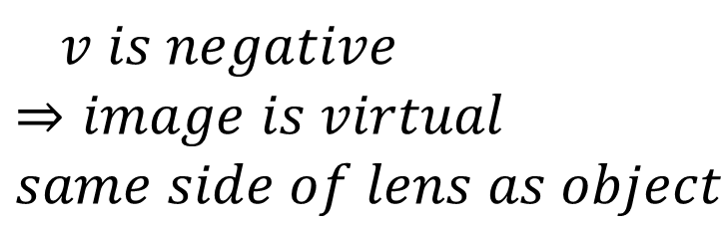
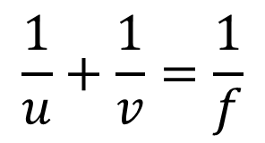

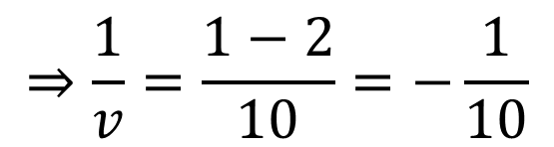
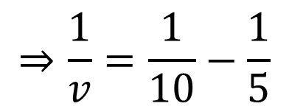
Example
Magnifying glasses are converging lenses. In normal use the object is closer to the lens than its Focus. If a lens has a focal length of 10 cm and an object is placed 5 cm from the lens. Will the image be real or virtual?
$$\frac{1}{u}+\frac{1}{v}=\frac{1}{f}$$
$$v is negative$$
$$⇒image is virtual$$
$$same side of lens as object$$
$$⇒\frac{1}{5}+\frac{1}{v}=\frac{1}{10}$$
$$⇒\frac{1}{v}=\frac{1}{10}−\frac{1}{5}$$
$$⇒\frac{1}{v}=\frac{1−2}{10}=−\frac{1}{10}$$
$$⇒v=−10 cm$$

Slide 33
Exercise
A converging lens has a focal length of 20 cm. An object is placed 30 cm from the lens,
calculate how far the image will be from the lens.
Is the image real or virtual.
60 cm
Real image

Slide 34
Exercise
A converging lens has a focal length of 20 cm. An object is placed 15 cm from the lens,
calculate how far the image will be from the lens.
Is the image real or virtual.
-60 cm
Virtual image

Slide 35
Exercise
A converging lens has a focal length of 15 cm. An object is placed 2 m from the lens,
To 4 significant figures, calculate how far the image will be from the lens.
Is the image real or virtual.
16.22 cm
Real image

Slide 36
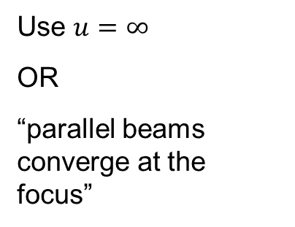
Exercise
A converging lens has a focal length of 20 cm.
How far from the lens will an image of the sun be formed.
Justify your answer
Will this image be real or virtual?
20 cm
Use $u=∞$
OR
“parallel beams converge at the focus”
Real image

Slide 37
Exercise
A projector lens forms an image on a screen 3 meters from the lens. The focal length of the lens is 8 cm. How far is the internal LCD (ie the object) from the lens.
8.22 cm

Slide 38
Exercise
A phone camera lens is 4.4 mm from the sensor. If an object 3 m from the camera is perfectly in focus, what is the focal length of the lens?
Answer to 4 significant figures.
4.394 mm

Slide 39
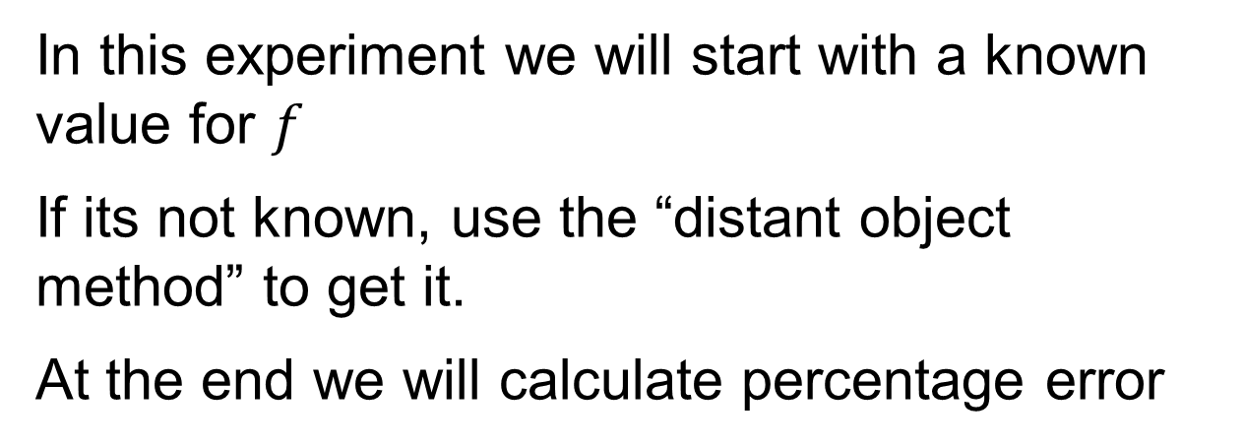



Experiment to Verify $\frac{1}{f}=\frac{1}{u}+\frac{1}{v}$
Object
Image
$$u$$
$$v$$
In this experiment we will start with a known value for $f$
If its not known, use the “distant object method” to get it.
At the end we will calculate percentage error

Slide 40


find $f$ using a distant object
Image of Tree
Screen
Distant object
Convex Lens
Create an image of a distant object on a screen. Move screen until image is sharp. Measure distance from screen to centre of lens.
$$f$$
Meter stick
If you know the exact focal length, use that value in the percentage error calculations.

Slide 41
find u and v
Image of cross thread
Cardboard screen
cross thread (object)
Convex Lens
Light
u
v
Meter stick

Slide 42
Alternative setup using a small LED
Image of LED
Convex Lens
LED
u
v
Cardboard screen

Slide 43
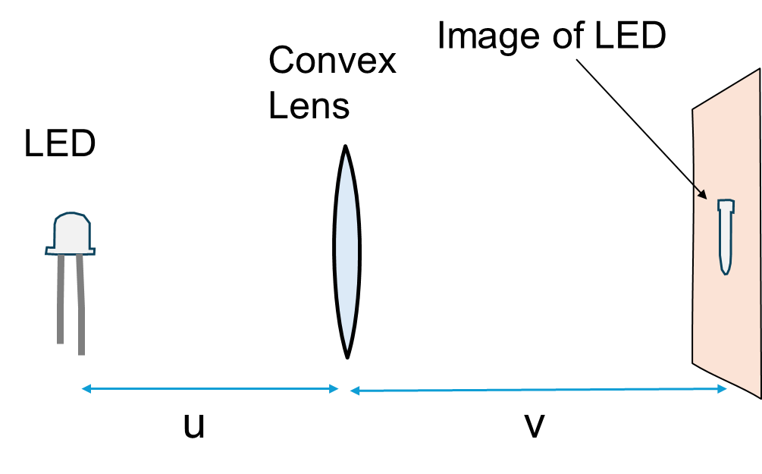
Find u and v
Create an image of a bright object on the screen
Move the screen until image is sharp.
Measure and record u and v
Repeat for different values of u
Note, when we get a sharp image we can say that it is “in focus”. This does NOT mean it is “at the focus” (its not)

Slide 44

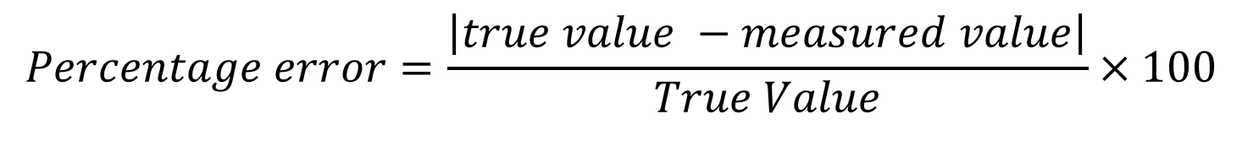







Data and calculations
$$\frac{1}{u}$$
$$\frac{1}{v}$$
$$\frac{1}{u}+\frac{1}{v}$$
$$\frac{1}{f}$$
$$f \\ (cm)$$
$$\% error$$
$$u (cm)$$
$$v (cm)$$
$$Percentage error=\frac{\left|true value −measured value\right|}{True Value}×100$$
If f is not given, use the value that you measured using a distant object as the true value.

Slide 45
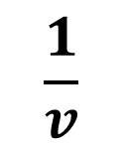
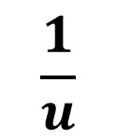
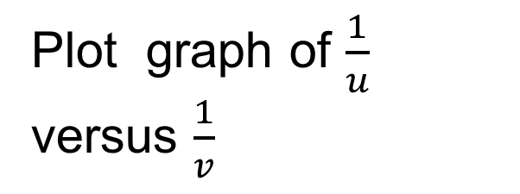
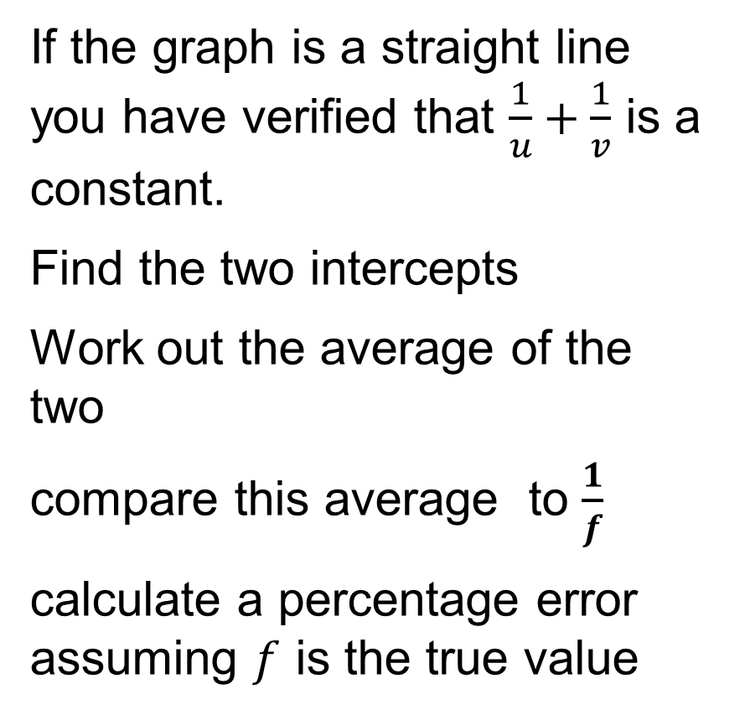
Graph
Plot graph of $\frac{1}{u}$ versus $\frac{1}{v}$
If the graph is a straight line you have verified that $\frac{1}{u}+\frac{1}{v}$ is a constant.
Find the two intercepts
Work out the average of the two
compare this average to $\frac{1}{f}$
calculate a percentage error assuming $f$ is the true value
$$\frac{1}{u}$$
$$\frac{1}{v}$$

Slide 46
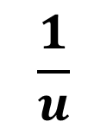
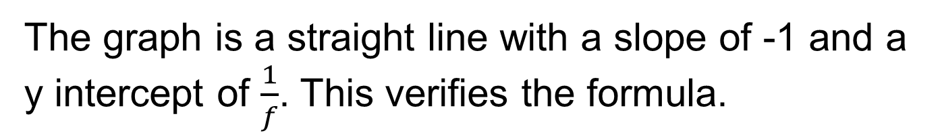
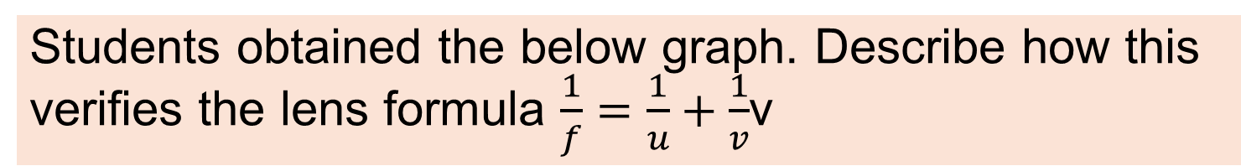
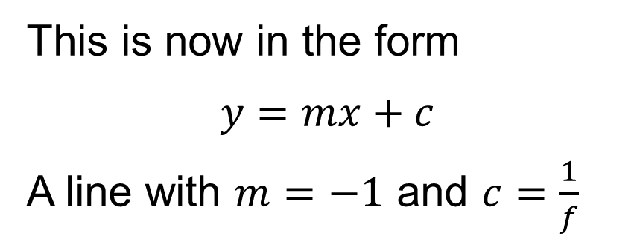
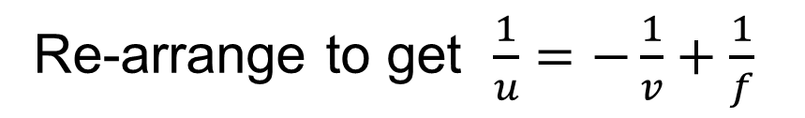
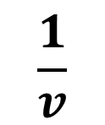
Example
Students obtained the below graph. Describe how this verifies the lens formula $\frac{1}{f}=\frac{1}{u}+\frac{1}{v}$v
$$\frac{1}{u}$$
Re-arrange to get $\frac{1}{u}=−\frac{1}{v}+\frac{1}{f}$
This is now in the form
$$y=mx+c$$
A line with $m=−1$ and $c=\frac{1}{f}$
$$\frac{1}{v}$$
The graph is a straight line with a slope of -1 and a y intercept of $\frac{1}{f}$. This verifies the formula.

Slide 47
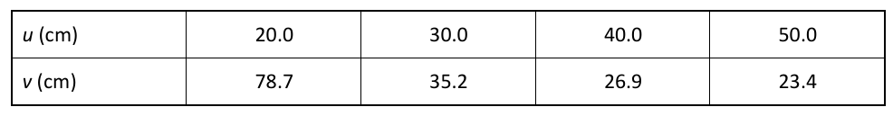


Exercise with Secondary Data
In an experiment to verify the lens formula students obtained the following data using a lens of focal length 16 cm. Use this data to draw a graph that verifies the formula and state how
the graph verifies the
formula
$$\frac{1}{u}$$
0.05 0.0333 0.025 0.02
$$\frac{1}{v}$$
0.0127 0.0284 0.0372 0.0427

Slide 48
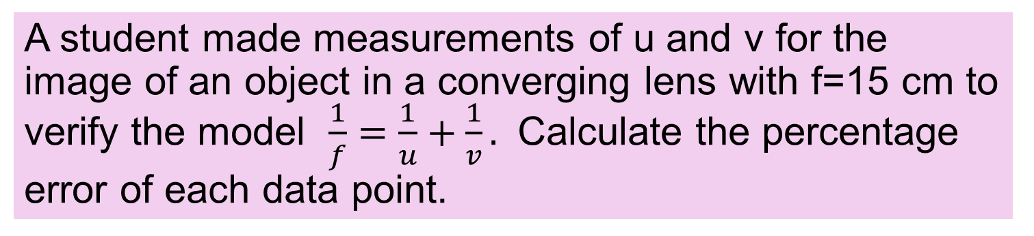

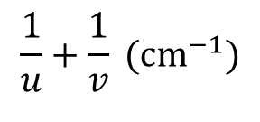
Exercise with Secondary Data
A student made measurements of u and v for the image of an object in a converging lens with f=15 cm to verify the model $\frac{1}{f}=\frac{1}{u}+\frac{1}{v}.$ Calculate the percentage error of each data point.
u (cm)
20
30
40
v (cm)
56.2
30.3
24.1
$$\frac{1}{u}+\frac{1}{v} ({cm}^{−1})$$
0.0665
0.0678
0.0663
$$\frac{1}{f} (cm^{−1})$$
0.0667
0.0667
0.0667
% error
1.8%
0.6%
0.3%

Slide 49
Diverging lenses

Slide 50
What type of image do you get with diverging lenses?
Always virtual
Always diminished
Always upright

Slide 51
Ray Diagram for diverging lenses
Object
F
Virtual Image

Slide 52
Ray 1: To the optic centre
Where does it go?
Goes straight on
Object
F

Slide 53
Ray 2: Parallel to axis
Where does it go
As if it came from the focus
Object
F

Slide 54
Do any rays intersect?
No
Extend this ray backwards to where it appears to come from.
What do you do?
Object
F

Slide 55
The image is at the intersection
Object
F
Image

Slide 56
Why do we say the image is virtual
Because the rays do not actually diverge from points on the image (they only appear to)
Object
F
Image

Slide 57
Diverging lens summary
Object
f
f
Image
The Image is always:
Virtual, Upright and Diminished and on the same side as the object.
Always always always always

Slide 58

Lens formula – diverging lens
$$\frac{1}{u}+\frac{1}{v}=\frac{1}{f}$$
f is negative for a diverging lens
v is negative (virtual image)
u = Object distance v = Image distance

Slide 59
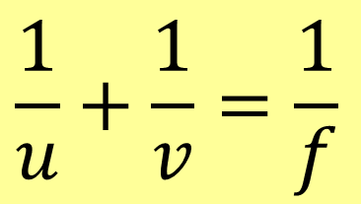
Negatives in the lens formula
1. u is always positive
2. f is negative if the lens is diverging
3. v is negative if it’s a virtual image
The formula in the tables has no negative signs.
$$\frac{1}{u}+\frac{1}{v}=\frac{1}{f}$$
Use the formula in the tables.

Slide 60
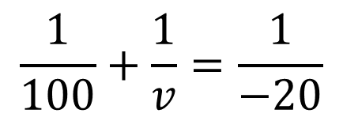

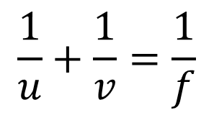


Example
Diverging lenses are used in doors to allow house occupants see who is outside. A man is standing 1 m away from such a lens. The lens has a focal length of 20 cm, How far from the lens will his image appear?
$$\frac{1}{u}+\frac{1}{v}=\frac{1}{f}$$
$$\frac{1}{100}+\frac{1}{v}=\frac{1}{−20}$$
$$diverging lens means f is negative$$
$$\frac{1}{v}=−\frac{1}{20}−\frac{1}{100}=\frac{−5−1}{100}$$
$$v=−\frac{100}{6}=−16.6 cm$$
$$negative⇒virtual$$

Slide 61
Exercise
A diverging lens has a focal length of 20 cm. An object is placed 15 cm from the lens,
calculate how far the image will be from the lens.
Is the image real or virtual.
Tip: recall that f is negative for diverging lenses
-8.57 cm
Virtual image

Slide 62

Exercise
A diverging lens has a focal length of 20 cm.
What distance from the lens will an image of the moon form.
Justify your answer
-20 cm
Use $u=∞$
OR
“parallel beams appear to diverge from the focus”
Virtual image

Slide 63

Exercise
In an experiment to verify the lens formula $\frac{1}{f}=\frac{1}{u}+\frac{1}{v}$ for a diverging lens, u and v were measured for different arrangements (v was determined using the “no parallax” method). Use the data obtained to calculate the focal length of the lens at each data point. Use the calculations to check if the formula has been verified.
u (cm) | 10.0 | 20.0 | 30.0 | 40.0 | 50.0
v (cm) | -6.1 | -8.5 | -10.0 | -11.0 | -11.4
-15.64, -14.78, -15.00, -15.17, -14.77 cm

Slide 64
summary of expected images
Converging (convex)
Real (u>f) or virtual (u<f)
Upright when virtual
Inverted when Real
Diverging (concave)
Always virtual
Always upright
Always diminished

Slide 65
Use of Optics

Slide 66
Cameras

Slide 67
Phone camera (simplified)
Real inverted image on a screen with millions of photo sensors (3 or 4 per pixel)
Converging lens

Slide 68
Exercise
A phone is to have two cameras, one for normal shots and one is a 3x telephoto (creates an image 3 times the height).
Indicate where the focus is on the telephoto lens.
F
Telephoto Lens
Answer: Where the top ray crosses the axis of the lens

Slide 69
Exercise
Engineers are designing a phone with 5x lens. A prism will help to create the “long lens” needed for telephoto. The below diagram is incorrect. Re-draw the prism correctly so the image will appear on the sensor.
Prism drawn incorrectly
Sensor
Search for “Periscope smartphones”.

Slide 70
The Eye
Ciliary muscle
Cornea
Lens
Retina
Iris
Optic nerve

Slide 71
How is light focused on the Retina?
The eye is a double lens consisting of the cornea, and the lens just behind it.
The focal length of the lens can be changed using the ciliary muscle. This allows the eye to focus on near or distant objects.
Ciliary muscle
Cornea
Lens
Retina
Iris
Optic nerve

Slide 72




Long sighted Short sighted
CC0
CC0
CC0
CC0

Slide 73
What does Short Sighted mean?
A Short-Sighted person can focus on nearby objects but not distant objects.
CC0

Slide 74
What kind of lens can correct short-sightedness?
Short-Sight can be corrected with a Diverging Lens (concave)
Cannot focus on distant objects
A concave lens allows you to focus

Slide 75
What does Long Sighted mean
A Long-Sighted person cannot see nearby objects clearly.
Some (but not all) can see distant objects clearly.
CC0
CC0

Slide 76
What kind of lens can correct Long-sight?
Long-Sight can be corrected with a converging Lens (convex)
Long sight
Cannot focus on near objects
Focus corrected with convex lens

Slide 77

Laser surgery
Treating long slightness
In laser thermal keratoplasty, a ring of concentric burns is made in the cornea, which causes its surface to steepen, allowing better near vision.
ReLEx SMILE a femtosecond laser is used to make a small incision and to create a pre-calculated mini lens tissue (or lenticule) inside the cornea.^{[13]}
Wikipedia

Slide 78

2015 12 b

Slide 79

Marking scheme

Slide 80
Exercise
Draw a ray diagram to find the image of the arrow in the plane mirror. Use your diagram to show that the image is the same size as the object.

