Slide 1
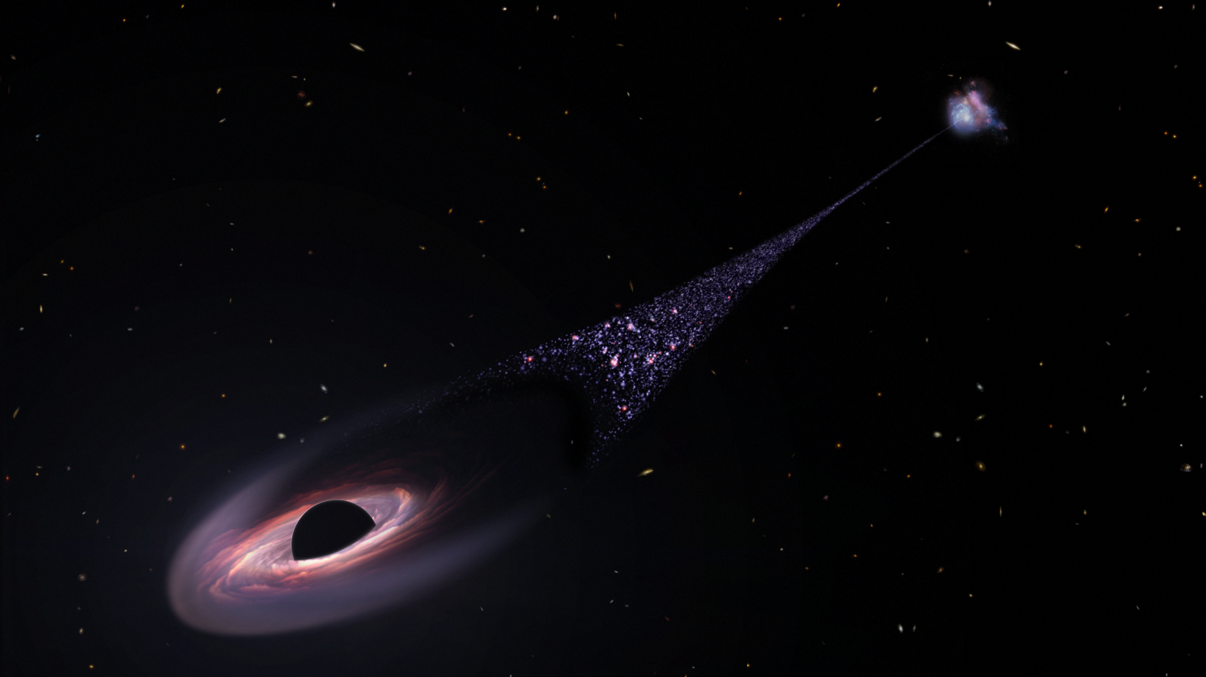
Gravity
CC0
A black hole produces an intense gravitational field

Slide 2
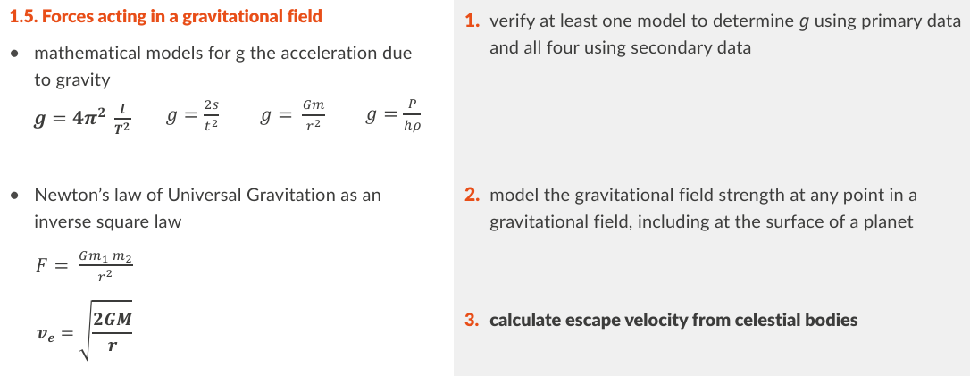
Physics specification 1.5 Forces acting in a gravitational field (slide 1 of 3)
1. verify at least one model to determine g using primary data and all four using secondary data

Slide 3
continued
2. Model the gravitational field strength at any point in a gravitational field, including at the surface of a planet

Slide 4
continued
3. calculate escape velocity from celestial bodies

Slide 5
Physics specification 1.5

Slide 6
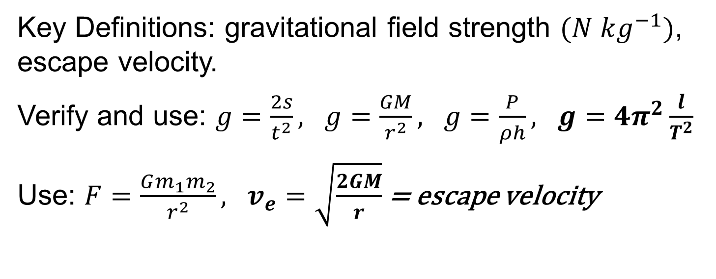
Revision Summary
Key Definitions: gravitational field strength $(N kg^{−1})$, escape velocity.
Verify and use: $g=\frac{2s}{t^{2}}, g=\frac{GM}{r^{2}}, g=\frac{P}{ρh}, g=4π^{2}\frac{l}{T^{2}}$
Use: $F=\frac{Gm_{1}m_{2}}{r^{2}}, v_{e}=\sqrt{\frac{2GM}{r}}$ = escape velocity

Slide 7
What is gravity?
The force of attraction between bodies that have mass.
Gravity is one of the 4 fundamental forces of nature.
At the centre of our galaxy there is a black hole which is 4 million times as massive as the Sun.
We don’t fall in because we are orbiting this black hole.

Slide 8
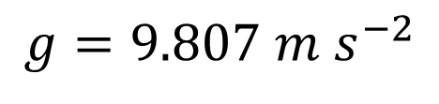
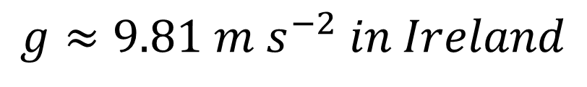
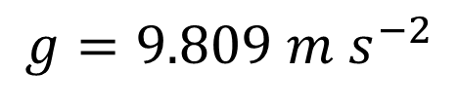
Recap: What is g?
The acceleration due to gravity
$$g≈9.81 m s^{−2} in Ireland$$
g differs from place to place:
Carrauntoohil
$$g=9.807 m s^{−2}$$
Sea level Kerry
$$g=9.809 m s^{−2}$$

Slide 9
Recap: What does F = ma refer to
Force = mass x acceleration
It’s a special case of Newton’s second law

Slide 10

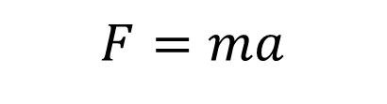


Write g in terms of F and m
$$F=ma$$
$$∴F=mg$$
$$∴mg=F$$
$$∴g=\frac{F}{m}$$
So, g = Force per unit mass
g = “gravitational field strength”
Note: later we will study “electric field strength”. This is the force per unit charge. Notice the similarity.

Slide 11
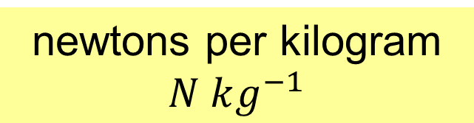
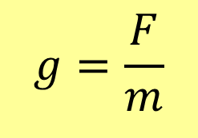
What is meant by gravitational field strength?
The force experienced per unit mass at a point in a gravitational field.
1 kg
9.8 N
$$g=\frac{F}{m}$$
Formula & Notation
2 kg
19.6 N
What are the units?
newtons per kilogram $N kg^{−1}$
1 kg
Vector or scalar?
Vector

Slide 12
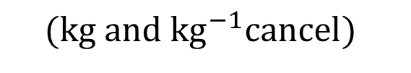
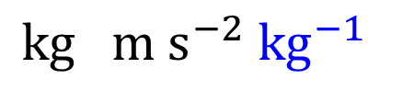
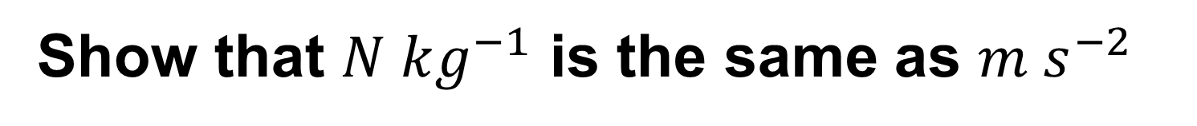
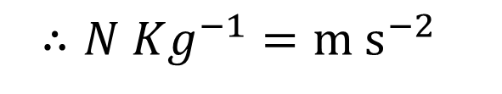
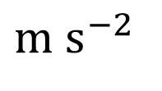


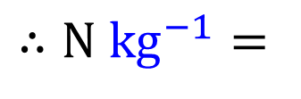


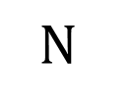

Show that $N kg^{−1}$ is the same as $m s^{−2}$
$$F=ma$$
$$∴$$
$$N$$
$$=$$
$$kg$$
$$m s^{−2}$$
$$∴N kg^{−1}=$$
$$kg m s^{−2} {kg}^{−1}$$
$$(divide by kg)$$
$$∴N Kg^{−1}=m s^{−2}$$
$$(kg and {kg}^{−1}cancel)$$

Slide 13
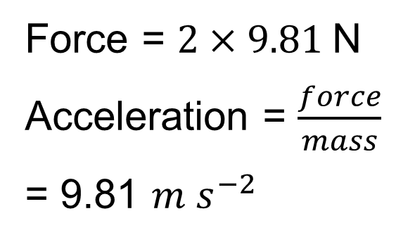
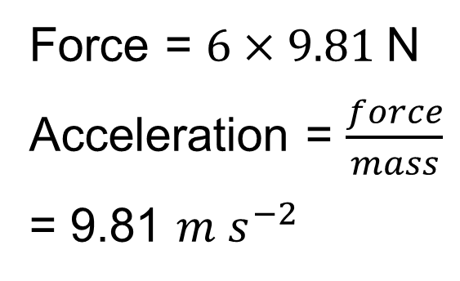
Why does acceleration due to gravity not depend on mass?
2 kg
6 kg
19.6 N
58.9 N
Force = $2×9.81$N
Acceleration = $\frac{force}{mass}$
= 9.81 $m s^{−2}$
Force = $6×9.81$N
Acceleration = $\frac{force}{mass}$
= 9.81 $m s^{−2}$

Slide 14
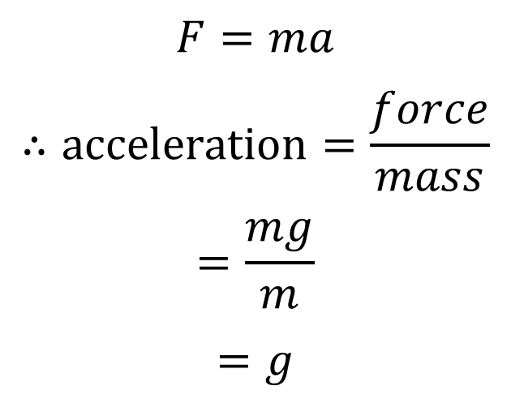
Why does acceleration due to gravity not depend on mass?
$$F=ma$$
$$∴acceleration=\frac{force}{mass}$$
$$=\frac{mg}{m}$$
$$=g$$

Slide 15
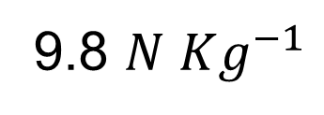
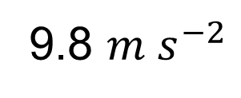
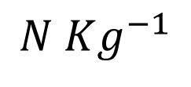
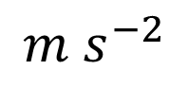
What are the two units used for g?
$$m s^{−2}$$
$$N Kg^{−1}$$
1 kg
9.8 N
1 kg
9.8 $m s^{−2}$
9.8 $N Kg^{−1}$

Slide 16
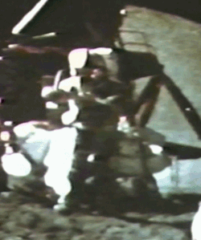
Hammer and Feather
If you drop a hammer and a feather on earth, the hammer will hit the ground first because air resistance slows the feather.
In a vacuum, both will reach the ground together.
This is because the acceleration is the same for both.
CC0
NASA, Apollo 15, Dave Scott drops a hammer and a feather.

Slide 17




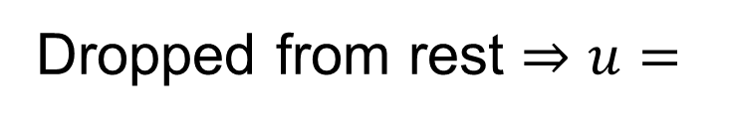

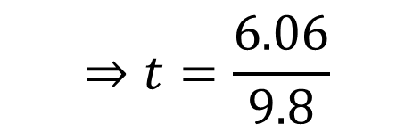

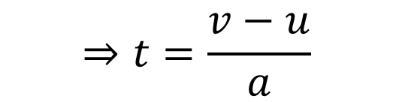


Example
A ball is dropped from 2 meters.
(i) What is its speed just before it lands,
(ii) how long did it take to fall.
(i)
Dropped from rest $⇒u=$
(ii)
$$0$$
$$v=u+at$$
$$v^{2}=u^{2}+2as$$
$$v^{2}=0^{2}+2(9.8)(2)$$
$$⇒t=\frac{v−u}{a}$$
$$v^{2}=39.2$$
$$v=\sqrt{39.2}$$
$$⇒t=\frac{6.06}{9.8}$$
$$v=6.06 m s^{−1}$$
$$=0.618 s$$

Slide 18




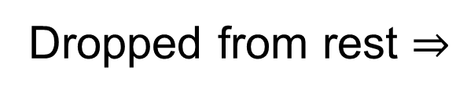

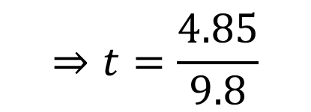

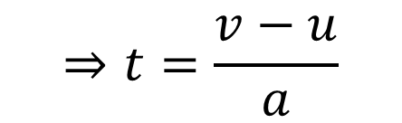
Exercise
A brick is dropped from 1.2 meters.
(i) What is its speed just before it lands,
(ii) how long did it take to fall.
(i)
Dropped from rest $⇒$
$$u=0$$
(ii)
$$v=u+at$$
$$v^{2}=u^{2}+2as$$
$$v^{2}=0^{2}+2(9.8)(1.2)$$
$$⇒t=\frac{v−u}{a}$$
$$v^{2}=23.52$$
$$v=\sqrt{23.52}$$
$$⇒t=\frac{4.85}{9.8}$$
$$v=4.85 m s^{−1}$$
$$=0.495 s$$

Slide 19
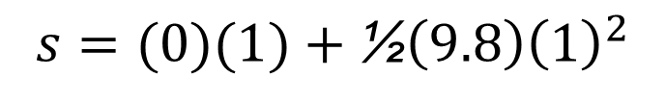
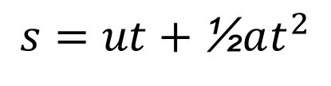

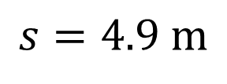
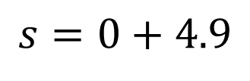
Example
From what height should you drop a steel ball so that it takes 1 second to reach the ground.
$$let s=height$$
$$s=ut+\text{½}at^{2}$$
$$s=(0)(1)+\text{½}\left(9.8\right){\left(1\right)}^{2}$$
$$s=0+4.9$$
$$s=4.9 m$$

Slide 20





Example
From what height would you drop an object so that it takes 250 ms to reach the ground?
$$let s=height$$
$$s=ut+\text{½}at^{2}$$
$$s=(0)(1)+\text{½}\left(9.8\right){\left(0.25\right)}^{2}$$
$$s=0+0.306$$
$$s=0.306 m$$

Slide 21

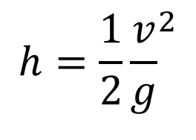

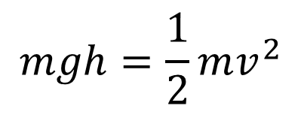




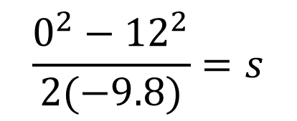
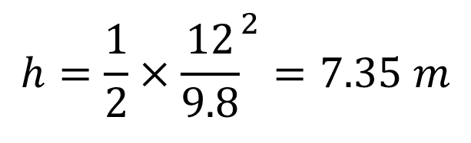
Example
A ball is projected upwards with an initial velocity
of 12 m s⁻¹. Find the maximum height it reaches.
$$let s=height$$
$$What is the velocity v at the greatest height?$$
$$v=0$$
Using conservation of energy:
$$v^{2}=u^{2}+2as$$
$$E_{p}=E_{k}$$
$$v^{2}−u^{2}=2as$$
$$mgh=\frac{1}{2}mv^{2}$$
$$\frac{v^{2}−u^{2}}{2a}=s$$
$$h=\frac{1}{2}{\frac{v}{g}}^{2}$$
$$\frac{0^{2}−{12}^{2}}{2(−9.8)}=s$$
$$h=\frac{1}{2}×{\frac{12}{9.8}}^{2}=7.35 m$$
$$s=7.35 m$$

Slide 22

Example
A ball is projected upwards with an initial velocity
of 5 m s⁻¹. Find the maximum height it reaches.
$$s=1.28 m$$

Slide 23
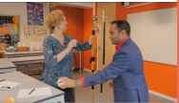
Video: g by freefall
https://www.youtube.com/watch?v=fcT_zUb3wis

Slide 24


Verify $g=\frac{2s}{t^{2}}$ by the Free Fall method
Measure s from bottom of ball to top of trap-door
Time is from release of ball to when it hits the trap-door
Release mechanism to start timer
Steel ball
$$s$$
Start
Meter stick
0000 ms
Trap door
Stop
Electronic timer

Slide 25
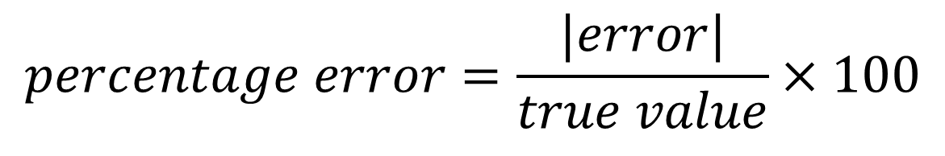
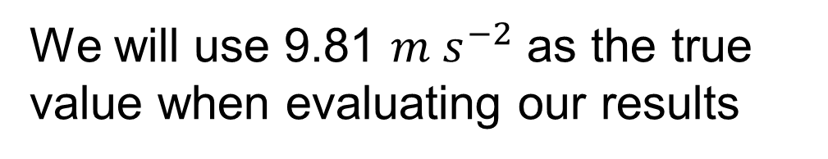
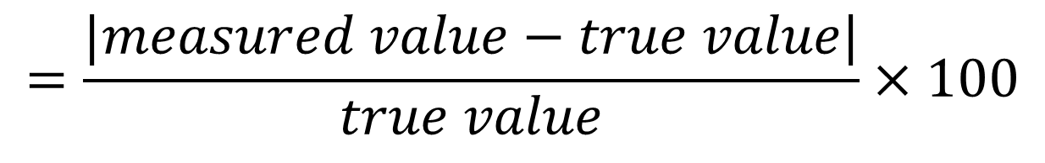
Recap: Write a formula for percentage error
$$percentage error=\frac{|error|}{true value}×100$$
$$=\frac{|measured value−true value|}{true value}×100$$
We will use 9.81 $m s^{−2}$ as the true value when evaluating our results

Slide 26

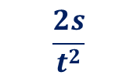
Data and analysis
Drop height
s (meters)
Time t (seconds)
$$t^{2}$$
$$\frac{2s}{t^{2}}$$
% error
Make many measurements with s ranging from 20 cm to a meter or more

Slide 27
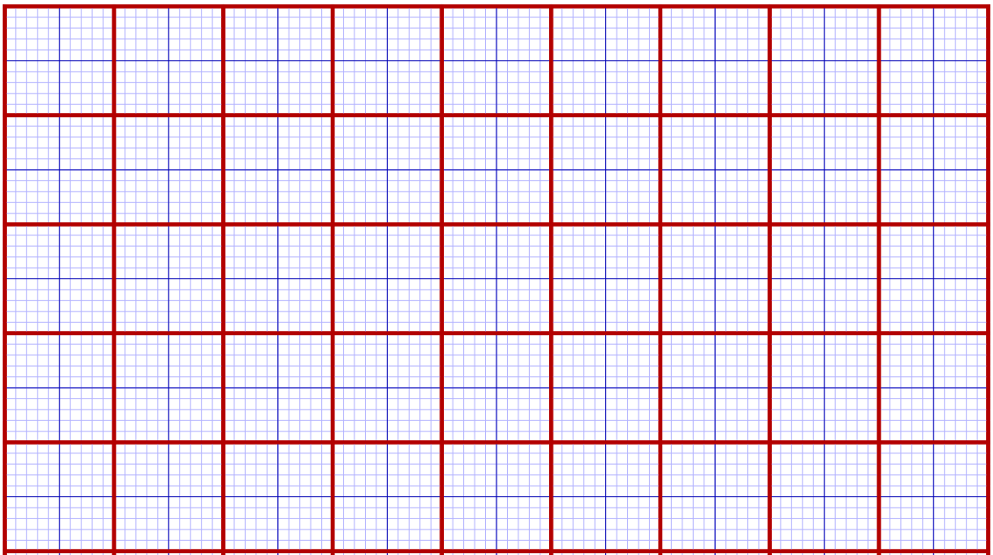
Drawing a suitable graph

Slide 28
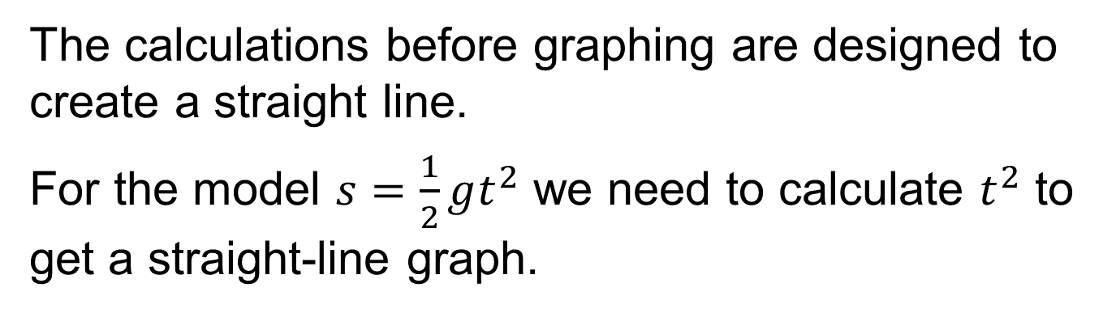
What is meant by a Suitable Graph?
If you are using a graph to verify a model, then a suitable graph is a straight-line graph.
The calculations before graphing are designed to create a straight line.
For the model $s=\frac{1}{2}gt^{2}$ we need to calculate $t^{2}$ to get a straight-line graph.

Slide 29
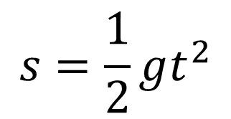
What do you get if you graph s vs t for freefall?
A non-linear graph
s(m)
$$s=\frac{1}{2}gt^{2}$$
t(s)

Slide 30

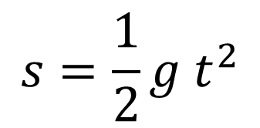

How do you get a linear graph?
Use $t^{2}$ instead of t
s(m)
$$s=\frac{1}{2}g t^{2}$$
$$t^{2}(t in seconds)$$

Slide 31



How do you get g from slope?
$$s=\frac{1}{2}g t^{2}$$
s(m)
This is the slope
$$⇒slope=\frac{1}{2}g$$
$$⇒g=2×slope$$
$$t^{2}(t in seconds)$$

Slide 32


Scaling the graph
s (m)
This is a good scale
Labels on the axes
Easy to use
Big enough
Max s = 1.2 m
Max $t^{2}$ = 0.24 $s^{2}$
1.2
1.0
0.8
0.6
0.4
0.2
0
0.1
0.2
0.3
0
$$t^{2}(t in seconds)$$

Slide 33

Bad Scale
s (m)
What is wrong with this scale?
1.2
Max s = 1.2
Max $t^{2}$ = 0.24
0.9
Difficult to use, e.g. 0.8 or 1.0 are not on the lines
0.6
0.3
0
0
0.1
0.2
0.3
$$t^{2}(t in seconds)$$

Slide 34
Why is this scale difficult?
0.9
Where do you put 0.8 ?
0.8 is between two lines and not even mid-way between them.
0.6

Slide 35
Another bad scale
s (m)
What is wrong with this scale?
1.2
Max s = 1.2
Max $t^{2}$ = 0.24
1.0
Doesn’t include (0,0)
0.8
0.6
0.4
0.2
0.3
0.1
$$t^{2}(t in seconds)$$

Slide 36
Plotting the graph
s (m)
Mark the points accurately.
Carefully with a long transparent ruler, draw a straight line with points on either side.
1.2
1.0
0.8
0.6
0.4
This is the line of best fit.
0.2
0
0.1
0.2
0.3
0
$$t^{2}(t in seconds)$$

Slide 37


Find the slope
s (m)
Pick points that you did not measure and far apart.
e.g. (0, 0) and (0.2, 0.97)
1.2
1.0
0.8
(0.2, 0.97)
Write $m=\frac{y_{2}−y_{1}}{x_{2}−x_{1}}$
0.6
0.4
$$⇒m=\frac{0.97−0}{0.2−0}$$
slope =4.85
0.2
(0, 0)
0
0.1
0.2
0.3
0
$$t^{2}(t in seconds)$$

Slide 38



Get g from slope
s (m)
The equation is
$$s= ½gt²$$
slope =4.85
Is in the form
$$y=mx+c$$
1.2
1.0
$$⇒slope=½g$$
$$⇒g=2×slope$$
$$⇒g=2×4.85$$
$$⇒g=9.7 m s^{−2}$$
0.8
0.6
0.4
0.2
0
0.1
0.2
0.3
0
$$t^{2}(t in seconds)$$

Slide 39

How does the graph verify the model
We have graphed s vs $t^{2}$ and our graph is a straight line through the origin with a slope approximately = $\frac{1}{2}g$
This verifies the model $s= ½gt²$

Slide 40






Summary of a good graph
$$s$$
Calculations (e.g. $t^{2}$)
Labels e.g. $s(metres)$.
Use a scale that is easy to use
(never go up in 3’s)
Make your graph big
Line of best fit,
points above and below
Slope $=\frac{y_{2}−y_{1}}{x_{2}−x_{1}}$ (points not in the table)
$$t$$
$$t^{2}$$
$$s(m)$$
4
2
0
$$t^{2}(s^{2})$$

Slide 41


conclusion
How does your graph verify the model $g=\frac{2s}{t^{2}}$
We graphed $s vs t^{2}$ and obtained a straight line through the origin. This verifies that $s$ is proportional to $t^{2}$ ($s∝t^{2}$)
The slope of our graph $≈\frac{g}{2}$
combining these observations verifies the model $g=\frac{2s}{t^{2}}$

Slide 42








Verify $g=\frac{P}{ρh}$
Theory
$$P=ρgh$$
This applies to fluids including air
Air pressure increases as you go down
$$P_{0}$$
$${P−P}_{0}=ρgh$$
$$h$$
$$⇒g=\frac{{P−P}_{0}}{ρh}$$
$$P$$
$ρ$ is the density of the atmosphere. It varies from day to day. We can use a typical value of $1.2 kg m^{−3}$ or read a more accurate value from a pressure / density graph.

Slide 43

Method
Phyphox app to measure pressure
Use the phyphox app on a phone or tablet to measure air pressure.
Measure height and air pressure at different heights (e.g. going down the stairs).
$$h$$
Note that phyphox gives readings in hPa. Multiply this by 100 to get SI units of Pa.

Slide 44









Method
$$P_{0}$$
$$h=0$$
Metre stick
$$h=1$$
$$h=2$$
Measure $h$ from highest point
$$h=3$$
$$h=4$$
Measure $P$ at each point
Calculate $P−P_{0}$ at each point

Slide 45



Data and calculations
Pressure at top level $P_{0}: ____________________$
Density of air (from air density graph) $ρ: _____________$
Height (m)
Pressure (Pa)
${P−P}_{0}$ (Pa)
$$\frac{{(P−P}_{0})}{ρh}$$
$$(m s^{−2})$$
% error

Slide 46



Graph
$${P−P}_{0}$$
(Pa)
$h$ (metres)
If the graph is a straight line with $slope =ρg$, you have verified the model

Slide 47

Sources of error
Air pressure variations
Air density variations (see air density graph)
$h$ measurements

Slide 48


Handling of variables
Describe how variables were handled.
Our independent variable was the height ($h$) of air causing the pressure difference. $h$ was the vertical distances below the $P_{0}$ point.
The dependant variable is the pressure difference caused by this depth of air. This was calculated by subtracting $P_{0}$ from our measurement.
Air density and temperature should be kept constant for valid results. We did the experiment over a short period of time in order to minimise natural variations in air temperature and density.

Slide 49



Air density (ρ)
Use this graph to determine air density $ρ$ on the day
$$air density ρ in kg m^{−3}$$
10°C
14°C
18°C
1.25
22°C
1.20
1.15
$$air pressure in kPa$$
1.10
95
100
105
The Engineering ToolBox (2003). Air Density, Specific Weight, and Thermal Expansion Coefficients at Varying Temperatures and Pressures. [online] Available at: https://www.engineeringtoolbox.com/air-density-specific-weight-d_600.html [28/10/2025]

Slide 50

conclusion
How does your graph verify the model $g=\frac{P}{ρh}$ ?
We graphed $P vs h$and obtained a straight line through the origin.
The slope of our graph $≈ρg$
combining these observations verifies $g=\frac{P}{ρh}$

Slide 51




Measure Altitude using the air pressure sensor on your phone
pressure sensor
Equation
$$P_{2}−P_{1}=ρgh$$
$$P_{2}$$
Use $ρ=1.2 kg m^{−3}$
$$h$$
Using the above devise a way to measure altitude difference say between your home and school or when you climb a mountain.
$$P_{1}$$

Slide 52


The Simple Pendulum
For a small angle of swing a Simple Pendulum can be used to measure the acceleration due to gravity.
$$l$$
A “simple pendulum” is one where the mass is concentrated at the end.
$$θ$$
The formula used only works well for small angles, e.g. less than 5°

Slide 53


Write the Pendulum equation
For small swing angles:
$$T =2π \sqrt{\frac{l}{g}}$$
$$l$$
T = Period of pendulum,
l = Length of pendulum,
(point of suspension to centre of gravity of the bob)
g = Acceleration due to gravity.
Centre of gravity = centre of bob

Slide 54



Why a small angle?
The equation $T=2π\sqrt{\frac{l}{g}}$ is based on the approximation:
$θ≈\sin{θ}$
when $θ$ is small
$$l$$
$$θ$$

Slide 55





Why a small angle?
Complete this table:
degrees
$$sin⁡(θ)$$
$θ$ radians
% error
1°
0.017452
0.017453
0.0057%
5°
0.087156
0.087267
0.13%
$$l$$
10°
20°
$$θ$$
remember: 1° = $\frac{2π}{360}=0.017453 radians$
Note: A large angle causes a systematic error. The impact is similar to the error calculated here.
10°
0.17364
0.17453
0.51%
20°
0.34202
0.34907
2.1%

Slide 56




Rearrange to get g
$$T =2π \sqrt{\frac{l}{g}}$$
$$l$$
$$T^{2}=\frac{4π^{2}l}{g}$$
$$g=4π^{2}\frac{l}{T^{2}}$$
So, we need to measure $l and T$
Centre of gravity = centre of bob

Slide 57

Verify $g=4π^{2}\frac{l}{T^{2}}$ for a simple pendulum
Key points
Split cork
Measure to the centre of the ball.
Time about 50 cycles
Small swing angle
40 cm minimum length
Split cork
Fixed anchor
l
Thread
Timer
0:24
bob

Slide 58



Results and calculations
Length (m)
50 T
$$T$$
$$T^{2}$$
$$\frac{4π^{2}l}{T^{2}}$$
% error

Slide 59






Graph
Plot $l vs T^{2}$
$l(metres$)
$$g=4π^{2}\frac{l}{T^{2}}$$
$$g=4π^{2}×slope$$
$T^{2}$ $(T in seconds)$
The graph is a straight line passing through the origin.
and $4π^{2}(slope)$ $≈g$. This verifies the model.

Slide 60

Questions
Why time so many oscillations?
Between what two points is $l$ measured
Why use a small angle of swing
Why is a smooth metal ball used

Slide 61


Acceleration due to Gravity “g” Typical exam questions

Slide 62


Acceleration due to Gravity “g” Typical exam questions
A small, dense ball was used as an object in this experiment, State and agvantage of using this type of ball.

Slide 63

Newton’s law of universal gravitation
$$F=\frac{Gm_{1}m_{2}}{d^{2}}$$

Slide 64




State Newton's Law of Universal Gravitation
The force between two bodies is proportional to product of masses and is inversely proportional to distance squared. HL 2019, 2025
$$F∝\frac{m_{1}m_{2}}{d^{2}}$$
Equation and Notation
$$m_{2}$$
$$m_{1}$$
$$d$$

Slide 65



Combine the two proportionalities
$$F∝\frac{1}{d^{2}}$$
$$F∝m_{1}m_{2}$$
and
$$⇒ F∝\frac{m_{1}m_{2}}{d^{2}}$$

Slide 66


Add the gravitation constant: G
$$F∝\frac{m_{1}m_{2}}{d^{2}}$$
Let the constant of proportionality = G
$$⇒ F=\frac{Gm_{1}m_{2}}{d^{2}}$$

Slide 67







State Newton’s law of Gravitation as a formula
$$m_{1}$$
$$m_{2}$$
$$F$$
$$F$$
$$d$$
$$F=\frac{Gm_{1}m_{2}}{d^{2}}$$
$F$= Force between bodies
$G$ = Universal gravitation constant
$m_{1},m_{2}$ = magnitude of two masses
$d$ = distance between centres

Slide 68


Relate Newtons 3rd law to Gravitation
Force on each mass is the same.
1
$$F$$
Earth
$$F$$
Sun
Earth pulls the Sun with the same force the Sun pulls the earth
2
Man pulls the earth up with the same force as the earth pulls the man down!

Slide 69


From where does the gravitational force appear to act?
The gravitational force appears to act from the centre of mass of a body.
$$d$$
$d$ is measured between the centres
Every particle in a body creates its own gravity but the net effect from the outside is as if it is all centred at one point.

Slide 70
More about G
G is the Universal Gravitation Constant
Universal because it's considered to the same everywhere in the universe.
G = 6.7 × 10⁻¹¹ N m² kg⁻².
(its very small and hard to measure)
Formula book page 46

Slide 71
Consequence of G being so small
In Nuclear Physics, despite the great “density” of the particles, gravitational forces between particles is negligible.
Why do we say nuclear particles like the neutron and the proton have great density?
Because an atom is mostly empty space and thus all the mass is concentrated in the nucleus.

Slide 72

What is meant by an Inverse Square Law?
$$F∝\frac{1}{d^{2}}$$
thus:
If distance is doubled the force decreases by a factor of 4.
If distance is increased by a factor of 10, the force decreases by a factor of 100.
Note: Light and sound intensities and electrostatic forces also follow an inverse square law.

Slide 73



Work out the units for G.
The Units for G can be found by re-arranging the equation
$$F = \frac{G m_{1} m_{2}}{d^{2}}$$
$$⇒ G = \frac{Fd^{2}}{m_{1}m_{2} }$$
Units = $N m^{2} kg^{−2}$

Slide 74
What causes planetary orbits?
The force of gravity combined with the velocity of the planets keeps the planets in orbit around the Sun.
Without the force of gravity, they would travel in a straight line.

Slide 75
Recap
State Newton’s Law of gravitation
Write the equation for this law.
Where is d measured between?
Give 2 properties of gravitation.
What is G?, where is it in the tables?
Is G big or small?
Describe an inverse square law.
If the distance between two objects is made 3 times bigger, by how much does the force of gravity change?
Work out the units for G

Slide 76






Example
Use $F=\frac{Gm_{1}m_{2}}{d^{2}}$ to find the gravitational force on 1 kg at the surface of the Earth.
Mass of Earth=$6×{10}^{24}kg$
Radius = $6.4×{10}^{6}m$
$$G=6.7×{10}^{−11} N m^{2} kg^{−2}$$
$$F=\frac{Gm_{1}m_{2}}{d^{2}}=$$
$$\frac{6.7×{10}^{−11}×6×{10}^{24}×1}{{(6.4×{10}^{6})}^{2}}=$$
$$9.81 N$$
or
$$mg=9.81 N$$

Slide 77




Example
Henry Cavendish was the first to accurately measure the gravitational force between two masses (1798). His two masses were a 0.73 kg lead ball and a 158 kg lead ball. Calculate the force between these balls when they are 210 mm apart.
$$G=6.7×{10}^{−11} N m^{2} kg^{−2}$$
$$F=\frac{Gm_{1}m_{2}}{d^{2}} =$$
$$1.75×{10}^{−7}N$$
158 kg
0.73 kg
Cavendish devised a way to measure this tiny force. He had to enclose his apparatus in an air-tight room and use a telescope to take the measurements.
CC0

Slide 78



Exercise
Find the gravitational attraction between a Tungsten sphere of mass 158 kg and another of mass 0.73 kg placed 180 mm apart.
$$G=6.7×{10}^{−11} N m^{2} kg^{−2}$$
$$F=\frac{Gm_{1}m_{2}}{d^{2}} =\frac{6.7×{10}^{−11}\left(158\right)\left(0.73\right)}{{\left(0.18\right)}^{2}}$$
$$=2.38×{10}^{−7}N$$
Note, Tungsten has a higher density than lead, thus modern replicas of Cavendish’s experiment use tungsten to allow a smaller separation between masses and thus a bigger force.

Slide 79




Exercise
Find the gravitational attraction between the earth and the moon.
Mass of Earth: 5.97×10²⁴ kg.
Mass of moon 7.35×10²² kg.
Average Earth-Moon distance: 384 000 km.
$$G=6.674×{10}^{−11} N m^{2} kg^{−2}$$
$$F=\frac{Gm_{1}m_{2}}{d^{2}}$$
$$F=\frac{6.674×{10}^{−11}\left(\text{5.97}\text{×}\text{10²⁴}\right)\left(\text{7.35}\text{×}\text{10²²}\right)}{{\left(\text{384 000}\text{ 000}\right)}^{2}}$$
$$=1.986×{10}^{20} N$$

Slide 80
Exercise
Which force diagram best represents the gravitational force of attraction between earth and the moon. Justify your answer.
A
B
C
Earth
Moon
A by Newton’s third law

Slide 81




Derive an expression for g
Planet
Mass M
$$g=force per unit mass$$
$$F=\frac{GMm}{d^{2}}$$
d
$$now g=\frac{F}{m}$$
Object mass m
$$∴g=\frac{GM}{d^{2}}$$
Tables p56

Slide 82




Is g a constant?
$$g=\frac{GM}{d^{2}}$$
No, it depends on where you are
9.8 on surface
Decreases as you move away
Earth
$$\frac{9.8}{4}$$
$$\frac{9.8}{9}$$
$$\frac{9.8}{16}$$
9.8
g is inversely proportional to the square of the distance from the centre of the planet.
Centre of mass

Slide 83

g in other places
Surface of Moon g = 1.6 N kg⁻¹
surface of the Sun g = 274 N kg⁻¹
Space station g = 8.6 N kg⁻¹
CC0 penubag
TV satellite g = 0.224 N kg⁻¹
(geostationary)

Slide 84
Differences in “g” at earth’s surface
In general, g is higher at the poles than at the equator due to the bulging of the Earth.
North Pole, 9.83 N kg⁻¹
Equator 9.78 N kg⁻¹
CC0 penubag
g is also lower at high altitude
(e.g. Mt Everest: g = 9.77 N kg⁻¹ )

Slide 85


$$g_{0}$$
Sometimes the notation $g_{0}$ is used for standardised gravity. It’s an average value for gravity at Earth’s surface $=9.806 m s^{−2}$.
$$g_{0}=9.806 m s^{−2}$$
CC0 penubag

Slide 86




Example
Find the acceleration due to gravity on the moon. Mass of moon =7.35×10²² kg, Radius of moon = 1.74×10⁶ m.
$$g = \frac{G M}{d^{2}}$$
Tables p56
$$\frac{6.67×{10}^{−11}×7.35×{10}^{22}}{{(1.74×{10}^{6})}^{2}}=1.62 m{ s}^{−2}$$
How much does 1 kg weigh on earth and on the moon?
Weight = mg
On Earth:
On the Moon:
$$Weight=mg=9.8 N$$
$$Weight=mg=1.62 N$$

Slide 87

Example
Uranus has a mass of 8.7 × 10²⁵ kg and a radius
of 25 400 km.
Calculate the acceleration due to gravity on Uranus.
$g=\frac{G M}{d^{2}}=9. 0 m s^{−2}$

Slide 88




Example
Find the acceleration due to gravity 900 km above the earth. Mass of Earth = 5.97×10²⁴ kg.
Radius of Earth =6.38×10⁶ m.
$$900 km=900000 m$$
$$d=900 000+6 380 000$$
$$=7.28×{10}^{6} m$$
900 km
d
$$g_{900}= \frac{GM}{d^{2}}$$
R
F&T p56
$$=\frac{6.7×{10}^{−11}×5.97×{10}^{24}}{{(7.28×{10}^{6})}^{2}}$$
$$=7.5 m{ s}^{−2}$$

Slide 89








Example
Find the acceleration due to gravity 900 km above the earth.
Radius of earth = 6.38×10⁶ m,
g on surface = 9.8 m s⁻² $=g_{0}$
$$g_{0}= \frac{GM}{R^{2}}$$
$$g_{0}$$
Multiply above and below by R²
900 km
$$\frac{GMR^{2}}{R^{2}d^{2}}$$
$$g_{900}= \frac{GM}{d^{2}}=$$
d
R
$$g_{900}= g_{0}×\frac{R^{2}}{d^{2}}$$
$$=\frac{(9.8){(6.38×{10}^{6})}^{2}}{{(6.38×{10}^{6}+9×{10}^{5})}^{2}}$$
$$=7.5 m s^{−2}$$

Slide 90






Exercise
g on the moon is 1.6 m s⁻² and the radius of the moon is 1.74 × 10⁶ m. Calculate g at a height of 133 km above the moon.
$$g_{s}=surface gravity$$
$$g_{s}= \frac{GM}{r^{2}}$$
$$g_{133}= \frac{GM}{d^{2}}=\frac{GM}{r^{2}}×\frac{r^{2}}{d^{2}}$$
$$g_{133}=g_{s}×\frac{r^{2}}{d^{2}}$$
$$=\frac{(1.6){(1.74×{10}^{6})}^{2}}{{(1.74×{10}^{6}+1.33×{10}^{5})}^{2}}$$
$$=1.4 m s^{−2}$$

Slide 91






Example
Taking R as the radius of a planet, at what distance from the centre is g exactly half of its value at the surface.
Let g = surface value, thus new value $=\frac{g}{2}$
Let D = distance from Centre
$$g=\frac{GM}{R^{2}}$$
$$\frac{1}{2}g=\frac{GM}{D^{2}} ⇒g=\frac{2GM}{D^{2}}$$
$$⇒\frac{GM}{R^{2}}=\frac{2GM}{D^{2}}$$
R
D
$$⇒{GMD}^{2}=2{GMR}^{2}$$
$$⇒D^{2}=2R^{2}$$
$$⇒D=\sqrt{2}R$$

Slide 92







Exercise
Taking R as the radius of a planet, at what distance above the surface is g exactly half of its value at the surface.
h
R
Let g = surface value, new value $=\frac{g}{2}$
Let h = distance above the planet
$$g=\frac{GM}{R^{2}}$$
$$\frac{1}{2}g=\frac{GM}{{(R+h)}^{2}}$$
$$⇒\frac{GM}{R^{2}}=\frac{2GM}{{\left(R+h\right)}^{2}}$$
$$⇒GM{\left(R+h\right)}^{2}=2GMR^{2}$$
$$⇒R+h=\sqrt{2}R$$
$$⇒h=\sqrt{2}R−R$$
$$⇒h=1.414R−R≈0.414R$$

Slide 93
Example
Draw vectors to represent the gravitational force at these 5 points.
CC0 penubag
All vectors point to the centre of the earth.
Force is weaker further from Earth.

Slide 94
Example
Draw the gravitational field-lines around the Earth.
CC0 penubag

Slide 95
Gravitational Field-lines
Gravitational field-lines show the direction a small mass would move if released from rest at any point in a gravitational field.
Field lines never cross each other.
The field is stronger when the lines are closer together.
Field lines are continuous.
Same direction as the force vectors.
CC0 penubag

Slide 96
Which is correct?
Newton's Law of universal gravitation states that any two point-masses in the universe attract each other with a force that is:
Directly proportional to the product of the 2 masses
and
Inversely proportional to the square of the distance between them.
A
B
Directly proportional to the sum of the 2 masses
and
Inversely proportional to the square of the distance between them.
C
Directly proportional to the sum of the 2 masses
and
Inversely proportional to the distance between them.
A

Slide 97

Verify $g=\frac{GM}{R^{2}}$ using this data
Body | g (m s⁻²) | M (kg) | R (km)
Earth | 9.81 | 5.972×10²⁴ | 6 371.0
Moon | 1.627 | 7.346×10²² | 1 737
Sun | 275 | 1.9885×10³⁰ | 695 700
Jupiter | 24.8 | 1.8982×10²⁷ | 71 492
Data Source: Wikipedia.org

Slide 98


Verify $g=\frac{GM}{R^{2}}$
Body | g (m s⁻²) | M (kg) | R (km)
Earth | 9.81 | 5.972×10²⁴ | 6 371.0
Moon | 1.627 | 7.346×10²² | 1 737
Sun | 275 | 1.9885×10³⁰ | 695 700
Jupiter | 24.8 | 1.8982×10²⁷ | 71 492
Method 1: evaluate $\frac{GM}{R^{2}}$ and show it is approximately = g in each case
Method 2: Draw a graph of $g vs\frac{M}{R^{2}}$, verify that it is a straight line with slope = G
Data Source: Wikipedia.org

Slide 99



Method 1: Evaluate $\frac{GM}{R^{2}}$
Calculations
Body | g (m s⁻²) | M (kg) | R (km)
Earth | 9.81 | 5.972×10²⁴ | 6 371.0
Moon | 1.627 | 7.346×10²² | 1 737
Sun | 275 | 1.9885×10³⁰ | 695 700
Jupiter | 24.8 | 1.8982×10²⁷ | 71 492
 | % error
9.82 | 0.1%
1.625 | 0.1%
274 | 0.4%
24.8 | 0.0%
$$\frac{GM}{R^{2}}$$
Conclusion: The calculated values for $\frac{GM}{R^{2}}$ agree closely with the accepted values for g, thus the model $g=\frac{GM}{R^{2}}$ is verified.

Slide 100





Method 2: graph of $g vs\frac{M}{R^{2}}$,
Slope
$$=\frac{270}{4×{10}^{12}}$$
$$=6.75×{10}^{−11}$$
$$≈G$$
Conclusion: The graph of $g vs\frac{M}{R^{2}}$ is a straight line through the origin with a slope of G thus the model $g=\frac{GM}{R^{2}}$ is verified.

Slide 101
Comment
Body | g (m s⁻²) | M (kg) | R (km)
Earth | 9.81 | 5.972×10²⁴ | 6 371.0
Moon | 1.627 | 7.346×10²² | 1 737
Sun | 275 | 1.9885×10³⁰ | 695 700
Jupiter | 24.8 | 1.8982×10²⁷ | 71 492
The chances are that the model we are trying to verify has been used to calculate some of the figures that we used. If this is the case, we have not truly verified the model. On the other hand, the two methods used are valid methods for verifying a model.
g for the moon was measured directly on the Apollo 17 mission.

Slide 102
Ballistic motion

Slide 103
What are the forces on a ball in the air?
There are only two forces:
Air resistance
Weight
There is no force moving the ball from left to right
Don’t draw one!

Slide 104
When can we ignore air resistance?
At low velocities, air resistance is negligible
Air resistance
Weight

Slide 105

How does the weight impact the movement?
Weight
The weight only affects the vertical component of the velocity
$⇒$The Horizontal component does not change

Slide 106


Recap:
draw the vertical and horizontal components of the velocity at these two points
$$v_{1}$$
$$v_{2}$$

Slide 107


Answer:
draw the vertical and horizontal components of the velocity at these two points
Vertical component of $v_{1}$
Horizontal not changed
$$v_{1}$$
$$v_{2}$$
Vertical is changed
Horizontal component of $v_{1}$

Slide 108
For a body in freefall…
The vertical velocity component keeps changing
The horizontal velocity component stays constant

Slide 109
Example
Draw the position of the ball every 0.5 seconds. Ignore air resistance. The first few are done.
Height (metres)
1 s
10
0.5 s
5
Start
5
10
15
20
25
Horizontal distance (metres)

Slide 110
Example
Answer
Height (metres)
1.5 s
1 s
2 s
10
Horizontal
velocity is constant, therefore, each position is the same distance to the right of the previous one (4 squares).
0.5 s
2.5 s
5
3 s
Start
5
10
15
20
25
Horizontal distance (metres)

Slide 111

Example
Estimate the velocity at the highest point.
Velocity at top = horizontal velocity
Height (metres)
$$=8 m s^{−1}$$
1.5 s
1 s
2 s
10
0.5 s
2.5 s
5
3 s
Start
5
10
15
20
25
Horizontal distance (metres)

Slide 112

Example
Estimate from the graph, the vertical component of the initial velocity.
Height (metres)
$$v=\frac{3.5}{0.25}=14 m s^{−1}$$
1 s
10
0.5 s
5
0.25 seconds, 3.5 metres
Start
5
10
15
20
25
Horizontal distance (metres)

Slide 113




Example
If the ball reaches a height of 11.5 m, calculate the vertical component of the initial velocity.
Height (metres)
$$\frac{1}{2}mv^{2}=mgh$$
1 s
$$v=\sqrt{2gh}$$
10
$$v=\sqrt{2\left(9.8\right)\left(11.5\right)}$$
0.5 s
$$v=15.01 m s^{−1}$$
5
Start
5
10
15
20
25
Horizontal distance (metres)

Slide 114



Example
A player kicks a ball at an angle of 43° to the horizontal at an initial velocity of 21 m s⁻¹. Calculate how far the ball will travel horizontally in 2 s.
21 m s⁻¹
43°
Find the horizontal component of the velocity vector
21 m s⁻¹
43°
$$v_{h}$$
$$v_{h}=21\cos{{43}^{o}}=15.36 m s^{−1}$$
The ball moves with constant horizontal velocity while in the air
$$∴s=vt=15.36\left(2\right)=30.7 m$$

Slide 115


Exercise
A hurler hits a sliotar (ball) at an angle of 41° to the horizontal at an initial velocity of 18 m s⁻¹. Calculate how far the sliotar will travel horizontally in 1.3 s.
$$v_{h}=18\cos{{41}^{o}}=13.58 m s^{−1}$$
$$s=vt=13.58\left(1.3\right)=17.7 m$$

Slide 116




Example
If you want to throw something as far as possible you should throw it at an angle of 45°. Calculate how long a ball thrown at 45° with an initial velocity of 15 m/s will be in the air.
15 m s⁻¹
45°
Find the vertical component of the velocity vector
$$u_{v}=15\sin{{45}^{o}}=10.606 m s^{−1}$$
It will be in the air until $v_{v}=−10.606 m s^{−1}$
$$a=\frac{v−u}{t}⇒t=\frac{v−u}{a}⇒t=\frac{−10.606−\left(−10.606\right)}{−9.8}$$
$$t=2.16 s$$

Slide 117



Example
How far will it go?
15 m s⁻¹
45°
Find the horizontal component of the velocity vector
$$u_{h}=15\cos{{45}^{o}}=10.606 m s^{−1}$$
$$t=2.16 s$$
$$s=ut=23 m$$

Slide 118
Escape velocity

Slide 119
Thought experiment:
If you throw a stone up, it comes back down.
If you throw harder, it goes higher but still comes down.
A bullet from a gun pointed upwards would go really high, but it would eventually come back down.
Is there a speed you can shoot something upwards such that it never falls back?
Yes …

Slide 120

What is escape velocity?
It is the minimum velocity required to move away from a celestial body (e.g. planet) without falling back at some point (in the absence of other forces).
$$v=\sqrt{\frac{2GM}{r}}$$
Not in formula book
It is also the theoretical velocity a body will hit the planet if it fell from rest from an infinite distance.

Slide 121

From Earth to the Moon (1865)
In a science fiction novel by French author Jules Verne, a space craft was shot towards the moon from a 270 m long cannon buried in the ground.
The initial velocity out of the cannon was 10.97 km/s.
There was no further propulsion, but the initial velocity was big enough to bring it to the moon.
CC0
engraving from the 1872 illustrated edition

Slide 122



Example
Calculate the escape velocity from Earth using G.
Mass of Earth = $5.97×{10}^{24}$ kg. Radius of earth = $6.38×{10}^{6}$ m
$$v=\sqrt{\frac{2GM}{r}}$$
$$v=\sqrt{\frac{2(6.67×{10}^{−11})(5.97×{10}^{24})}{6.38×{10}^{6}}}$$
$$v=11 200 m s^{−1}$$

Slide 123
Example
Verne used a velocity of 11 000 m/s, but we have calculated escape velocity to be 11 200 m/s. There is general agreement that Verne had a correct velocity for getting to the moon. Suggest a reason why he could be right.
1. Getting as far as the moon is not a complete escape from Earth because the Earth’s gravity still exists at this distance.
2. The gravitational field of the Moon would partly cancel the Earth’s field.

Slide 124
escape velocity is not…
It’s not a constant velocity; it's the initial velocity you must have to escape without further propulsion.
It is not the velocity needed to get into orbit. (It’s bigger).

Slide 125





Write escape velocity in terms of g.
$$v_{e}=\sqrt{\frac{2GM}{r}}$$
$$=\sqrt{\frac{2gr^{2}}{r}}$$
($g=\frac{GM}{r^{2}}$
$⇒GM=gr^{2}$)
$$v_{e}=\sqrt{2gr}$$

Slide 126




An interesting co-incidence…
We have seen$:$
$$\frac{1}{2}mv^{2}=mgh$$
(conservation of energy. Assumes h is small such that g is constant)
$$⇒v=\sqrt{2gh}$$
This looks very similar to the escape velocity formula
$$v_{e}=\sqrt{2gr}$$
r is distance from centre of planet.
Might be a way to remember it.

Slide 127



Example
Calculate the escape velocity from Earth using g.
g = 9.8 m s⁻² . Radius of earth = $6.38×{10}^{6}$ m
$$v=\sqrt{2gr}$$
$$v=\sqrt{2(9.8)(6.38×{10}^{6})}$$
$$v=11 200 m s^{−1}$$

Slide 128



Exercise
Calculate the escape velocity from the moon’s surface.
Radius of moon = 1737 km,
mass of moon 7.35×10²² kg.
$$v=\sqrt{\frac{2GM}{r}}$$
$$v=\sqrt{\frac{2(6.67×{10}^{−11})(7.35×{10}^{22})}{1.737×{10}^{6}}}$$
$$v=2 380 m s^{−1}$$

Slide 129




Exercise
In Verne’s book, the space craft was accelerated to
11 km/s in a 270 m cannon. Calculate the average acceleration within the cannon.
270 m
$$v^{2}=u^{2}+2as$$
$$a=\frac{v^{2}}{2s}$$
(u=0)
Capsule
$$a=\frac{{11000}^{2}}{540}$$
Explosives
$$a=224000 m s^{−2}$$
Crushing the craft and occupants

Slide 130




Exercise
In Verne’s book, the space craft was accelerated to
11 km/s. Calculate the length of cannon needed if the average acceleration is to be kept below 4g.
$$v^{2}=u^{2}+2as$$
$$s=\frac{v^{2}}{2a}$$
(u=0)
$$s=\frac{{11000}^{2}}{2×4×9.8}$$
$$s=1543 000 m$$
1543 km
Such a cannon would have to be built horizontally. This could still work.

Slide 131

Exercise
The event horizon of a black hole is the boundary beyond which events cannot affect an outside observer. At the event horizon the escape velocity is equal to the speed of light. Calculate the radius of the event horizon of a black hole with the mass of Earth.
Mass of Earth = $5.97×{10}^{24}$ kg.
$$v=\sqrt{\frac{2GM}{r}}$$
r = 2GM/c²
r = 9 mm
This radius is called the Schwarzschild radius. If such a black hole exists it would be classed as a micro black hole

Slide 132






Example
Analyse the escape velocity formula using unit analysis. The units for G are in the formula book.
Units for G: $m^{3}kg^{−1}s^{−2}$
$$v=\sqrt{\frac{2GM}{r}}$$
Left hand units:
Right hand units:
$$m s^{−1}$$
$$\sqrt{\frac{m^{3}kg^{−1}s^{−2}kg}{m}}$$
Conclusion:
Left hand units = right hand units
Thus, unit analysis does not indicate any problem with the formula.
$$=\sqrt{m^{2} s^{−2}}$$
$$=m s^{−1}$$

Slide 133
Revision Summary
Key Definitions: gravitational field strength $(N kg^{−1})$, escape velocity.
Verify and use: $g=\frac{2s}{t^{2}}, g=\frac{GM}{r^{2}}, g=\frac{P}{ρh}, g=4π^{2}\frac{l}{T^{2}}$
Use: $F=\frac{Gm_{1}m_{2}}{r^{2}}, v_{e}=\sqrt{\frac{2GM}{r}}$ = escape velocity

Slide 134
0.9
0.8
0.7
0.6
0.5
0.4
0.3
0.2
10 cm
10 cm
0.1
A
B
C
D
E
F
G
H
I
J
K
L
M
Notes:
Background for taking a video of ballistic flight of small ball

