Slide 2
2017 q12
The Use of Mirrors and Lenses by Renaissance Artists

Slide 3
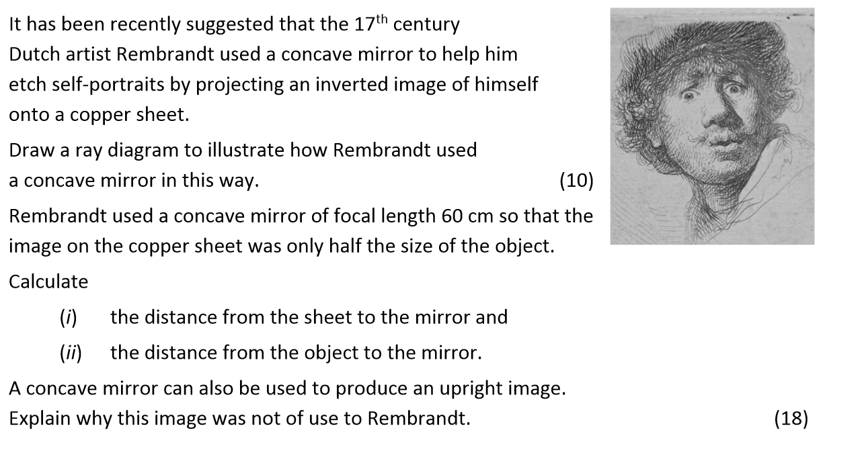
2017 q 12 (c)

Slide 4
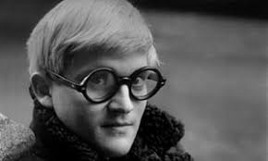
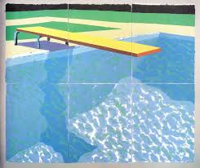
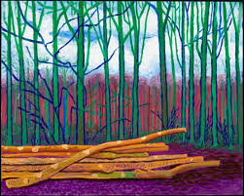
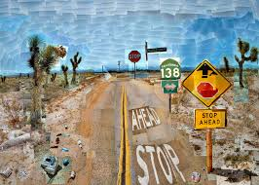
The background…..
David Hockney is a British Artist
Some of his work is shown here
He often wondered how Renaissance artists could paint with almost photographic realism.
He began to examine old artworks…..
David Hockney

Slide 5
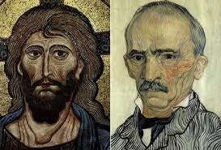
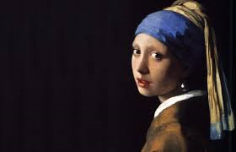
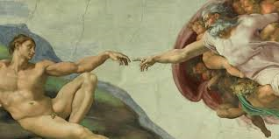
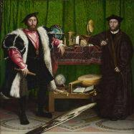
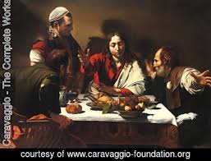
1300s, before realism
1900s, after realism
David Hockney
In between, beginning in the 1400s, extraordinary realism was achieved….

Slide 6

In between, beginning in the 1400s, extraordinary realism was achieved….
The arrival or realistic painting corresponded to the discover of curved mirrors and lenses
He believes the artists were using these to help their painting…..

Slide 7
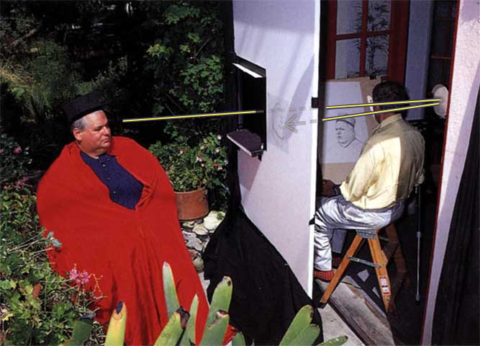
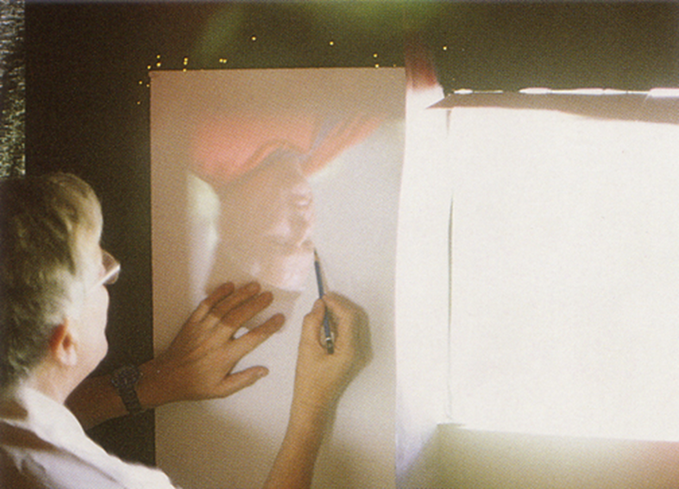
This is how it could have been done…..

Slide 8
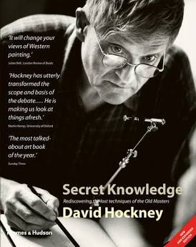
His theory is outlined in his book, Secret Knowledge….
The question from 2017 examines the physics of this theory….

Slide 9
2017 q 12

Slide 10
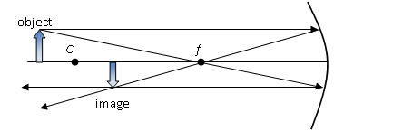
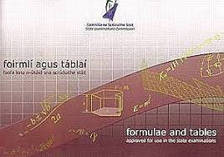
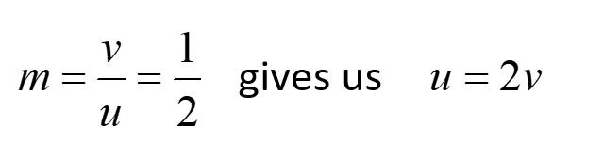
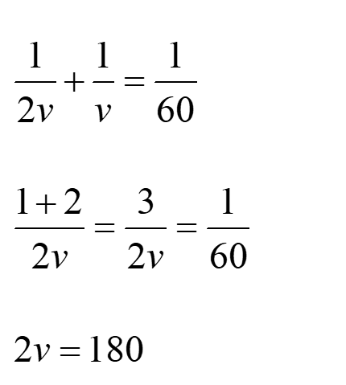
Draw a ray diagram to illustrate how Rembrandt used a concave mirror in this way. (10)
Calculate
(i) the distance from the sheet to the mirror and
(ii) the distance from the object to the mirror.
The sheet would have been 90cm from the mirror
The distance from the object to the mirror would have been 180cm

Slide 11
A concave mirror can also be used to produce an upright image.
Explain why this image was not of use to Rembrandt.
A concave mirror will only produce an upright image when the object is inside the focal length, and this image is always a virtual image. Virtual images cannot be formed on a screen, and therefore would have been no use to an artist.

Slide 12
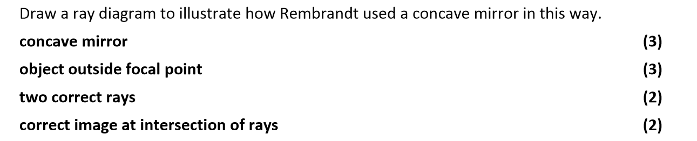
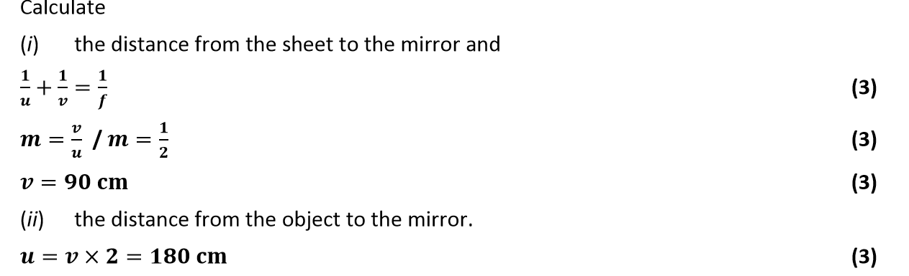
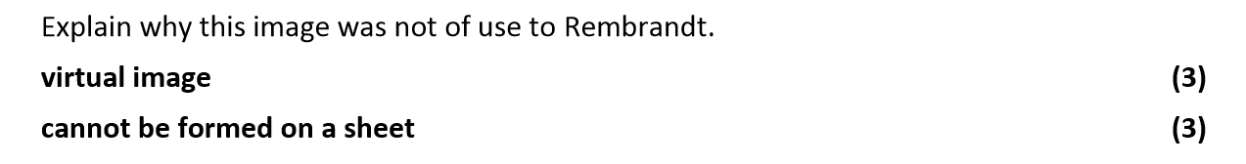
Marking Scheme

