Slide 1
2013 q.12c

Slide 2
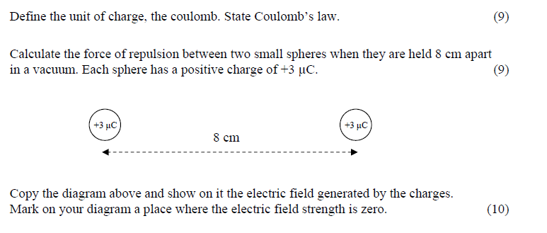
2013 q.12c

Slide 3


Define the unit of charge, the coulomb. State Coulomb’s law.
Coulomb’s Law states the force between two point charges is directly proportional to product of the charges and inversely proportional to the square of the distance between them.
The coulomb?
If a current of one amp is flowing in a conductor, one Coulomb is the quantity of charge that passes any one point in one second.

Slide 4

Calculate the force of repulsion between two small spheres when they are held 8 cm apart in a vacuum. Each sphere has a positive charge of +3 μC.

Slide 5
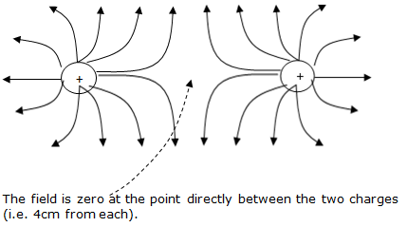
Copy the diagram and show on it the electric field generated by the charges. Mark on your diagram a place where the electric field strength is zero.

Slide 6
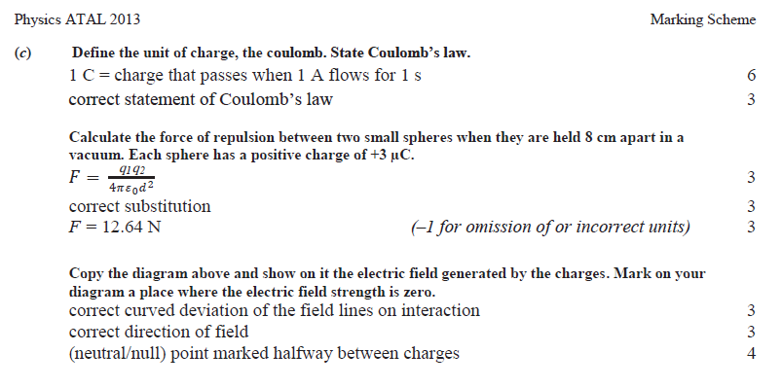
Marking Scheme

