Slide 1
2006 q6

Slide 2
2006 q.6

Slide 3
Define (i) velocity, (ii) angular velocity. (12)
Velocity is speed in a given direction?
Velocity is the rate of change of displacement
Angular velocity, ω, is given by ω = θ / t
(Where θ is the angle through which an object has moved in a given time t )

Slide 4
Derive the relationship between the velocity of a particle travelling
in uniform circular motion and its angular velocity. (12)

Slide 5
Derive the relationship between the velocity of a particle travelling
in uniform circular motion and its angular velocity. (12)
l
θ

Slide 6
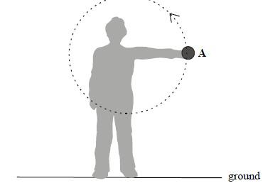
A student swings a ball in a circle of radius 70 cm in the vertical plane as shown. The angular velocity of the ball is 10 rad s^{–1}. What is the velocity of the ball? How long does the ball take to complete one revolution? (9)

Slide 7
A student swings a ball in a circle of radius 70 cm in the vertical plane as shown. The angular velocity of the ball is 10 rad s^{–1}. What is the velocity of the ball? How long does the ball take to complete one revolution? (9)

Slide 8
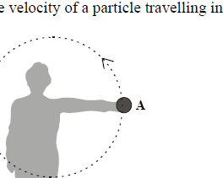
Draw a diagram to show the forces acting on the ball when it is at position A. (6)
Normal reaction
Centripetal force
Weight

Slide 9
The student releases the ball when it is at A, which is 130 cm above the
ground, and the ball travels vertically upwards.
Calculate
the maximum height, above the ground, the ball will reach;
(ii) the time taken for the ball to hit the ground after its release from A. (17)
1.3m

Slide 10
the maximum height, above the ground, the ball will reach;
u =
v =
a =
s =
t =
7
= (7)² + 2(-9.8) s
0
-9.8
S = 2.5m
s
Max ht. = 2.5 +1.3
t
= 3.8 m
1.3m

Slide 11
the time taken for the ball to hit the ground after its release from A.
u =
v =
a =
s =
t =
7
v
-1.30 = 7t - ½(9.8)t ²
-9.8
t = 1.59s
-1.3
t
+
-
1.3m

