Slide 1
Isaac Physics
Mastering Physics by Problem Solving

Slide 2
What is Isaac Physics?
Isaac Physics is a teaching/learning resource designed to help students improve their Physics problem solving skills
It is designed specifically with AfL (Assessment for Learning) in mind
It supports students from all backgrounds
The resource consists mainly of questions, which involve calculations
GCSE Physics translates well to the LC Physics syllabus
It is funded by the DfE (England), with local IOPI support for teachers in Ireland

Slide 3
In Tonight’s Workshop
We review the benefits of Isaac Physics
We show you how to
  Login/register as a student
  Complete an assignment (as a student)
  Login/register as a teacher
  Create a class group
  Set homework/classwork
  Track the progress of your group
  Access online help
  Integrate Isaac Physics into your Physics planning
We facilitate the sharing of views on our experience of Isaac Physics
Notes:
This is a note

Slide 4
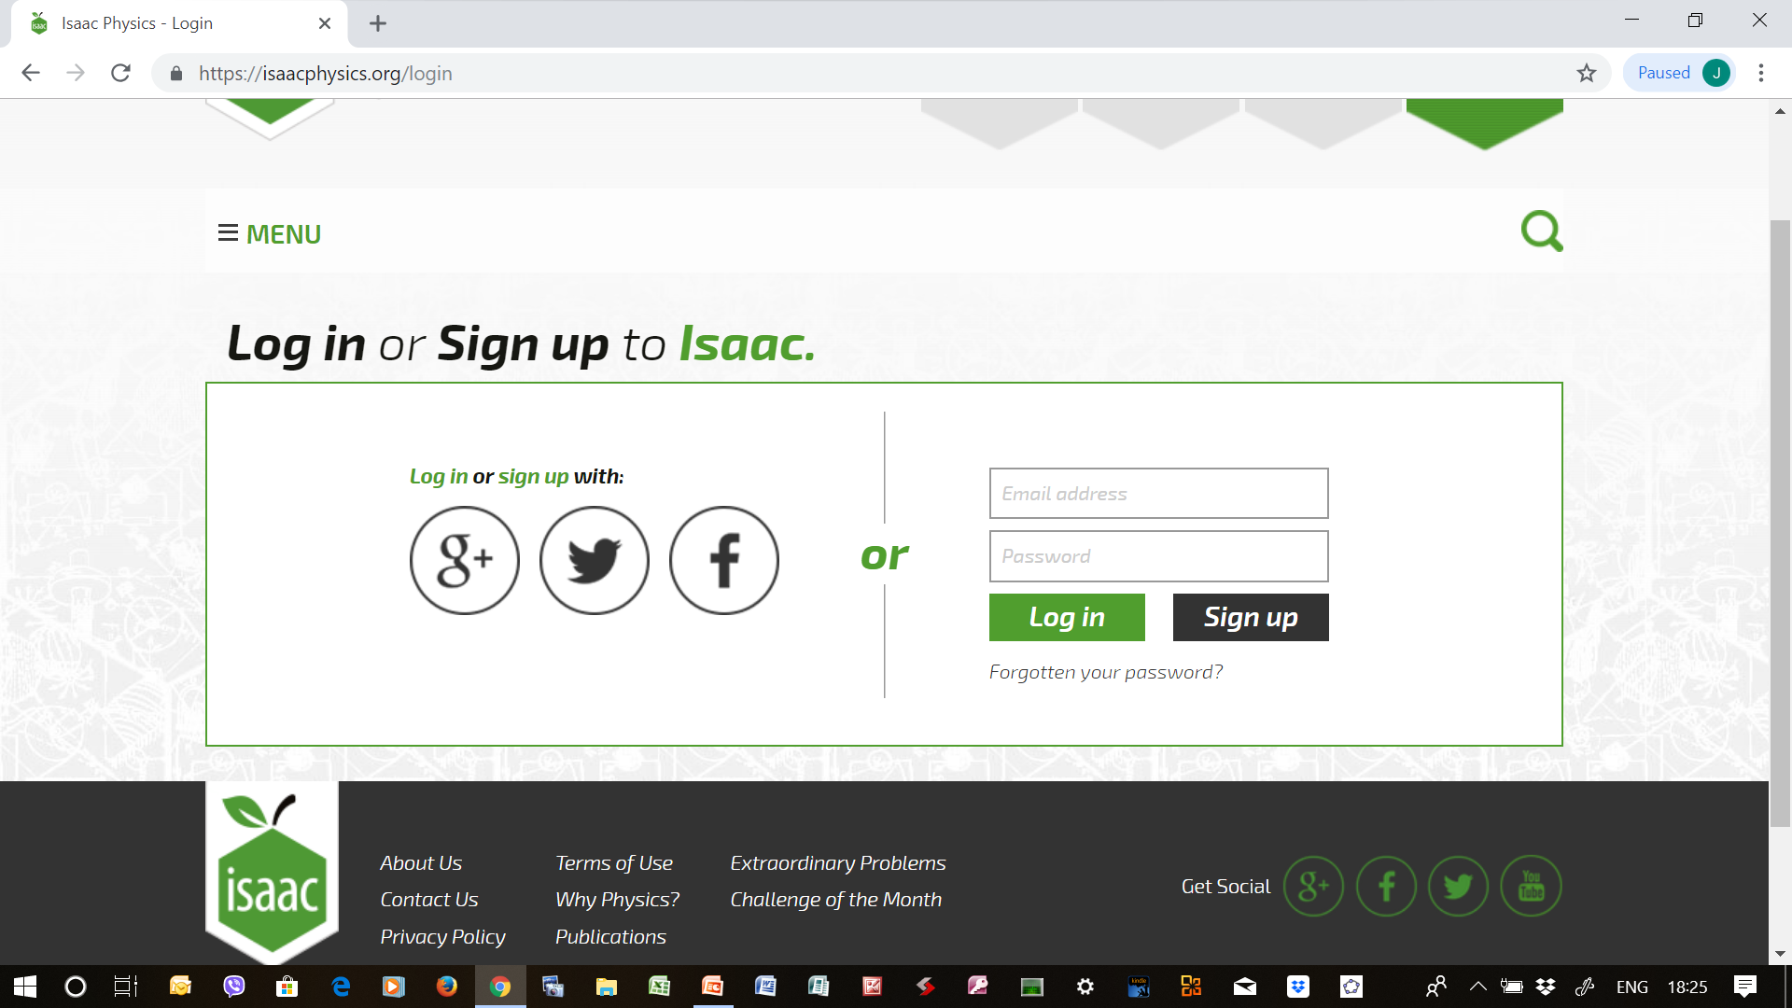
Creating a Student Account
Menu → Login→ Enter email address + password → Signup → Enter personal details → Register Now

Slide 5
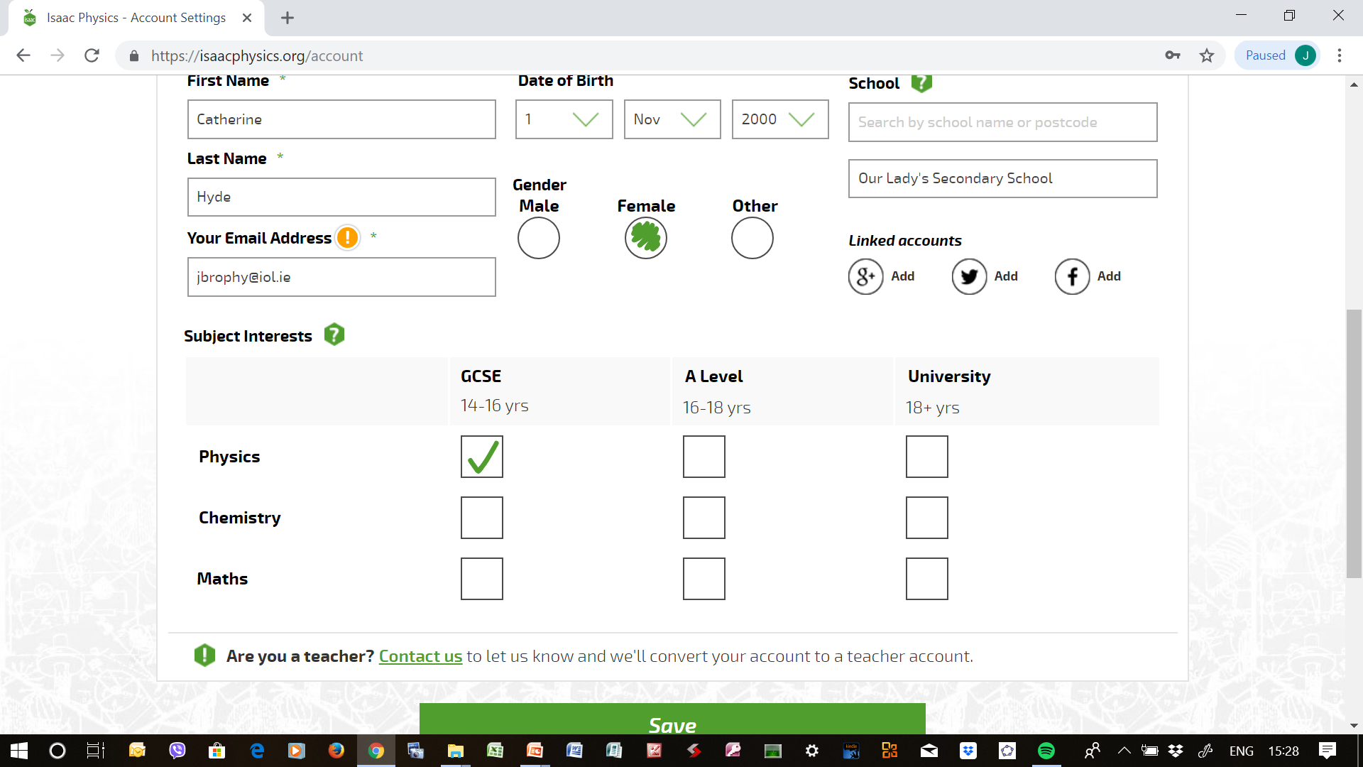
Entering/Modifying Account Details
Menu → My account→ Enter /Modify account details→ Save

Slide 6
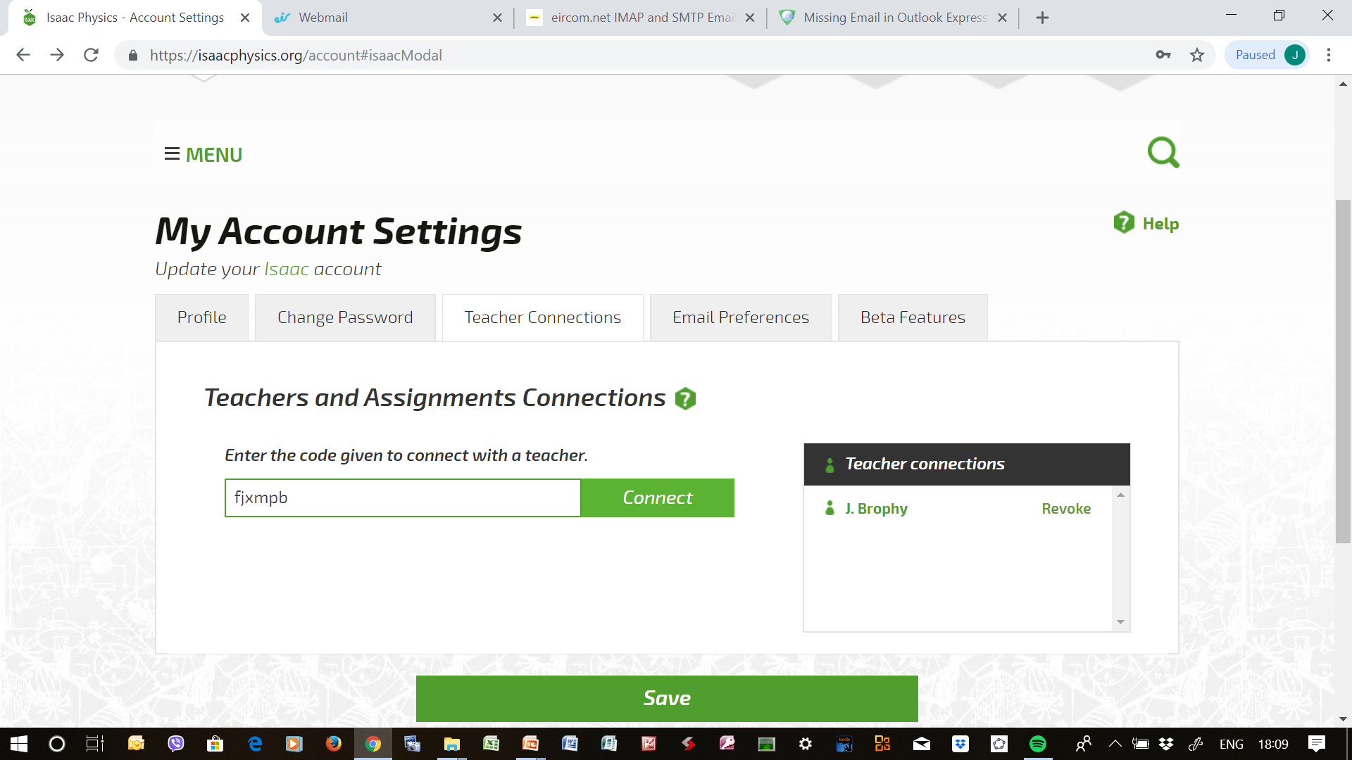
Joining a Group (From Student A/c)
Menu → My Account→ Teacher Connection→ Enter Token → Connect → Confirm → Save

Slide 7
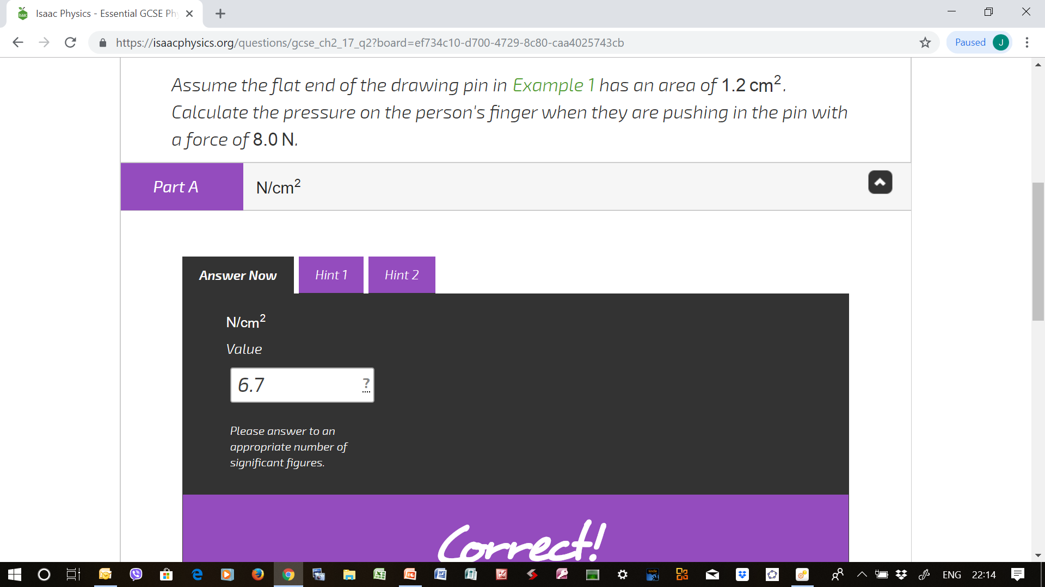
Answering An Assignment
Menu → My Assignments → View Assignment → Choose Hexagon → Answer Question(s)→ Check My Answer (Use Hints if Necessary)

Slide 8
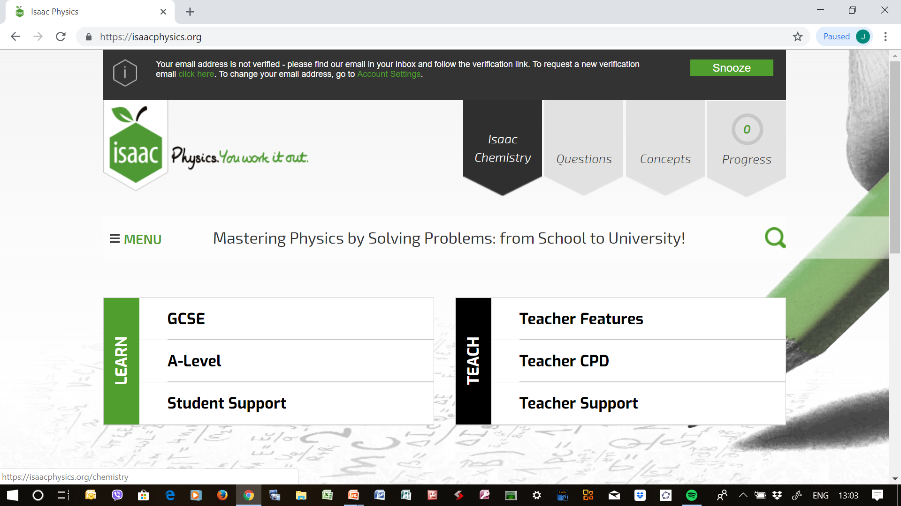
Practising Questions from the Book
GCSE → Click Search Icon→ Enter Question Number in Text Box → Search→ Click on Question → Answer Question → Check My Answer (Use Hints if Necessary)

Slide 9
Creating a Teacher Account
  You can upgrade from a student account to a teacher account.
  You must have a teacher account to enable you to form groups, set assignments and monitor students’ progress
To upgrade to a teacher account, you must request teacher status from Isaac Physics
You can request an upgrade from Student Status to Teacher Status this evening by attempting the assignment given to you earlier by the facilitator
The name of Ally Davies (ally@isaacphysics.org) has been added as a second group manager of this group, so Ally will receive your details when you attempt the assignment
Allow a few days for your account to be updated
Notes:
Teachers should be told to make sure that they meet the conditions for a teacher account, especially:
They enter their name and surname, not Mr or Ms etc for their first name.
They use school issued email address (and they verify it) by clicking the link in the automatic verification email.
They enter the name of their school in their my account page
If they don’t do these things, then we have to ask them to do them before they get upgraded and that adds delay.

Slide 10
Creating a Teacher Account - Notes
Teachers should make sure that they meet the conditions for a teacher account, especially:
  They enter their name and surname, not Mr or Ms, etc., for their first name
  They use a school issued email address, and they verify it by clicking the link in the automatic verification email
  They enter the name of their school in their ‘My Account’ page

Slide 11
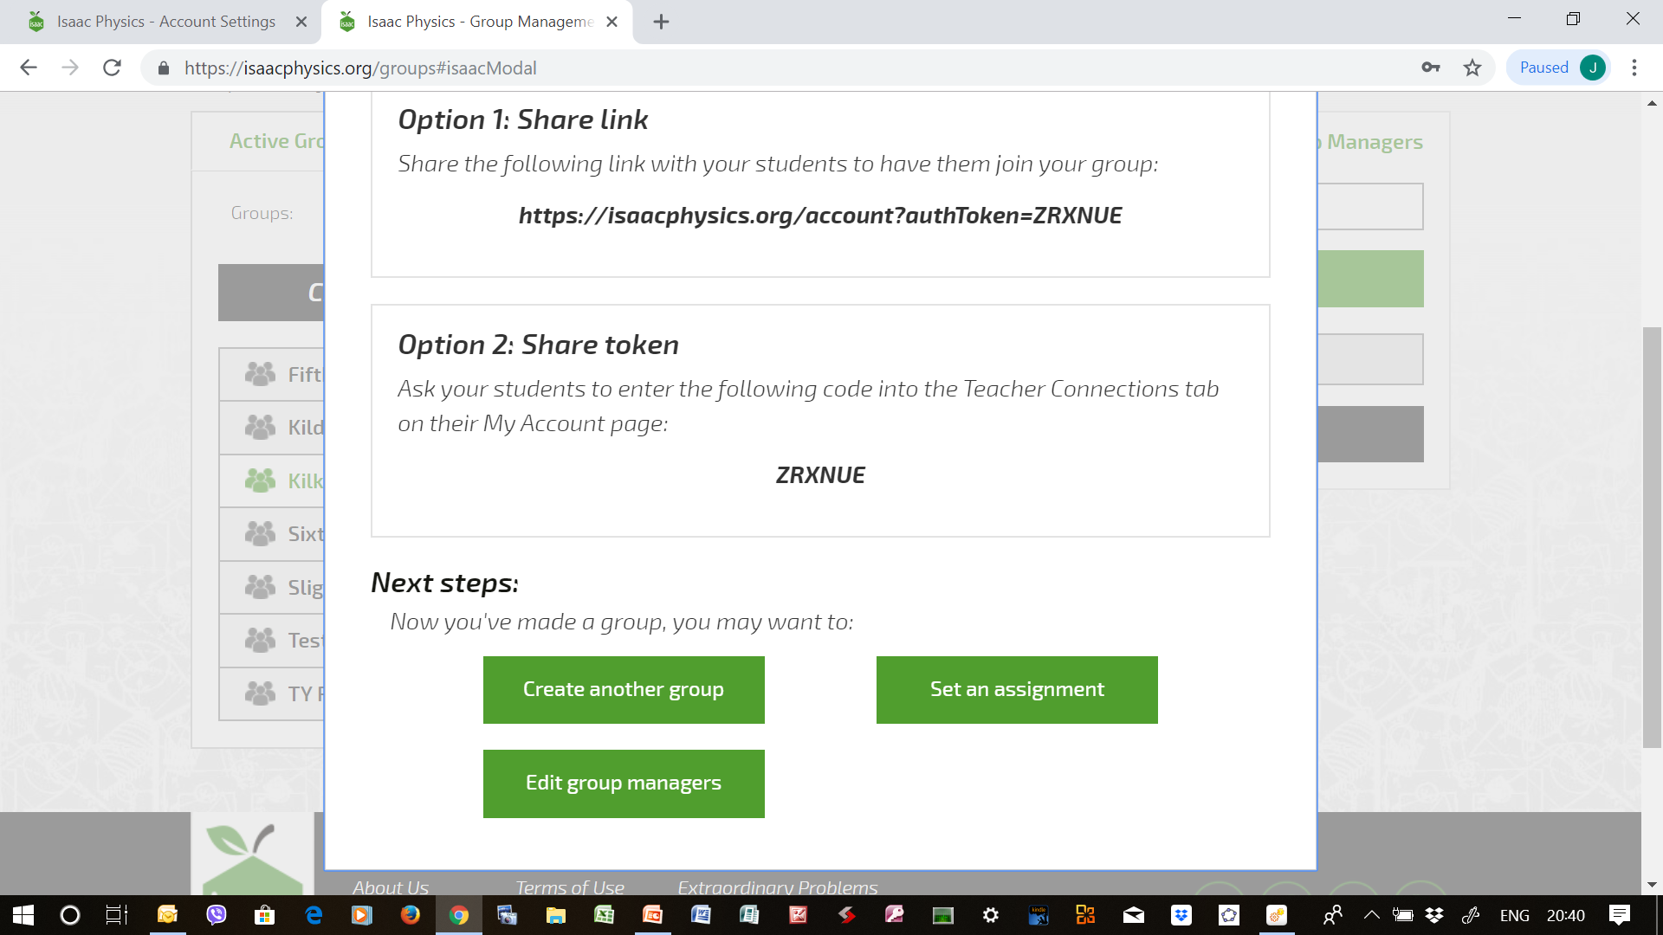
Creating a Group
Menu → Manage Groups → Enter Name of Group → Create → Take Note of Token → Edit Group Managers→ Add ally@isaacphysics.org as a second manager

Slide 12
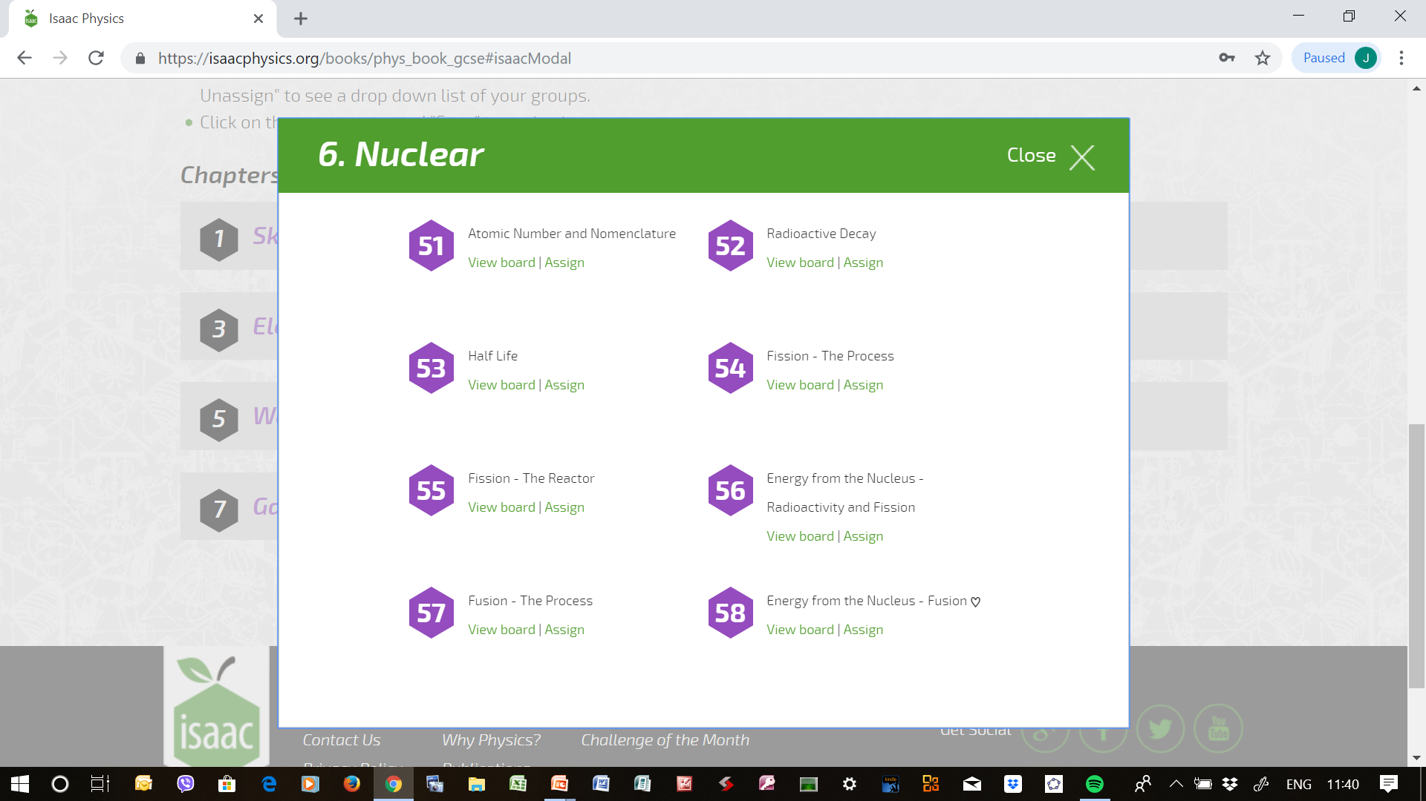
Creating a Board (From GCSE Book)
Menu → Set Assignments → Add a Board→ From GCSE & A-Level Books →
GCSE Physics → Chapters → Nuclear → 57

Slide 13
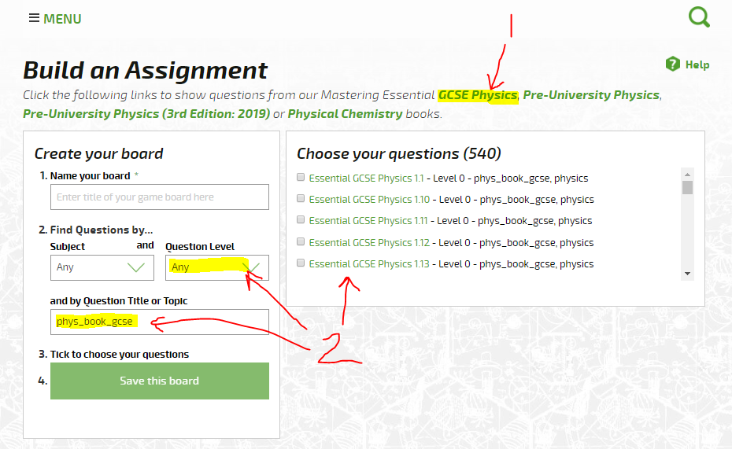
Creating a Board (By Topic)
Menu → Set Assignments → Create a Board→ Name Your Board → Subject → Topic
→ Choose Your Questions → Save This Board
Notes:
facilitators remember to show teachers that they need to click GCSE Physics to set the filters to show the questions in the GCSE book.
Click “GCSE Physics”
This populates the filters so that the GCSE book questions all appear in the “Choose your questions” pane.

Slide 14
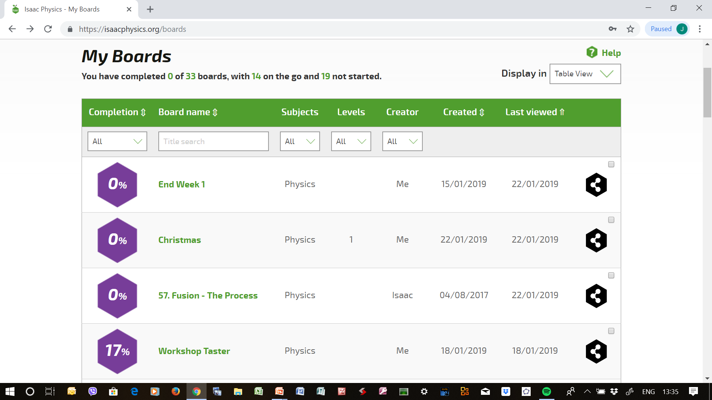
Cloning/Editing a Board
Menu → My Boards → Click Share Icon of Board → Clone & Edit → Subject → Topic
→ Choose Your Questions (select/deselect) → Save This Board

Slide 15
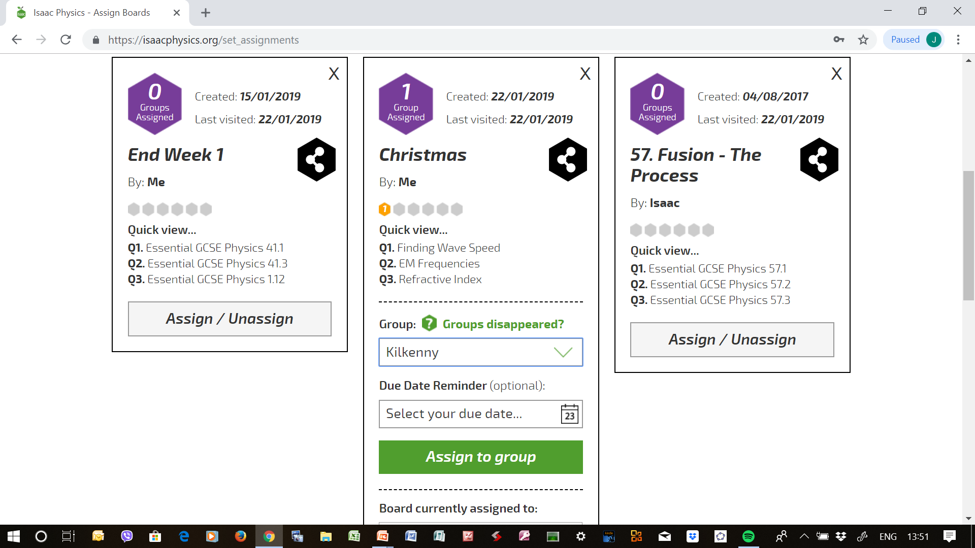
Assigning a Board to a Group
Menu → Set Assignments → Choose Board → Assign → Choose Group → Due Date Reminder → Assign to Group → Close

Slide 16
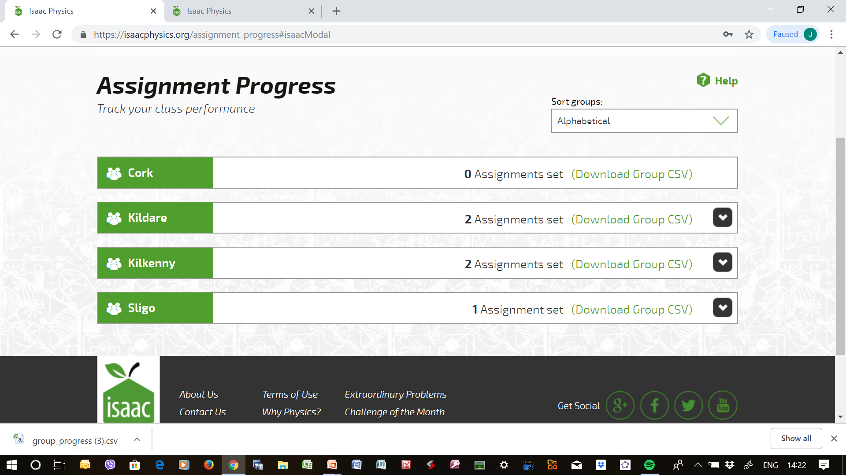
Assignment Progress of Group
Menu → Assignment Progress → Choose Group → Download Group CSV of Group→ group_progress.csv appears at bottom of screen → Click to Open (Excel File)

Slide 17
Exploring Online Help
There is excellent online help available on the Isaac Physics website
On the homepage, from Menu, you can choose from
  Problem Solving Guide
  Teacher Support
  Student Support

Slide 18
Online Help Through Social Media
Get help, and keep in touch with the Isaac Physics online community, through Twitter and Talkphysics.org
Twitter, link at the end of each Isaac Physics web page
Talkphysics, linked from the teacher support pages (teacher support): https://www.talkphysics.org/groups/isaac-physics/

Slide 19
Benefits of Online Assessment
A student can complete assignments and have them assessed at home
There can be a more relaxed environment
It rewards perseverance – the system does not record the number of times a student submitted a wrong answer to a question
A teacher can quickly see where there may be difficulties
The emphasis is on Assessment for Learning (AfL)
It may encourage useful collaboration with fellow students
Specific feedback messages for thousands of common wrong answers
Note: It is still highly recommended that students show their workings on paper
Notes:
specific feedback for thousands of common wrong answers – often addressing misconceptions and common errors in physics.

Slide 20
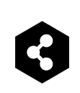
Isaac Physics in your Physics Planning
It is desirable that you integrate Isaac Physics into your overall Physics planning
Wherever you see this share symbol, , clicking it will display the link to the place in the Isaac Physics website where you are now at
You can copy the link and paste it to your planning documents
Clicking on the link will send you back to where you were, be it a board, an assignment, a page in online help
Examples:
  Nuclear Fusion Question 57.6
    https://isaacphysics.org/questions/gcse_ch6_57_q6
  How to join a class group
    https://isaacphysics.org/pages/support_walkthrough_join_class_group

Slide 21
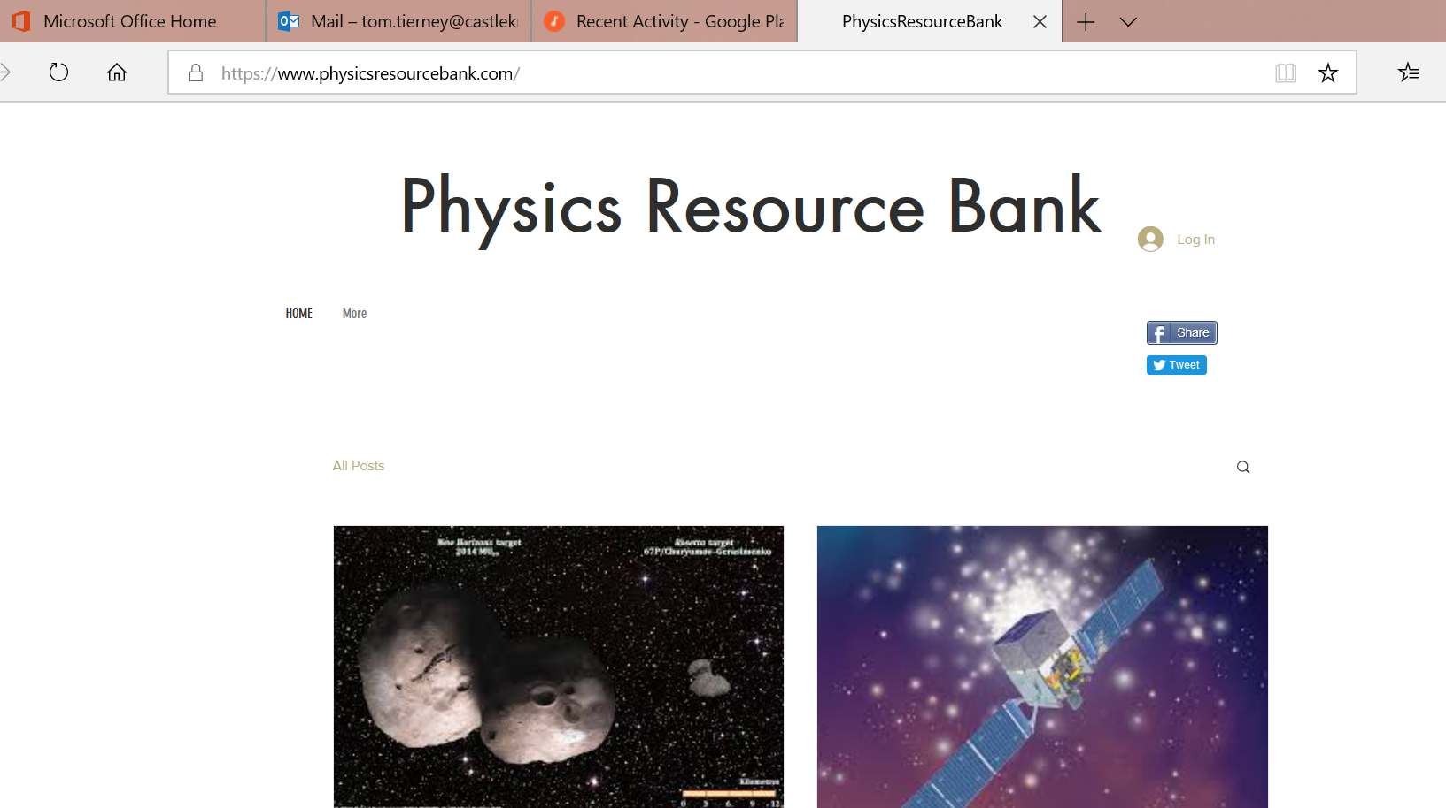

Slide 22
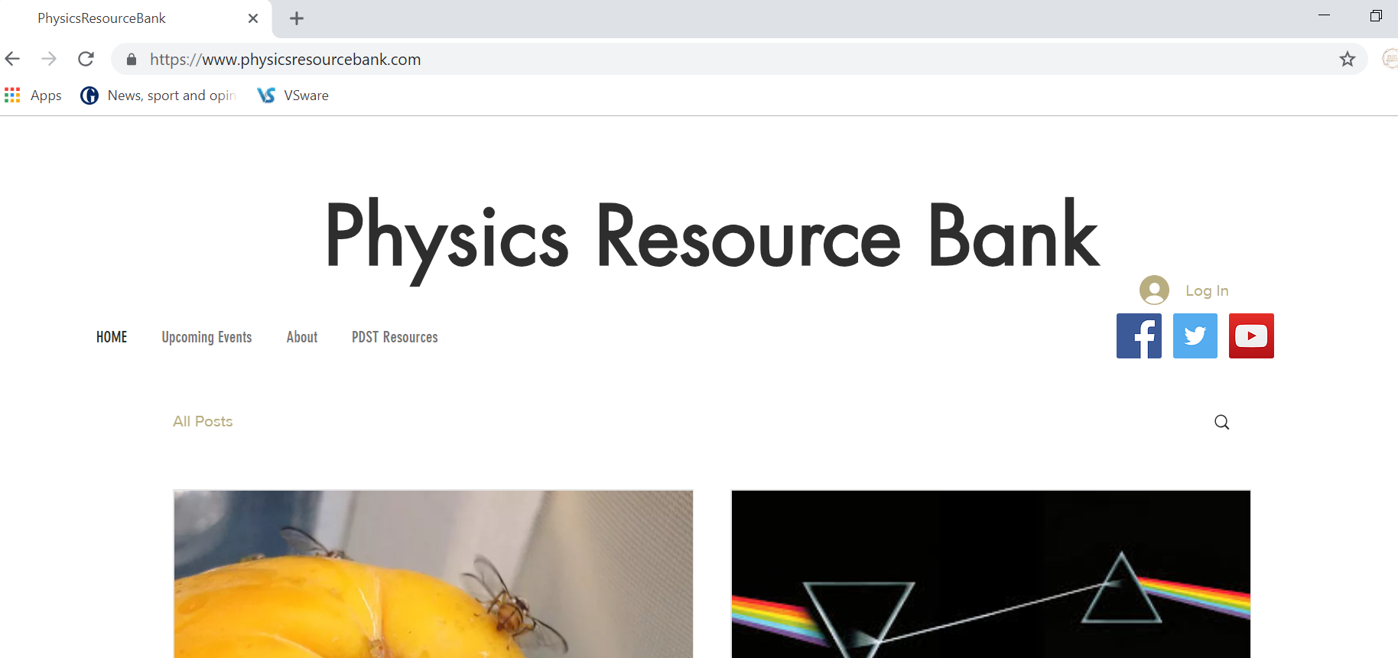
www.physicsresourcebank.com

Slide 23
to join…..

Slide 24
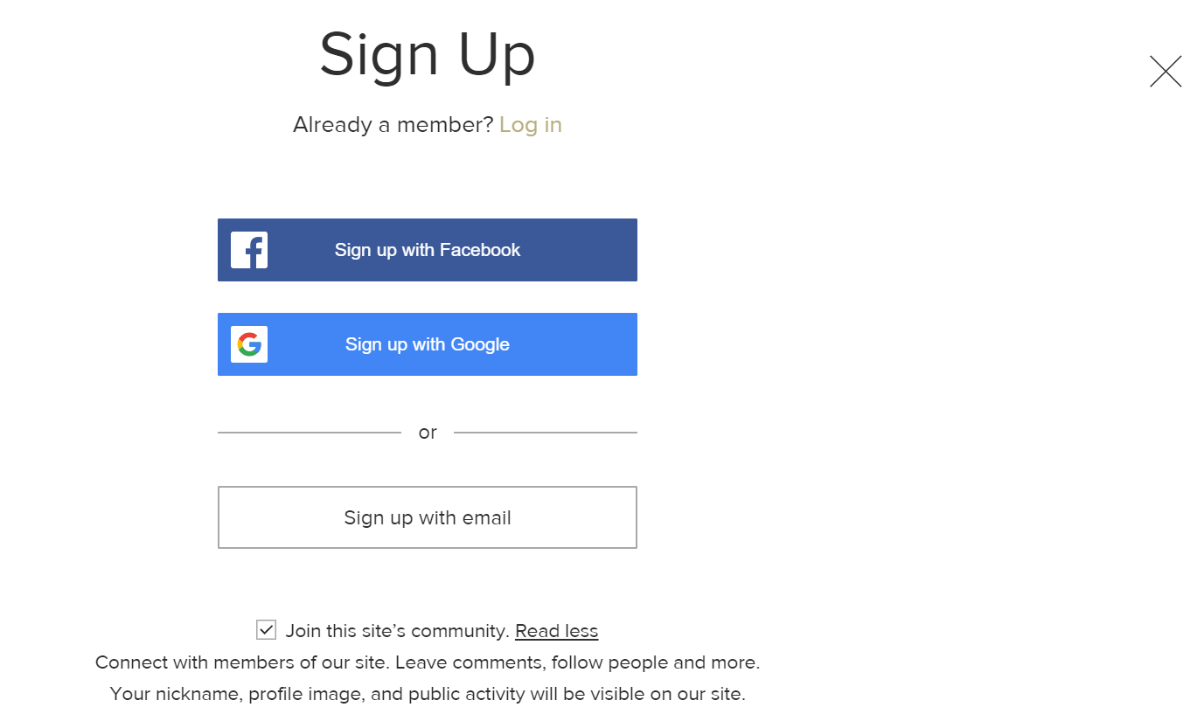
to join….
tick, or untick. as you decide
all shared data is respected

Slide 25
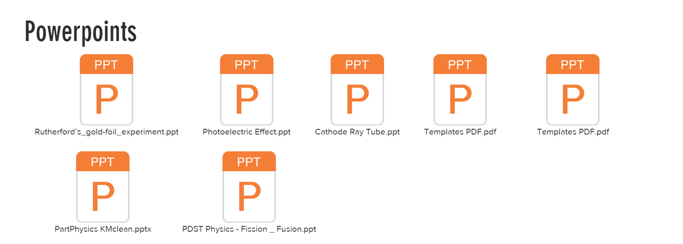
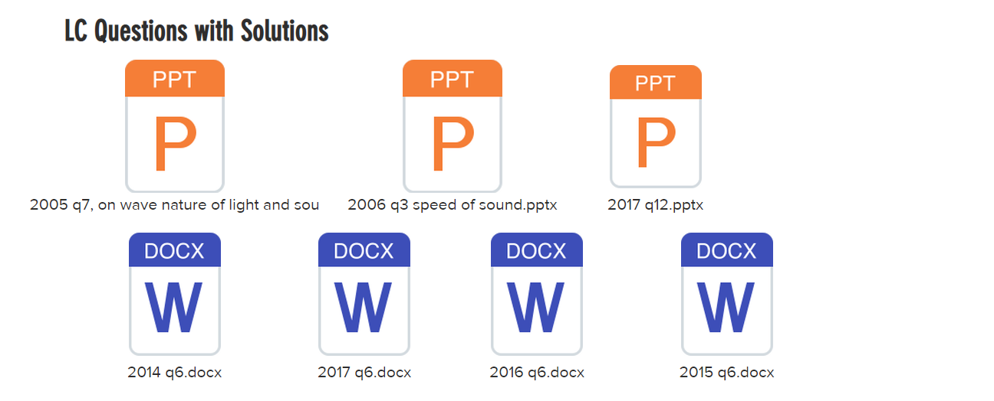
As a member, you have access to…..
+ more to be added….

Slide 26
If you would like to share resources….
email: tom.tierney@castleknockcollege.ie
We will email you sparingly, to let you know of upcoming events

Slide 27
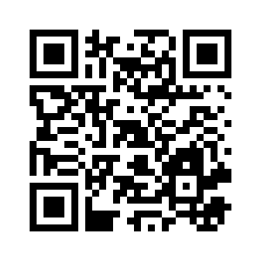
Evaluation & What Next?
PDST Isaac Physics Spring 2019 Evaluation link
https://surveyhero.com/c/8ad3a155
It is very important that you indicate the areas of Physics you would like support in at future workshops

