Slide 1
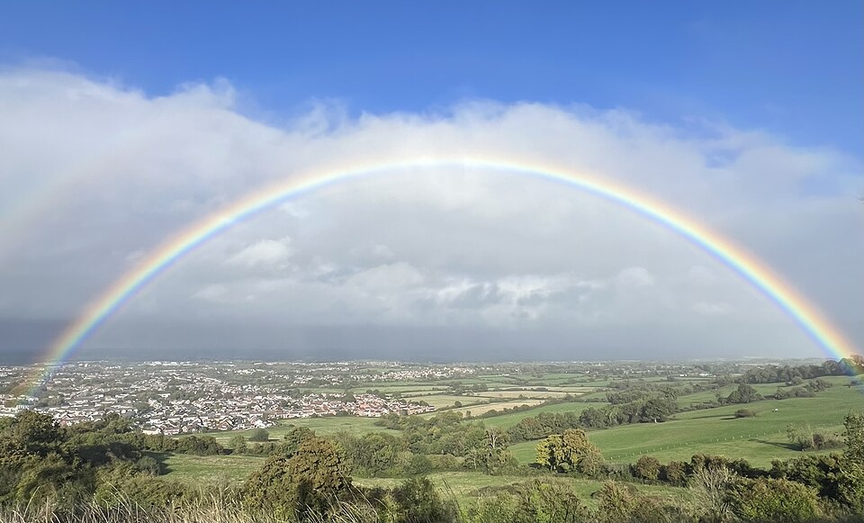
2.4 Electromagnetic Energy
CC0
Notes:
Rainbows show the dispersion of light into its various colours. Light is a small but important part of the full electromagnetic spectrum.

Slide 2
Physics Specification 2.4
2.4 Electromagnetic energy
Students learn about
electromagnetic spectrum and sources of electromagnetic energy; ionising radiation
dispersion
Students should be able to
categorise electromagnetic waves by their wavelength, frequency, ionising ability and everyday use
demonstrate dispersion and explain the phenomenon
Source: LC Physics Specification (2025), ncca.ie, © NCCA

Slide 3
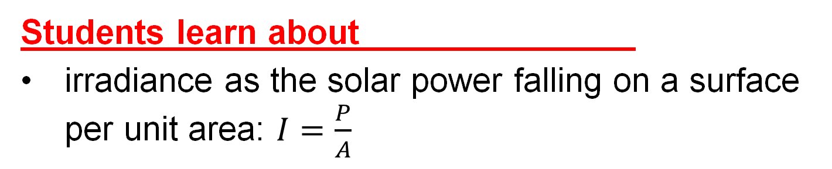
Physics Specification 2.4
2.4 Electromagnetic energy
Students learn about
irradiance as the solar power falling on a surface per unit area: $I=\frac{P}{A}$
Students should be able to
investigate solar irradiance and its impact on life on earth using secondary sources
Source: LC Physics Specification (2025), ncca.ie, © NCCA

Slide 4
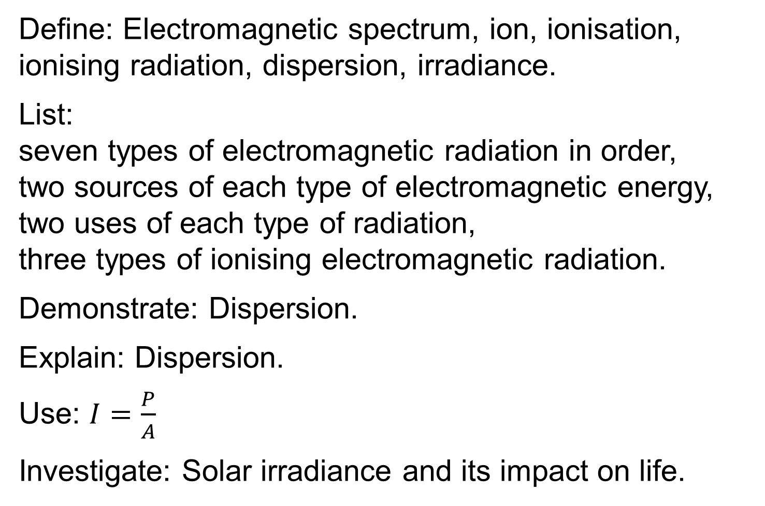
Revision summary
Define: Electromagnetic spectrum, ion, ionisation, ionising radiation, dispersion, irradiance.
List:
seven types of electromagnetic radiation in order,
two sources of each type of electromagnetic energy, two uses of each type of radiation,
three types of ionising electromagnetic radiation.
Demonstrate: Dispersion.
Explain: Dispersion.
Use: $I=\frac{P}{A}$
Investigate: Solar irradiance and its impact on life.

Slide 5

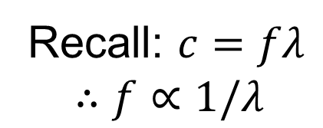

Recap: What is meant by Electromagnetic Spectrum?
High frequency $→$ Short wavelength
gamma rays
x-rays
ultraviolet light
visible light
infrared
microwaves
radio waves
The full range of electromagnetic waves.
Recall: $c=fλ$
$$∴f∝1/λ$$
Low frequency $→$ Long wavelength

Slide 6
For each type of EM radiation name two possible sources
gamma rays
x-rays
ultraviolet light
visible light
infrared
microwaves
radio waves
the sun
the sun
the sun
the sun
the sun
the sun
the sun
nuclear reactions
x-ray machine
special LEDs
fire
warm objects
WiFi or Bluetooth device
radio transmitter

Slide 7
Exercise
List 5 types of electromagnetic radiation on order of frequency starting with the highest frequency.
Any 5: gamma rays, x-rays, ultraviolet light, visible light, infrared, microwaves, radio waves
Which has the longest wavelength? Infrared, ultraviolet or microwave radiation?
microwave
Name two types of electromagnetic radiation that come from a lighted candle?
Visible light, infrared

Slide 8
The atom and ionisation

Slide 9
Name the subatomic particles
-
Electron
+
Proton
+
Neutron
-

Slide 10
What is an ion?
An ion is an atom or a molecule that has lost or gained one or more electrons.
Ionised air:
O₂
O₂
N₂
N₂

Slide 11
What is meant by ionisation?
The adding or removing of electron(s) to or from an atom or molecule HL 2022, 2024
Ionisation can be caused by high frequency electromagnetic radiation (x-rays and gamma rays)
It can also be caused by electron attachment, chemical reactions, high temperatures ….
Definition wording per SEC marking schemes at examinations.ie

Slide 12
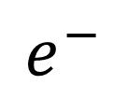
What happens when an x-ray ionises an atom e.g. Neon?
$$e^{−}$$
x-ray
Ne
Ne⁺
The x-ray knocks out an electron, leaving an Ne⁺ ion

Slide 13
What is meant by ionising radiation?
Ionising radiation is radiation that can ionise atoms or molecules.
-
Electron
Ionising radiation
+
Atom becoming ionised due to the loss of an electron
Notes:
The wavelengths that will cause ionisation depend on the type of atom or molecule that is being tested
Typical atoms or molecules that are tested for health and safety include O2, N2, H2O. These require extremely high frequency UV light (extreme UV) or X-rays to ionise them.

Slide 14
Which types of electromagnetic radiation cause ionisation?
gamma rays
x-rays
ultraviolet light
visible light
infrared
microwaves
radio waves
Strongly ionising
Ionising
Weakly (higher-frequency UV)
no
no
no
no
Notes:
UV that reaches earth from the Sun does not cause ionisation in DNA but it is still harmful because it can damage DNA by breaking bonds.
Ionising radiation is defined here
https://www.irishstatutebook.ie/eli/2019/si/30/
In this document ionising radiation is defined as radiation with a wavelength less than 100 nm. This cutoff point excludes so-called UVA, UVB and UVC.
To muddle things a little, UVC is not legally classed as ionising, but some UVC wavelengths can in fact ionise DNA under specific conditions. The type of UV that causes general ionisation is “extreme UV” (EUV) 10 nm – 121 nm

Slide 15

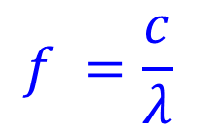
Example 1
UV light can be sub divided into categories according to wavelength, e.g.
UVA 315 – 400 nm
UVB 280 – 315 nm
UVC 100 – 280 nm
Which of these categories has the lowest frequency?
$$c = fλ$$
$$f =\frac{c}{λ}$$
UVA has the longest wavelength and thus the lowest frequency

Slide 16
Uses of EM radiation

Slide 17
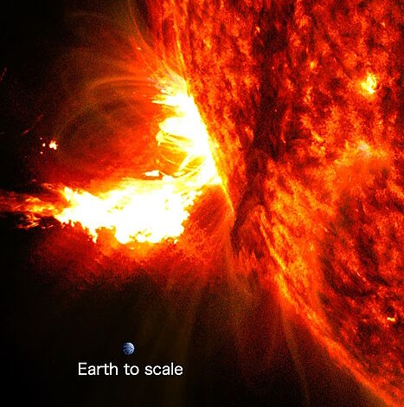
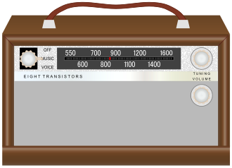
Radio waves (up to 300 MHz)
Can travel long distances, can bend around obstacles (diffraction), can cause heating
CC0
CC0
Examining solar flares
Communication
Notes:
Radio telescopes are used to analyse solar flares and understand the mechanisms behind them. They also give advance warnings. The picture shown is from an optical telescope. There is a tiny disk in the photo representing the earth to scale.

Slide 18

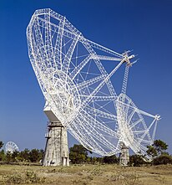
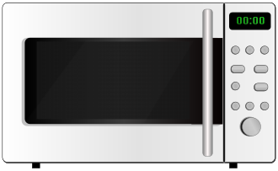
Microwaves (up to 300 GHz)
Very high information carrying capability, can cause heating, need line of sight.
CC0
CC0
Wi-Fi, Bluetooth,
mobile calls and data
Microwave oven
CC0
Astronomy

Slide 19
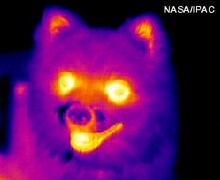
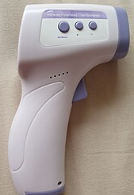
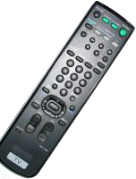
Infrared
Emitted from warm or hot objects, poor penetration (surface heating only), easy to detect, but invisible.
CC0
CC0
Heat sensing cameras
Remote control
CC0
Non-contact thermometers

Slide 20
Visible light
Visible, reflects well, refracts well, non-destructive
Photosynthesis
Lighting
Cameras

Slide 21
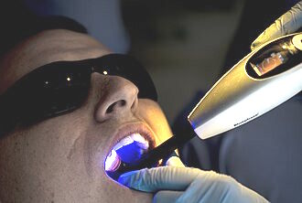
Ultraviolet
UV can excite electrons causing fluorescence or chemical reactions or even some ionisation, also changes in electrical conductivity
Niea Klac
Z-123456
CC0
Checking fluorescent security markings
Curing of UV-activated resin (e.g. dentist)

Slide 22
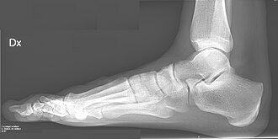
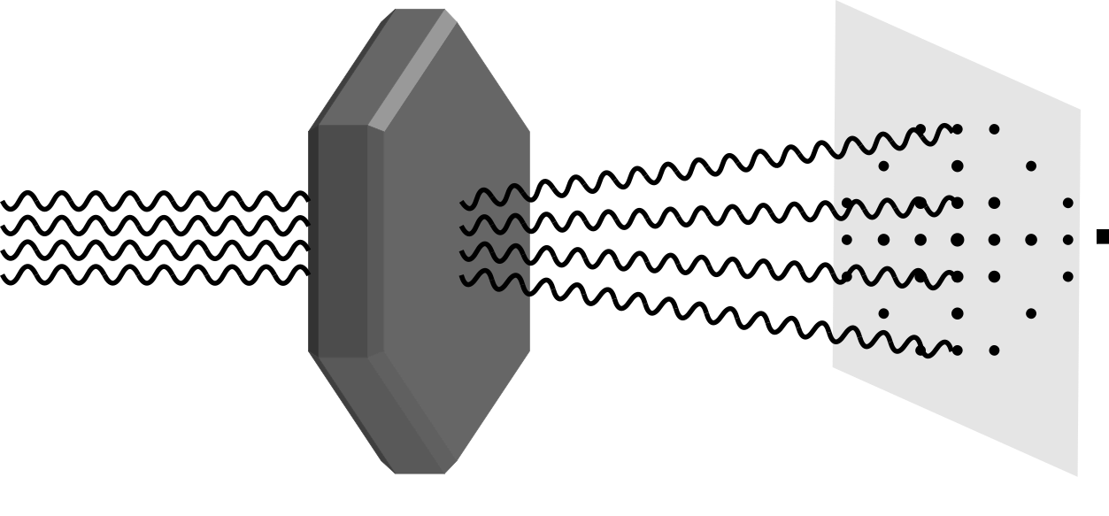
X-ray
Penetrates soft tissue, not bone, very short wavelength = high resolution, high energy
CC0
CC0
X-ray photography
X-ray crystallography in mineralogy, chemistry and biology

Slide 23
Gamma-ray
Produced by nuclear activity, very penetrating, extremely ionising, causes DNA damage.
Weld
Cobalt-60
Iridium‑192
Detector
Inspecting welds
Sterilisation of medical supplies
Notes:
Weld inspection: Iridium‑192 based gamma rays are used because of the portability of the equipment compared to an x-ray machine.
Medical supplies: Gloves, syringes, dressings, implants etc. are irradiated in bulk. Cobalt-60 is used instead of Iridium‑192 because it emits much higher energy gamma rays than Iridium-192 and can penetrate and sterilise full pallets of product in one go. It is done by specialist companies requiring high levels of certification and training.

Slide 24
Exercise
Name two types of electromagnetic radiation other than visible light and
State which has the longest wavelength
Give a practical use for one of them
E.g. infrared and ultraviolet,
Infrared has the longest wavelength
Infrared is used in night vision
Ultraviolet is used to cure dental resins

Slide 25
Exercise
UV light can be sub divided into categories according to wavelength, e.g.
UVA 315 – 400 nm
UVB 280 – 315 nm
UVC 100 – 280 nm
(i) Which of these three categories is most likely to cause ionisation?
(ii) Justify your answer.
UVC
It has the highest frequency / it is closest to x-ray and gamma ray frequency

Slide 26
Dispersion
CC0

Slide 27
Wavelength and Colour
Violet
400 nm
Cyan
500 nm
Yellow
600 nm
Red
700 nm
Light is a wave. Colour is determined by wavelength
‘Visible Light’ has a Wavelength between 400 nm and 700 nm.
Notes:
500 nm actually sits between green and cyan according to Wikipedia

Slide 28
What is Dispersion?
Dispersion is the splitting up of light into its different colours. HL 2024
Dispersion
White light
Split into its colours
Definition wording per SEC marking schemes at examinations.ie

Slide 29
Which shows dispersion?
A
B
CC0
C
A

Slide 30
Demonstrate dispersion
Darkened room
Dispersed light
Ray box
Glass prism
White screen

Slide 31
Why does dispersion occur in a prism?
White light is a mix of all the wavelengths of light from 400 nm to 700 nm.
Glass has a different refractive index for each wavelength. (Blue bends more than red)
A prism can thus separate all the colours.
CC0

Slide 32
What about a diffraction grating?
Grating
CC0
A diffraction grating will also separate all the colours. Diffraction gratings are covered later in 2.6.

Slide 33
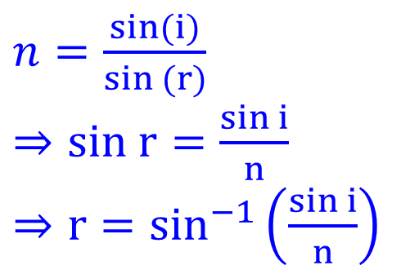
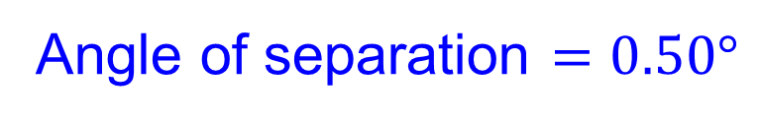
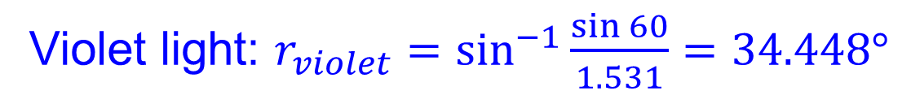
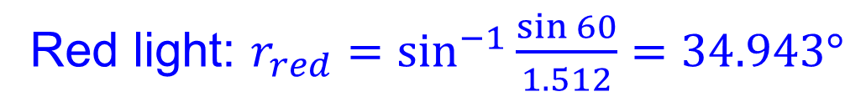
Example 2
The refractive index for the glass in the prism shown is 1.512 for red light (700 nm) and 1.531 for violet light (400 nm). Calculate the angle between the red and violet rays in the diagram.
Angle to calculate
$n=\frac{sin(i)}{sin (r)}$
$⇒sin r=\frac{sin i}{n}$
$⇒r=\sin^{−1}\left(\frac{sin i}{n}\right)$
60°
Red light: $r_{red}=\sin^{−1}{\frac{\sin{60}}{1.512}}=34.943°$
Violet light: $r_{violet}=\sin^{−1}{\frac{\sin{60}}{1.531}}=34.448°$
Angle of separation $=0.50°$
Notes:
Good to explain how subtraction reduces the number of significant figures in the answer.

Slide 34
Exercise
Explain why the blue ray bends more than the red
White light
Glass prism
Each colour has a different refractive index
Angle of incidence the same ∴ angle of refraction is different
Blue bends more therefore the refractive index for blue is greater than for red

Slide 35



Exercise
The refractive index for the glass in the prism shown is 1.471 for red light (700 nm) and 1.493 for violet light (400 nm). Calculate the angle between the red and violet rays in the diagram.
75°
Angle to calculate
Red light: $r_{red}=\sin^{−1}{\frac{\sin{75}}{1.471}}=41.045°$
Voilet light: $r_{violet}=\sin^{−1}{\frac{\sin{75}}{1.493}}=40.314°$
Angle of separation $=0.73°$

Slide 36

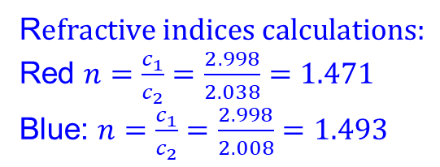

Exercise HL
700 nm red light travels at 2.038×10⁸ m s⁻¹ in glass and 450 nm blue light travels at 2.008×10⁸ m s⁻¹. Calculate the angle between the red and blue rays in the diagram.
Speed of light in vacuum = 2.998×10⁸ m s⁻¹
R$efractive indices calculations:$
Red $n=\frac{c_{1}}{c_{2}}=\frac{2.998}{2.038}=1.471$
Blue: $n=\frac{c_{1}}{c_{2}}=\frac{2.998}{2.008}=1.493$
Angle to calculate
Angle of incidence = 90° – 30° = 60°
30°
Red light: $r_{red}=\sin^{−1}{\frac{\sin{60}}{1.471}}=41.045°$
vacuum
glass
Blue light: $r_{blue}=\sin^{−1}{\frac{\sin{60}}{1.493}}=40.314°$
Angle of separation $=0.73°$

Slide 37
Irradiance

Slide 38
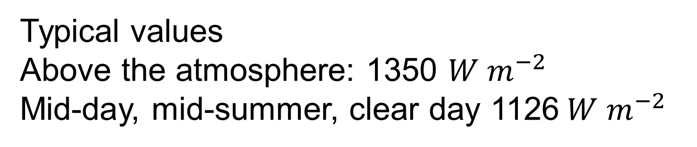
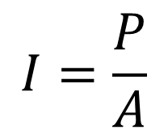
What is Solar Irradiance?
the solar power falling on a surface per unit area. Physics specification
$$I=\frac{P}{A}$$
I = Irradiance
P = Power
A = Area
Typical values
Above the atmosphere: 1350 $W m^{−2}$
Mid-day, mid-summer, clear day 1126$W m^{−2}$
Definition wording: LC Physics Specification (2025), ncca.ie, © NCCA

Slide 39
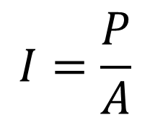
Irradiance Examples
If irradiance = 1000 W m⁻²
Then:
one square metre gets 1000 watts
two square metres get 2000 watts
½ square metre gets 500 watts
$$I=\frac{P}{A}$$

Slide 40

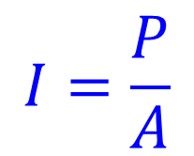

Example 3
On a day with light clouds, the irradiance from the sun measures 650 W m⁻². How much of the sun’s energy will strike a solar panel which measures 6 cm x 12 cm if the panel is facing the sun?
Irradiance I = 650 W m⁻²
Area = 0.06 x 0.12 = 0.0072 m²
$$I=\frac{P}{A}$$
$$P=IA$$
$$P=650\left(0.0072\right)=4.68 W$$

Slide 41

Exercise Irradiance
The maximum solar irradiance in Ireland is about 1100 W m⁻². How much of the sun’s energy will strike a solar panel which measures 0.9 m x 1.2 m if the panel is facing the sun?
$$P=1100\left(1.08\right)=1188 W$$

Slide 42
Investigate solar irradiance and its impact on life on earth using secondary sources

Slide 43
Example 4
Below is a graph which shows how the sun’s power varies with wavelength. The data was from a small satellite named CSIM which flew in a “dawn-dusk” sun-synchronous orbit from 2019 to 2023. The area under any section of the curve represents the total energy between any two wavelengths. Calculate the total solar irradiance.
2
Irradiance per nm
(W m⁻² nm⁻¹)
1
0
1000
2000
Wavelength (nm)
Data Source: https://lasp.colorado.edu/lisird/data
Notes:
A “Dawn-Dusk” Sun-synchronous orbit is an orbit which passes over both the north and south polar regions and follows the line on the planet that separates light from darkness (dawn, dusk line). Thus, the satellite was almost always in sunlight making it ideal for observing the Sun.

Slide 44
Method 1
Counting boxes
The total irradiance = area under the curve
Full boxes: 7
Partial boxes: 15
Area = 7 + 15/2 = 14.5
Area of one box: 0.5 x 200= 100
Total Area = 1450 W m⁻²
2
Irradiance per nm
(W m⁻² nm⁻¹)
1
0
0
1000
2000
Wavelength (nm)
Data Source: https://lasp.colorado.edu/lisird/data

Slide 45
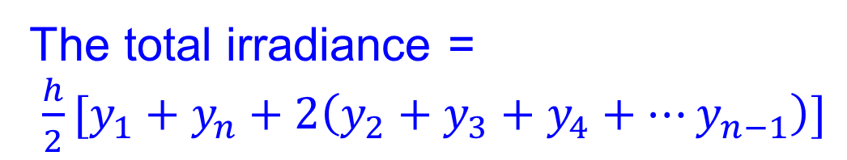
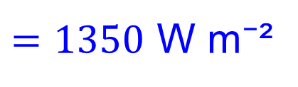

Method 2
Trapezoidal rule
The total irradiance =
$\frac{h}{2}[y_{1}+y_{n}+2\left(y_{2}+y_{3}+y_{4}+…y_{n−1}\right)]$
$$=\frac{200}{2}[0+0.1+2(.1+1.2+1.7+1.1+.7+.5+.4+.3+.3+.2+.2)]$$
$$=100\left(13.5\right)$$
$=1350$ W m⁻²
2
Irradiance per nm
(W m⁻² nm⁻¹)
1
0
0
1000
2000
Wavelength (nm)
Data Source: https://lasp.colorado.edu/lisird/data

Slide 46
Exercise
The range of wavelengths associated with visible light is shown in green. Calculate the total irradiance for the visible wavelengths.
Visible light range
2
Irradiance per nm
(W m⁻² nm⁻¹)
1
0
500
1000
1500
2000
Wavelength (nm)
Data Source: https://lasp.colorado.edu/lisird/data
520 W m⁻²

Slide 47



Exercise
A solar panel can use wavelengths between 400 nm and 1000 nm to generate electrical power.
1. What % of the total solar power is available to the solar panel?
2. Which of the wavelengths 400 nm or 1000 nm is infrared?
2
Irradiance per nm
(W m⁻² nm⁻¹)
1
0
1000
2000
Wavelength (nm)
$$\frac{200}{2}\left[1.2+0.7+2\left(1.7+1.1\right)\right]=750 \text{W m}\text{⁻²}$$
Data Source: https://lasp.colorado.edu/lisird/data
$$750\text{/1350 : 56\%}$$
$$1000 nm=infrared$$
Notes:
Actual solar panels typically range from 380 nm to 1050 nm and are more efficient at converting infrared than visible light. Simplifications have been made for the exercise.

Slide 48
Recap: Wavelength and Colour
Ultraviolet
Infrared
CC0
Violet
400 nm
Cyan
500 nm
Yellow
600 nm
Red
700 nm
Recall Red has the longest wavelength of visible light

Slide 49
Biology Link: Photosynthesis
Photosynthesis converts the sun’s energy to chemical energy by creating glucose.

Slide 50
Example 5
Below is the absorption spectrum of chlorophyll. Indicate the colours red, green and blue in the boxes.
A.
B.
80%
60%
Absorption %
40%
C.
20%
400
500
600
700
Wavelength (nm)
Chlorophyll absorption spectrum
A: Blue
B: Red
C: Green
redrawn and simplified from rseco.org (accessed 2026)

Slide 51
Example 6
Below is the absorption spectrum of chlorophyll. A higher value means more light is absorbed. Use this graph to explain why plant leaves that use chlorophyll look green.
Chlorophyll absorption spectrum
80%
60%
Absorption %
40%
20%
0%
400
500
600
700
Wavelength (nm)
Blue and red absorbed therefore green reflected
redrawn and simplified from rseco.org (accessed 2026)

Slide 52
Exercise
Plants convert very little of the incident solar irradiance into chemical energy (glucose). Using the graphs, deduce one factor that contributes to this low conversion factor.
Chlorophyll absorption spectrum
Solar irradiance
80
2
60
Irradiance per nm
(W m⁻² nm⁻¹)
Absorption %
40
1
20
400
500
600
700
0
1000
2000
Wavelength (nm)
Wavelength (nm)
Solar irradiance is strong over all wavelengths from 400 nm to 1000 nm and beyond
Chlorophyll only uses two small parts of that spectrum, i.e. blue and red light.
redrawn and simplified from rseco.org (accessed 2026)
https://lasp.colorado.edu/lisird/data

Slide 53
Possible mini research exercises
Research the impact of each type of solar radiation on life on Earth.
Research how we are protected from harmful solar radiation.

Slide 54
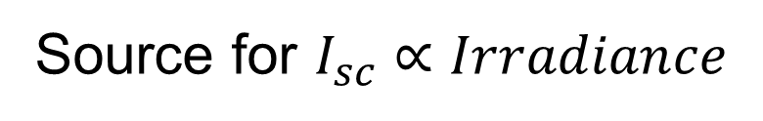
Links
Source for $I_{sc}∝Irradiance$
https://www.thegreenwatt.com/isc/
Source for fill factor and efficiency
https://www.thegreenwatt.com/fill-factor/

Slide 55
Revision summary
Define: Electromagnetic spectrum, ion, ionisation, ionising radiation, dispersion, irradiance.
List:
seven types of electromagnetic radiation in order,
two sources of each type of electromagnetic energy, two uses of each type of radiation,
three types of ionising electromagnetic radiation.
Demonstrate: Dispersion.
Explain: Dispersion.
Use: $I=\frac{P}{A}$
Investigate: Solar irradiance and its impact on life.

Slide 56
Please give feedback…
These slides are new and still being refined.
If anything in the slides did not work in class or was unclear e.g. so that you had to use the whiteboard to make it clear, send me a WhatsApp or email with feedback.
Students can give feedback via their teacher.

