Slide 1
Electric Fields
introduction

Slide 2
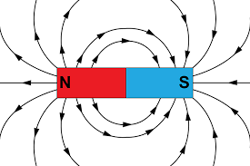
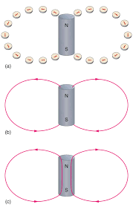
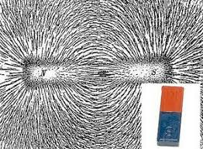
Electric Fields
At Jnr Cert you learned about magnetic fields…
…where the arrows point from north to south
…which can be demonstrated using iron filings…
…or plotting compasses
The magnetic field is the area around a magnet where the magnet has an effect

Slide 3
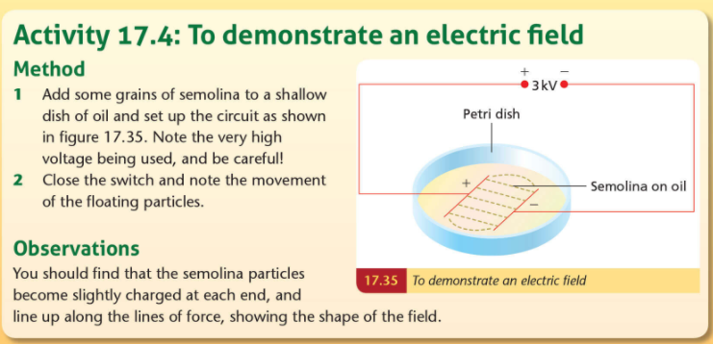
Electric Fields: demonstration
At L Cert we learn about Electric Fields….
…..the area around an electric charge where the charge has an effect
…..It can be demonstrated in the lab…

Slide 4
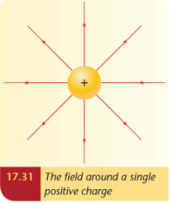
Electric Fields: diagrams
At L Cert we learn about Electric Fields….
…..the area around an electric charge where the charge has an effect
…..when we draw them, the arrows show the direction a small positive charge would move
…..imagine a single positive charge, fixed in place, as shown here
….which way would a small positive charge move?
…..overall the magnetic field looks like this
+
+
+
+

Slide 5
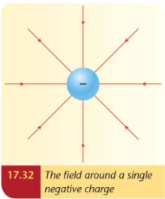
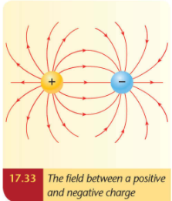
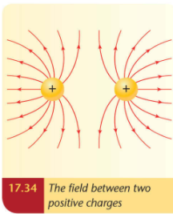
Electric Fields: diagrams
At L Cert we learn about Electric Fields….
…..the area around an electric charge where the charge has an effect
…..when we draw them, the arrows show the direction a small positive charge would move
…..that means the arrows go away from positive and/or towards negatives

Slide 6
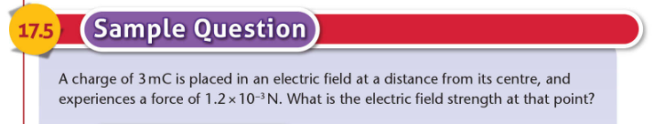
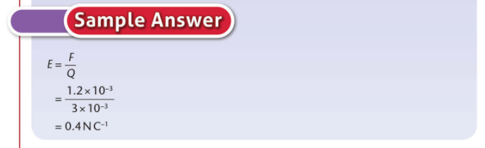
Electric Fields: the maths
The electric field strength is the force per unit charge at a point in the field
(…shows us what force a charge of +1C would experience)

Slide 7
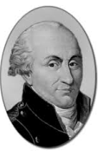


Electric Fields: the maths
Remember Coulomb’s Law…..
…states that the force between two point charges is directly proportional to the product of the
charges, and inversely proportional the square of the distance between them.
The electric field strength is the force per unit charge at a point in the field
(i.e. the force that would be felt by a charge of +1 C in the Electric Field created by a charge, Q)
$$F=\frac{1}{4πε}\frac{Q_{1}(1)}{d^{2}}$$
(Force calculation: in Newtons)
$$E=\frac{1}{4πε}\frac{Q_{}}{d^{2}}$$
(Electric Field: in Newtons per Coulomb)

Slide 8
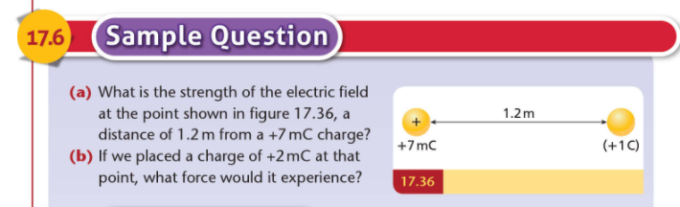
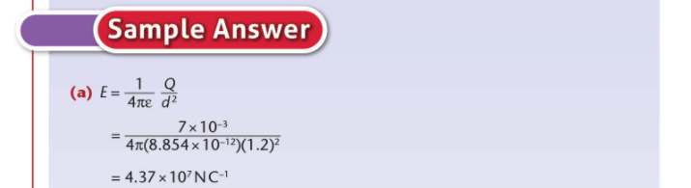
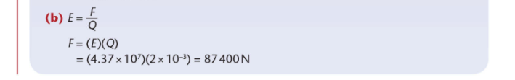
Electric Fields: the maths

