Slide 1
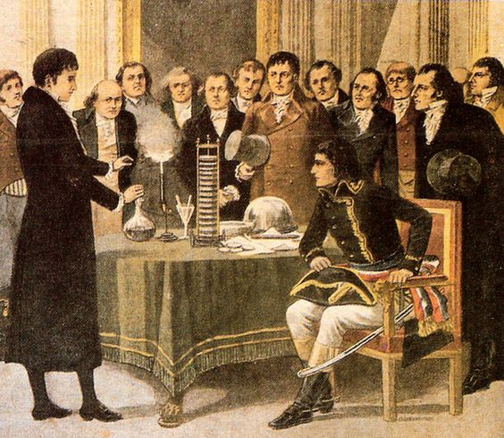
Electric Circuits 1
CC0
Alessandro Volta présente sa pile électrique à Napoléon en 1801
Notes:
Volta demonstrates electric sparks using his recently invented battery. He would have also demonstrated the ability of his battery to give electric shock. This newly invented electric battery was the first source of a continuous electric current. Before this only instantaneous discharge from charged objects was possible. The demonstration was at Napoleon’s request. [Wikipedia]
Sources
Wikipedia (n.d.) Voltaic pile. Available at: https://en.wikipedia.org/wiki/Voltaic_pile (Accessed: 1 March 2026).
Wikipedia (n.d.) Alessandro Volta – Demonstration before Napoleon. Available at: https://en.wikipedia.org/wiki/Alessandro_Volta (Accessed: 1 March 2026).

Slide 2
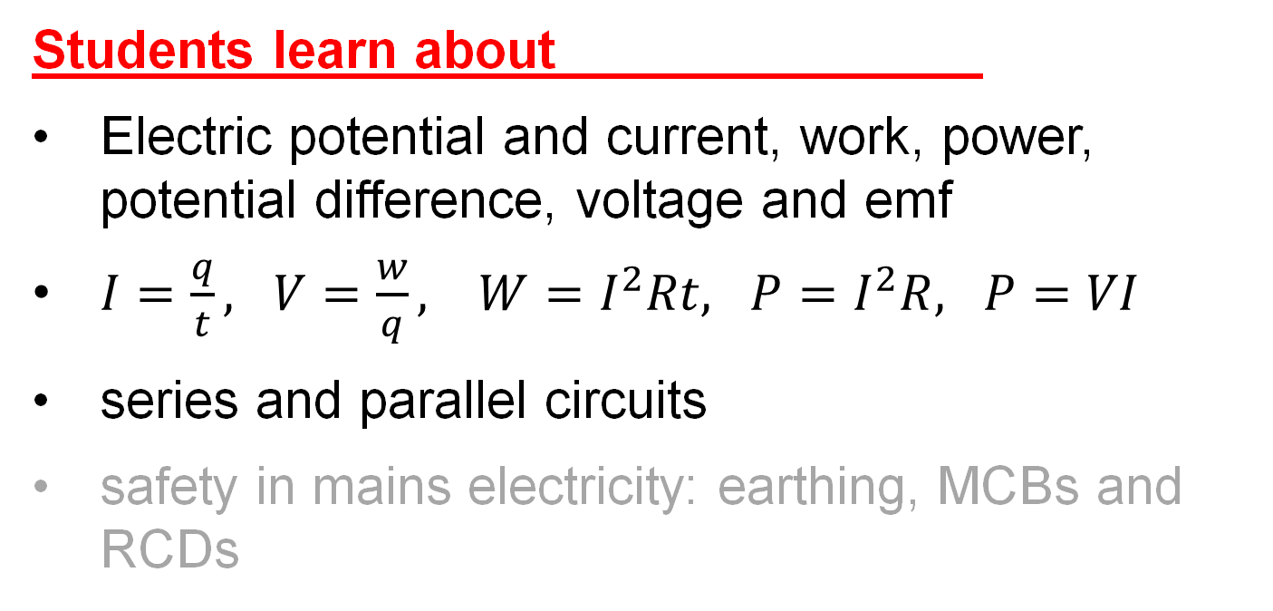
Physics Specification 3.3
3.3 Electric Circuits
Students learn about
Electric potential and current, work, power, potential difference, voltage and emf
$I=\frac{q}{t}, V=\frac{w}{q}, W=I^{2}Rt, P=I^{2}R, P=VI$
series and parallel circuits
safety in mains electricity: earthing, MCBs and RCDs
Items in light text will be covered in Electric Circuits 2

Slide 3
Physics Specification 3.3
3.3 Electric Circuits
Students should be able to
Model
  the relationship between current and charge
  the relationship between work, charge and potential difference
  the relationship between electric current, conventional current, power and resistance
  series and parallel circuits
  the rate of conversion of electrical energy in components of electric circuits
  fuses and circuit breakers

Slide 4
Physics Specification 3.3
3.3 Electric Circuits
Students learn about
doping; n-type, p-type and p-n junction, depletion layer
transistors as switches
circuit components: voltage source, switch, light bulb, resistor, variable resistor, ammeter, voltmeter, ohmmeter, diode, LDR, LED, thermistor, transistor

Slide 5
Physics Specification 3.3
3.3 Electric Circuits
Students should be able to
investigate the use of semi-conductors in real-world applications using secondary sources
model a relationship between current flowing through and the voltage across a diode in forward and reverse bias using primary and secondary data.

Slide 6
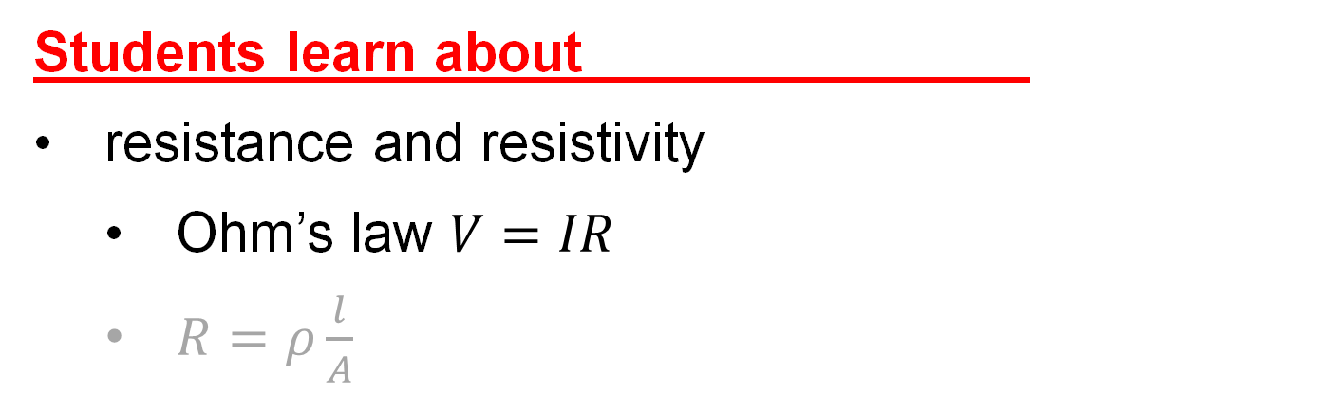
Physics Specification 3.3
3.3 Electric Circuits
Students learn about
resistance and resistivity
  Ohm’s law $V=IR$
  $R=ρ\frac{l}{A}$
Students should be able to
verify the relationship between current flowing through and the voltage cross an ohmic conductor using primary and secondary data

Slide 7
Physics Specification 3.3
3.3 Electric Circuits
Students learn about
Non-ohmic conductors: filament bulb, diode
Students should be able to
investigate the relationship between current flowing through and the voltage across non-ohmic conductors using primary and secondary data

Slide 8
Physics Specification 3.3
3.3 Electric Circuits
Students learn about
heating effect of an electric current and its implications for electrical supply
Students should be able to
investigate the effect of varying temperature on the resistance of a conductor using primary and secondary data

Slide 9
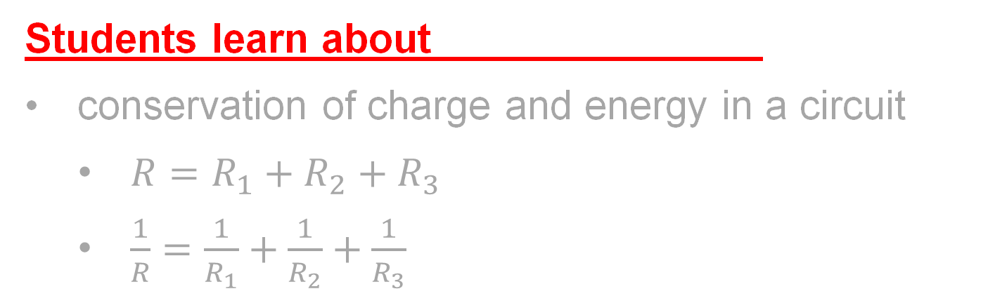
Physics Specification 3.3
3.3 Electric Circuits
Students learn about
conservation of charge and energy in a circuit
  $R=R_{1}+R_{2}+R_{3}$
  $\frac{1}{R}=\frac{1}{R_{1}}+\frac{1}{R_{2}}+\frac{1}{R_{3}}$
Students should be able to
model resistances in series and parallel in electric circuits using primary and secondary data
derive and use the formulae for resistors in series and parallel

Slide 10
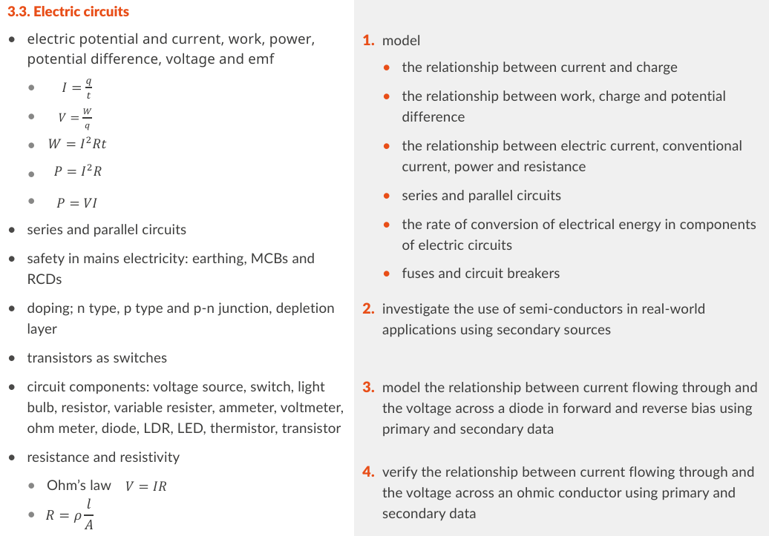
Physics Specification 3.3
✔
✔
✔
✔
✔
✔
✔
✔
✔
🗴
Concept only
✔
🗴
🗴
🗴
🗴
🗴
✔
🗴
🗴
🗴
🗴
🗴
🗴
✔
🗴
✔
✔
🗴

Slide 11
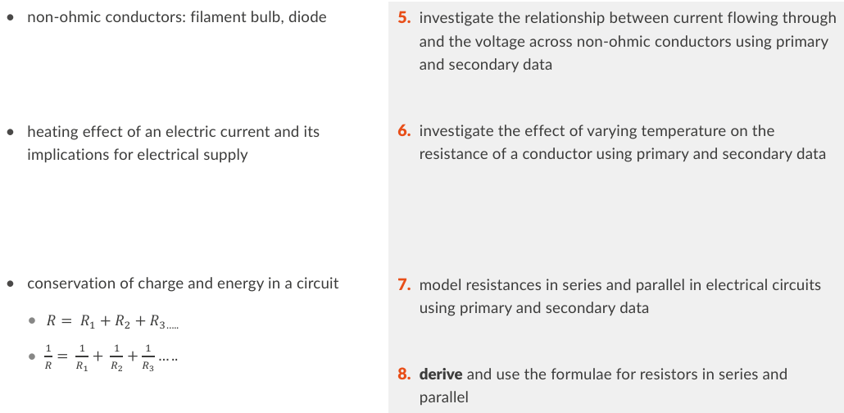
Physics Specification 3.3
🗴
🗴
✔
✔
🗴
🗴
🗴

Slide 12
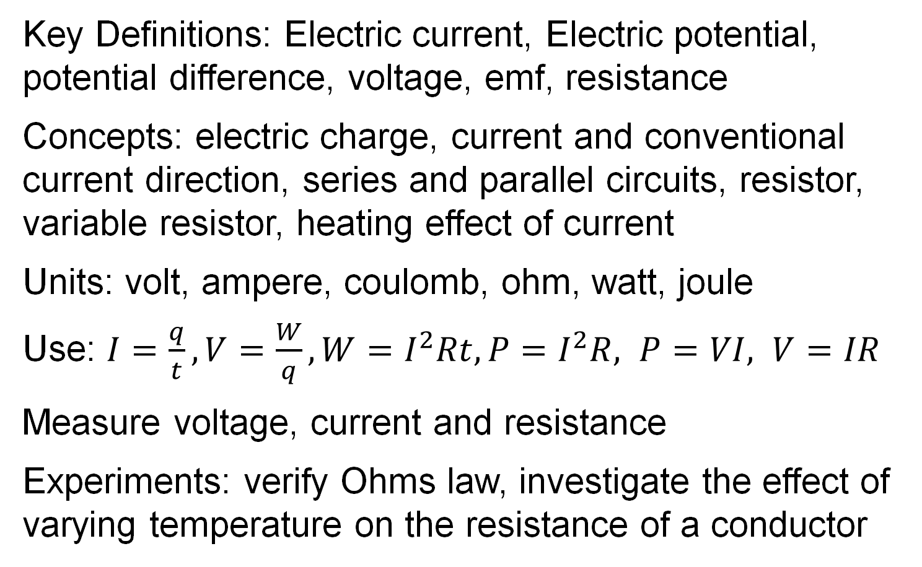
Revision summary
Key Definitions: Electric current, Electric potential, potential difference, voltage, emf, resistance
Concepts: electric charge, current and conventional current direction, series and parallel circuits, resistor, variable resistor, heating effect of current
Units: volt, ampere, coulomb, ohm, watt, joule
Use: $I=\frac{q}{t}, V=\frac{W}{q}, W=I^{2}Rt, P=I^{2}R, P=VI, V=IR$
Measure voltage, current and resistance
Experiments: verify Ohms law, investigate the effect of varying temperature on the resistance of a conductor

Slide 13
Definitions
Learn the definitions before any analogies even if they seem meaningless at first.
Otherwise, the analogies will become enemies to correct understanding.

Slide 14
Unit-Symbols and Quantity-symbols
There are a lot of new symbols in electricity. To reduce confusion, learn to distinguish between quantity-symbols and unit-symbols.
Quantity
Quantity symbol
Unit symbol
Unit name
time
t
s
second
mass
m
kg
kilogram
resistance
R
Ω
ohm
Remember: Quantity-symbols appear in formulae
Unit-symbols appear in answers
Example: m = F/a = 20 kg

Slide 15
Symbols used in electricity
Quantity
Quantity symbol
Unit symbol
Unit name
Current
I
A
ampere
Voltage
V
V
volt
Resistance
R
Ω
ohm
Charge
q
C
coulomb
Power
P
W
watt
Work
W
J
joule
Remember: Quantity-symbols appear in formulae
Unit-symbols appear in answers

Slide 16
Hands on - get the lamp working
1.5 V
Observations:
Needs a closed circuit
Something must “flow” in the wires

Slide 17
What is electric current?
Electric current is the flow of electric charge HL 2020
but what is charge?

Slide 18
What is electric charge?
A property of some sub-atomic particles
Electrons are –
Protons are +

Slide 19
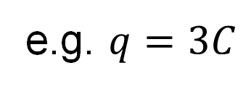
What is the unit of electric charge?
The coulomb
About 6300000000000000000 electrons
unit-symbol?
C
quantity-symbol?
q
e.g. $q=3C$

Slide 20
What is electric current? (again)
Electric current is a flow of electric charge HL 2020
1.5 V
Flow
Flow

Slide 21
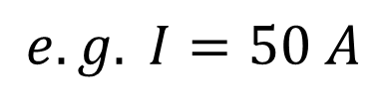
What is the unit of electric current?
The unit of electric current is the ampere
(1 coulomb per second)
unit-symbol?
A
e.g. 50 A
quantity-symbol?
I
$$e.g. I=50 A$$
I from Intensity

Slide 22
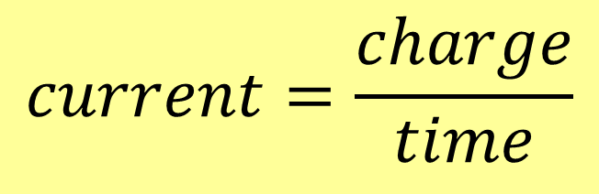
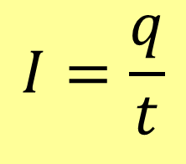
How are current and charge related?
$$current=\frac{charge}{time}$$
$$I=\frac{q}{t}$$
1 ampere = 1 coulomb per second
e.g. if 3 coulombs passes a point in a circuit in
10 seconds then we calculate the current to be 0.3 A

Slide 23
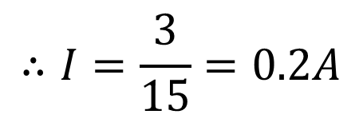
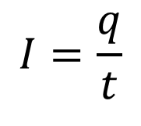
Example 1
This battery pushes 3 coulombs of charge through the bulb in 15 seconds. What is the current?
1.5 V
$$I=\frac{q}{t}$$
$$∴I=\frac{3}{15}=0.2A$$

Slide 24
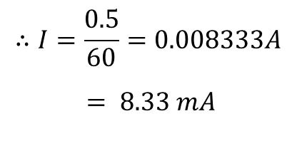
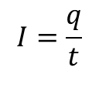
Exercise
This 2.5 V battery pushes 0.5 coulombs of charge through an LED in 1 minute. What is the current in milliamps (mA)?
2.5 V
$$I=\frac{q}{t}$$
$$∴I=\frac{0.5}{60}=0.008333A$$
$$= 8.33 mA$$

Slide 25
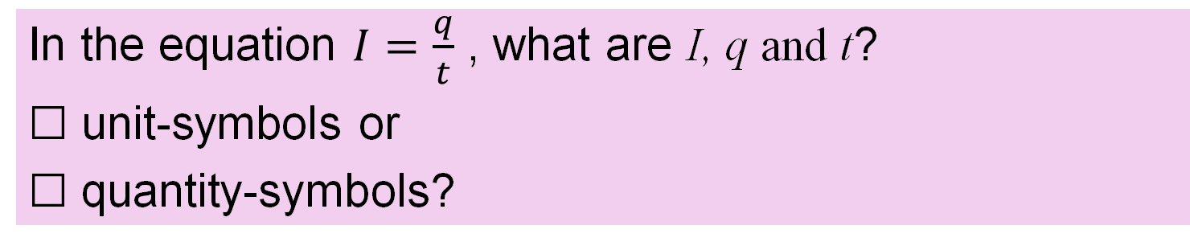
Exercise
In the equation $I=\frac{q}{t}$ , what are I, q and t?
☐ unit-symbols or
☐ quantity-symbols?
Hint, m is the quantity symbol for mass, kg is the unit symbol
2.5 V
I, q and t are
Quantity-symbols

Slide 26
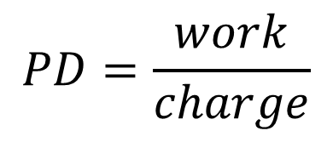
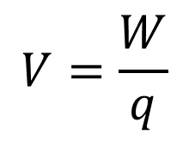
Define Potential Difference
The work done per coulomb of charge moved between two points
HL 2019, 2022D, 2023, 2025
$$PD=\frac{work}{charge}$$
$$V=\frac{W}{q}$$
OR
Pg 61
Formula + notation
Voltage is another word for potential difference
A 3 V battery does 3 joules of work every time it pushes 1 coulomb of charge around a circuit.
Notes:
I

Slide 27
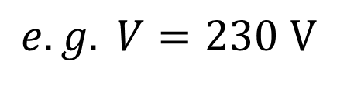
What is the unit of potential difference?
The unit of potential difference is the volt
(1 joule per coulomb)
unit-symbol?
V
e.g. 230 V
quantity-symbol?
V
$$e.g. V=230 V$$

Slide 28
Give two other words for potential difference?
Voltage and emf
Emf stands for electromotive force
Emf is the cause of a current flowing
Voltage can be the cause of or can be caused by a current flowing.
Source: Circuit Globe (n.d.) Difference Between Electromotive Force & Potential Difference. Available at: https://circuitglobe.com/difference-between-electromotive-force-and-potential-difference.html (Accessed: 1 March 2026).

Slide 29
Voltage and emf
Emf is the cause of a current flowing
Voltage can be the cause of or can be caused by a current flowing.
I
voltage
Emf
or
voltage
voltage
Notes:
You can build this circuit and test that there is different voltage across each lamp

Slide 30
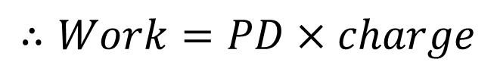
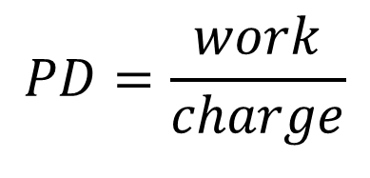
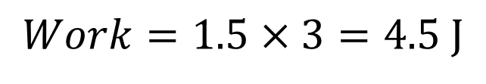
Example 2
This battery pushes 3 coulombs of charge through the bulb. How much work is done:
1.5 V
$$PD=\frac{work}{charge}$$
$$∴Work=PD×charge$$
$$Work=1.5×3=4.5 J$$

Slide 31
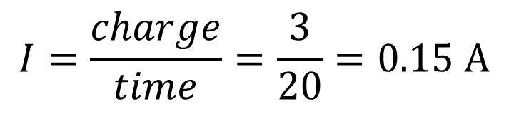
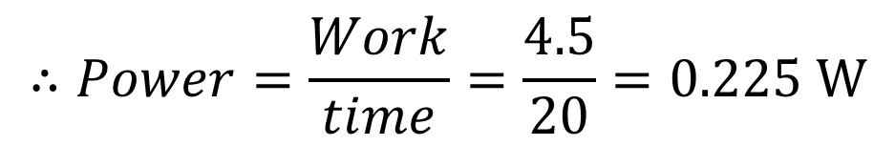
Example 3
We have calculated the work done = 4.5 J when 3 coulombs moves through the bulb. If this take 20 seconds, calculate (i) the current and (ii) the power
1.5 V
3 C for 20 s
$$I=\frac{charge}{time}=\frac{3}{20}=0.15 A$$
$$∴Power=\frac{Work}{time}=\frac{4.5}{20}=0.225 W$$

Slide 32



Exercises
A 3 V battery pushes 15 coulombs of charge through a bulb. How much work is done:
$$Work=3×15=45 J$$
A 3 V battery drives 20 mA though an LED:
(i) How many coulombs pass in 5 minutes?
(ii) How much energy is used in 5 minutes?
$$q=It=0.02\left(5×60\right)=6 C$$
$$W=qV=6\left(3\right)=18 J$$

Slide 33
Example 4
Draw a circuit diagram for this arrangement.
The long line represents the positive terminal of the cell
Circuit symbols are in the formula book Page 72 - 78

Slide 34
Series vs parallel
1.5 V
Lamps in series
Lamps in parallel

Slide 35
Exercise
Draw a circuit diagram for this setup.

Slide 36
What direction does electric current flow?
From + to -
Current
+ to – is called “conventional current”
the electrons flow in the opposite direction to conventional current.
(negative charge)
Notes:
The direction in which current flows was decided a long time before the electron was discovered. The problem of electrons flowing in the opposite way to which we say that the current flows was solved by saying that the electrons had a negative charge.

Slide 37
Which direction is right?
From + to -
Current
On circuit diagrams, always show + to – (conventional current)
Notes:
The direction in which current flows was decided a long time before the electron was discovered. The problem of electrons flowing in the opposite way to which we say that the current flows was solved by saying that the electrons had a negative charge.

Slide 38
Measuring current and voltage

Slide 39
Measuring current
Current is measured with an ammeter
The circuit symbol for an ammeter is
A
Where would you place the ammeter in this circuit?
A
Place the ammeter in series with the circuit in either of these positions.
A

Slide 40
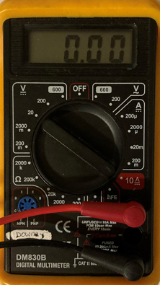
Measuring current
A
A
Turn the multimeter dial to the A settings (A for amperes)
Connect in series
The exact setup varies

Slide 41
Measuring voltage
Voltage is measured with a voltmeter
The circuit symbol for a voltmeter is
V
Where would you place the voltmeter in this circuit?
Place in parallel with the device
V

Slide 42
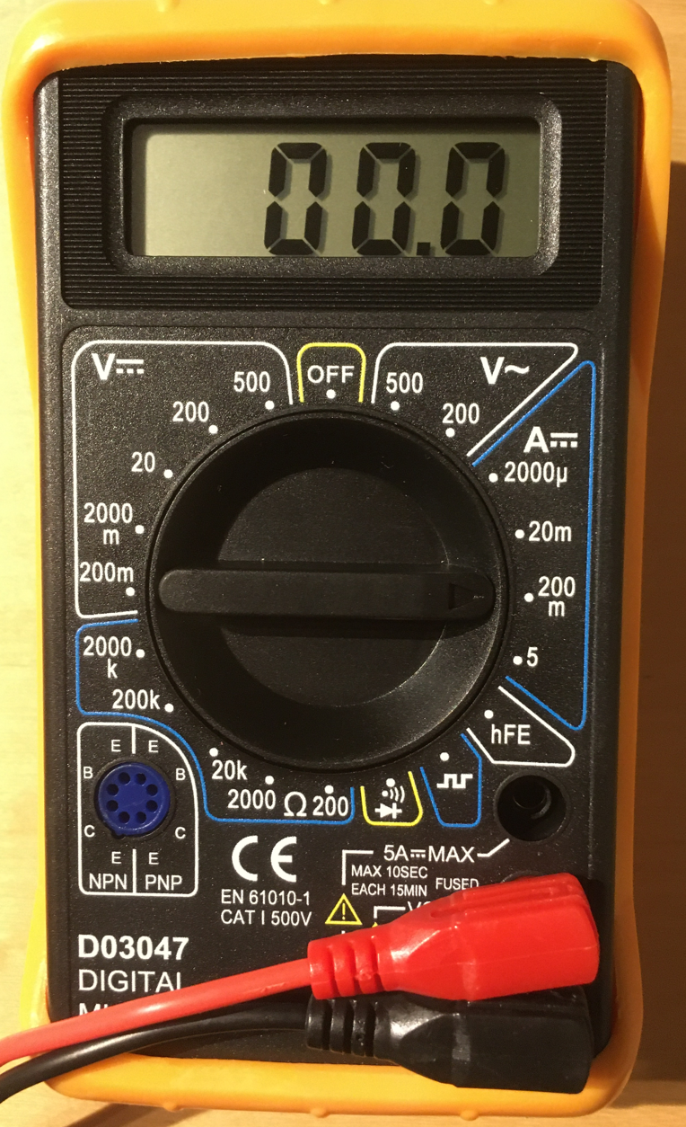
Measuring voltage
V
1.5 V
Turn the multimeter dial to the Volt settings.
V
Connect the leads as in parallel.
The exact setup varies.

Slide 43
Exercise
The two circles represent an ammeter and a voltmeter. Write the correct letter in each.
A
V

Slide 44

Example 6 Multimeter accuracy
A multimeter has a stated accuracy of:
±(1.0% +2) for current
The multimeter is reading 0.74 A,
What is the maximum and minimum the actual current can be?
±(1.0% +2) means ± (1% of the reading on the meter plus 2 least significant digit counts)
i.e. ± (0.0074 + 0.02) = ± (0.0274)
The maximum the actual could be is:
0.74 + 0.0274 = 0.7674 ≈ 0.77 A
minimum = 0.74 - 0.0274 ≈ 0.71A
So true value lies between 0.71 A and 0.77 A

Slide 45
Exercise
A multimeter has the below accuracy statement
DC Voltage 2V, 20V 200V ±(0.8%+5)
The meter is reading 1.48 V
What is the maximum and minimum value the voltage could be?
0.8% of 1.48 = 0.012, 5 digits = 0.05 total ±0.062 Thus max = 1.542 V, min = 1.418 V
A multimeter has the below accuracy statement
DC current 10A ±(3%+2)
The meter is reading 2.52 A
What is the maximum and minimum the current could be?
3% of 2.52 = 0.0756, 2 digits = 0.02 Total ±0.096 Thus max = 2.616A, min = 2.424 A

Slide 46
Resistance

Slide 47
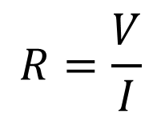
What is electrical resistance?
ratio of potential difference across to current in a conductor HL 2022D, 2023D, 2025
$$R=\frac{V}{I}$$
Formula + notation

Slide 48
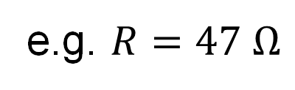
What is the SI unit of resistance?
The ohm
When 1 volt drives 1 ampere
unit-symbol?
Ω
quantity-symbol?
R
e.g. $R=47 Ω$

Slide 49
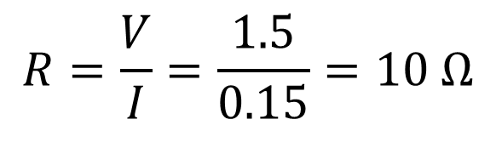
Example 5
0.15 A flows through the lamp when the potential difference is 1.5 V. Calculate the resistance of the lamp.
1.5 V
I = 0.15 A
$$R=\frac{V}{I}=\frac{1.5}{0.15}=10 Ω$$

Slide 50
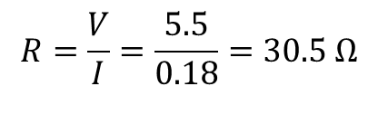
Exercise
180 mA flows through the lamp when the potential difference is 5.5 V. Calculate the resistance of the lamp at this current.
5.5 V
$$R=\frac{V}{I}=\frac{5.5}{0.18}=30.5 Ω$$

Slide 51
What is a resistor?
A device that has resistance
What is the circuit symbol?

Slide 52
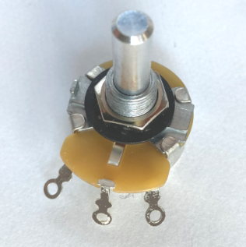
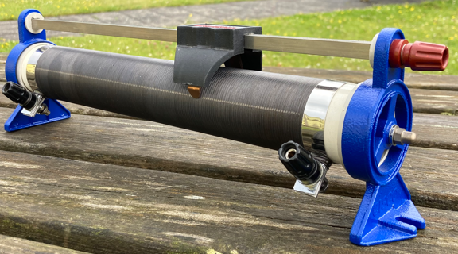
What is a variable resistor?
A device that lets you change its resistance
What is the circuit symbol?
Own Photo
Own Photo

Slide 53
How do you measure resistance?
Use an ohmmeter
Ω
Ω
E.g. multimeter set to ohms.
NB never have a battery in the circuit. This can damage the multimeter.

Slide 54
Electrical circuit symbols (Recap)
Pages 72 to 78 of formula book
Learn these ones:
filament bulb
Switch
Variable resistor
Battery
Resistor
V
A
Ammeter
Voltmeter

Slide 55
Exercise
Draw a circuit diagram of a battery and a variable resistor being used to control the brightness of a lamp.

Slide 56
State Ohm’s Law.
The current through a conductor is directly proportional to the voltage across the conductor. OL 2018, OL sample 2
Current (amps)
Voltage (volts)

Slide 57
Verify Ohm’s Law
Variable resistor
Measure I and V
Vary the voltage using the variable resistor
Measure I and V for different inputs
A
V
R
Resistance being measured
Results
V
I
R

Slide 58
Are these two circuits the same?
A
V
R
A
R
V
Yes, a circuit diagram is not an exact physical representation. Its purpose is to show where the connections are made.

Slide 59

Graph
When graphing current versus voltage, it is standard practice in engineering to put voltage (independent variable) on the x axis.
This means that in the Ohm’s law experiment the slope will give the value of 1/R.
Current (amps)
Voltage (volts)

Slide 60
Example 7
A graph of current against voltage is plotted for a conductor that obeys Ohm’s Law. Describe how the graph verifies Ohm’s Law
The graph of current against voltage is a straight line through the origin. This shows that current is directly proportional to the voltage and this verifies Ohm’s Law.
Current (amps)
Voltage (volts)

Slide 61
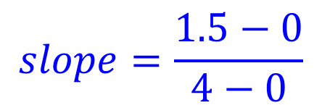
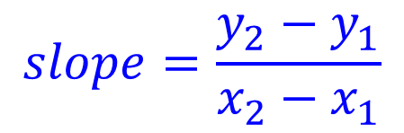
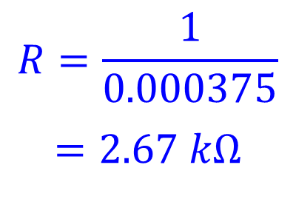
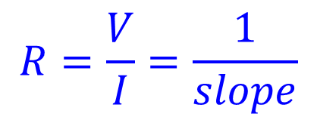
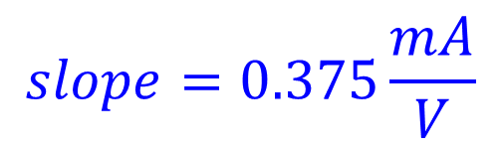
Example 8
Find the slope of this graph and calculate the resistance of the conductor.
2
$$slope=\frac{y_{2}−y_{1}}{x_{2}−x_{1}}$$
Current (mA)
$$slope=\frac{1.5−0}{4−0}$$
1.5
$$slope=0.375\frac{mA}{V}$$
1
$$R=\frac{V}{I}=\frac{1}{slope}$$
0.5
$$R=\frac{1}{0.000375}$$
$$=2.67 kΩ$$
1
2
3
4
Voltage (V)

Slide 62
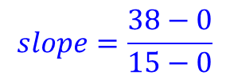
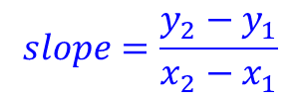
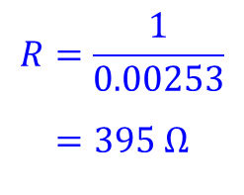
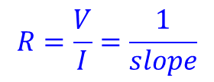
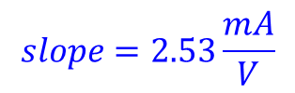
Exercise
Use the graph to calculate the resistance
of the conductor.
40
Current (mA)
30
$$slope=\frac{y_{2}−y_{1}}{x_{2}−x_{1}}$$
20
$$slope=\frac{38−0}{15−0}$$
$$slope=2.53\frac{mA}{V}$$
10
$$R=\frac{V}{I}=\frac{1}{slope}$$
$$R=\frac{1}{0.00253}$$
$$=395 Ω$$
5
10
15
20
Voltage (V)

Slide 63
Effect of varying temperature on resistance.
Thermometer
Ohm-meter
Set the multimeter to 200 Ω
setting
Gradually heat the water.
Note the temperature and the resistance at different points
Plot R vs T on a graph
2000
Ω 200
Long Thin Copper wire
Water
Heat
Notes:
Also in the Heat chapter but proper to this chapter according to the specification.
If you have a pre-constructed metal resistance thermometer, then use it to save trouble.
Alternatively use for example 10 meters of laminated copper wire with a diameter of about 0.13 mm (quite thin). This will give about 10 ohms resistance. Wind the wire about something insulating and non soluble (e.g. test tube or pvc pipe). Use insulating tape to hold it in place. The lamination will ensure that the wire does not short circuit and reduce the effective length however a neat coil is recommended as a further precaution against shorting.
Be sure the scrape the lamination off both ends of the wire for attaching to the ohmmeter. Most ohm-meters have a resolution of 0.1 ohm, hence the need get a resistance of about 10 ohms of wire. This needs to be prepared and tested before class as it is fiddley and time consuming. Try to make something you can re-use.
Nichrome wire is problematic as its resistance does not change that much with temperature.
Some recommend glycerol instead of water because of the lower electrical conductivity of glycerol, however the difference is negligible and unlikely to alter any readings in a school lab. Water is shown in a partially drawn diagram in the Ordinary Level Sample paper 1 issued for the new specification.

Slide 64
Effect of varying temperature on resistance
Results
T ℃
R Ω
Graph
Resistance of metals increases with temperature.
very linear within the measurement range – particularly for platinum.
Resistance (Ω)
Temperature (℃)
Platinum
Notes:
Bureau International des Poids et Mesures use Platinum resistance thermometers to make standard thermometers.

Slide 65
Electric Power

Slide 66
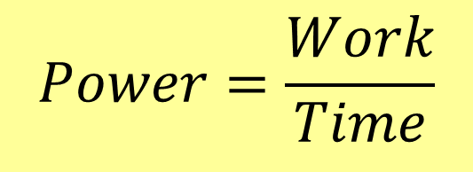
Recap: What is Power?
the rate of doing work (work per second).
$$Power=\frac{Work}{Time}$$
What is the unit of power?
The watt (W)
1 watt = 1 joule per second

Slide 67
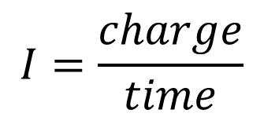
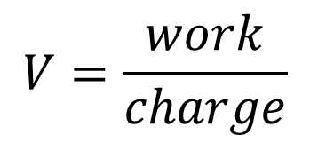
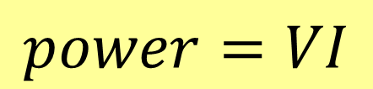

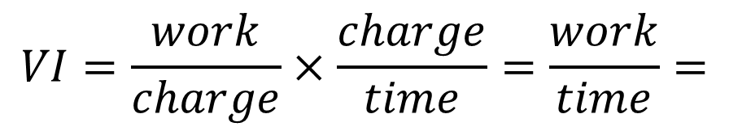
Derive P=VI.
$$V=\frac{work}{charge}$$
$$I=\frac{charge}{time}$$
$$VI=\frac{work}{charge}×\frac{charge}{time}=\frac{work}{time}=$$
$$power$$
$$power=VI$$
Tables pg 62

Slide 68


Example 9
An electric drill draws 1.5 A when connected to a 230 V electricity source. Calculate the power drawn.
$$P=VI$$
$$P=1.5\left(230\right)=345 W$$

Slide 69



Exercise
An electric kettle consumes 2200 W when connected to a 230 V electricity source.
what is the current
What is the resistance of the kettle
What would the power consumption be if the supply voltage dropped to 220 V
(i) $P=VI ⇒ I=\frac{P}{V}=\frac{2200}{230}=9.565 A$
(ii) $R=\frac{V}{I} =\frac{230}{9.565}=24.05 \text{Ω}$
(iii) $P=\frac{V^{2}}{R} = \frac{{220}^{2}}{24.05}=2012 W$

Slide 70
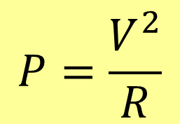

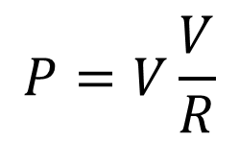




Power when you know R
$$R=\frac{V}{I}⇒ V=IR OR I=\frac{V}{R}$$
$$P=VI$$
$$P=VI$$
$$P=IRI$$
$$P=V\frac{V}{R}$$
$$P=\frac{V^{2}}{R}$$
$$P=I^{2}R$$
useful in heat experiments

Slide 71

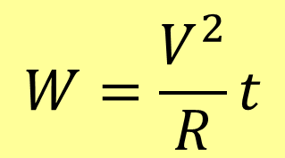




Write 3 power and 3 work equations
$$P=\frac{V^{2}}{R}$$
$$P=VI$$
$$P=I^{2}R$$
$$W=\frac{V^{2}}{R}t$$
$$W=VIt$$
$$W=I^{2}Rt$$

Slide 72



The heating effect of electric current
Whenever current flows through a conductor which has some resistance, heat is generated.
I
R
The amount of heat can be calculated using the equations:
$$P=I^{2}R$$
$$W=I^{2}Rt$$
$$W=VIt$$
Electric heating can be determined quite accurately.

Slide 73


Example 10
A 2.3 Ω resistor has 1.5 A flowing through it. Calculate the amount of heat energy generated in 1 minute.
$$P=I^{2}R$$
$$P={1.5}^{2}\left(2.3\right)=5.175 W$$
1 minute = 60 seconds
$$heat=Pt=5.175\left(60\right)=310.5 J$$

Slide 74






Exercises
A 2.7 Ω resistor has 4 V across it. Calculate the amount of heat energy generated in 70 seconds.
$$W=\frac{V^{2}}{R}t$$
$$Heat=\frac{4^{2}}{2.7}\left(70\right)=414.8 J$$
A 2.5 Ω resistor has 1.2 A flowing through it. Calculate the amount of heat energy generated in 2 minutes.
$$P=I^{2}R$$
$$P={1.2}^{2}\left(2.5\right)=3.6 W$$
$$heat=Pt=3.6\left(120\right)=432 J$$
What is the resistance of a 230 V lamp rated at 9 W
$$P=\frac{V^{2}}{R}⇒R=\frac{V^{2}}{P}=\frac{{230}^{2}}{9}=5878 \text{Ω} \text{or}\text{ 5.88 }\text{k}\text{Ω}$$

Slide 75
Example 11
Electricity is supplied to a device using a long cable as shown. The total resistance of the wire in the cable is 1.2 Ω (0.6 Ω there and 0.6 Ω back). The supply voltage is 230 V and 12 A flows in the wire. Calculate how much power is delivered from the source and calculate how much is lost as heat In the wires
I =12 A
0.6 Ω
230 V
0.6 Ω
Device
Power delivered = VI = 230(12)=2760 W
Resistance of connecting wires = 0.6 + 0.6 = 1.2 Ω
Power lost as heat = $I^{2}R={12}^{2}\left(1.2\right)=173 W$

Slide 76
Example 12
The supply voltage is doubled to 460 V and the same amount of power is delivered.
(i) Calculate the new current
(ii) Calculate the new heat loss
I =6 A
0.6 Ω
460 V
0.6 Ω
Device
Power remains same: 2760 W $⇒I=\frac{2760}{460}=6A$
Power lost as heat = $I^{2}R=6^{2}\left(1.2\right)=43.2 W$
This is a dramatic reduction from 173 W to 43.2 W

Slide 77


High voltage transmission
We have just seen that by doubling the voltage we can reduce the transmission losses by $\frac{1}{4}$ If we increase the voltage by a factor of 1000, we reduce the losses by a factor of 1 000 000.
250 kV
Extra High Voltage systems are very efficient. In Ireland, about 8% of electricity generated is lost on the way to the consumer.
World Bank (2026) Electric power transmission and distribution losses (% of output). Available at: https://data.worldbank.org/indicator/EG.ELC.LOSS.ZS (Accessed: 1 March 2026)
Notes:
The figure for Irelsnd includes both Transmission (Extra High Voltage) and Distribution losses (High and low voltage)

Slide 78
Water analogy for electricity
  The height of the water in the tank gives it potential energy in a similar way that the potential difference is the energy per coulomb of charge.
  Current flows
  Resistance opposes the flow
Voltage is like water pressure
Current is like water flow
Resistance is like a narrow pipe
NB its only an analogy – there are many differences

Slide 79

Water analogy for electricity
Increased height $→$ increases the flow
For a given conductor, increasing the potential difference or voltage increases the current

Slide 80
Memory aid: EMF vs voltage
here is your energy, off you go and do some work
here is where I spent the energy
Battery
Charge
Charge
Voltage
EMF

Slide 81
Hands on : increasing the voltage
1.5 V
More volts, more push, more current, more energy
1.5 V
1.5 V

Slide 82
Revision summary
Key Definitions: Electric current, Electric potential, potential difference, voltage, emf, resistance
Concepts: electric charge, current and conventional current direction, series and parallel circuits, resistor, variable resistor, heating effect of current
Units: volt, ampere, coulomb, ohm, watt, joule
Use: $I=\frac{q}{t}, V=\frac{W}{q}, W=I^{2}Rt, P=I^{2}R, P=VI, V=IR$
Measure voltage, current and resistance
Experiments: verify Ohms law, investigate the effect of varying temperature on the resistance of a conductor

Slide 83
Appendix - Multimeters
Notes:
The purpose of this appendix is to give easy access to the accuracy specifications of some multimeters commonly used in schools. The specifications are all quite similar so if your model does not appear you can use one of the others to give you some idea.
Accuracy figures are highly abbreviated e.g. ±(2%+5) This means ±2% of the reading on the screen and ±5 of the least significant digit on the screen. For example, if the number 300 were on the screen, you would calculate the maximum error as 2%= 6 and you also have the 5 digits giving a maximum possible error of ±11 digits, ie the true value is between 289 and 311. Expressed as a percentage this is 11x100/300 = 3.7%.

Slide 84

UNI-T UT33B
Function
Range
Accuracy
DC Voltage
All
±(0.5%+2)
AC Voltage
All
±(1.2%+10)
DC Current
200 μA
±(1.0%+2)
200 mA
±(1.2%+2)
10 A
±(2%+5)
Resistance
200 Ω
±(0.8%+5)
Resistance
2kΩ..200kΩ
±(0.8%+2)
Resistance
20MΩ
±(5%+10)
Source Uni-Trend Technology (2002) UT33B/C/D Operating manual (Printed manual)

Slide 85

Mercury MTB02
DC Voltage 200mV
±(0.5%+3)
DC Voltage 2V, 20V 200V
±(0.8%+5)
DC Voltage 500V
±(1.0%+5)
AC Voltage 200/500V
±(2.0%+10)
DC Current 200μA 2mA 20mA
±(1.8%+2)
DC Current 200mA
±(2.0%+2)
DC Current 5A
±(2.0%+10)
Resistance 200Ω
±(1.0%+10)
Resistance kΩ MΩ
±(1.0%+4)
AVSL (n. d.) MTB01, MTB02 Digital multimeter (Printed manual)

Slide 86

Duratool D03046 and D03047
DC Voltage 200mV
±(0.5%+3)
DC Voltage 2V, 20V 200V
±(0.8%+5)
DC Voltage 500V
±(1.0%+5)
AC Voltage 200/500V
±(2.0%+10)
DC Current 200μA 2mA 20mA
±(1.8%+2)
DC Current 200mA
±(2.0%+2)
DC Current 5A
±(2.0%+10)
Resistance 0-200
±(1.0%+10)
Resistance kΩ MΩ
±(1.0%+4)
Comments: very low cost, no AC current measurement
47 has a buzzer 46 does not
Premier Farnell Ltd (n.d.) Digital Multimeter: Models D03046 and D03047. Available at: https://www.farnell.com/datasheets/2707700.pdf (Accessed: 1 March 2026)

Slide 87

Duratool D03124
DC Voltage all
±(0.5%+2)
AC Voltage all
±(0.9%+3)
DC Current all
±(1.5%+3)
AC Current all
±(1.5%+3)
Resistance
±(0.8%+2)
Up to 200 kΩ
Resistance
2, 20 MΩ
±(1.0%+2)
For simplicity, 600V settings are not shown
Premier Farnell Ltd (2023) Handheld Digital Multimeter: D03124 (V1.2). Available at: https://www.farnell.com/datasheets/4018326.pdf (Accessed: 1 March 2026)

Slide 88

Bosstek DT9330
No data sheet found.
Suggest using the specification for the Rapid 328 DMM

Slide 89

Rapid Electronics 318 DMM
DC Voltage All ex 1000V
±(0.5%+1)
DC Voltage 1000V
±(0.8%+2)
AC Voltage 200 mV
±(1.2%+3)
AC Voltage 2V, 20V, 200V
±(0.8%+3)
AC Voltage 700V
±(1.2%+3)
DC Current 20μA
±(2.0%+5)
DC Current 200μA, 2mA, 20mA
±(0.8%+1)
DC Current 200mA, 2A
±(1.5%+1)
DC Current 10A, 20A
±(2.0%+5)
The 318 and 328 have the same specs except 328 can take 20A nut 318 can measure smaller currents
Rapid Electronics (1997) Instruction Manual 318/328 Digital LCD Multimeter Rev A. (printed manual)

Slide 90
Rapid Electronics 318 DMM continued
AC Current 200μA
±(1.8%+3)
AC Current 2mA, 20mA
±(1.0%+3)
AC Current 200mA, 2A
±(1.8%+3)
AC Current 10A, 20A
±(3.0%+7)
Resistance 200 Ω
±(0.8%+3)
Resistance 2k, 20k, 200k, 2M
±(0.8%+1)
Resistance 20MΩ
±(1.0%+2)
The 318 and 328 have the same specs except 328 can take 20A nut 318 can measure smaller currents
Rapid Electronics (1997) Instruction Manual 318/328 Digital LCD Multimeter Rev A. (printed manual)

Slide 91

Rapid 328 DMM page 1
DC Voltage All ex 1000V
±(0.5%+1)
DC Voltage 1000V
±(0.8%+2)
AC Voltage 200 mV
±(1.2%+3)
AC Voltage 2V, 20V, 200V
±(0.8%+3)
AC Voltage 700V
±(1.2%+3)
DC Current 20μA
±(2.0%+5)
DC Current 200μA, 2mA, 20mA
±(0.8%+1)
DC Current 200mA, 2A
±(1.5%+1)
DC Current 10A, 20A
±(2.0%+5)
Rapid Electronics (1997) Instruction Manual 318/328 Digital LCD Multimeter Rev A. (printed manual)

Slide 92
Rapid 328 DMM page 2
AC Current 200μA
±(1.8%+3)
AC Current 2mA, 20mA
±(1.0%+3)
AC Current 200mA, 2A
±(1.8%+3)
AC Current 10A, 20A
±(3.0%+7)
Resistance 200 Ω
±(0.8%+3)
Resistance 2k, 20k, 200k, 2M
±(0.8%+1)
Resistance 20MΩ
±(1.0%+2)
Rapid Electronics (1997) Instruction Manual 318/328 Digital LCD Multimeter Rev A. (printed manual)

Slide 93
Rapid 212
DC Voltage 200V
±(0.5%+2)
No photo but looks similar to ATP DT-830D+ in these slides
DC Voltage 600V
±(0.8%+2)
AC Voltage All
±(1.2%+10)
DC Current μA 20mA
±(1.0%+2)
DC Current 200mA
±(1.5%+2)
DC Current 10A
±(3.0%+2)
Resistance 0-200Ω
±(0.8%+3)
Resistance kΩ
±(0.8%+2)
(2kΩ, 20kΩ, 200kΩ)
Resistance 2000kΩ
±(1.0%+2)
(2kΩ, 20kΩ, 200kΩ)
Rapid Electronics (2003) 212 Pocket-sized Digital Multimeter, Operators Instruction Manual Rev A (Printed version)

Slide 94

DT-830B
No specification found, suggested estimates:
DC Voltage ±(0.5% +2)
AC Voltage ±(1.2% +10)
DC Current
Lower ranges ±(1.5%+2)
10 A range ±(3%+7)
Resistance ±(1.0% +2)

Slide 95

ATP DT-830D+
No specification found, use these estimates
DC Voltage ±(0.5% +2)
AC Voltage ±(1.2% +10)
DC Current
Lower ranges ±(1.5%+2)
10 A range ±(3%+7)
Resistance ±(1.0% +2)
Notes:
Photo from teacher, cannot find details

