Slide 1
Electricity
An introduction

Slide 2
What is electricity?

Slide 3
What is electricity?
Look at protons and electrons…..
Like charges repel, unlike charges attract
e
e
p⁺
e⁻
p
p
positively charged
negatively charged
p
e
The force that makes this happen is what we call electricity

Slide 4
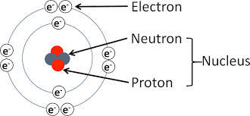
Where do protons and electrons come from?
As the electrons are on the outside of the atoms, they can move more easily. In general:
Items with a negative charge have gained electrons
Items with a positive charge have lost electrons

Slide 5
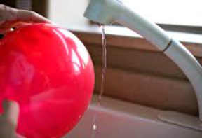

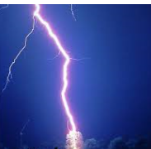

Charging by contact
By friction, electrons are removed from the atoms of one item and attached to the other

Slide 6
charged by friction
+ +
+ +
+ +
charged by induction
- + - + - +
+ - + - + - + - + -
+ - + - + - + - +
+ - + -
- - - - - -
- - - - - - -
+ + + + +
+ +

Slide 7
Electroscope: showing the presence of a charge
what we see…

Slide 8
Electroscope: showing the presence of a charge
+ + + +
- - - - - - -
+ +
+ +
what’s happening…

Slide 9
Electroscope: maintaining the presence of a charge
what we see…

Slide 10
Electroscope: maintaining the presence of a charge
+ + + +
- - - - - - -
- - -
- -
- -
- -
- -
---
+ +
+ +
what’s happening…

Slide 11
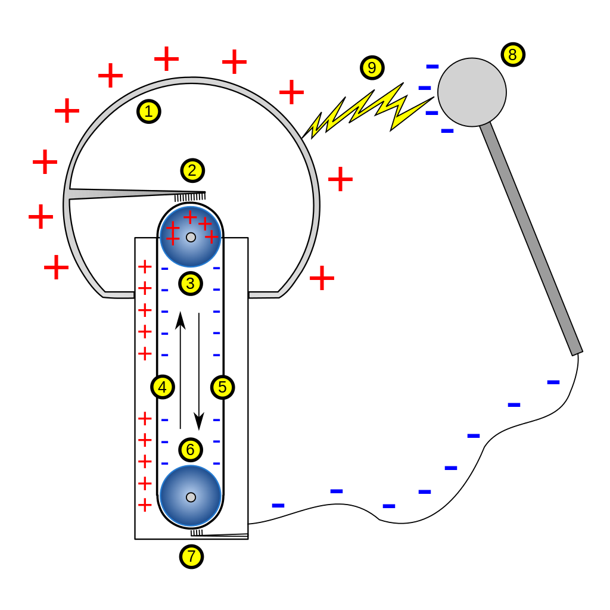
Van de Graaf
charge transfers to dome
(and becomes large)
(small) charge builds up by friction

Slide 12
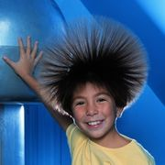
Van de Graaf
charge transfers to hair

Slide 13
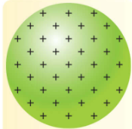
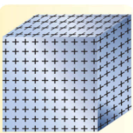
Point Effect
like charges repel….
…and spread out as much as possible
…which works well on a sphere
…but not on a cube
…where charge builds up on a corner

Slide 14
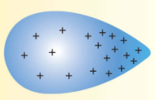
Point Effect
Charge always builds up on a point

Slide 15
Point Effect
Charge always builds up on a point
+ + + + + + + ++
+ + + + + + + ++

Slide 16
Point Effect
The air becomes ionised…
_ _
_
_ _
_
+
+
+
+ + + + + + + + ++
+ + + + + + + + ++
+
+
+

Slide 17
Point Effect
The air becomes ionised…
_ _
_
_ _
_
+
+
+
+ + + + + + + + ++
+ + + + + + + + ++
+
+
+
…the object loses its charge

Slide 18

Point Effect
Sharp points remove the charge from an object….
…or from a nearby object
…the basis of the Lightning Conductor

Slide 19
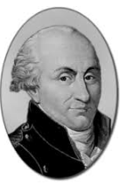
Coulomb’s Law
…states that the force between two point charges is directly proportional to the product of the charges, and inversely proportional the square of the distance between them.

Slide 20
What is the force on a charge of 10μC placed a distance of 50cm from a charge of 5 μC, in air?
+
+
(Permittivity of free space = 8.854 x 10⁻¹² Fm⁻¹)

Slide 21
ε
What is permittivity?
(epsilon)
permittivity is the ability of a substance to store electrical energy in an electric field.
In loose terms, if two charges are separated by, say, air, - and another two charges are separated by oil, the forces created would vary. This is because of the effect of the substance between the charges, and this effect is measured by the permittivity.
+
Substance of permittivity ε
+

Slide 22
ε
What is the permittivity of free space?
_{o} (epsilon-zero)
When two charges are separated by air, or a vacuum, we refer to that as ‘free space’
(Permittivity of free space: ε₀ = 8.854 x 10⁻¹² Fm⁻¹)
ε₀
+
+

Slide 23
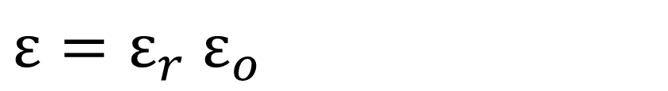
ε
What is the permittivity of other materials?
_{r}
When two charges are separated by something other than air, we will be given the relative permittivity, ε_{r}
$ε=ε_{r}$ $ε_{o}$
ε_{r}
+
+

Slide 24
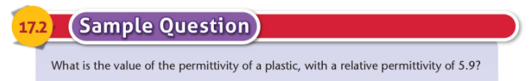
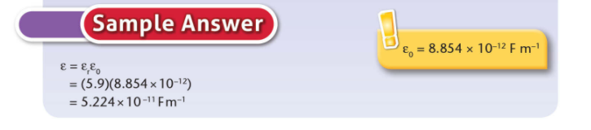

Slide 25
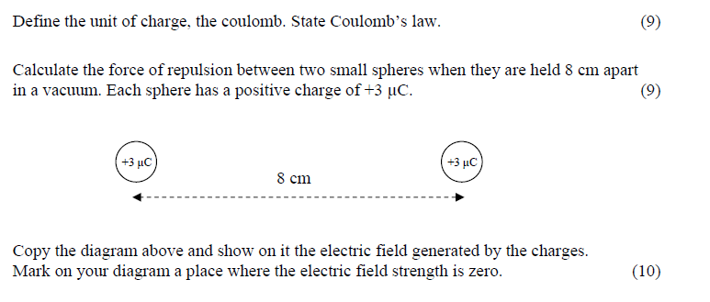
2013 q.12c

Slide 26


Define the unit of charge, the coulomb. State Coulomb’s law.
Coulomb’s Law states the force between two point charges is directly proportional to product of the charges and inversely proportional to the square of the distance between them.
The coulomb?
If a current of one amp is flowing in a conductor, one Coulomb is the quantity of charge that passes any one point in one second.

Slide 27

Calculate the force of repulsion between two small spheres when they are held 8 cm apart in a vacuum. Each sphere has a positive charge of +3 μC.

Slide 28
2013 q.12c

