Slide 1
Science Fiction
The facts

Slide 2
The Martian (Gravity Assist)

Slide 3
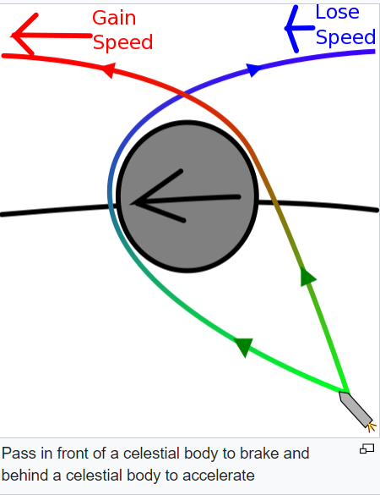
Gravity Assist
Is this plausible?
Gravity assist means using the gravitational attraction of a planet to increase, or decrease, the velocity of a passing spacecraft
is the effect real?
The effect is real, but you have to factor in the motion of the planet itself to control it…..
Gravity assist | The Planetary Society

