Slide 1
Electric Potential
introduction

Slide 2
Electric Potential
Imagine a large positive charge fixed in place….
Another, smaller and more mobile charge is released as shown…
Which way will it move, and why?
+
It will move downwards, as shown
This is because like charges repel
As described by Coulomb’s Law
+

Slide 3
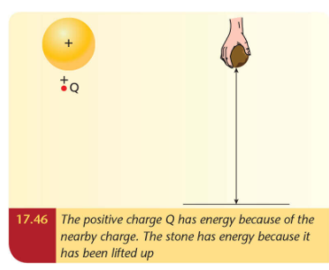
Electric Potential
+
When a force moves an object, work is done…
…and this means is energy is transformed
Here, the kinetic energy is coming from the electric potential energy
+
Positive charges will move from high potential to low potential….
….just like a falling ball moves from high to low (gravitational) potential

Slide 4
Electric Potential
+
What if it a negative charge?
This will move towards the plus.
So, Negative charges will move from low to high potential
-

Slide 5




Electric Potential
+
+
$$V=\frac{W}{Q}$$

Slide 6
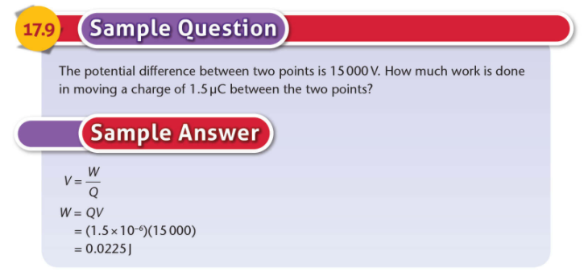
Electric Potential

Slide 7
