Slide 1

2.5 Sound Energy
Blue whale, the loudest animal
CC0
Notes:
The blue whale has the most powerful voice of any animal with a maximum measured loudness of 191 dB (https://www.antarctica.gov.au/news/2015/antarctic-blue-whale-song-penetrates-the-vast-southern-ocean). The blue whale’s call can be detected up to 1000 km away (https://www.marinemammals.gov.au/research/antarctic-blue-whale-and-krill-voyage-2019/team-members/dr-brian-miller/). Part of the reason for these extraordinary numbers it that sound behaves differently in water than in air

Slide 2
Physics Specification 2.5
2.5 Sound energy
Students learn about
sound energy needs a medium to travel through
ultrasound
Students should be able to
examine evidence to support the mechanical wave nature of sound
relate the pitch and loudness of sounds to their wave characteristics using observation and secondary data
investigate the use of ultrasound in technological and medical contexts using secondary sources
Source: LC Physics Specification (2025), ncca.ie, © NCCA

Slide 3
Revision Summary
Key Definitions: ultrasound
Concepts: medium, loudness, pitch
Demonstrations:
Evidence of the mechanical wave nature of sound: (e.g. candle in a sound wave, no sound in a vacuum)
Relate pitch and loudness to frequency and amplitude
Investigate: ultrasound in practice.

Slide 4
Recap: What is a wave?
A wave is a disturbance that transfers energy without transferring matter.
LC specification
Disturbance
CC0
Energy
No matter transferred
Definition wording: LC Physics Specification (2025), ncca.ie, © NCCA

Slide 5

Recap: Transverse and Longitudinal Waves
CC0
Animation link
Light is transverse
CC0
Sound is longitudinal
Animation link

Slide 6
Recap: What is a longitudinal wave?
A wave whose direction of vibration is parallel to the direction of travel.
Direction of vibration
CC0
animation link
Direction of travel

Slide 7

What kind of wave is sound?
CC0
animation link
Longitudinal
Pick one molecule and follow its movement with your eye.
You will see that it is oscillating back and forth and on average stays where it started.
Thus, there is no overall movement of the air. It is just the pressure wave and energy that moves.

Slide 8
Why does sound look transverse, but is longitudinal?
Because the air molecules vibrate parallel to the direction the wave travels.
Vibration
Reality:
Amplitude but not direction
Computer:
On the computer, the y-axis represents the magnitude of the displacement but not the direction.

Slide 9
Mechanical Waves

Slide 10

Recap: What is a mechanical wave?
A disturbance that passes through matter by making the matter particles vibrate.
CC0

Slide 11
What is meant by a medium?
For waves, a medium is the material the wave travels through.
Notes:
The wave moves, but there is no overall movement of the medium. The particles vibrate, but overall, they stay in the same place.

Slide 12
If the particles do not move from the source of the wave to the observer, what does move?
CC0
Energy
Notes:
“The wave” moves is not incorrect, but “Energy” is much stronger physics

Slide 13
Demonstrate that sound needs a medium
Switch on buzzer.
Remove the air.
Observe the sound getting quieter.
Let the air back in, observe it getting louder.
Battery
Bell Jar
Buzzer
Vacuum
This is evidence that sound is a mechanical wave.
CC0
Vacuum pump

Slide 14
Demonstrate that sound is a mechanical wave
Speaker playing low pitch
Slow-motion video camera
Observation
Candle vibrates in unison with the sound
This is evidence that sound is a mechanical wave
Candle
https://www.youtube.com/shorts/4t3BsZ0pMg4
https://www.youtube.com/watch?v=rL5Vbw5gdi4
Notes:
I expect you would need a large speaker and a low frequency sound, The videos show it well.

Slide 15
Explain how the candle flame verifies sound is a mechanical wave
Speaker playing a low pitch
Definition:
A mechanical wave is a disturbance that passes through matter by making the matter particles vibrate.
Analysis
The vibrating flame is evidence that the air molecules in the flame are vibrating.
Candle

Slide 16
Demonstrate that sound is a mechanical wave
Observation
Ping-pong ball moves, showing that the second tuning fork resonates with only air in between.
Vibrating
Ping-Pong ball
This is evidence that sound is a mechanical wave
Two tuning forks on sound boxes separated by air
https://www.youtube.com/shorts/Pagl1zg0j4A
https://www.youtube.com/shorts/NVjLk0yKmmI
Notes:
Might be difficult to get working, the videos are clear. It is an example of both resonance and propagation.

Slide 17
How does being able to hear someone banging on a pipe in a distant room demonstrate that sound is a mechanical wave?
Definition:
A mechanical wave is a disturbance that passes through matter by making the matter particles vibrate
Observation:
The sound is travelling along the pipe (matter)
Conclusion:
The sound is a mechanical wave

Slide 18
Exercise
Describe two ways to demonstrate that sound is a mechanical wave.
Buzzer in a vacuum / loudspeaker and candle / 2 tuning forks
Equipment, method and observation
Explain how the candle in front of the loudspeaker verifies that sound is a mechanical wave.
Definition:
A mechanical wave is a disturbance that passes through matter by making the matter particles vibrate.
Analysis
The vibrating flame is evidence that the air molecules in the flame are vibrating

Slide 19
Loudness and Pitch

Slide 20
What wave characteristic determines the loudness of a sound?
The amplitude
Loud
Quiet
If the amplitude of a wave is increased, what happens to the energy?
Also increases.

Slide 21
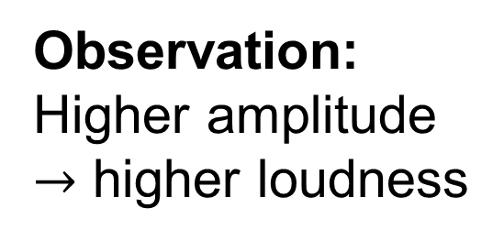
Demonstrate that loudness is related to amplitude
Guitar or sonometer plucked softly and then strongly.
Observation:
Higher amplitude $→$ higher loudness

Slide 22
What wave characteristic determines the pitch of a sound?
The frequency
The higher the frequency - the higher the pitch.
Blue whale 10 – 40 Hz
Bats
12 kHz – 200 kHz
CC0

Slide 23
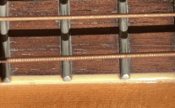
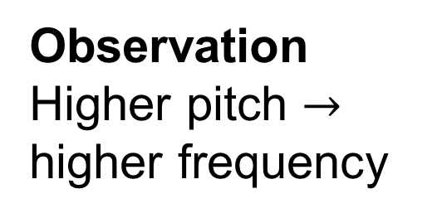
Demonstrate that pitch is related to frequency
Slow-motion video camera
Vibrating string
Vary the pitch and observe the frequency.
Tips: use guitar or sonometer
at very low frequency (tune it down).
Observation
Higher pitch $→$ higher frequency
Notes:
Note: use frequencies lower than about 60 Hz if possible, some people may even be able to “see” the frequency without the camera. Frequencies this low are hard to measure with phyphox but they work better for the visual inspection and the video. A variation is to have two strings at different pitches.

Slide 24
Audio software tools
TwistedWave
Browser or iPad app
Allows you to see the waveform
A
t
A
noisemeter.co
Browser-based spectrum analysis
f
phyphox app
Generate tones, view waveforms, analyse spectra
Notes:
Notes – These are not mandatory, just useful for measuring and visualising. Twisted wave can be used in a browser on a laptop or chromebook. It has an app for ipads (browser may not work on ipad), there are 2 experiments on the next two slides to reinforce some concepts.

Slide 25
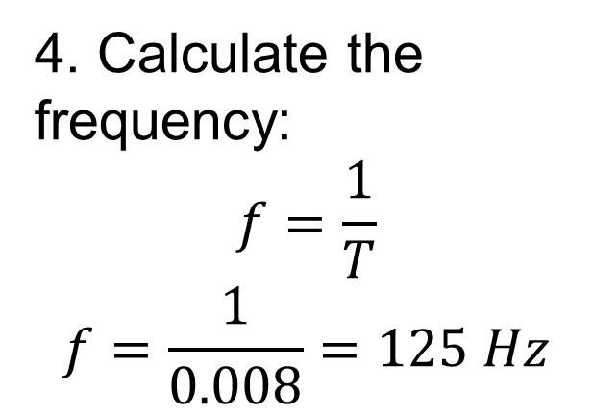
Waveform and frequency
https://twistedwave.com/
1. Record a low-pitched hum then a hissing sound.
2. Zoom in on part of the wave:
+
150 ms
200 ms
4. Calculate the frequency:
$$f=\frac{1}{T}$$
$$f=\frac{1}{0.008}=125 Hz$$
T
= 8 ms
5. Repeat for higher frequency
3. Measure the period
Notes:
Note: 1. there are clearly harmonics in this waveform. Harmonics are on the course in section 2.6 so they can be discussed here if students ask.
2. An app like phyphox can be used to generate tones which are then picked up by the likes of twisted wave or an oscilloscope, and the frequency can be verified from the waveform on the screen.
3. If the recording is very low it can be amplified on screen using the amplify or normalise effect.

Slide 26
Waveform and loudness
https://twistedwave.com/
Record a low-pitched hum and increase your volume but hold your pitch.
CC0
Observation: As loudness increases, amplitude increases.
Check if you managed to keep a constant pitch.
Notes:
Note:

Slide 27
Oscilloscope and microphone
Displacement
Time
Similar demonstrations can be performed with an oscilloscope and microphone.

Slide 28
Spectrum analysis
https://noisemeter.co/sound-spectrum-analyzer/
Use your voice, musical instrument, or a signal generator (phone app) to generate tones of different pitch.
View the spectrum analyser and observe how increased pitch is caused by increased frequency
Low pitch
High pitch
A
A
f
f
CC0
Notes:
Note:

Slide 29
Give an advantage of each of these views:
Waveform view
Spectrum view
150 ms
200 ms
A
f
Good for:
Good for:
Observing how pitch and volume vary with time (rhythm)
Determining pitch without calculations

Slide 30
Exercise
State which sound has the highest pitch, and which is the loudest.
Displacement
A
B
Time
Highest pitch: A
Loudest: A

Slide 31
Exercise
Estimate the period and frequency of this wave
Time (ms)
10
20
30
T = 10 ms, f = 100 Hz
Estimate the frequency of this wave
Time (ms)
10
20
30
T = 6 ms, f = 167 Hz

Slide 32
Ultrasound
Investigate the use of ultrasound in technological and medical contexts using secondary sources

Slide 33
What is ultrasound?
Sound with a frequency above 20 kHz

Slide 34
Is ultrasound high pitch or low pitch, loud or quiet?
Ultrasound is high-pitched because the frequency of 20 kHz is much higher than everyday sounds.
The 20 kHz tells you nothing about loudness.

Slide 35

Can you hear ultrasound?
Humans cannot
CC0
Dogs can hear some
Bats can hear more

Slide 36
What frequencies are used in medical imaging?
2-18 MHz
Not even bats can hear this
Open MedScience (2024) The role of ultrasound in medical imaging. Available at: https://openmedscience.com/the-role-of-ultrasound-in-medical-imaging/ (Accessed: 4 April 2026).

Slide 37
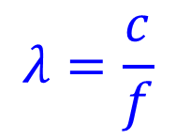

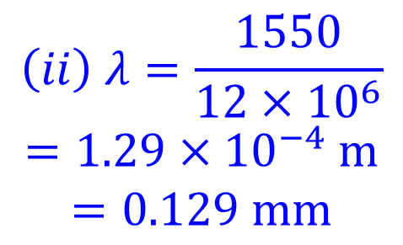
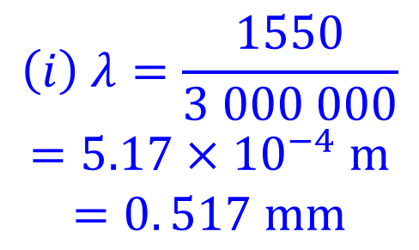
Example 1
Sound is a wave and so the wave formula c = 𝑓 λ can be used. Sound travels at 1550 m s⁻¹ in muscle. What is the wavelength in millimetres of (i) 3 MHz and (ii) 12 MHz ultrasound in muscle?
$$λ=\frac{c}{f}$$
$$\left(i\right) λ=\frac{1550}{3 000 000}$$
$$=5.17×{10}^{−4} m$$
$$=0. 517 mm$$
$$c=fλ$$
$$\left(ii\right) λ=\frac{1550}{12×{10}^{6}}$$
$$=1.29×{10}^{−4} m$$
$$=0.129 mm$$

Slide 38
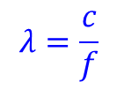

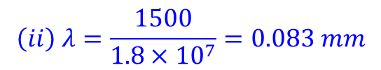
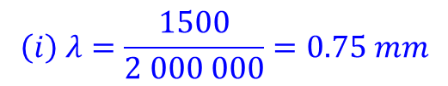
Exercise
The smallest detail an ultrasound can resolve is half the wavelength of the sound. Sound travels at
1500 m s⁻¹ in soft body tissue. What is the wavelength of (i) 2 MHz and (ii) 18 MHz ultrasound?
$$λ=\frac{c}{f}$$
$$\left(i\right) λ=\frac{1500}{2 000 000}=0.75 mm$$
$$c=fλ$$
$$\left(ii\right) λ=\frac{1500}{1.8×{10}^{7}}=0.083 mm$$

Slide 39
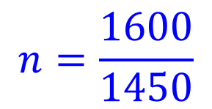
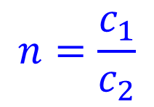

Example 2 (HL)
The speed of sound in a muscle is 1600 m s⁻¹ and in the surrounding fat it is 1450 m s⁻¹; what is the refractive index for sound waves passing from muscle to fat (faster to slower)?
$$n=\frac{c_{1}}{c_{2}}$$
$$n=\frac{\text{1600}}{1450}$$
$$n=1.103$$

Slide 40
Example 3 (HL)
Sound waves refract in a similar way to light when they pass from one medium to another. In the diagram below, which ray is correct - A or B? Justify your answer. Tip: identify the faster and slower medium.
A
Normal
B
Faster
Muscle
Fat
Slower
1600 m s⁻¹
1450 m s⁻¹
A, because waves bend away from the normal when entering a faster medium.

Slide 41



Exercise (HL)
The speed of sound in the liver is 1590 m s⁻¹ and in the surrounding fat it is 1450 m s⁻¹; what is the refractive index for sound waves passing from the liver to the fat?
$$n=\frac{c_{1}}{c_{2}}$$
$$n=\frac{1590}{1450}$$
$$n=1.096$$
Complete the ray diagram.
ultrasound
Liver
Fat
1590 m s⁻¹
Liver
1450 m s⁻¹
1590 m s⁻¹
Fat
1450 m s⁻¹

Slide 42

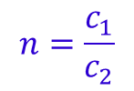
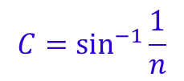
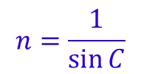

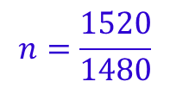
Exercise (HL)
A whale emits a call at a depth where the speed of sound is 1480 m s⁻¹. The warmer water above has a sound-speed of 1520 m s⁻¹. What is the critical angle for a sound wave approaching the warm water from the cooler water?
$$n=\frac{c_{1}}{c_{2}}$$
$$n=\frac{1520}{1480}$$
$$n=1.027027$$
CC0
$$n=\frac{1}{\sin{C}}$$
$$C=\sin^{−1}{\frac{1}{n}}$$
$$C={76.8}^{o}$$
Notes:
One of the reasons whales can communicate over large distances is this total internal reflection and a similar total internal reflection in the sea below the whale. The reflection below the whale is because sound-speed in the very deep water is greater than in the water above it due to the greater pressure. So, you have the whale swimming in the part of the sea with the lowest sound-speed. Above and below the sound-speed is higher and thus total internal reflection occurs above and below the whale.

Slide 43
Exercise (HL)
Ultrasound can be used to estimate bone density by measuring the speed of sound in a bone. Total internal reflection will hinder measurements. (i) In the diagram, where is total internal reflection more likely to occur, at A or B? (ii) Justify your answer.
Speed of sound in soft tissue is 1540 m s⁻¹; in bone, 3500 m s⁻¹.
Bone 3500 m s⁻¹
Soft tissue 1540 m s⁻¹
Transmit
Receive
A
B
A:
Tissue to bone
Slower to faster
Desired sound ray

Slide 44

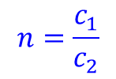
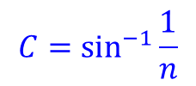
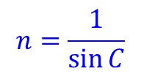

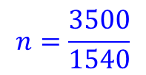
Exercise (HL)
(iii) Calculate the critical angle
Speed of sound in soft tissue is 1540 m s⁻¹, speed of sound in bone 3500 m s⁻¹.
(iv) Draw the reflected ray
Bone
Transmit
Soft tissue
Bone
Transmit
$$n=\frac{c_{1}}{c_{2}}$$
$$n=\frac{3500}{1540}$$
$$n=2.2727$$
Soft tissue
$$n=\frac{1}{\sin{C}}$$
$$C=\sin^{−1}{\frac{1}{n}}$$
$$C={26.1}^{o}$$
Reflected ray

Slide 45
Revision Summary
Key Definitions: ultrasound
Concepts: medium, loudness, pitch
Demonstrations:
Evidence of the mechanical wave nature of sound: (e.g. candle in a sound wave, no sound in a vacuum)
Relate pitch and loudness to frequency and amplitude
Investigate: ultrasound in practice.

