Slide 1
20015 q7

Slide 2
2005 question 7
(p.125)

Slide 3
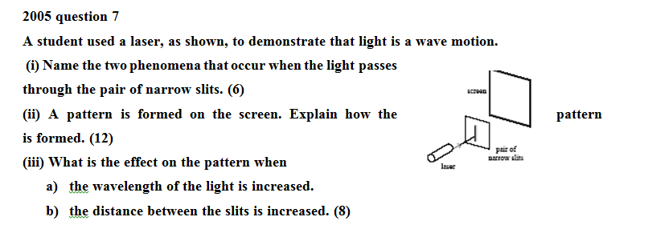
2005 question 7

Slide 4

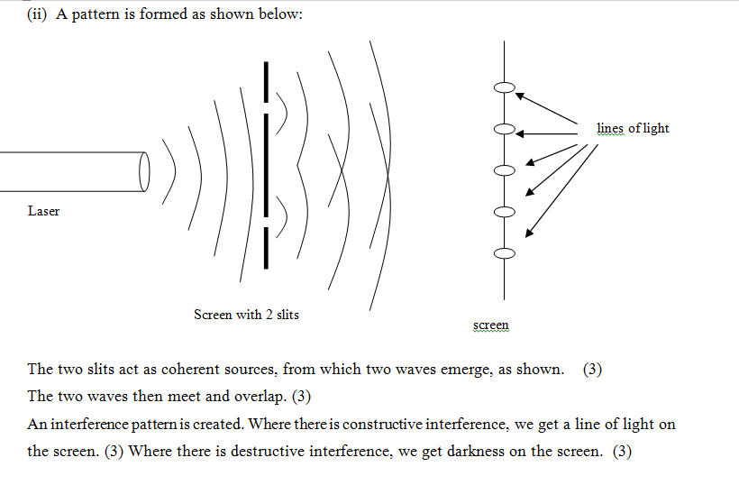
2005 question 7

Slide 5
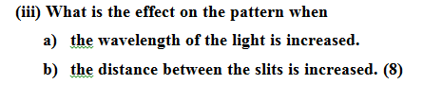
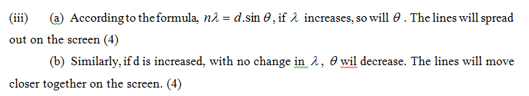
2005 question 7

Slide 6
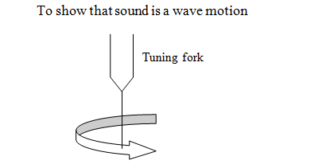
2005 question 7
Describe an experiment to show that sound is a wave motion. (12)
Method:
Strike a tuning fork and hold it to your ear. (3) Rotate the tuning fork, as shown. (3)
Observations: You will hear the sound repetitively grow and fall in volume (3)
Conclusion: This is an interference pattern
and therefore sound is a wave.

Slide 7
Marking Scheme / 2005 q.7
A student used a laser, as shown, to demonstrate that light is a wave motion.
(i) Name the two phenomena that occur when light passes through the pair of narrow slits. (6)
diffraction 3
interference 3
(ii) A pattern is formed on the screen. Explain how the pattern is formed. (12)
slits act as coherent sources 3
waves overlap / meet / path difference between waves (or shown on diagram ) 3
constructive interference gives brightness / bright lines / bright fringes 3
destructive interference gives darkness / dark lines / dark fringes 3
(iii) What is the effect on the pattern when (a) the wavelength of the light is increased. ( 4)
distance between fringes / lines / spots increases // pattern more spread out 4
(b) the distance between the slits is increased. ( 4)
distance between fringes / lines / spots decreases // pattern less spread out 4

Slide 8
Describe an experiment to demonstrate that sound is also a wave motion. (12)
two loudspeakers connected to signal generator // rotate vibrating (tuning) fork 3
walk in front of and parallel to speakers // near ear 3
observation: (e.g. sound loud and low / waxes and wanes) 3
conclusion: interference occurs showing that sound is a wave motion 3
Sound travels as longitudinal waves while light travels as transverse waves. Explain the difference between longitudinal and transverse waves. (9)
longitudinal waves: the direction of the vibrations (of medium) 3
is parallel to the direction of (propagation) of the wave 3
transverse wave: the direction (of the vibrations) is perpendicular to the (direction of the) wave 3
Describe an experiment to demonstrate that light waves are transverse waves. (9)
light source and two pieces of polaroid 3
rotate one polaroid relative to the other and light (intensity)decreases (to zero) 3
polarization indicates transverse waves 3

