Slide 1
Dispersion and the
Electromagnetic Spectrum

Slide 2

Young’s Double Slit Experiment
light
slits
screen

Slide 3

Young’s Double Slit Experiment
destructive interference
constructive interference
The experiment demonstrates the presence of diffraction and interference
This shows that light must be a wave

Slide 4
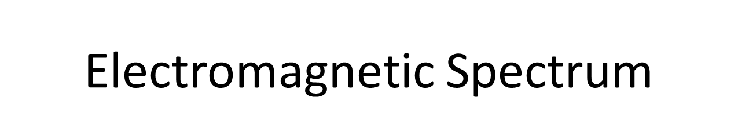
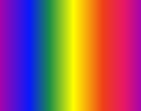
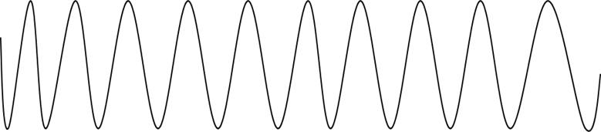
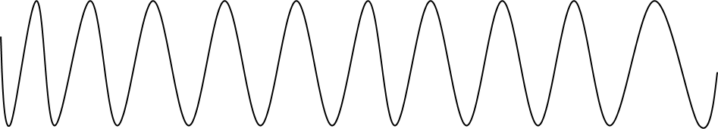
We know that light is a wave (Young’s Experiment)
We can measure the wavelength of light (using )
Different wavelengths/frequencies correspond to different colours
Short waves long waves
High frequency low frequency

Slide 5

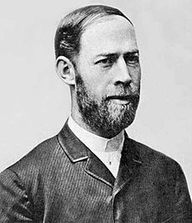
What about waves longer than red?
What about waves shorter than blue

Slide 6
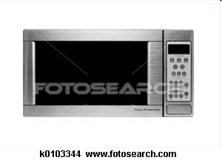
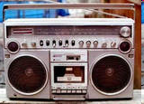
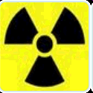
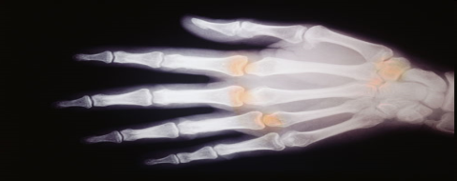
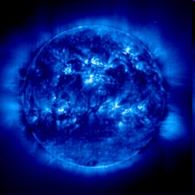
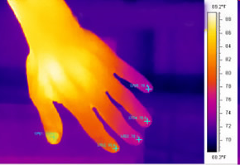
Electromagnetic Spectrum
Short waves
Long waves
High frequency
Low frequency
High energy
Low energy
γ-ray
X-ray
UV
visible
Infra-Red
Micro-wave
Radio

Slide 7
Greenhouse Effect
Sun
E-m spectrum
earth
Layer of CO₂
Radiation from the sun warms the earth
The earth releases IR to cool itself down
The CO2 traps the radiation so the earth cannot cool itself

Slide 8
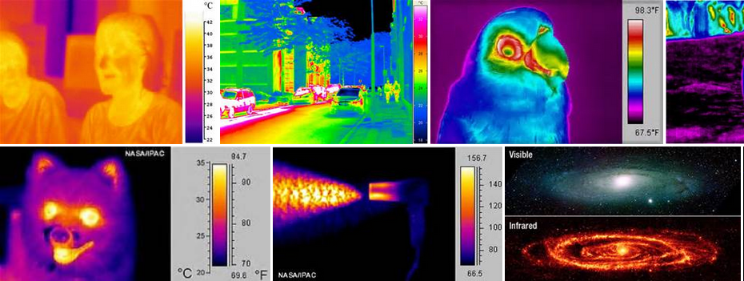
Infra red

Slide 9
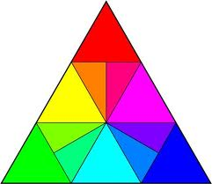
Colour triangle
red
green blue
yellow magenta
cyan
Primary colours: red, green, blue
Secondary colours: yellow, magenta, cyan
White light is an even mix of red, green and blue
Black is the absence of light

Slide 10
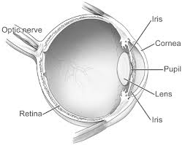
The retina in the eye is only sensitive to red, green and blue
Colour blindness happens when we are not sensitive to a particular colour

Slide 11
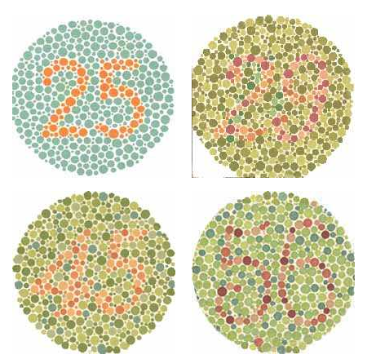
Colour blindness happens when we are not sensitive to a particular colour

Slide 12
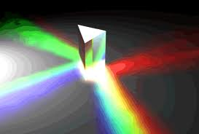
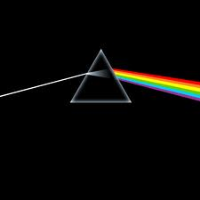
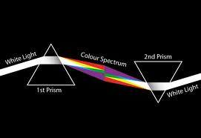
dispersion
White light can be split up into its constituent colours by:
refraction

Slide 13
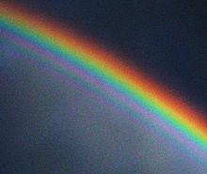
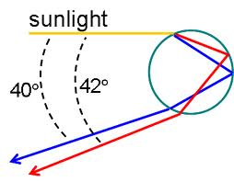
rainbows
Caused by refraction and total internal reflection…

Slide 14

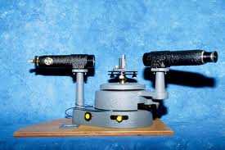
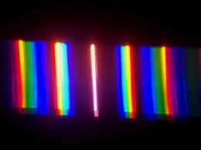
Diffraction and interference:

