Slide 1
To measure velocity and acceleration

Slide 2
Velocity and acceleration can be measured using either
A ticker-tape timer
Light gates (with an air-track)
Each one is described here, but in other velocity/acceleration experiments, our slides show the use of light gates

Slide 3
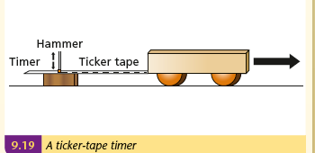

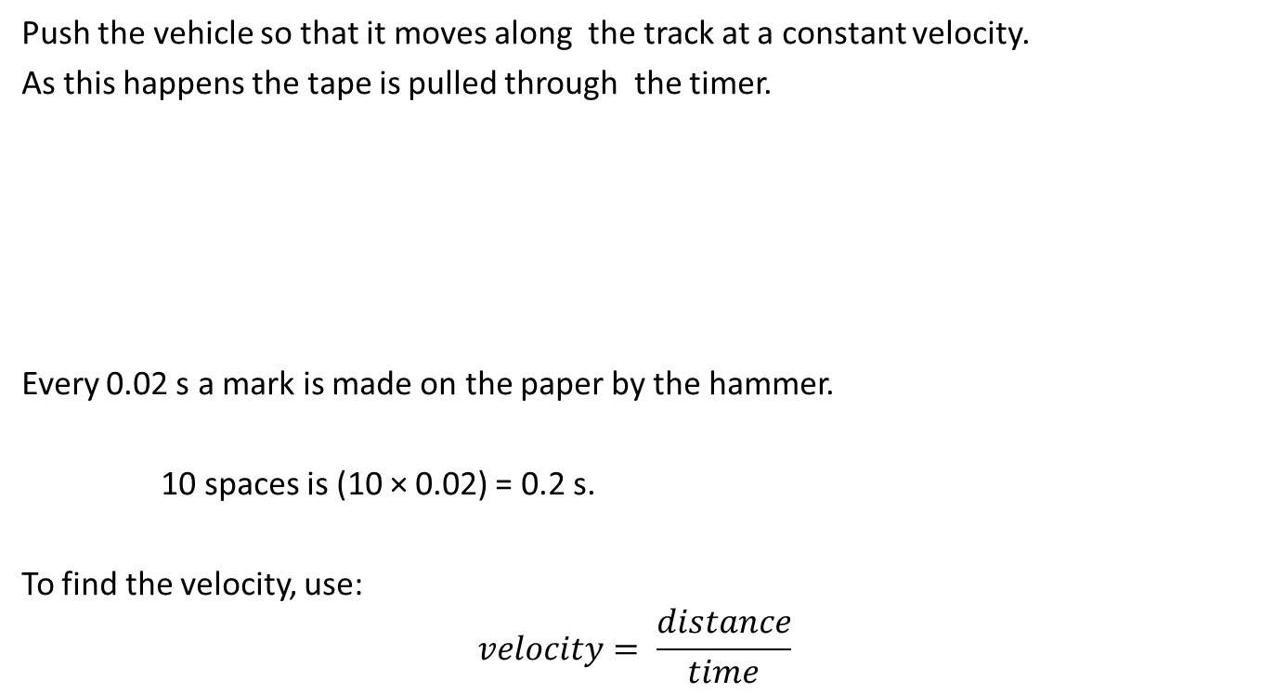
Ticker Tape Timer
Push the vehicle so that it moves along the track at a constant velocity.
As this happens the tape is pulled through the timer.
Every 0.02 s a mark is made on the paper by the hammer.
10 spaces is (10 × 0.02) = 0.2 s.
To find the velocity, use:
$$velocity= \frac{distance}{time}$$

Slide 4
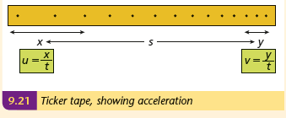

Ticker Tape Timer
To find acceleration, attach a falling weight to the trolley
The accelerating trolley creates a tape like that shown:
Find the initial and final velocities as shown
Use the formula $a=\frac{v^{2}−u^{2}}{2s}$ to find the acceleration

Slide 5
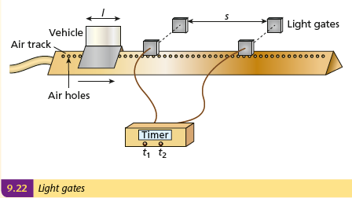
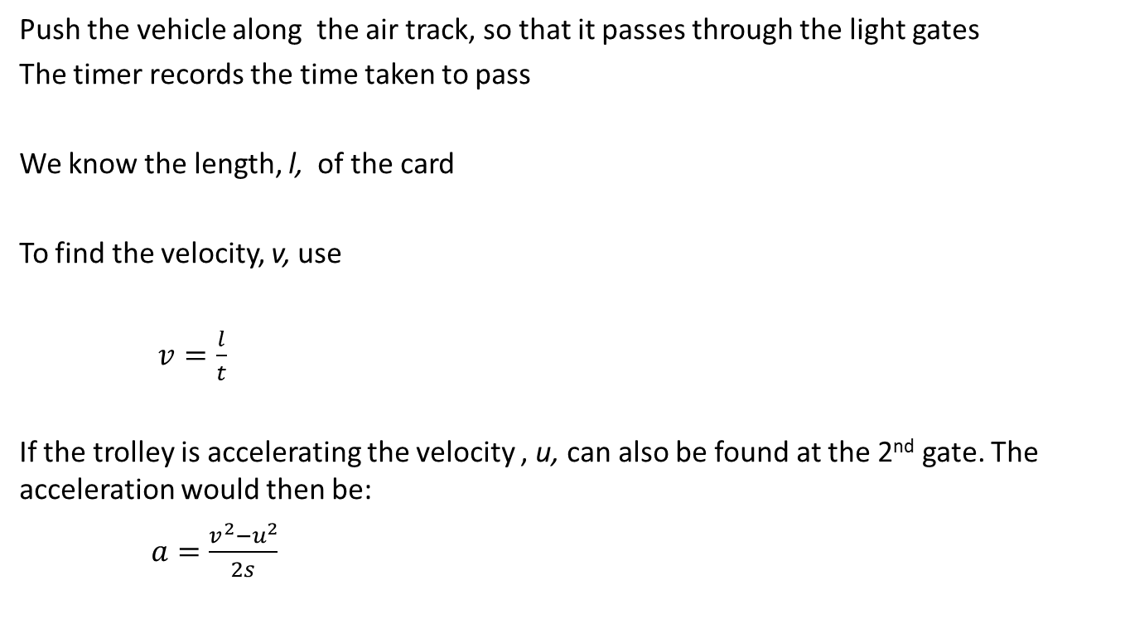
Light Gates
Push the vehicle along the air track, so that it passes through the light gates
The timer records the time taken to pass
We know the length, l, of the card
To find the velocity, v, use
$v=\frac{l}{t}$
If the trolley is accelerating the velocity , u, can also be found at the 2nd gate. The acceleration would then be:
$a=\frac{v^{2}−u^{2}}{2s}$

