Slide 1
Atomic Spectra (from Contact)

Slide 2
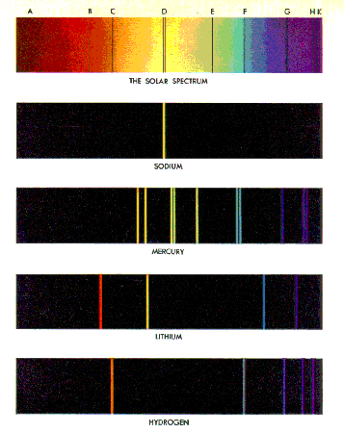
Atomic Spectra
Note every element emits its own spectrum when heated

Slide 3
Atomic Spectra (from Contact)
Why might aliens use the frequency of the Hydrogen spectrum to communicate?
….because they would expect it to be universally recognised
….Hydrogen is the most plentiful element in the universe
What problems might it create to use that frequency to communicate?
…Hydrogen is so plentiful, a signal would get ‘lost’ in all the other radiation created by Hydrogen
How did the aliens in the movie deal with this problem?
….by multiplying the Hydrogen frequency by pi – also likely to be universally recognised

