Slide 1
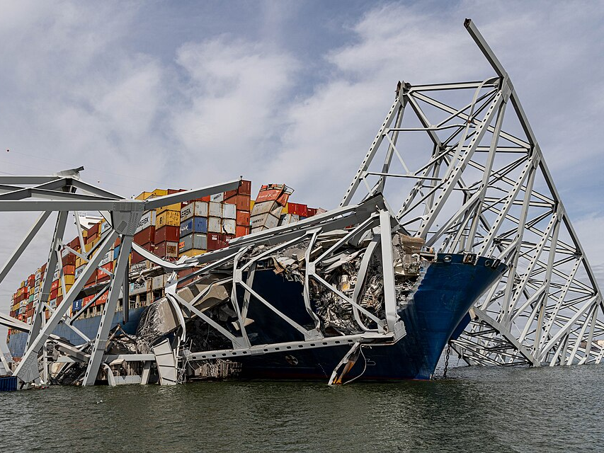

Force density pressure momentum
MV Dali 15 km/h, $1.5×{10}^{8}kg$,
CC0

Slide 2
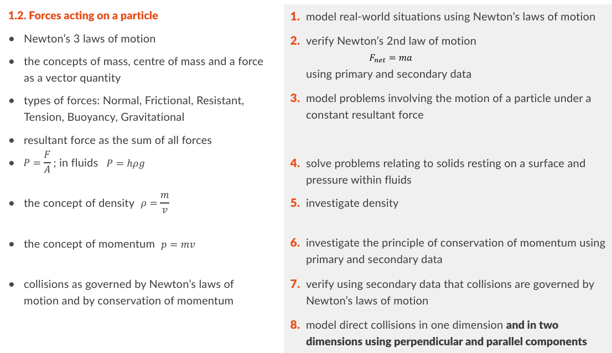
Physics Specification
Draw force diagrams

Slide 3
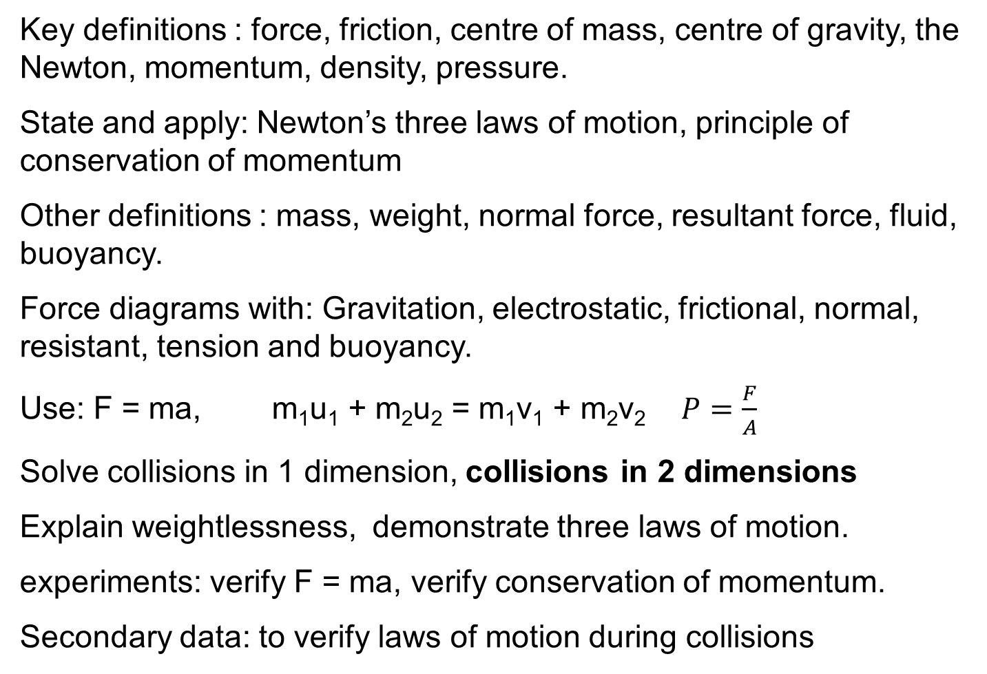
Revision Summary
Key definitions : force, friction, centre of mass, centre of gravity, the Newton, momentum, density, pressure.
State and apply: Newton’s three laws of motion, principle of conservation of momentum
Other definitions : mass, weight, normal force, resultant force, fluid, buoyancy.
Force diagrams with: Gravitation, electrostatic, frictional, normal, resistant, tension and buoyancy.
Use: F = ma, m₁u₁ + m₂u₂ = m₁v₁ + m₂v₂ $P=\frac{F}{A}$
Solve collisions in 1 dimension, collisions in 2 dimensions
Explain weightlessness, demonstrate three laws of motion.
experiments: verify F = ma, verify conservation of momentum.
Secondary data: to verify laws of motion during collisions

Slide 4
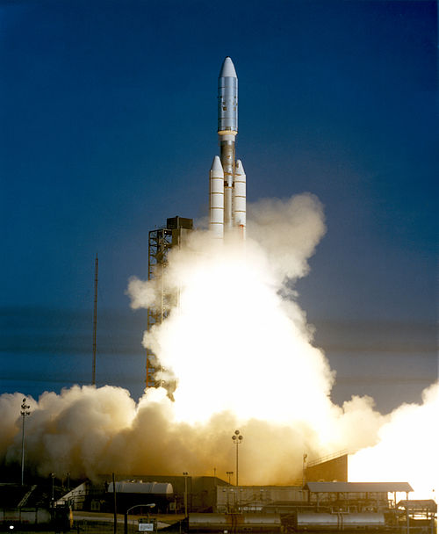
What is a force?
Force is what Causes Acceleration.
HL 2019
CC0

Slide 5
What about this?
A force only causes acceleration if it is not counterbalanced by another force. In this case friction is a counterbalancing force.

Slide 6

What is Friction
a force that opposes one surface sliding along another.
Sliding body
$$v$$
Friction
Friction is a force - it causes the velocity to change

Slide 7
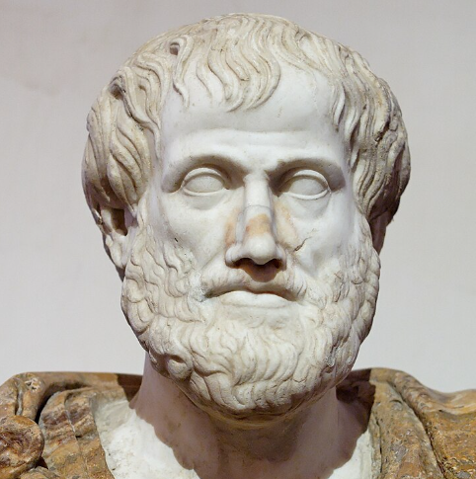
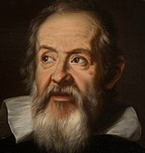
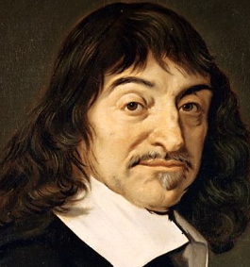
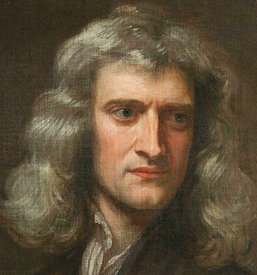
Theories of motion
All motion requires a mover
Aristotle
A problem for modern physics
384–322 BCE)
CC0
Galileo
Things continue moving horizontally if there is no force.
1564 - 1642
CC0
Descartes
Things continue moving in any direction if there is no force.
1596 –1650
CC0
Newton
Newton’s 1st law
1642-1727
CC0

Slide 8
State Newton’s First Law of Motion
A body remains at a constant velocity or at rest unless acted upon by an external force.
HL 2020

Slide 9
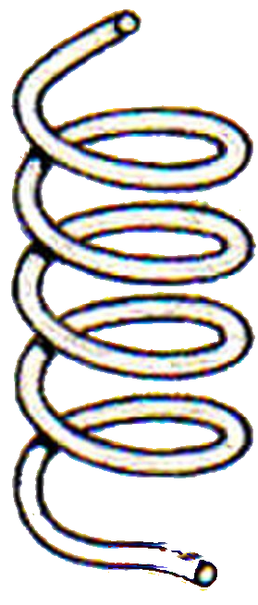
Can an internal force cause acceleration?
Only an External Force can cause the velocity of an object to change.
A falling object experiences an external force of gravity.
The internal force created by this spring cannot move the trolley.

Slide 10
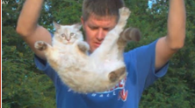
Video – cat fall
https://www.youtube.com/watch?v=RtWbpyjJqrU

Slide 11


The Acceleration of a body is directly proportional to the Force causing it.
F
$$a$$
2F
$$2 a$$
Double the force, double the acceleration

Slide 12


If force is constant the acceleration of a body is inversely proportional to its mass.
F
$$a$$
F
$$\frac{1}{2} a$$
Double the mass, half the acceleration

Slide 13
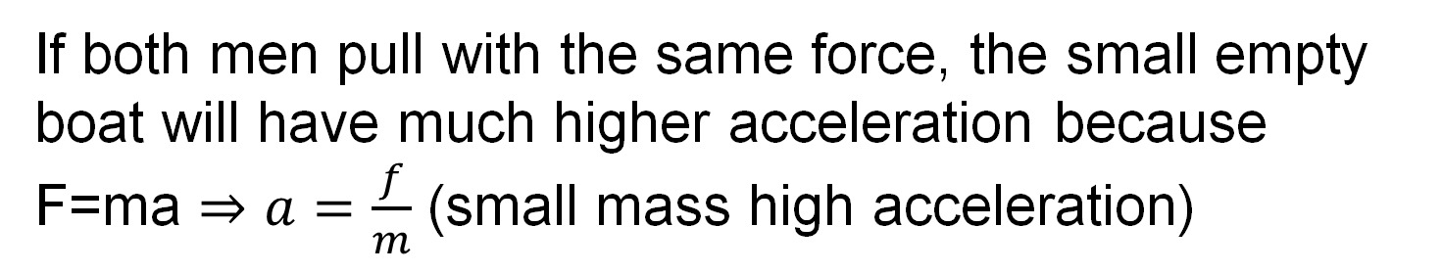
Example mass and acceleration.
Which boat will have the higher acceleration?
If both men pull with the same force, the small empty boat will have much higher acceleration because F=ma $⇒a=\frac{f}{m}$ (small mass high acceleration)

Slide 14
What is Mass?
The mass of an object is a measure of its resistance to acceleration in the absence of friction.
What is the SI unit of Mass?
The kilogram (kg).

Slide 15
What is the Centre of Mass?
The point at which all the mass of an object appears to be concentrated for the purpose of analysing motion.
For a sphere or cylinder or cuboid, it is the geometric centre
For this half disc. The centre of mass will be closer to the straight edge than the curved edge.
It can also be called the centre of gravity because the force of gravity appears to act through that point

Slide 16

What is the SI Unit of Force?
The SI Unit of Force is the newton (N).
About the weight of a calculator.
$$W≈1N$$

Slide 17

Define the newton.
the force that gives a mass of 1 kg an acceleration of 1 m s⁻².
1 N
1 kg
$$a=1 m s^{−2}$$

Slide 18
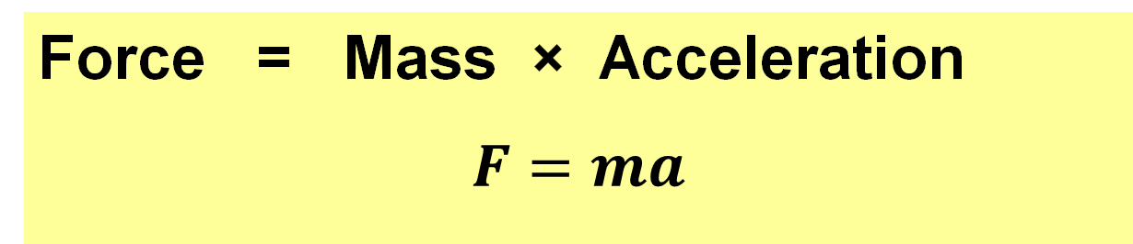
What is the relationship between Force, Mass and Acceleration?
Force = Mass × Acceleration
$$F=ma$$

Slide 19
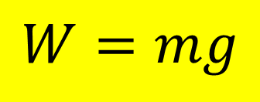
What is Weight?
The gravitational force acting on a mass. HL 2025
$$W=mg$$
Equation and Notation
What is the SI Unit of Weight?
the newton (N).

Slide 20
Newtons and kilograms
On Earth, a 1 kg mass will experience a downward force of 9.8 N
We say the gravitational field strength is 9.8 newtons per kg.
9.8 N is the weight
1 kg is the mass
1 kg
9.8 N

Slide 21
Example 1
Find the weight of a 200 g mass
200 g = 0.2 kg
Weight is a force measured in newtons
Weight = 0.2 x 9.8 = 1.96 N

Slide 22
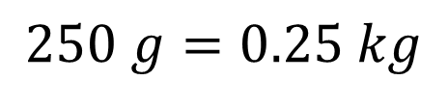
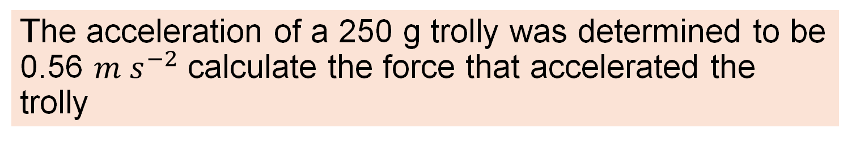
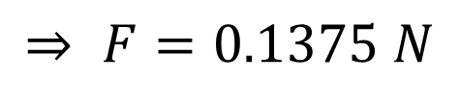
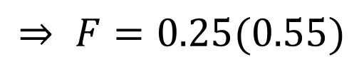
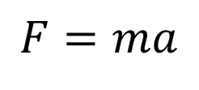
Example 2
The acceleration of a 250 g trolly was determined to be 0.56 $m s^{−2}$ calculate the force that accelerated the trolly
$$250 g=0.25 kg$$
$$F=ma$$
$$⇒ F=0.25(0.55)$$
$$⇒ F=0.1375 N$$

Slide 23
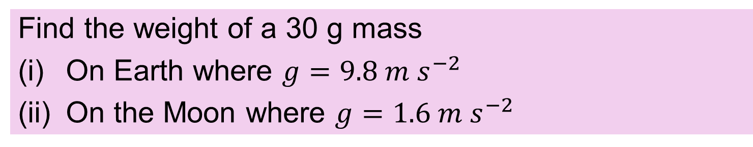
Exercise
Find the weight of a 30 g mass
On Earth where $g=9.8 m s^{−2}$
On the Moon where $g=1.6 m s^{−2}$
0.294 N
0.048 N

Slide 24
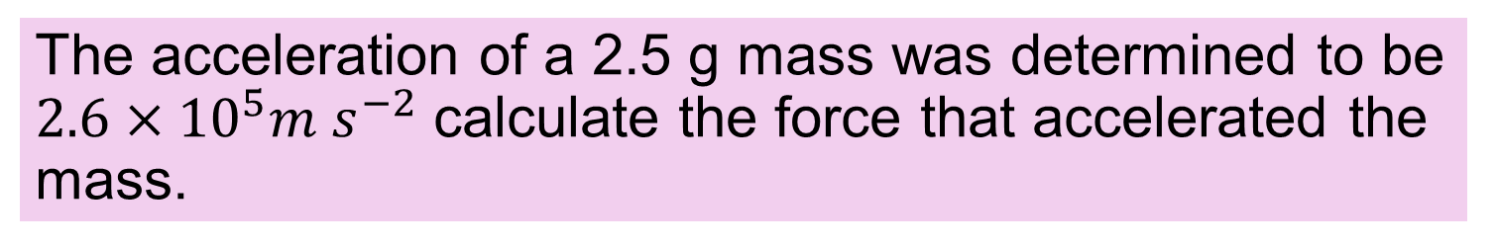
Exercise
The acceleration of a 2.5 g mass was determined to be $2.6×{10}^{5}m s^{−2}$ calculate the force that accelerated the mass.
650 N

Slide 25
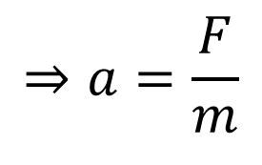
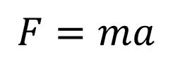
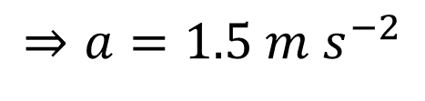
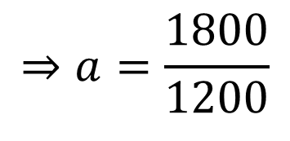
Example 3
A driving force of 1800 N is applied to a vehicle with a gross mass of 1200 kg. Calculate the acceleration.
Gross mass = total mass
$$F=ma$$
$$⇒a=\frac{F}{m}$$
$$⇒a=\frac{1800}{1200}$$
$$⇒a=1.5 m s^{−2}$$

Slide 26

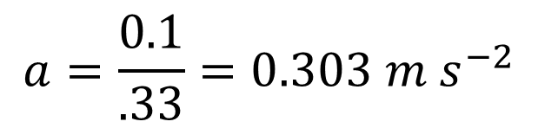

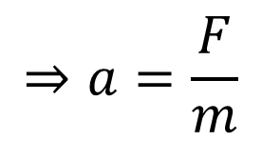


Example 4
A trolly of mass 330 g is accelerated by a force of 0.1N. What will its velocity be after 1.2 seconds
Formula?
$$F=ma$$
$$⇒a=\frac{F}{m}$$
Re-arrange
$$a=\frac{0.1}{.33}=0.303 m s^{−2}$$
Substitute
Formula?
$v=u+at$
Substitute
$$=0+\left(0.303\right)\left(1.2\right)$$
$$=0.364 m s^{−1}$$

Slide 27

Example 5
A car of gross mass 1300 kg has a maximum driving force of 4500 N. Calculate the maximum acceleration.
$$3.46 m s^{−2}$$

Slide 28


Exercise
A trolly of mass 630 g is accelerated by a force of 0.5 N. What will its velocity be after 0.4 seconds?
Give your answer to 3 significant figures
$$a=0.7937 m s^{−2}$$
$$v=0.317 m s^{−1}$$

Slide 29


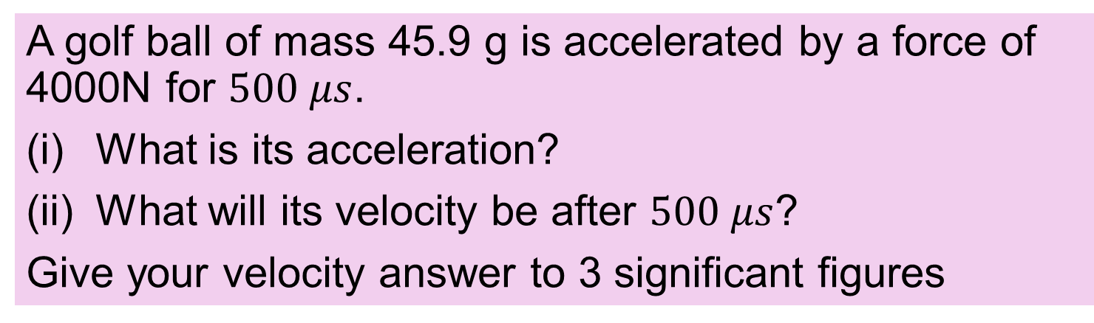
Exercise
A golf ball of mass 45.9 g is accelerated by a force of 4000N for $500 μs$.
What is its acceleration?
What will its velocity be after $500 μs$?
Give your velocity answer to 3 significant figures
$$a=87145 m s^{−2}$$
$$v=43.6 m s^{−1}$$

Slide 30
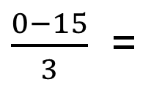
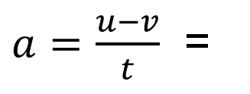

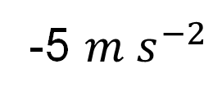
Example 6
What is the force required to stop a 1100 kg car travelling at 15 $m s^{−1}$ in 3 seconds?
u = 15, v = 0, t = 3 a = ? F = ?
$a=\frac{u−v}{t}$ =
$\frac{0−15}{3}$ =
-5 $m s^{−2}$
F =
ma =
1100x5 =
5500 N

Slide 31
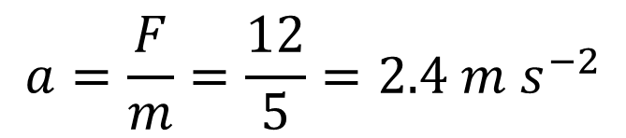
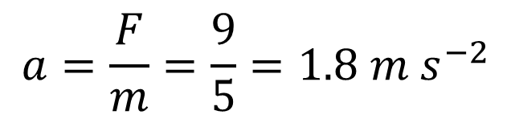
Example 7
Find the acceleration
12 N
5kg
$$a=\frac{F}{m}=\frac{12}{5}=2.4 m s^{−2}$$
To the right
3 N
12 N
F = 12-3 = 9 N
5kg
$$a=\frac{F}{m}=\frac{9}{5}=1.8 m s^{−2}$$
To the right

Slide 32

Exercise
What is the force required to stop a 1300 kg car travelling at 12 $m s^{−1}$ in 4 seconds?
3900 N

Slide 33

Exercise
What is the force required to stop a 1340 kg car travelling at $50 kilometers per hour$ in 4 seconds?
Give your answer to 3 significant figures.
6260 N

Slide 34


Exercise
Find the acceleration
14 N
30 g
7 N
4 N
50kg
$467 m s^{−2}$ to the right
$$0.06 m s^{−2} to the left$$

Slide 35

Exercise
A Saturn 5 rocket used to bring astronauts to the moon had a maximum thrust of 33,000 kN and a take off mass of 2.8 million kg. Calculate the take off acceleration. NB you must subtract the rocket weight from the thrust before calculating acceleration.
thrust
weight
$$1.97 m s^{−2}$$

Slide 36

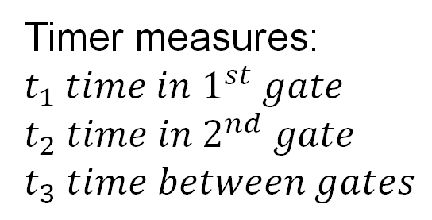
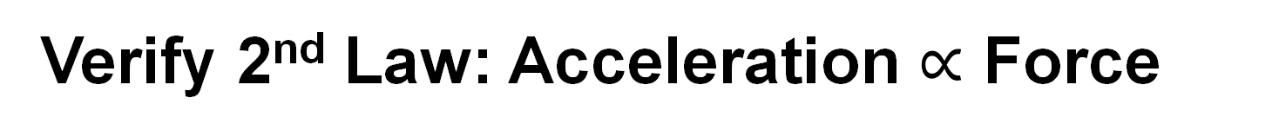
Verify 2nd Law: Acceleration $∝$ Force
Card to interrupt light gates
pully
$$s$$
A
B
Light gates
thread
Low friction track
Trolly with masses
Hanging Weights to create a force
Timer measures:
$$t_{1} time in 1^{st} gate$$
$$t_{2} time in 2^{nd} gate$$
$$t_{3} time between gates$$
Timer

Slide 37
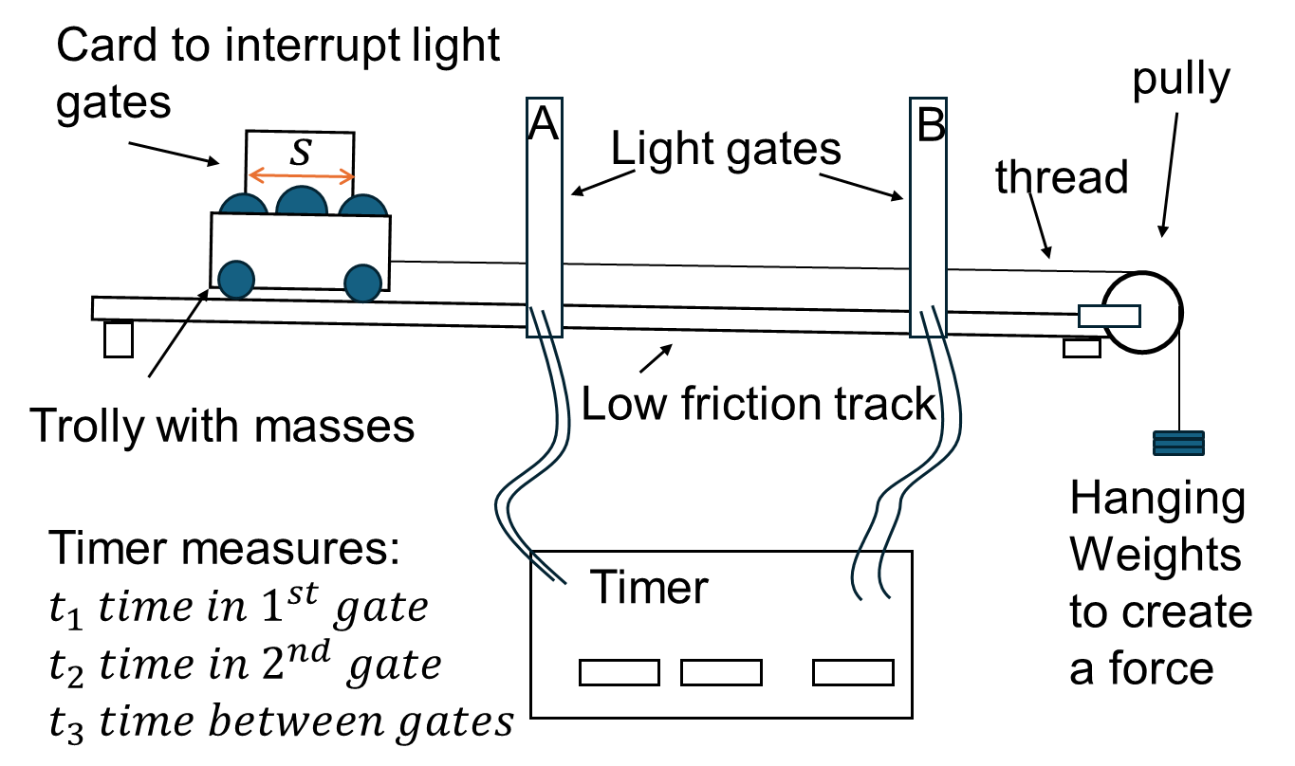
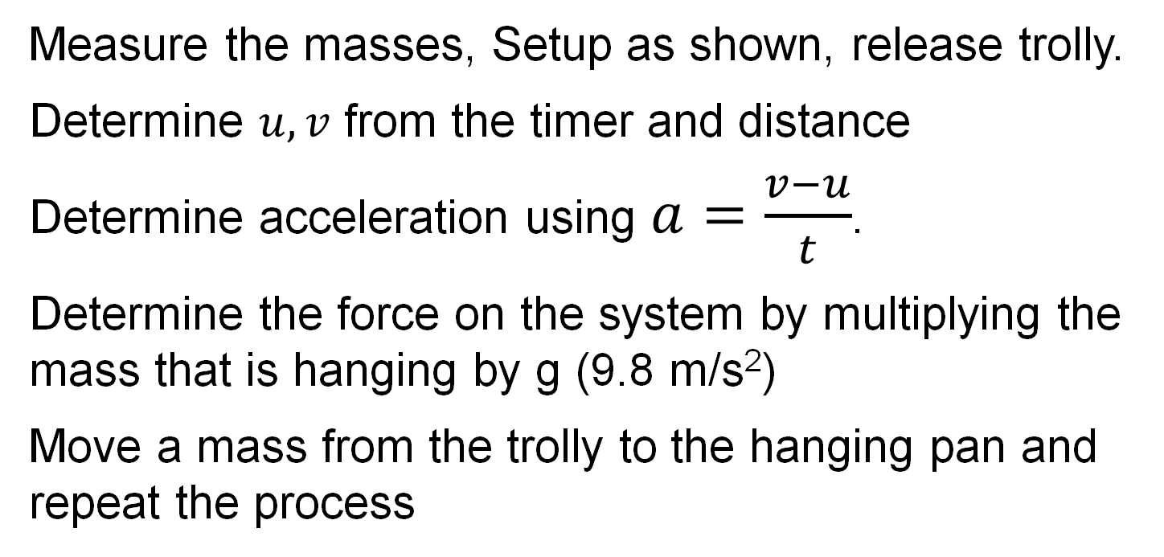
Method
Measure the masses, Setup as shown, release trolly.
Determine $u, v$ from the timer and distance
Determine acceleration using $a=\frac{v−u}{t}$.
Determine the force on the system by multiplying the mass that is hanging by g (9.8 m/s²)
Move a mass from the trolly to the hanging pan and repeat the process

Slide 38
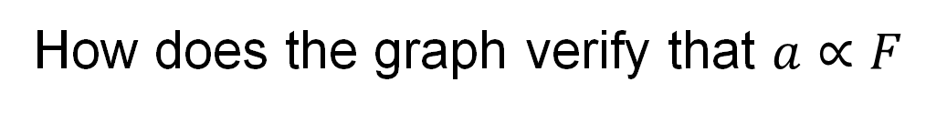
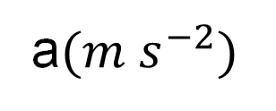
graph
F (Newtons)
slope = total mass
a$(m s^{−2})$
How does the graph verify that $a∝F$
The graph is a straight line passing through the origin. This shows that: a ∝ F
What is the slope of the graph
From the formula F = ma, the slope is the total mass

Slide 39

What is Momentum?
Momentum = Mass × Velocity
$$p = mv$$
Equation and Notation
Is momentum a vector or scaler quantity?
Vector
The direction is the direction of the velocity.

Slide 40
What is the SI Unit of Momentum?
Hint: Momentum = mass x velocity
So, get the units of mass and velocity
kg m s⁻¹
You can work this out as follows
Momentum = mass x velocity
In units that’s kg x m s⁻¹
Or simply kg m s⁻¹

Slide 41
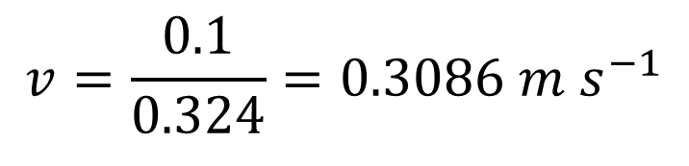
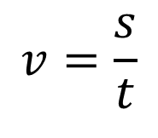
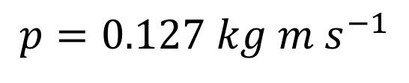
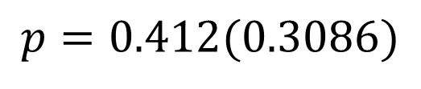
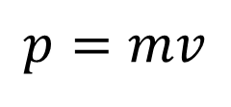
Example 8
Calculate the momentum of a 412 g trolly which travels 10 cm in 324 ms
$$v=\frac{s}{t}$$
$$v=\frac{0.1}{0.324}=0.3086 m s^{−1}$$
$$p=mv$$
$$p=0.412(0.3086)$$
$$p=0.127 kg m s^{−1}$$

Slide 42


Exercise
Calculate the momentum of a 630 g trolly which travels 14 cm in 300 ms.
$$v=0.4667 m s^{−1}$$
$$p=0.294 kg m s^{−1}$$

Slide 43

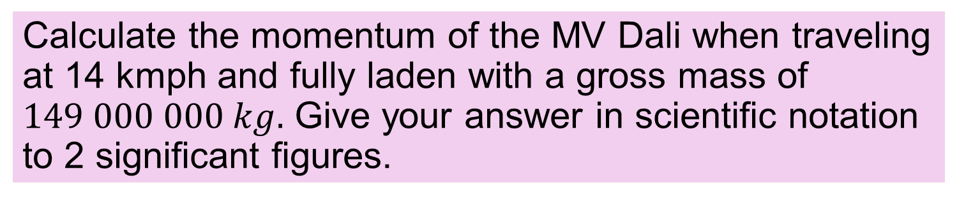
Exercise
Calculate the momentum of the MV Dali when traveling at 14 kmph and fully laden with a gross mass of $149 000 000 kg.$ Give your answer in scientific notation to 2 significant figures.
$$p=5.6×{10}^{8} kg m s^{−1}$$

Slide 44
Exercise
Calculate the momentum of a 630 g trolly which travels 14 cm in 300 ms.
$$v=0.4667 m s^{−1}$$
$$p=0.294 kg m s^{−1}$$

Slide 45

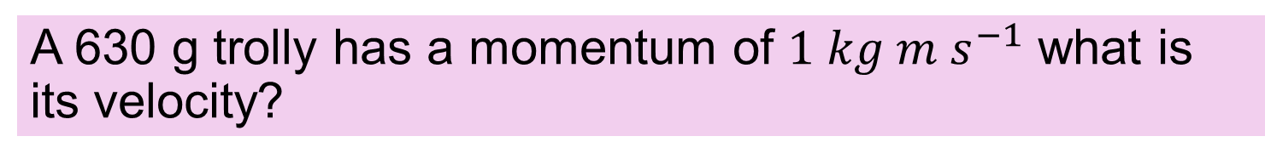
Exercise
A 630 g trolly has a momentum of $1 kg m s^{−1}$ what is its velocity?
$$v=1.59 m s^{−1}$$

Slide 46
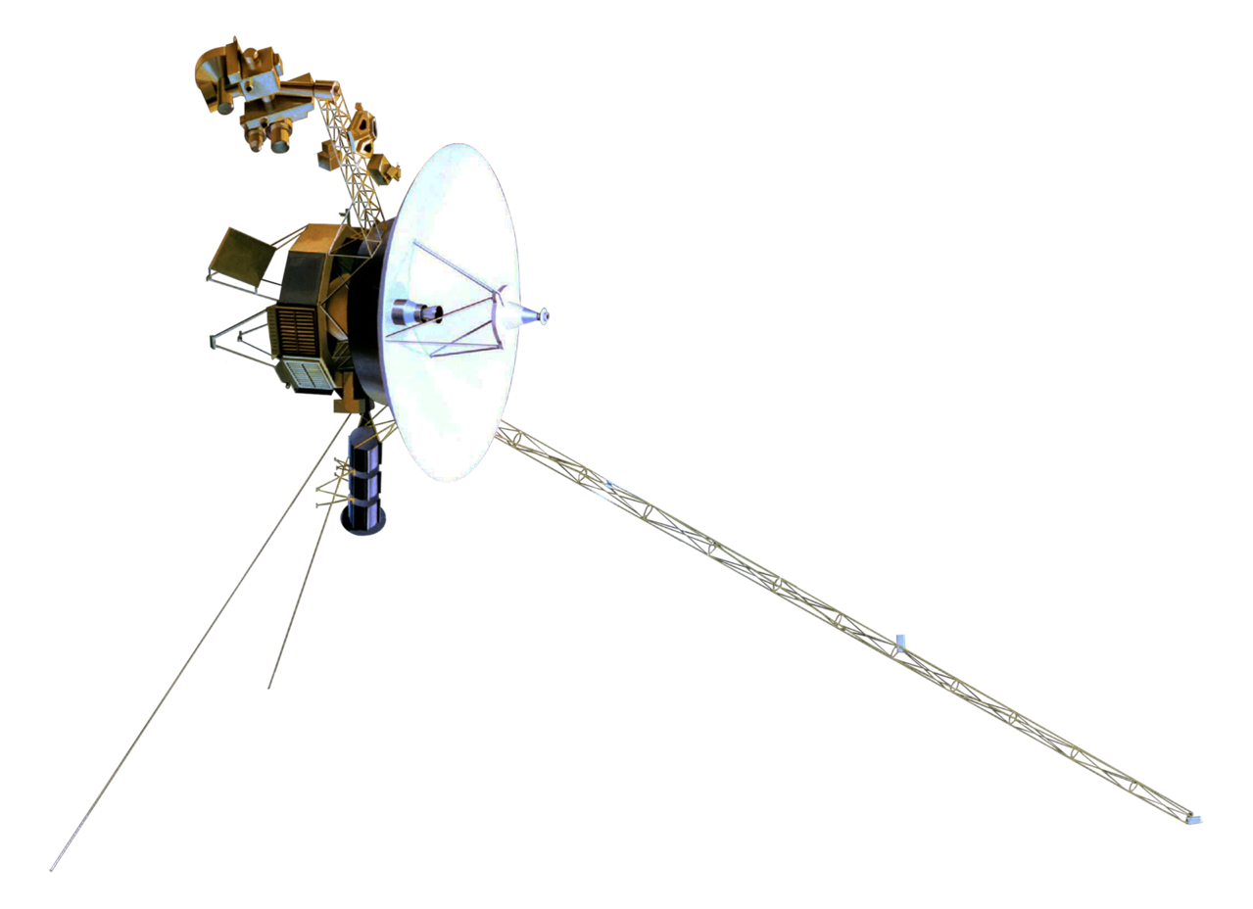
State Newton’s First Law of Motion
A body remains at a constant velocity or at rest unless acted upon by an external force.
HL 2020
Voyager 1 launched in 1977 is the farthest man-made object from Earth.
It travels with an almost constant velocity.
cco

Slide 47
State Newton’s Second Law of Motion
when force acts on a body, the force is proportional to the rate of change of momentum
HL 2020, 2021
CC0

Slide 48
State Newton’s Third Law of Motion
When body A applies a force to body B, Body B applies an equal and opposite force to body A
HL 2021
NB Both forces are of the same type.

Slide 49

State the 1st Law and give an example
A body remains at a constant velocity or at rest unless acted upon by an external force.
Example
When you peddle a bike, you accelerate. When you stop peddling the bicycle keeps moving.
The only reason you slow down is because of the resistant forces of air resistance and road friction.

Slide 50
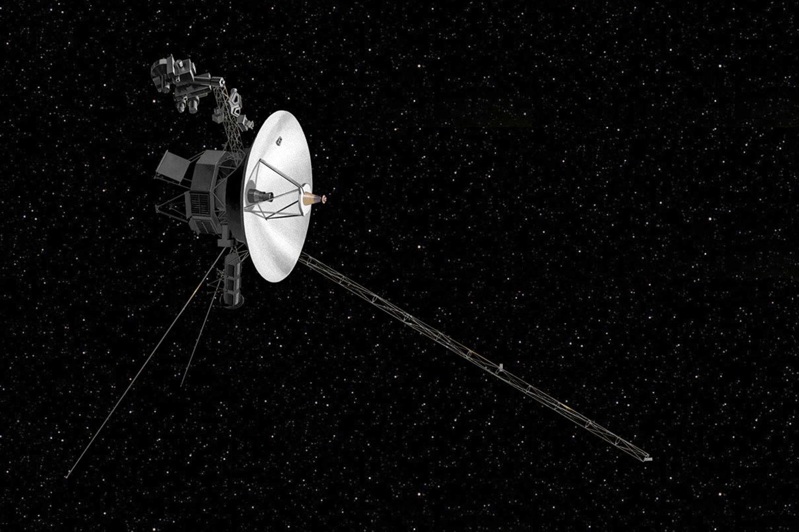
Explain Voyager 1’s motion using the 1st law
Voyager 1 is traveling a long way beyond the planets. The sun’s gravitation is very small at this distance. The pull of gravity is thus very small. Thus, with no external force acting on it, the craft moves with constant velocity.

Slide 51




Example 9
Explain why the velocity of Voyager 1 is almost constant today?
Voyager 1 velocity time graph
The velocity is almost constant now because being so far from the sun, there is almost no external force on the craft.
Velocity m/s
$$4×{10}^{4}$$
Saturn
$$3×{10}^{4}$$
Almost constant velocity
Jupiter
$$2×{10}^{4}$$
$$1×{10}^{4}$$
Passed Neptune’s orbit
1980
2000
2020
Time (Year)

Slide 52
Explain this picture using the 1st Law
When the bike stops suddenly, very little force restrains the rider so he keeps moving.
1st law: A body remains at a constant velocity or at rest unless acted upon by an external force.

Slide 53
Explain the need for safety belts using the 1st Law
When the car stops suddenly, everything loose in the car keeps moving. If the occupants do not have seatbelts they will also keep moving and hit the windscreen or other car parts.
1st law: A body remains at a constant velocity or at rest unless acted upon by an external force.

Slide 54
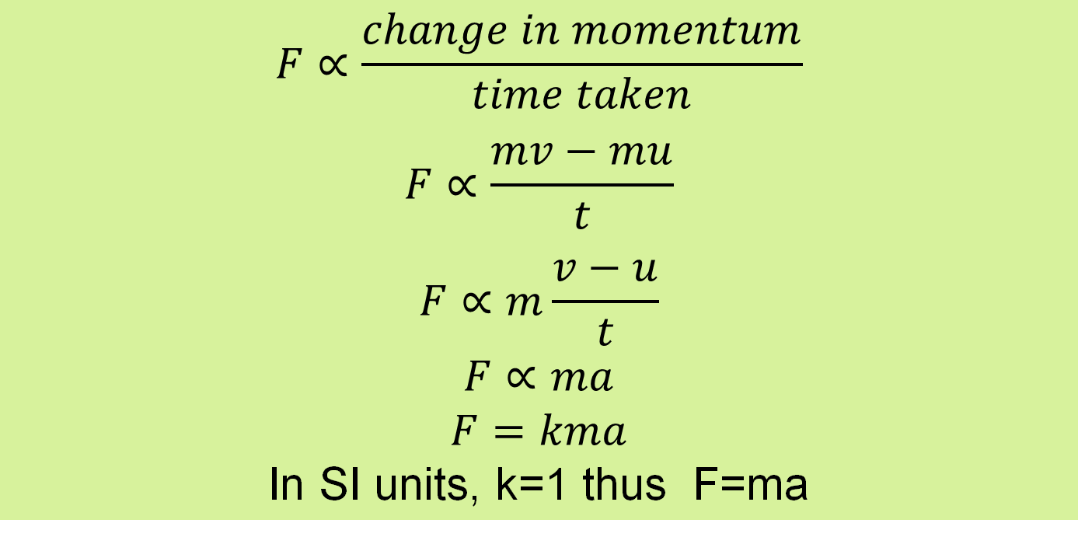
Show how F=ma is a special case of the 2nd Law
2nd Law: when force acts on a body, the force is proportional to the rate of change of momentum
$$F∝\frac{change in momentum}{time taken}$$
$$F∝\frac{mv−mu}{t}$$
$$F∝m\frac{v−u}{t}$$
$$F∝ma$$
$$F=kma$$
In SI units, k=1 thus F=ma
F = ma is a special case (case of constant mass)

Slide 55
3rd Law example
When body A applies a force to body B, Body B applies an equal and opposite force to body A
The moon exerts a gravitational force of 2 x 10²⁰ N on the earth.
The Earth’s mass is 81 times the mass of the moon.
What is the gravitational force exerted by the earth on the moon?
Moon
Earth
Based on Newton’s 3rd law the two forces are identical i.e. the earth exerts the same force of 2 x 10²⁰ N on the moon.

Slide 56
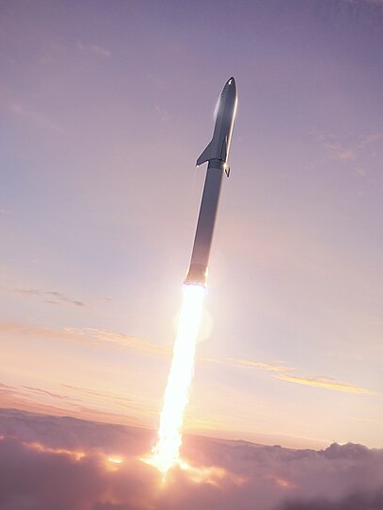
How does a rocket accelerate?
The gas of combustion escapes downward through nozzles. Inside the combustion chamber the gas pressure pushes upwards on the rocket but not as much downwards (because it is escaping downwards). Thus the net force is up.
CC0
You can also explain it using conservation of momentum.

Slide 57

This toy uses the same principle as a rocket engine

Slide 58

force pairs
Describe the third law for the books on the table
1.
The Earth is pulling the books down and the books are pulling the Earth up.
2.
The books are pressing on the table and the table is pressing on the books.
These are 2 Force Pairs
You cannot say that the table is reacting against the gravity of the books as an example of the 3rd law.
Action – reaction pairs must be the same type of force e.g. gravitation, tension, or contact.

Slide 59
Third Law and force pairs
The two forces act on two different bodies.
Both forces are always of the same type
Examples include
Gravitational - A pulls B, B pulls A
electrostatic - A pulls B, B pulls A
normal reactions - A pushes B, B pushes A

Slide 60

Exercise
An 800 kg car has a breaking force of 6000 N
Calculate the maximum deceleration.
$$7.5 m s^{−2}$$

Slide 61








Exercise
An 800 kg car has a breaking force of 6000 N
a) What is the stopping distance if travelling at 30 kmph
b) What is the stopping distance if travelling at 60 kmph
$$30 kmph =8.333 m s^{−2}$$
$$60 kmph =16.667 m s^{−2}$$
$a=\frac{F}{m}=−7.5 m s^{−2}$
$$v^{2}=u^{2}+2as$$
$s=\frac{v^{2}−u^{2}}{2a}$
$s=\frac{−u^{2}}{2a}$
$$a) s=\frac{{8.333}^{2}}{15}=4.6 m$$
$$b) s=\frac{{16.667}^{2}}{15}=18.5 m$$

Slide 62
Verify Newton’s laws using secondary collision data

Slide 63
Verify First law
In this collision it is observed that items that are not restrained in the car keep moving after the collision until they hit something. This shows that bodies in motion remain in motion unless they are acted on by a force.

Slide 64
Verify 2nd law
A force sensor on the front of a 240 g trolly travelling at 2.5 m/s registered a force 1.3 N for 0.46 s when it collided with an obstacle and came to rest.
Use this data to verify Newton’s 2nd law

Slide 65
Verify 3rd law
A force sensor is attached to the trolley and another to the obstacle. What observation would you make to verify Newton’s 3rd law?

Slide 66
Force diagrams and force types
Gravitational
Frictional
Normal
Resistant,
Tension,
Buoyancy,

Slide 67
What is a force diagram?
A diagram which shows all the forces acting on a body.

Slide 68
What is a gravitational force?
The force between objects that is due to the masses of the objects
There is a gravitational force between planets and the sun. This keeps them in orbit.

Slide 69
Give another name for gravitational force?
Weight
What is the symbol used for weight
W
W

Slide 70
What is the direction of a gravitational force?
Gravitational forces are towards the centre of mass of the objects
Astronauts on an Asteroid
centre of mass
Note in reality, an asteroid of this size would not create a sufficient gravitational force to hold the astronauts.

Slide 71
What is Friction?
Friction is a force that opposes one surface sliding along another.

Slide 72


When is friction useful ….. When is it not?
useful
Not useful
Walking
Rock Climbing
Car turning
Sky diving
Parachutes
Engine efficiency
CC0

Slide 73




How is friction minimised?
CC0
CC0
Lubricants
Wheels and rollers
CC0
CC0
Mag-lev
Shape

Slide 74
What is a Normal force
It is the push force perpendicular to the surface of two objects that are in contact
Normal reactions
The letter N or R is typically used to represent the normal reaction force.
N
N

Slide 75



Draw the Normal forces on the rock
$$N_{1}$$
$$N_{2}$$
Often there will be a combination of a friction and a normal force at a point.
$$F_{2}$$

Slide 76
Example 10
A book is decelerating as it moves to the right on a horizontal table. Draw a labelled diagram to show the forces acting on the book as it moves on the table.
Normal reaction
Friction
Weight
Direction of motion (not a force)

Slide 77
Example 11
A brick is at rest on a slopped surface. Draw a force diagram for the brick.
Friction
Normal reaction
Weight
The friction force is just the right size to counteract the resultant of the weight and the normal reaction.

Slide 78

Exercise
A cyclist applies the breaks going downhill. Draw the forces acting on the bike and cyclist. For this question treat the bike and rider as a single unit.
Breaking Friction
Normal reaction
air resistance
Weight

Slide 79
Give examples of tension forces
T
T
T
T
Tension forces act in the direction of the string
Tension forces are equal and opposite at either end if the string is light
T is the most common symbol

Slide 80

Example 12
Draw a force diagram for this pendulum bob hanging from a string and free to move.
Tension
Weight
These are the only two forces. The resultant of these two forces $≠$ 0. Thus, the bob will accelerate to the right.

Slide 81
What are Resistant forces?
Forces that work against the motion of a body
Air resistance and water resistance and friction
The direction of a resistant force is opposite to the direction of motion

Slide 82

Forces on a skydiver:
Weight W acts down.
Air resistance R acts up.
CC0
R
Accelerating
R < W
W
R
Constant speed
R = W
(terminal velocity)
W

Slide 83
Example 13
Explain why B is travelling faster than A even though in both cases, air resistance = weight
R
R
A
B
W
W
v = 55 m/s
v = 150 m/s
Air resistance increases with surface area and velocity. If the surface area is reduced, and resistance is the same, then the velocity must increase.

Slide 84
What is a buoyancy force?
The upward force exerted by a fluid on an object in that fluid
B
Hot air balloon
Boat
B

Slide 85
Exercise
A boat is sitting stationary in the water. Indicate the forces acting on the boat
Buoyancy
Weight

Slide 86
Exercise
A boat is traveling at a constant velocity using an engine. Indicate the forces acting on the boat.
Buoyancy
thrust
resistance
Weight
For constant velocity thrust is equal in magnitude to resistance.

Slide 87
What is a Resultant force?
The vector sum of all the forces on a body
Propulsion
Lift
Drag
Weight
If the vector sum of all the forces on this plane is 0, what can we say about the motion of the plane?
It is travelling at constant velocity

Slide 88
Example 14: Resultant force
What is the resultant force on this object?
5 N
3 N
4 N
Resultant force = 5 + 4 – 3 = 6 N to the right

Slide 89

Example 15: (higher)
Draw the resultant force on this trolly?
N
N
W
W
use the parallelogram rule

Slide 90
Example 16 (Higher)
Draw a scaled vector diagram of the forces at the knot from this experiment. Use the diagram to show how this experiment verifies the law of addition of vectors.
7.5 N
7.5 N
knot
Addition of the two upward tensions = 4 N
15.5°
15.5°
Newton balance
Newton balance
weight
4 N
Parallelogram rule
The law of addition is verified because the calculated resultant (red vector) is equal and opposite to the 4 N weight.
7.5 N
7.5 N
4 N

Slide 91


Exercise (higher)
Draw the resultant force on these trollies.
N
N
W
W

Slide 92

Example 17
A 15 kg mass in the end of a rope is accelerated upwards with an acceleration of $2.3 m s^{−2}$. Calculate the tension in the rope.
T = tension in rope
W = weight of block
T
T –W = ma
T –15(9.8) = 15(2.3)
T =15(2.3)+15(9.8)
W
T =181.5 N

Slide 93

Example 18
A 15 kg mass in the end of a rope is accelerated downwards with an acceleration of $2.3 m s^{−2}$. Calculate the tension in the rope.
T = tension in rope
W = weight of block
T
T –W = ma
T –15(9.8) = -15(2.3)
T = -15(2.3)+15(9.8)
W
T =112.5 N

Slide 94

Example 19
A 15 kg mass in the end of a rope is accelerated downwards with an acceleration of $9.8 m s^{−2}$. Calculate the tension in the rope.
T = tension in rope
W = weight of block
T –W = ma
T
T –15(9.8) = -15(9.8)
T = -15(9.8)+15(9.8)
W
T = 0 N

Slide 95

Example 20
A 15 kg mass in the end of a rope is moving downwards at a steady speed. Calculate the tension in the rope.
T = tension in rope
W = weight of block
T –W = ma
T
Steady speed
$⇒$ no acceleration
T –15(9.8) = -15(0)
T = -15(0)+15(9.8)
W
T = 147 N

Slide 96

Exercise
A 500 g mass in the end of a string is accelerated upwards with an acceleration of $4.5 m s^{−2}$. Calculate the tension in the string.
T
W
T =7.15 N

Slide 97

exercise
A 30 g mass in the end of a string is accelerated downwards with an acceleration of $3.2 m s^{−2}$. Calculate the tension in the string.
T
W
T = 0.198 N

Slide 98


Example 21
Explain why these people experience weightlessness
For a second or two, the gondola accelerates downwards with the same acceleration as a falling body.
$⇒$ the falling occupants have no acceleration relative to the falling gondola.
$⇒$ no forces between the occupants and the gondola.
$⇒$ they feel weightless relative to the gondola.
CC0

Slide 99


Zero-g
CC0
Aircraft
CC0
Space station

Slide 100


How can a parabolic flight path produce weightlessness
CC0
CC0
The aircraft follows the same path as a projectile that is only influenced by gravity.
The occupants have the same acceleration as their surroundings and thus feel weightless.

Slide 101

Video: Zero g
https://www.youtube.com/watch?v=b5hg2UuPUck

Slide 102
Density and Pressure

Slide 103



What is Density?
$$\text{Density}= \frac{\text{Mass}}{\text{Volume}}$$
$$ρ=\frac{m}{V}$$
or
$ρ$ is a Greek letter used for density pronounced rho
Notice the slight difference between $ρ$ and p

Slide 104


What is the SI Unit of Density?
kilogram per cubic metre ( kg m⁻³).
This comes from $ρ=\frac{m}{V}$
$$\frac{kg}{m^{3}}$$
Is density a scalar or vector quantity?
Scalar

Slide 105
Solid and liquid densities
Substance | Density in kg m⁻³
Osmium | 22 590
Gold | 19 280
Tungsten | 19 250
Lead | 11 350
Iron | 7 870
Stone (approx.) | 2 700
Water at 4 ºC | 1 000
Wood (pine) | ~400
Source: Wikipedia

Slide 106
Gas densities
Substance | Density in kg m⁻³
Air (0 ºC) | 1.27
Nitrogen | 1.23
Oxygen | 1.41
Carbon dioxide | 1.94
Argon | 1.76
Methane | 0.706
Helium | 0.176
Hydrogen | 0.089
Source: Density of Gases - The Engineering Mindset

Slide 107
converting volumes
Be really really careful, it’s a bit of a trap
1 m³ = 1,000,000 cm³
1 cm³ = 1 × 10⁻⁶ m³
100 cm
100 cm
100 cm
$$100×100×100 =1 000 000 cm^{3}in 1 m^{3}$$

Slide 108

The litre
1 litre = 1,000 cm³ = 0.001 m³
Historical aside:
Up to 1964, the litre was defined as the volume of 1 kg of water at 3.98 ℃.
This is how the density of water is almost exactly 1 000 $kg m^{−3}$

Slide 109



Example 22
Calculate the density of iron if a cube of iron measuring 10 cm x 10 cm x 10 cm has a mass of 7.6 kg
$$ρ=\frac{m}{V}$$
$$ρ=\frac{7.6}{(0.1×0.1×0.1)}$$
$$ρ=7600 kg m^{−3}$$

Slide 110






Example 23
The density of seawater is 1024 $kg m^{−3}$ what is the mass of one litre of sea water?
1 litre = 10 cm x 10 cm x 10 cm = ${10}^{−3} m^{3}$
$$ρ=\frac{m}{V}$$
$$m=ρV$$
$$m=1024×{10}^{−3}$$
$$m=1.024 kg$$

Slide 111

Exercise
Calculate the density of a softwood if a cube of that wood measuring 10 cm x 10 cm x 10 cm has a mass of 450 g.
$$ρ=450 kg m^{−3}$$

Slide 112



Example 24
The density of cooking oil is 920 $kg m^{−3}$ what is the mass of 2 litres of that oil?
1 litre = 10 cm x 10 cm x 10 cm = ${10}^{−3} m^{3}$
$$m=1.84 kg$$

Slide 113




Example 25
What is the volume of 500 g of honey in litres. The density of honey is 1450 $kg m^{−3}$?
$$ρ=\frac{m}{V}$$
$$V=\frac{m}{ρ}$$
$$V=\frac{0.5}{1450}=0.000345 m^{3}$$
multiply by 1000 to get litres
=0.345 litres

Slide 114



What is Pressure?
Pressure is force per unit area.
$$\text{Pressure} = \frac{\text{Force}}{\text{Area}}$$
$$P = \frac{F}{A}$$
i.e.
High Pressure
CC0

Slide 115
What is the SI Unit of Pressure?
the pascal (Pa).
1 pascal = 1 newton per square metre
i.e. 1 Pa = 1 N m⁻²
Is pressure a scalar or vector quantity?
Scalar Quantity.

Slide 116


Example 26
A force of 20 N acts on an area of 4 square meters. Calculate the pressure.
$$P=\frac{F}{A}$$
$$P=\frac{20}{4}=5 Pa$$

Slide 117


Example27
What is the downward pressure caused by the weight of this block?
35 kg
30 cm
40 cm
Weight = 35(9.8) = 343 N
Area of underside = 0.4 x 0.3 = 0.12 $m^{2}$
$$P=\frac{F}{A}=\frac{343}{0.12}=2858 Pa$$

Slide 118



Example 28
A car tyre exerts a force of 3000 N of the road. The contact area is 10 cm x 10 cm. Calculate the pressure on the road.
$$P=\frac{F}{A}$$
$$P=\frac{3000}{0.1×0.1}$$
$$P=300 000 Pa$$

Slide 119


Example 29
A force of 20 N acts on an area of 3 $cm^{2}$. Calculate the pressure.
Give your answer to three significant figures.
$$66700 Pa$$

Slide 120

Exercise
What is the downward pressure caused by the weight of this block of steel?
300 kg
25 cm
45 cm
$$26133 Pa$$

Slide 121

Exercise
What is the downward pressure caused by the weight of this block of steel? Give your answer to three significant figures.
300 kg
12 cm
21 cm
$$117000 Pa$$

Slide 122


What is a fluid?
A fluid is a liquid or a gas.
CC0
CC0
Water is a fluid
Air is a fluid

Slide 123
Pressure in a fluid
The weight of a fluid puts pressure on the sides and base of a container.
The pressure increases with depth because there is more fluid above.

Slide 124








Derive the Pressure in a fluid
Let $A$ = area of the base,
$⇒$the volume above $=Ah$
If $ρ$ is the density then the mass of fluid above $m=ρAh$
$⇒$weight = $mg=ρAhg$
$$h$$
$$pressure=\frac{weight}{area}$$
$A$ (area of the base)
$$⇒pressure=\frac{ρAhg}{A}=ρgh$$
$$⇒P=ρgh$$

Slide 125



Pressure in a fluid
$$P=ρgh$$
$$h$$
$$P=pressure at h$$
$ρ=density$
$g=acceleration due to gravity$
$h=depth$

Slide 126




Example 30
Find the pressure due to oil at a depth of 2 m. Density of the oil is $880 kg m^{−3}.$
$$P=ρgh$$
$$P=880×9.8×2$$
$$P=17248 Pa$$
This is the pressure due to the oil
To get the actual pressure you must add atmospheric pressure

Slide 127



Exercise
The pressure under water is the sum of the atmospheric pressure (101,000 Pa) and the pressure due to the water. What is the pressure 40 meters below the surface of the sea? The density of sea water is 1024 $kg m^{−3}$. Take $g=9.8 m s^{−1}$
Pressure due to water = $ρgh=401 408 Pa$
Add Atmospheric pressure: $+ 101 000 Pa$
T$otal=502 000 Pa$

Slide 128

Sample paper 1 Q4
Draw a graph of pressure vs height
Pressure (kPa)
100
50
0
5
10
Height (km)

Slide 129


Sample paper 1 Q4
To determine a value for atmospheric pressure 𝑝 , the height $h_{mercury}$of a column of mercury can be used in the following formula: $P_{atm}=ρg h_{mercury}$
Use the formula to calculate atmospheric pressure $P_{atm}$, at sea level. $density of mercury = 13 546 kg m^{–3}:$
$$acceleration due to gravity = 9.8 m s^{–2} \\ Height of column of mercury at sea level = 760 mm$$
Answer
$$P_{atm}=ρg h_{mercury}$$
$$P_{atm}=1.009×{10}^{5}Pa$$

Slide 130
Demonstrate that Pressure in a liquid increases with depth.
Drill several holes in a plastic bottle
Fill with water
Water squirts strongest from the lowest hole
This demonstrates the formula P = ρ g h.

Slide 131


What is air?
Air is a mixture of gasses:
78% Nitrogen
21% Oxygen
0.9% Argon
0.04% $CO_{2}$
0.0018% Neon
0.0002% Methane
CC0
Air also contains up to 5% water vapour, so the above list is for “dry air”

Slide 132
Define Buoyancy Force
the upward force exerted by a fluid on a body in the fluid.
R Downey

Slide 133

Reason for Buoyancy Force
Pressure increases with depth.
Greater depth
$⇒$greater force on underside.
R Downey
The resultant force is upwards.

Slide 134
Demonstrate upthrust
Newton balances
Measure the weight of an object in air and submerged in water.
The difference = upthrust
b
a
Upthrust = a - b
Works best with an object which is only slightly denser than water, e.g. plasticine. This allows you to feel the difference.

Slide 135
Momentum and collisions

Slide 136

What is Momentum?
Recap
Momentum = Mass × Velocity
$$p = mv$$
Is momentum a vector or scaler quantity?
Vector
The direction is the direction of the velocity.

Slide 137
State the Principle of Conservation of Momentum
momentum before an interaction = momentum after if there are no external forces
HL 2016, 2021
Momentum before = Momentum after

Slide 138

Momentum before = Momentum after
Car Crash From The 1910s
CC0

Slide 139










Write a conservation of momentum equation
Momentum Before collision = Momentum After
$$m_{1}u_{1} + m_{2}u_{2} = m_{1}v_{1} + m_{2}v_{2}$$
$$u_{1}$$
$$u_{2}$$
$$m_{1}$$
$$v_{1}$$
$$v_{2}$$
$$m_{1}$$
$$m_{2}$$
$$m_{2}$$
Before collision
After collision
$u_{1}and u_{2}$ = velocity before
$v_{1}and v_{2}$ = velocity after

Slide 140
Example 31:
find the velocity after the collision
Before
After
5 ms ̄ ¹
v
3kg
2kg
stopped
Joined together
Momentum Before = Momentum After
$$m_{1}u_{1} + m_{2}u_{2} = m_{1}v_{1} + m_{2}v_{2}$$
Let v = common velocity after collision
3 x 5 + 2 x 0 = 3 v + 2 v
15 = 5v
v = 3 m s ̄ ¹

Slide 141
Verify Conservation of Momentum
Ticker timer and tape
2nd trolly
Velcro to make trolleys stick together
Low friction track
Meter stick
1st trolly
Ticker Tape
After
Before

Slide 142



Write the equation that this experiment verifies.
$$m_{1}u=\left(m_{1}+m_{2}\right)v$$
This is a simplification of $m_{1}u_{1}+m_{2}u_{2}=m_{1}v_{1}+m_{2}v_{2}$
where $u_{2}=0$ and $v_{1}=v_{2}$

Slide 143


Conservation of momentum (light gates)
Light gates
Card to interrupt light gates
Velcro or wax to make trolleys stick together
Trolly 2
Low friction track
Trolly 1
with masses
Mass Scale
Timer measures:
$$t_{1} time in 1^{st} gate$$
$$t_{2} time in 2^{nd} gate$$
Timer
$$m$$
Metre stick

Slide 144
Single light gate version
Can be used if the timer has memory
Twin Card to interrupt light gate before and after
Light gate
Velcro
Timer with memory

Slide 145

Conservation of momentum
Key points:
Velcro to make the trollies stick together.
Forces to overcome:
-Gravitational force
-Friction force
Gravity overcome using horizontal track (no component of the force accelerating the trollies).
Friction overcome with air track or a slight slope on the track.

Slide 146










Results
Length of card on trolly $d=$
10 cm
Mass of trolly 1
$m_{1}$ (g)
Mass of trolly 2
$m_{2}$ (g)
Time in Gate A
$$t_{u}(ms)$$
Time in Gate B
$t_{v}(ms)$
Initial velocity $u=\frac{d}{t_{u}}$
$(m s^{−1})$
Final velocity $v=\frac{d}{t_{v}}$
$$(m s^{−1})$$
Momentum before collision
$$m_{1}u$$
Momentum after collision
$$\left(m_{1}+m_{2}\right)v$$

Slide 147



Calculations and Conclusion
Momentum before
= $m_{1}u$
$$=0.45×1.23 \\ =0.554 kg m s^{−1}$$
Momentum after
= ${(m}_{1}+m_{2})v$
$$=\left(0.45+0.31\right)×0.73 \\ =0.555 kg m s^{−1}$$
Thus, $momentum before≈momentum after$
Thus, the principle of conservation of momentum is demonstrated.
Key Points - don’t start with the equation … calculate before and after separately
- Include the units

Slide 148
How did the student counteract the force of gravity and the force of friction in this experiment?
Gravity: the student used a horizontal track so that there was no component of the gravity force acting in the direction of motion.
Friction: the student used an air-track to minimise the force of friction
OR
The student inclined the track just enough to counteract the force of friction

Slide 149


Exam Marking scheme

Slide 150


Slide 151





Example 32
A trolly of mass 650 g travelling at 3.2 $m s^{−2}$ collides with a stationary trolly of mass 520 g on a horizontal frictionless track. The two trollies stick together. Calculate their velocity after the collision.
Momentum before:
$$p=m_{1}u_{1}=.65×3.2=2.08 kg m s^{−1}$$
Momentum before= Momentum After:
$$2.08=m_{1}v_{1}+m_{2}v_{2} \\ 2.08 =0.65v_{1}+0.52v_{2}$$
$$but v_{1}=v_{2} because they are stuck together$$
$$2.08=(0.65+0.52{)v}_{1}$$
$$v_{1}=\frac{2.08}{0.65+0.52}=1.78 m s^{−1}$$

Slide 152


Exercise
A trolly of mass 640 g travelling at 2.9 $m s^{−2}$ collides with a stationary trolly of mass 370 g on a horizontal frictionless track. The two trollies stick together. Calculate their velocity after the collision.
$$v_{1}=\frac{.64×2.9}{0.64+0.37}=1.84 m s^{−1}$$

Slide 153


Exercise
Sphere A of mass 400 g is travelling horizontally with a speed of 6 m s^{–1} when it collides with sphere B of mass 150 g travelling in the opposite direction with a speed of 9 m s^{–1}. Sphere A comes to rest as a result of the collision. Calculate the new velocity of sphere B.
A
B
Take + to mean right and – to mean left
$$momentum before: \\ =0.4×6−.15×9=1.05$$
Momentum after:
$$1.05=0.15×v_{B}$$
$$⇒v_{B}=7 m s^{−1}$$
$$7 m s^{−1}$$

Slide 154
Collisions in 2 dimensions
(higher level)
Use momentum vector diagrams to find momentum after collision
Once you have final momentum calculate velocity

Slide 155




Example 33 (Higher)
A 5 kg mass travelling at 6 m/s collides at right angles with a 10 kg mass travelling at 4 m/s on a frictionless surface. Calculate the total momentum of the system and use this to calculate the velocity of the two masses after the collisions if they stick together.
$$total mometum=\sqrt{{\left(5×6\right)}^{2}+{\left(10×4\right)}^{2}}$$
$$=50 kg m s^{−1}$$
Momentum vectors
$$angle=\tan^{−1}{\frac{10×4}{5×6} }={53.1}^{o}$$
5x6
10x4
$$Let v = final velocity$$
$\left(5+10\right)v =50$ (conservation of momentum)
$⇒v=\frac{50}{15}=3.3 m s^{−1}$ at an angle of 53.1⁰ to the 5 kg

Slide 156




Exercise
A 1200 kg car travelling East at 3 m/s collides with a 2400 kg can travelling North at 2 m/s on an icy road. Calculate the velocity of the two vehicles after the collisions if they stick together.
$$total mometum=\sqrt{{\left(1200×3\right)}^{2}+{\left(2400×2\right)}^{2}}$$
$$=6000 kg m s^{−1}$$
$$angle=\tan^{−1}{\frac{2400×2}{1200×3} }={53.1}^{o}$$
$$Let v = final velocity$$
$$\left(1200+2400\right)v =6000$$
$⇒v=\frac{6000}{3600}=1.67 m s^{−1}$ at an angle of 53.1⁰ North of East

Slide 157



Example 34 (Higher)
A 500g ball travelling at 3 m/s collides with a stationary ball of mass 800g. The 500g ball bounces to the left at right angles to its original motion at a velocity of 1.2 m/s. Calculate the velocity of the 800g ball
1.2x0.5
Momentum before = momentum after
3x0.5
$$P_{x} = 3×0.5$$
$$P_{y} = 1.2×0.5$$
p
Using Pythagoras, p = 1.6155 kg m/s
$$v =\frac{1.6155}{0.8} = 2.019 m s^{−1}$$

Slide 158

Revision Summary
Key definitions : force, friction, centre of mass, centre of gravity, the Newton, momentum, density, pressure.
State and apply: Newton’s three laws of motion, principle of conservation of momentum
Other definitions : mass, weight, normal force, resultant force, fluid, buoyancy.
Draw Force diagrams with: Gravitation, electrostatic, frictional, normal, resistant, tension and buoyancy.
Use: F = ma, m₁u₁ + m₂u₂ = m₁v₁ + m₂v₂ $P=\frac{F}{A}$
Solve collisions in 1 dimension, collisions in 2 dimensions
Explain weightlessness, demonstrate three laws of motion.
experiments: verify F = ma, verify conservation of momentum.
Secondary data: to verify laws of motion during collisions

Slide 159
End

Slide 160
Zero-g Calculation challenge
CC0
22 seconds at 0 g,
Maximum Ascent angle: 45⁰
Maximum Descent angle 45⁰
CC0
Calculation Challenge
Approximate height difference during 0g?
Approximate speed of aircraft at max height
Approximate maximum speed

