Slide 1
the first sci-fi movie…
…and Newton’s Laws

Slide 2
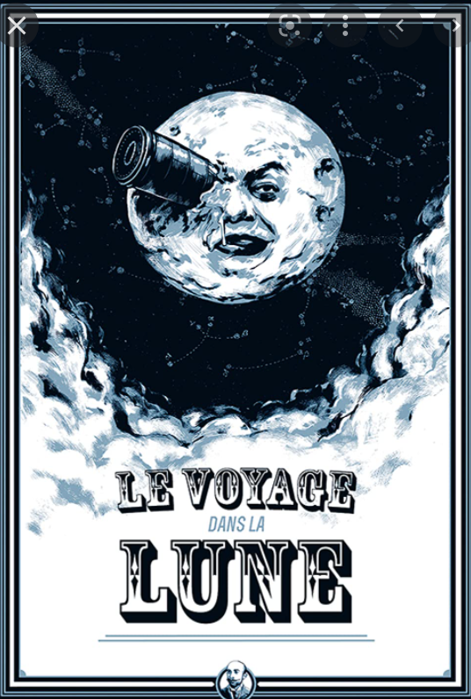
Journey to the Moon
released in 1902
based on the books by
  Jules Verne
  HG Wells
tells the story of a trip to the moon

Slide 3
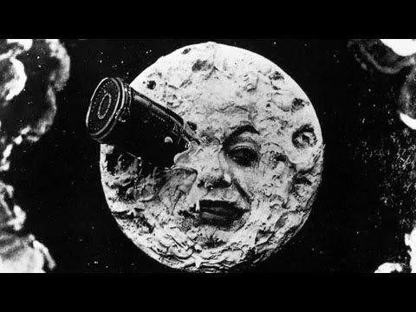
La Voyage dans la Lune (Méliès)

Slide 4
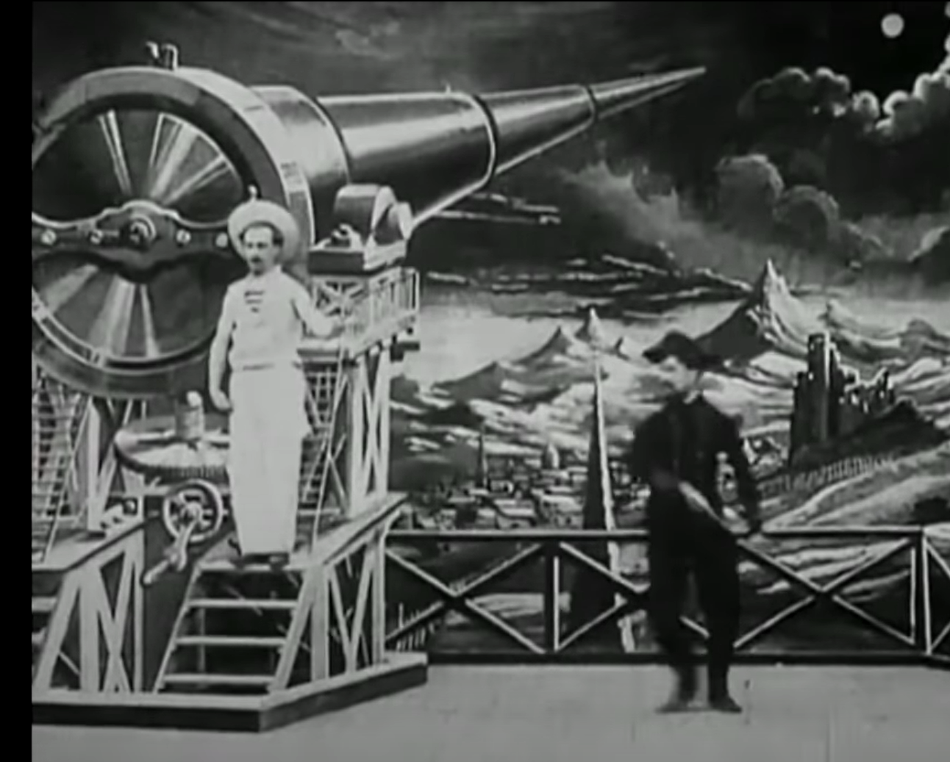
The physics…..
The explorers do not use a rocket to travel to the moon
Instead they use a capsule fired from a cannon (skip to 5 min 30 s)
Could this work?
Would the explorers survive?

Slide 5
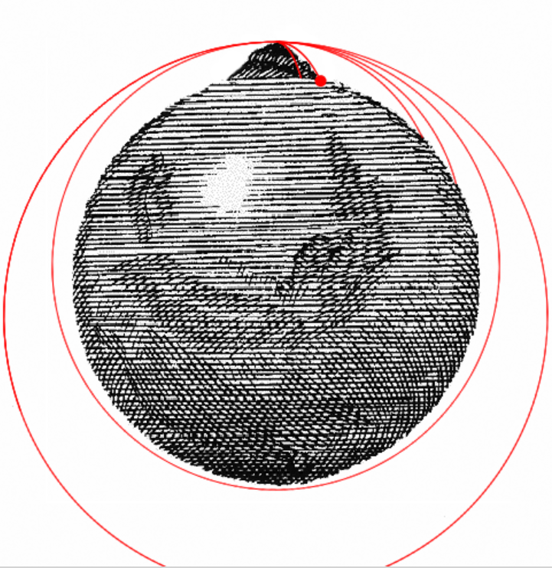
Newton’s Cannon
Newton pictured the use of a cannon to escape the earth’s orbit…
…and showed that escape velocity is 11.2 km/s
…that is the velocity needed on take-off to
get to the moon
…but could a human withstand the acceleration?
Click on the image to see how Newton’s cannon worked

Slide 6
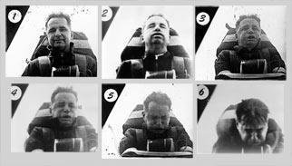
g-forces
High acceleration causes blood loss to the brain
In the 1950s, John Stapp survived 46.2 g for a few seconds
Most people can only withstand about 9 g
What acceleration would the capsule in the movie experience?

Slide 7
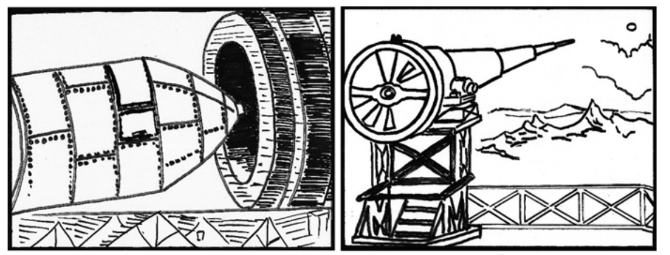
The cannon and capsule
In the Jules Verne novel, the cannon used is ‘900 ft’ long
The capsule must reach 11.2 km/s
What would its acceleration be?

Slide 8















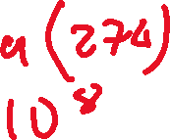












Slide 9
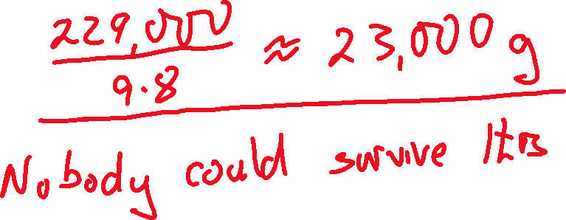








could humans survive 229, 000 ms⁻²

Slide 10
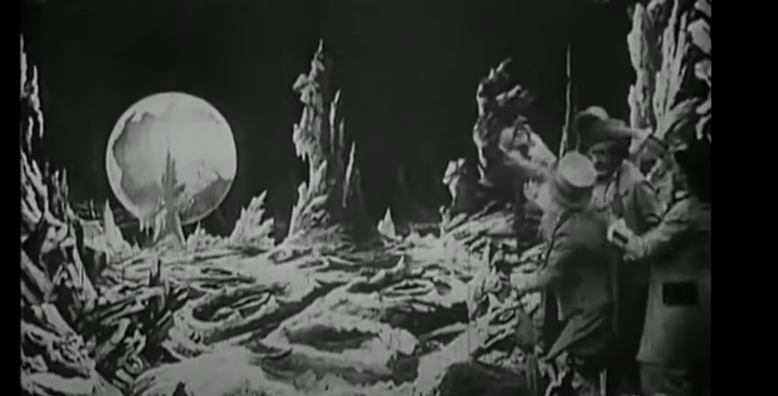
other issues….
In this scene (8:15), the astronomers see the earth-rise
Would this happen?
Why or why not?

Slide 11
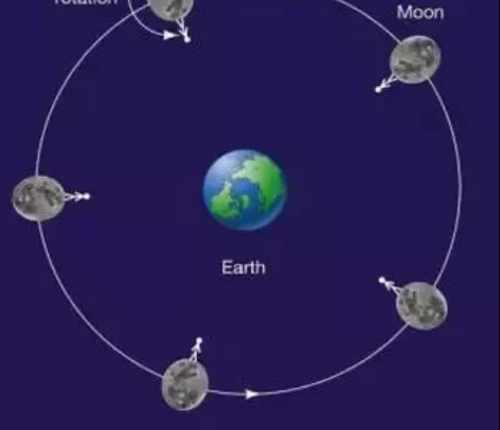
other issues….
In this scene (8:15), the astronomers see the earth-rise
The moon is ‘tidally locked’
one side of the moon always faces the earth
so there is no earth-rise visible from the moon.

Slide 12
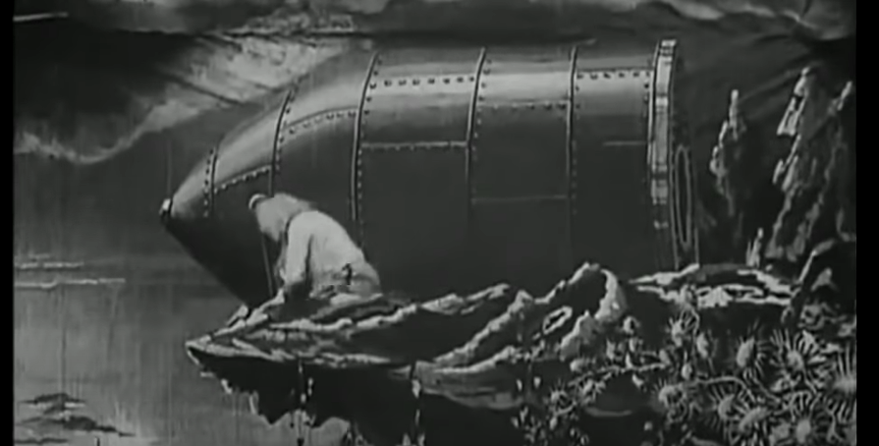
other issues
How do the astronomers return from the moon with no cannon?
Look at the scene at 12:30
Méliès had not studied Newton’s Law of Gravitation!

