Slide 1

Reflection and Refraction
CC0
Version 1.1
Notes:
Main Changes in version 1.1:
Added missing section on polarisation, diffraction and interference near the end
Changed the file name from 2-2 to 2-3 to match the specification
Corrected the numbers in example, (slide 67 in v1, 77 in v 1.1)
slide 64 now 76 simplified to make it clearer
Some redundant slides removed
Some exercises added
Many slides modified / moved

Slide 2
Physics Specification 2.3
2.3 Wave behaviour caused by the interaction of
waves with their environment
Students learn about
ray diagrams
reflection
  i = r
Students should be able to
model wave behaviour; reflection, refraction, diffraction, interference, polarisation
Source: LC Physics Specification (2025), ncca.ie, © NCCA
Notes:
Gone compared to old course:
Real and apparent depth
Spherical mirrors
Refractive index of liquid experiment
Mirages

Slide 3
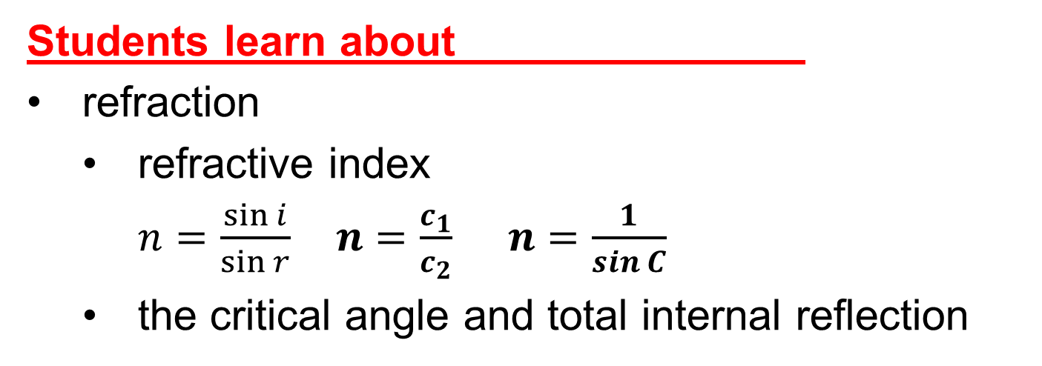
Physics Specification 2.3
2.3 Wave behaviour caused by the interaction of
waves with their environment
Students learn about
refraction
  refractive index
  $n=\frac{\sin{i}}{\sin{r}} n=\frac{c_{1}}{c_{2}} n=\frac{1}{sin C}$
  the critical angle and total internal reflection
Students should be able to
verify models for refraction using primary and secondary data
Source: LC Physics Specification (2025), ncca.ie, © NCCA

Slide 4
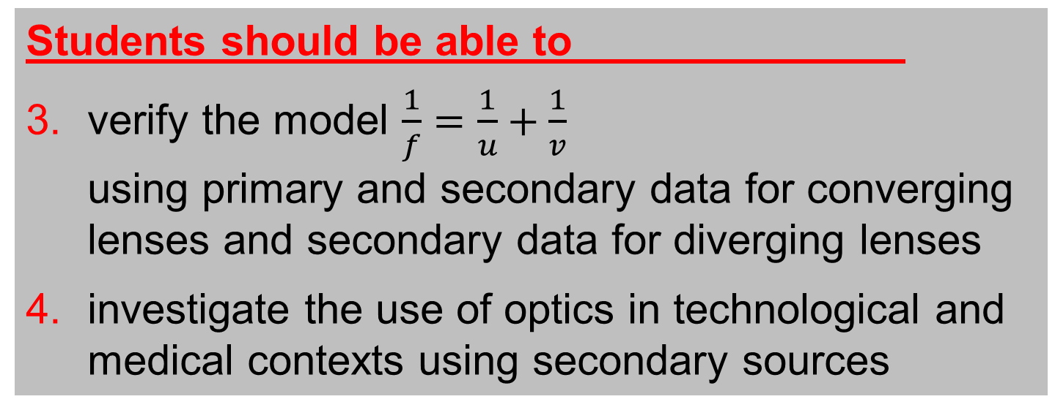
Physics Specification 2.3
2.3 Wave behaviour caused by the interaction of
waves with their environment
These topics are in a separate file
Students learn about
  converging and diverging lenses
Students should be able to
verify the model $\frac{1}{f}=\frac{1}{u}+\frac{1}{v}$
using primary and secondary data for converging lenses and secondary data for diverging lenses
investigate the use of optics in technological and medical contexts using secondary sources
Source: LC Physics Specification (2025), ncca.ie, © NCCA

Slide 5
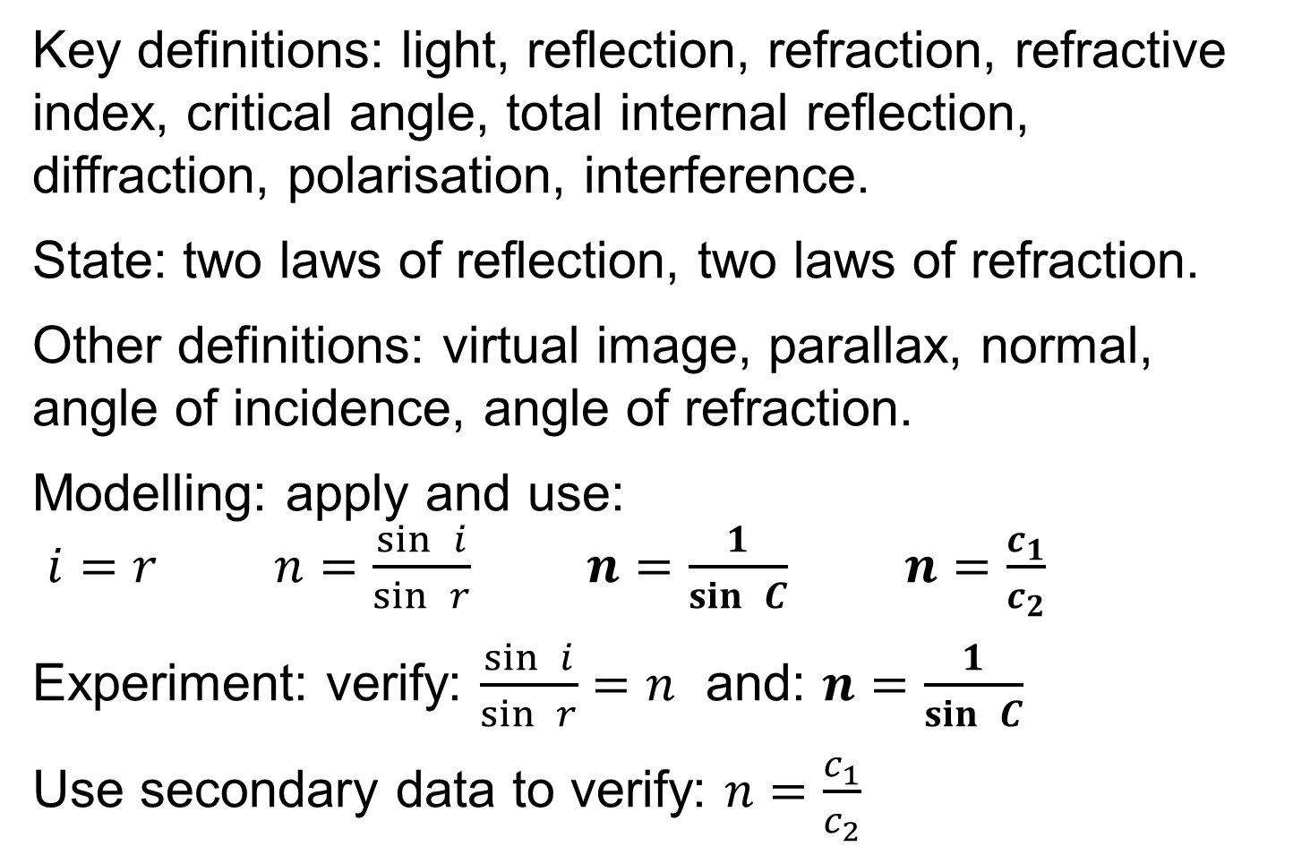
Revision summary
Key definitions: light, reflection, refraction, refractive index, critical angle, total internal reflection, diffraction, polarisation, interference.
State: two laws of reflection, two laws of refraction.
Other definitions: virtual image, parallax, normal, angle of incidence, angle of refraction.
Modelling: apply and use:
$i=r$ $n=\frac{\sin{ }i}{\sin{ }r}$ $n=\frac{1}{\sin{ }C}$ $n=\frac{c_{1}}{c_{2}}$
Experiment: verify: $\frac{\sin{ }i}{\sin{ }r}=n$ and: $n=\frac{1}{\sin{ }C}$
Use secondary data to verify: $n=\frac{c_{1}}{c_{2}}$

Slide 6
Nature of light

Slide 7
What is Light?
Light is electromagnetic energy and travels as a wave through a vacuum and some transparent materials

Slide 8
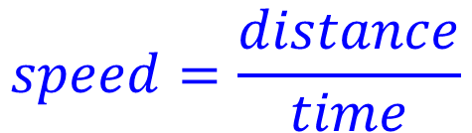
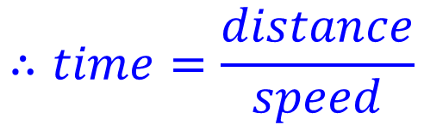



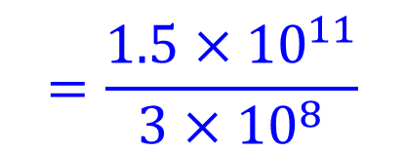
Example 1
The Sun is 1.5 x 10¹¹ m from Earth
How long does it take light to get from the Sun to the Earth? The speed of light = 3 x 10⁸ m s⁻¹
$$speed=\frac{distance}{time}$$
$$∴time=\frac{distance}{speed}$$
$$=\frac{{1.5×10}^{11}}{3×{10}^{8}}$$
$$=5 ×{10}^{2}$$
$$=500 s$$
$$≈8 minutes$$

Slide 9





Exercise
How far will light travel in 1 millisecond?
The speed of light = 3 x 10⁸ m s⁻¹
$$distance=time×speed$$
$$=0.001×3×{10}^{8}$$
$$=3×{10}^{8−3}$$
$$=3×{10}^{5}m$$
$$=300 km$$

Slide 10





Exercise
How far will light travel in 1 nanosecond?
The speed of light = 3 x 10⁸ m s⁻¹
$$distance=time×speed$$
$$={10}^{−9}×3×{10}^{8}$$
$$=3×{10}^{8−9}$$
$$=3×{10}^{−1}m$$
$$=30 cm$$

Slide 11
How can you prove that light travels in straight lines?
1
Thread pulled tight
Light
2
View through holes
CC0

Slide 12
Drawing light rays
Light travels in straight lines, thus light rays are straight until they hit something
Laser
Point source

Slide 13
Purpose of Ray Diagrams
Ray diagrams help you understand and make predictions about optical systems
This ray diagram shows the formation of an image with a lens. We will study this later.

Slide 14
Reflection

Slide 15
What is Reflection of Light?
Light bouncing off a surface.
HL 2014 2017
CC0
Definition wording per SEC marking schemes at examinations.ie

Slide 16
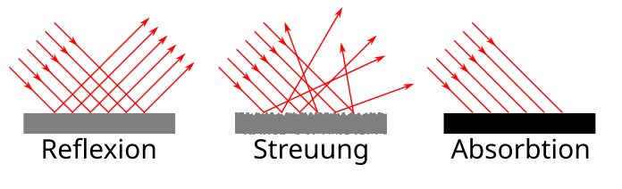
Name the two types of reflection
Regular reflection
(mirror)
CC0
Diffuse reflection
(paper)
CC0

Slide 17
How do you draw a plane mirror?
Reflective surface
Non-reflective side
Plane mirror
(flat mirror)

Slide 18


Key words
NB all angles are measured from the Normal
Normal at point of incidence
Angle of incidence
Angle of reflection
Incident ray
Reflected ray
$$i$$
$$r$$
Point of incidence
Plane mirror
Regular reflection

Slide 19
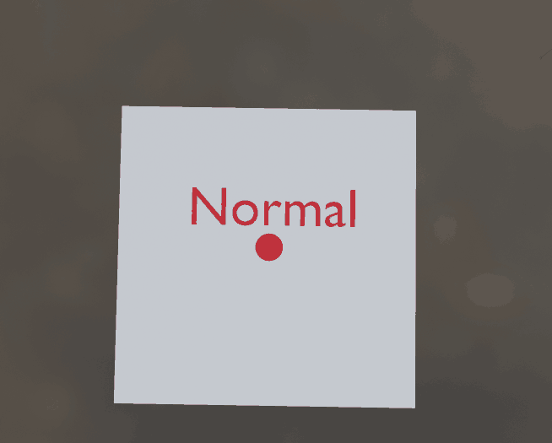
What is a “normal”?
A line or vector perpendicular to a surface

Slide 20
Exercise
Label parts a, b and c
b:
a:
c:
x
y
(2 words)
w
z
a: incident ray, b: normal c: plane mirror

Slide 21
Exercise
Which is the angle of incidence?
Which is the angle of reflection?
x
y
w
z
x, y

Slide 22
State the Laws of Reflection of Light
First: The incident ray, the normal at the point of incidence and the reflected ray are all in the same plane.
Second: The angle of incidence is equal to the angle of reflection. i = r

Slide 23
Based on this diagram, state the first law of reflection.
Normal at point of incidence
Reflected ray
Incident ray
Common plane
Mirror
CC0
The incident ray, the normal at the point of incidence and the reflected ray are in the same plane.
Notes:
Version 1.1, converted it into an activity

Slide 24


Based on this diagram, state the second law of reflection.
Angle of incidence
Angle of reflection
$$i$$
$$r$$
Plane mirror
The angle of incidence is equal to the angle of reflection. i = r
Notes:
Version 1.1, converted into an activity

Slide 25
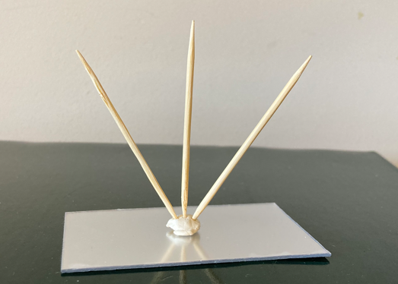
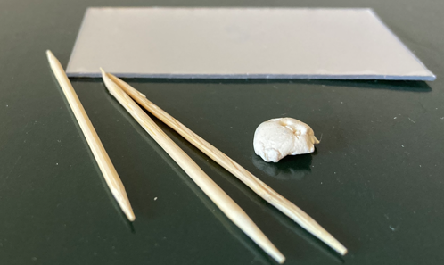
Activity: Model of the laws of reflection
Notes:
The toothpicks represent the incident ray, the normal and the reflected ray. Students must manipulate the toothpicks to represent the laws of reflection. Points to correct: Normal is not perpendicular, picks are not in the one plane, angles not equal.

Slide 26
Demonstrate the laws of reflection

Slide 27


Demonstrate the 2nd Law of Reflection
Trace the
rays.
Mark the
position
of the mirror.
Draw in the
normal at the
point of incidence.
Measure i and r.
Repeat for different values of i.
Observation: i = r.
Normal
Sheet of paper
Ray box
Angle of incidence
Angle of reflection
Incident ray
Reflected ray
$$i$$
$$r$$
Point of incidence
Regular reflection
Plane mirror
Notes:
Version 1.1 shortened and re-flowed the text

Slide 28
Demonstrate the 1st Law of Reflection
Same setup
Observation: the incident ray and reflected ray and the normal are all in the plane of the paper sheet – thus all are in the same plane.
Might be more obvious if a laser is used.
Normal
Sheet of paper
Ray box
Incident ray
Reflected ray
Regular reflection
Plane mirror

Slide 29

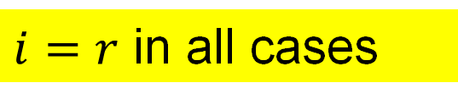

Draw a ray diagram for the image in a plane mirror
Object
Image
$$i$$
$i=r$ in all cases
$$r$$
Notes:
Version 1.1, removed references to virtual image.

Slide 30
Exercise
Draw a ray diagram to determine if A can see B
A
B
A
B

Slide 31
Exercise
Draw a ray diagram to determine if A can see B
A
B
A
B

Slide 32
Exercise
Draw a ray diagram to determine if A can see B
A
Drawing to show the closest a ray from B will get to A. Thus, A cannot see B:
B
A
B

Slide 33
Exercise
Draw a ray diagram to determine if A can see C
A
C

Slide 34
Exercise
Draw a ray diagram showing how the image of a point A is formed in a plane mirror.
A

Slide 35


What is a virtual image?
an image formed by the apparent intersection of rays. OL 2020, 2022
Object
Virtual Image
$$i$$
The rays only appear to intersect
$$r$$
Definition wording per SEC marking schemes at examinations.ie
Notes:
Version 1.1, text under the image changed

Slide 36
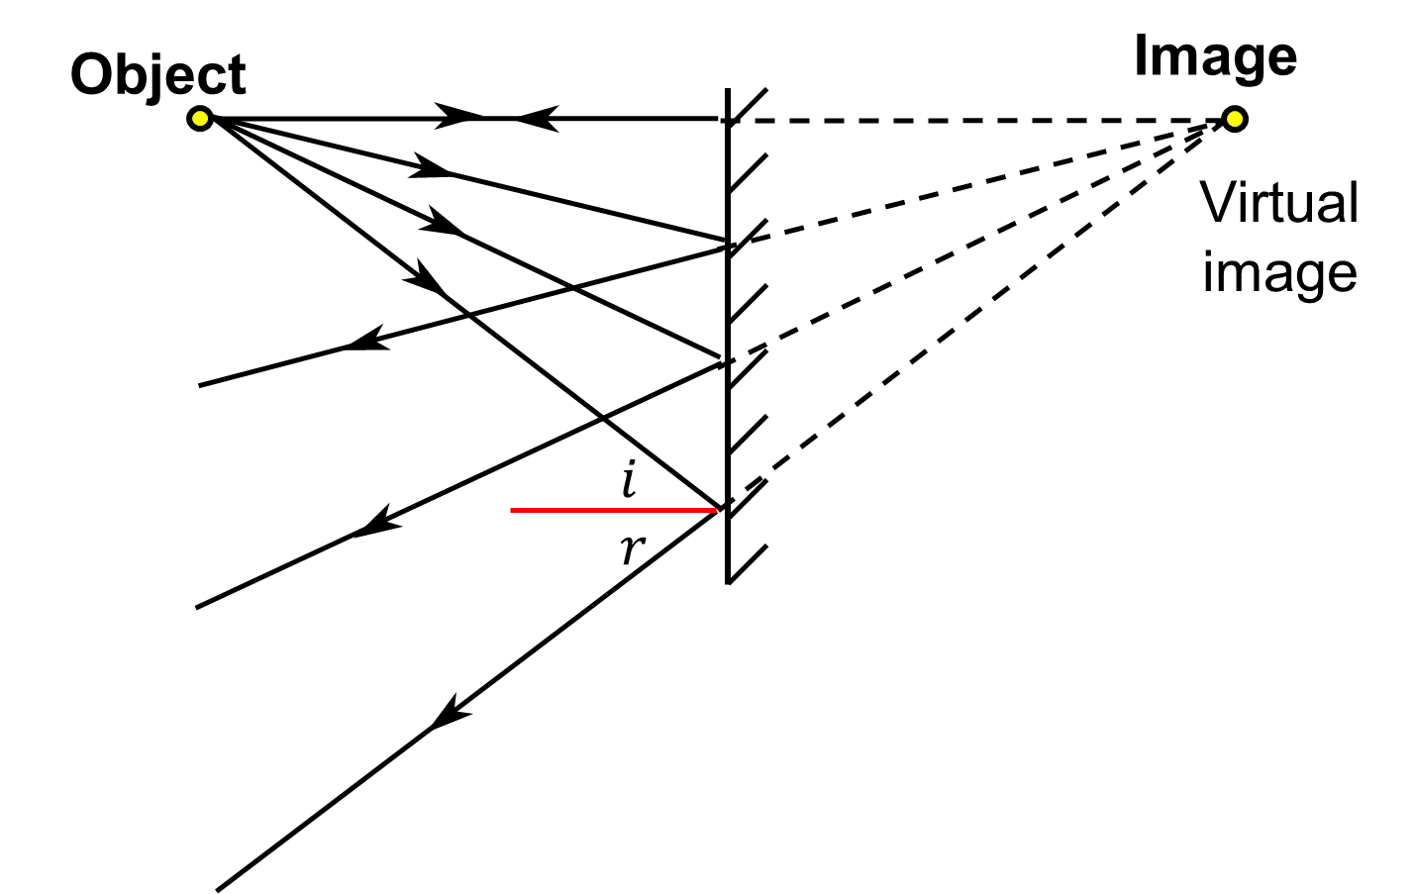
How far from the mirror is the image?
Same distance as the object is from the mirror.

Slide 37

What is Parallax?
The apparent change of position of something caused by the movement of the observer.
CC0
link

Slide 38
Give an example of Parallax.
the bird is in line with the soccer ball
A
B
the bird is in line with the rugby ball

Slide 39
Complete a ray diagram to show how parallax can lead to incorrect measurements and name two factors that influence parallax errors.
Viewing angle
Distance of object from scale

Slide 40
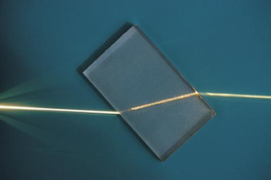

Refraction
CC0

Slide 41
What is Refraction of Light?
Refraction is the bending of light when it goes from one medium to another.
byjus.com
sciencelearn.org.nz
Refraction occurs in all wave motion (light, sound, water-waves, radio waves).

Slide 42

What causes the light to bend?
The difference in speed in the two media
Slower
CC0
Faster
Animation link

Slide 43
What is the fastest way to run from A to B?
A
full speed
Half speed
full speed
B

Slide 44
Which way does the light bend?
rarer to denser… bends towards the normal.
Air
Glass
denser to rarer … bends away from the normal.
Glass
Air

Slide 45
Does the light always bend?
Light source
Light source
Ray of light
Ray of light
Glass block
Glass block
bending
No bending

Slide 46
Key word check
light
What is this line called?
The normal at the point of incidence
A
B
Which is the angle of incidence, A or B?
A
Remember the normal is a very important line in optics. Angle of incidence, angle of reflection and angle of refraction are all measured from the normal.

Slide 47
Key word check
light
What is this ray called?
A
The incident ray
B
What is this ray called?
The refracted ray

Slide 48
Key word check
Which is the angle of incidence? _______
light
A
A
Air
B
Glass
D
Which is the angle of refraction? ______
C
C

Slide 49


Key words for Refraction
Normal at the point of incidence
Incident ray
$$i$$
Point of incidence
Angle of incidence
$$r$$
Refracted ray
Angle of refraction
Emergent ray

Slide 50
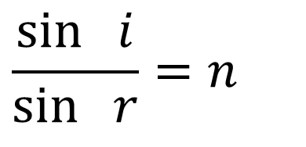
State the 2 Laws of Refraction of Light
1​^{st​} Law: The incident ray, the normal at the point of incidence and the refracted ray are in the same plane.
HL 2016
2^{​nd​} Law: The ratio of the sine of the angle of incidence to the sine of the angle of refraction is a constant.
HL 2016, 2022D
$$\frac{\sin{ }i}{\sin{ }r}=n$$
i.e.
Where n is a constant
Definition wording per SEC marking schemes at examinations.ie

Slide 51
1​^{st​} Law of Refraction diagram:
Normal at point of incidence
Incident ray
Common plane
Refracted ray
CC0

Slide 52

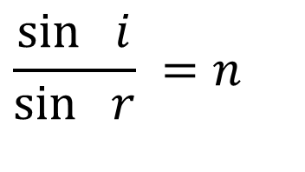

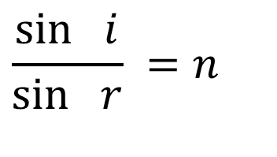

The second law of refraction
$$i$$
$$i$$
air
air
glass
glass
$$r$$
$$r$$
$$\frac{\sin{ }i}{\sin{ }r} =n$$
$$\frac{\sin{ }i}{\sin{ }r} =n$$
The ratio is the same regardless of the angles
The ratio is called the refractive index

Slide 53
Exercise
When does no bending occur?
When the angle of incidence is 0°
Glass block

Slide 54
Exercise
Draw the refracted ray inside the glass
air
glass
air
glass
Bends towards the normal

Slide 55
Exercise
Draw the refracted rays
air
air
glass
glass
air
glass
New V1.1

Slide 56
Exercise
Draw the refracted rays
air
air
glass
glass
air
glass
glass
air
New V1.1

Slide 57
Refractive Index

Slide 58
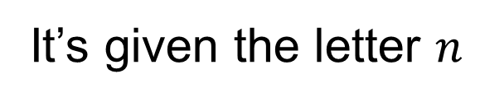
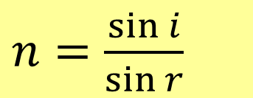
What is meant by the Refractive Index of a material?
ratio of the sine of the angle of incidence to the sine of the angle of refraction when light goes from a vacuum into the material HL 2024
It’s given the letter $n$
Vacuum
Material
$n=$ $\frac{\sin{i}}{\sin{r}}$
Definition wording per SEC marking schemes at examinations.ie

Slide 59
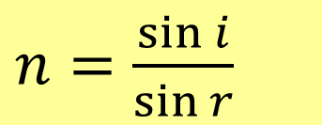
Can you use air instead of a vacuum when measuring refractive index?
Air
Material
$n=$ $\frac{\sin{i}}{\sin{r}}$
Yes when 2 or 3 significant figure accuracy is sufficient. This is because light travels at almost the same speed in air as in a vacuum (0.9997 times slower)

Slide 60
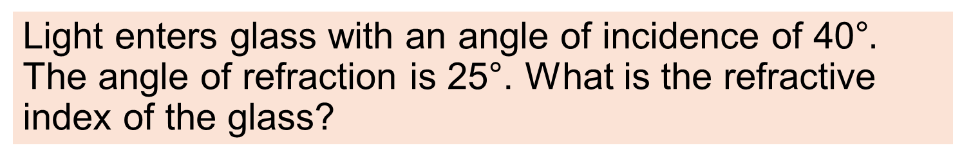
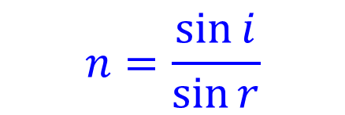
Example 2
Light enters glass with an angle of incidence of 40°$.$ The angle of refraction is 25°. What is the refractive index of the glass?
$$n=\frac{\sin{i}}{\sin{r}}$$
=1.52

Slide 61
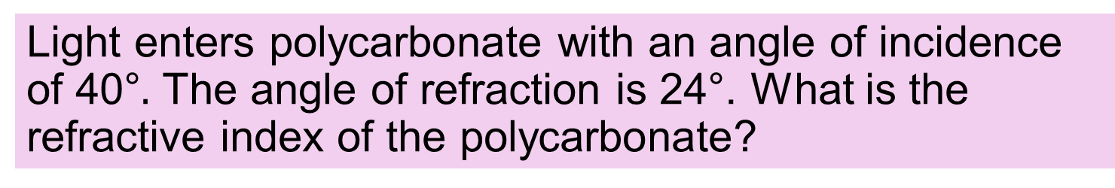

Exercise
Light enters polycarbonate with an angle of incidence of 40°$.$ The angle of refraction is 24°. What is the refractive index of the polycarbonate?
$$n=\frac{\sin{i}}{\sin{r}}$$
=1.58

Slide 62
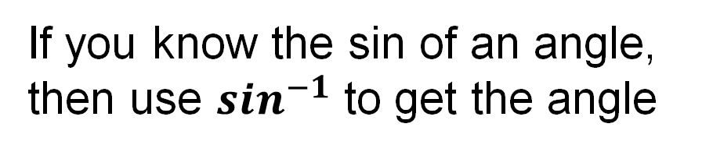

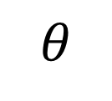
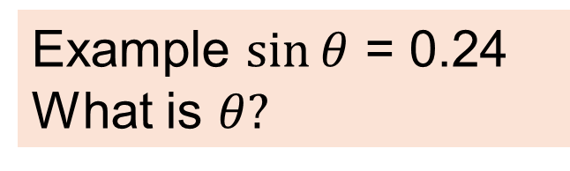
Recap on $sin^{−1}$
If you know the sin of an angle, then use $sin^{−1}$ to get the angle
Example $sin⁡θ$ = 0.24
What is $θ?$
$$θ$$
$$θ=\sin^{−1}{0.24}$$
$$θ={13.89}^{o}$$

Slide 63
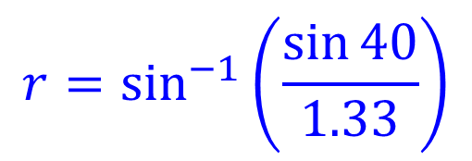
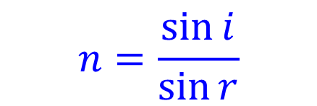
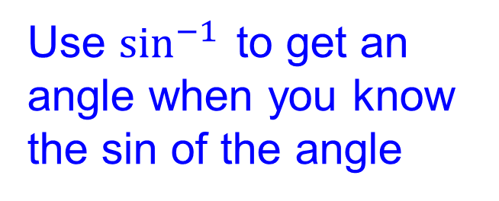
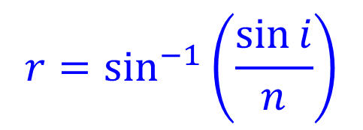
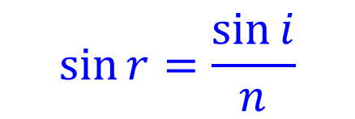
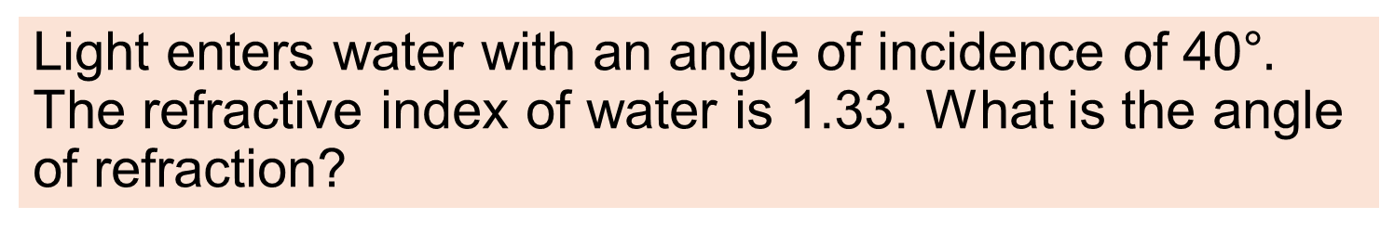

Example 3
Light enters water with an angle of incidence of 40°$.$ The refractive index of water is 1.33. What is the angle of refraction?
$$n=\frac{\sin{i}}{\sin{r}}$$
$$\sin{r}=\frac{\sin{i}}{n}$$
$$r=\sin^{−1}\left(\frac{\sin{i}}{n}\right)$$
Use $\sin^{−1}{ }$to get an angle when you know the sin of the angle
$$r=\sin^{−1}\left(\frac{\sin{40}}{1.33}\right)$$
$$r={28.9}^{0}$$

Slide 64


Exercise
A light ray enters water with an angle of incidence of 30°. Find the angle of refraction.
The refractive index of water is 1.33.
$$n=\frac{\sin{{30}^{o}}}{\sin{r}}$$
=1.33
$$⇒sin{r}=\frac{\sin{{30}^{o}}}{1.33}=0.3759$$
$$⇒{r}=\sin^{−1}{0.3759={22.1}^{o}}$$

Slide 65
B is parallel to A but in the opposite direction. Draw the refracted ray.
Parallel
It travels parallel to the direction of ray A in the air.
Air
Glass
A
B
Parallel

Slide 66
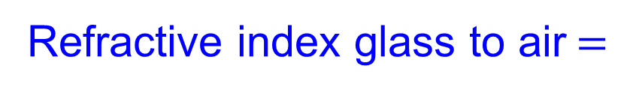

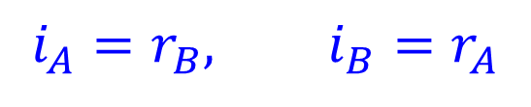


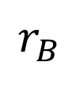
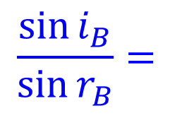

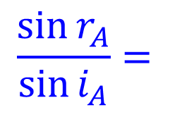
What is the refractive index from glass to air?
$$i_{A}$$
$$r_{B}$$
Air
Glass
A
B
$$r_{A}$$
$$i_{B}$$
$$i_{A}=r_{B}, i_{B}=r_{A}$$
$$\frac{\sin{i_{B}}}{\sin{r_{B}}}=$$
$$\frac{\sin{r_{A}}}{\sin{i_{A}}}=$$
$$\frac{1}{n}$$
Refractive index glass to air$=$

Slide 67

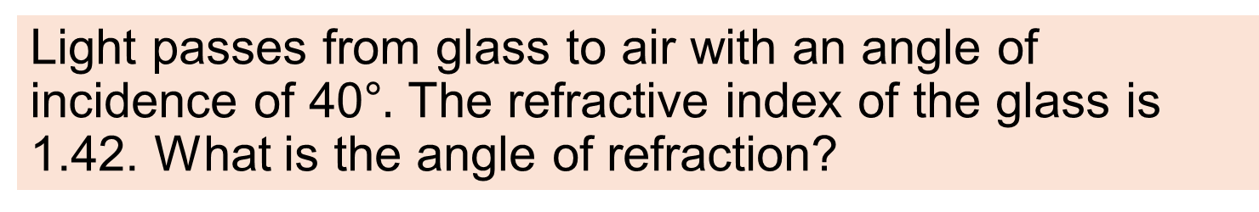

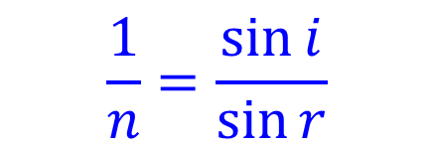

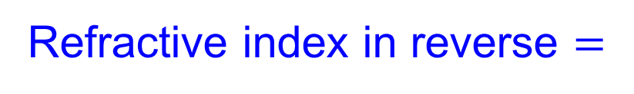
Example 4
Light passes from glass to air with an angle of incidence of 40°$.$ The refractive index of the glass is 1.42. What is the angle of refraction?
$$\frac{1}{n}$$
Refractive index in reverse $=$
$$\frac{1}{n}=\frac{\sin{i}}{\sin{r}}$$
$$\sin{r}=n\sin{i}$$
$$r=\sin^{−1}\left(n\sin{i}\right)$$
$$r=\sin^{−1}\left(1.42\sin{40\text{°}}\right)=65.89\text{°}$$

Slide 68

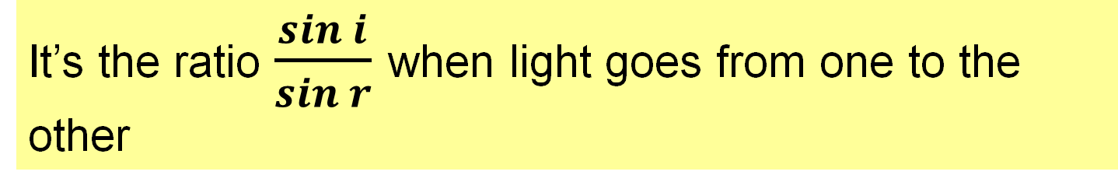
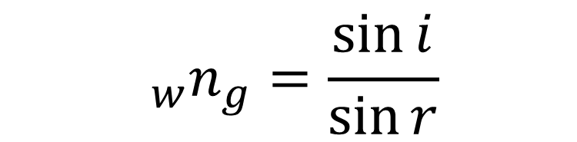

What is meant by the Refractive Index between 2 media?
It’s the ratio $\frac{\sin{i}}{\sin{r}}$ when light goes from one to the other
$$i$$
Water
Glass
The w and g refer to water and glass
$$r$$
$${ _{w}n}_{g}=\frac{\sin{i}}{\sin{r}}$$

Slide 69




Reversing the direction
$$i$$
Water
Refractive index Water to Glass
n
= 1.13
Glass
w
g
$$r$$
What is the refractive index from Glass to Water?
1
1
n
=
=
=
0.88
n
g
w
1.13
$$r$$
w
g
Water
Glass
$$i$$

Slide 70
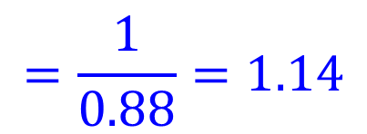
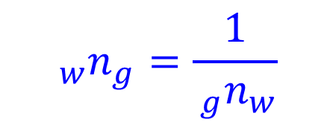
Example 5
The refractive index between glass and water is 0.88. What is the refractive index between water and glass?
$${ _{w}n}_{g}=\frac{1}{{ _{g}n}_{w}}$$
$$=\frac{1}{0.88}=1.14$$
Note the numeric discrepancy with the previous slide.
This has been caused by an accumulation of rounding differences and highlights the need to round to one extra digit during calculations.

Slide 71
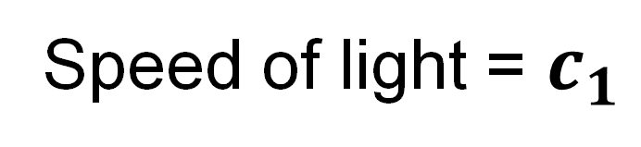
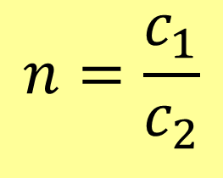
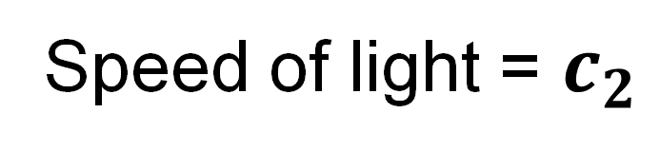
Write Refractive Index in terms of wave Speed
$$n=\frac{c_{1}}{c_{2}}$$
Tables page 59
Speed of light = $c_{1}$
Speed of light = $c_{2}$
Recall refraction is caused by the difference in speed

Slide 72
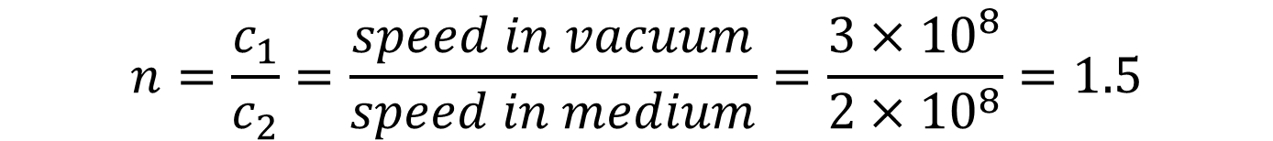
Example 6
Light travels at a speed of 2 x 10⁸ m s⁻¹ in a certain type of glass. Calculate its refractive index.
The speed of light in a vacuum is 3 x 10⁸ m s⁻¹
$$n=\frac{c_{1}}{c_{2}}=\frac{speed in vacuum}{speed in medium}=\frac{3×{10}^{8}}{2×{10}^{8}}=1.5$$

Slide 73
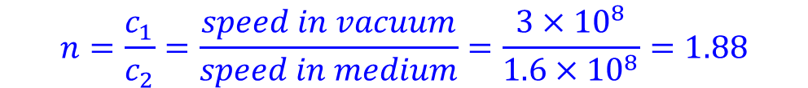
Exercise
Light travels at a speed of 1.6 x 10⁸ m s⁻¹ in a certain optical material. Calculate its refractive index.
The speed of light in a vacuum is 3 x 10⁸ m s⁻¹.
$$n=\frac{c_{1}}{c_{2}}=\frac{speed in vacuum}{speed in medium}=\frac{3×{10}^{8}}{1.6×{10}^{8}}=1.88$$

Slide 74

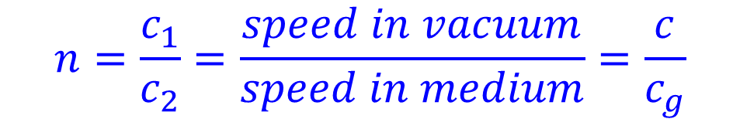
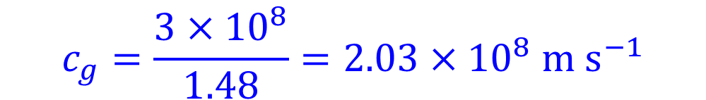
Example 7
Calculate the speed of light in glass that has a refractive index of 1.48.
The speed of light in a vacuum is 3 x 10⁸ m s⁻¹
$$n=\frac{c_{1}}{c_{2}}=\frac{speed in vacuum}{speed in medium}=\frac{c}{c_{g}}$$
$$c_{g}=\frac{c}{n}$$
$$c_{g}=\frac{3×{10}^{8}}{1.48}=2.03×{10}^{8} m s^{−1}$$

Slide 75



Exercise
Calculate the speed of light in water.
The refractive index of water is 1.33.
The speed of light in a vacuum is 3 x 10⁸ m s⁻¹
$$n=\frac{c_{1}}{c_{2}}=\frac{speed in vacuum}{speed in medium}=\frac{c}{c_{w}}$$
$$c_{w}=\frac{c}{n}$$
$$c_{w}=\frac{3×{10}^{8}}{1.33}=2.26×{10}^{8} m s^{−1}$$

Slide 76






Example 8
Calculate the refractive index from water n=1.33 to glass n=1.5
$$c=speed of light, c_{g} and c_{w}=speed in glass and water$$
$${ _{w}n}_{g}=\frac{c_{w}}{c_{g}}$$
Because $n=\frac{c_{1}}{c_{2}}$
Water
$$=c_{w}\left(\frac{1}{c_{g}}\right)$$
Glass
$$=\frac{c}{n_{w}}\left(\frac{n_{g}}{c}\right)$$
Because $c_{w}=\frac{c}{n_{w}}$ and $c_{g}=\frac{c}{n_{g}}$
$$=\frac{n_{g}}{n_{w}}=\frac{1.5}{1.33}=1.13$$
Notes:
Version 1.1 slide simplified

Slide 77







Exercise
A refractometer, measures the refractive index of a liquid by determining the critical angle between glass and the liquid.
(i) using the formula $n=\frac{c_{1}}{c_{2}}$, show that the refractive index going from a liquid of refractive index $n_{l}$ to glass of refractive index $n_{g}$ is given by $n=\frac{n_{g}}{n_{l}}$.
$${ _{l}n}_{g}=\frac{c_{l}}{c_{g}}$$
$$=c_{l}\left(\frac{1}{c_{g}}\right)$$
$$=\frac{c}{n_{l}}\left(\frac{n_{g}}{c}\right)$$
Because $c_{l}=\frac{c}{l}$ and $c_{g}=\frac{c}{n_{g}}$
CCO
$${ _{l}n}_{g}=\frac{n_{g}}{n_{l}}$$

Slide 78
Exercise continued
(ii) a refractometer measures the critical angle for light passing from glass of refractive index 1.47 into a liquid being tested to be 67.7°, calculate the refractive index of the liquid.
1.36

Slide 79







Example 9
Light enters water from glass. If the angle of incidence is 35° find the angle of refraction. $_{w}n_{g}=1.1$.
$_{w}n_{g}=1.1{{ ⇒ }_{g}n}_{w}=0.909$1
$${35}^{∘}$$
Glass
$${{ ⇒ }_{g}n}_{w}=0.9091=\frac{{\sin{35}}^{∘}}{\sin{r}}$$
Water
$$r$$
$$⇒\sin{r=\frac{sin35\text{°}}{0.9091}=0.6310}$$
$$⇒r=\sin^{−1}\left(0.6310\right)=39.1\text{°}$$
Notes:
Corrected in v1.1

Slide 80
Exercise
The refractive index between water and a certain type of glass is 1.15, what is the refractive index between that glass and water?
0.87

Slide 81
Exercise
A ray of light enters air from a plastic. The angle of incidence is 37° and the angle of refraction is 66.° Calculate the refractive index of the plastic.
1.52

Slide 82
Exercise HL
Plastic A and Plastic B are in contact. Their refractive indices are 1.44 and 1.47. What is the refractive index for light going from A to B?
A n=1.44
B n=1.47
1.021

Slide 83
Exercise
Which Ray Diagram is correct?
A
B
air
air
air
air
glass
glass
A

Slide 84


Which speed goes on top?
$$n=\frac{c_{1}}{c_{2}}$$
e.g. Glass and vacuum…
Consider...
Refractive index of any material is greater than 1
Thus… highest number goes on top
Light travels fastest in a vacuum
Thus… Speed of light in vacuum goes on top
$$⇒n = \frac{Speed of light in vacuum}{Speed of light in glass}$$

Slide 85


Exercise
The refractive index of diamond = 2.42 and the speed of light in air = $3×{10}^{8} m s^{−1}$. Calculate the speed of light in diamond.
$$n=\frac{c_{1}}{c_{2}}=\frac{c_{air}}{c_{diamond}}=2.42$$
$$⇒c_{diamond}=\frac{c_{air}}{2.42}$$
$$=\frac{3×{10}^{8}}{2.42}=1.24×{10}^{8} m s^{−1}$$

Slide 86


Exercise
The refractive index of water = 1.33 and the speed of light in a vacuum = $3×{10}^{8} m s^{−1}$. Calculate the speed of light in water.
$$2.26×{10}^{8} m s^{−1}$$

Slide 87

Verify
$n=\frac{sin\left(i\right)}{sin(r)}$

Slide 88


Verify $n=\frac{sin\left(i\right)}{sin\left(r\right)}$
Setup equipment as shown with a sheet of paper under the block.
Trace out the block and the rays.
Remove the block and draw the refracted ray and the normal.
Measure the angles i and r.
Repeat with different angles.
Ray box
Normal at the point of incidence
$$i$$
Incident Ray
Point of incidence
Protractor
$$r$$
Refracted ray
Glass block
Point of emergence
CC0
Paper
Emergent ray

Slide 89
Data and calculations
i
sin i
sin r
sin i
r
sin r

Slide 90






Draw a Suitable graph
$$\frac{\sin{ }i}{\sin{ }r}=n$$
$$sin i$$
$$n=slope$$
$$⇒\sin{i=n\sin{r}}$$
$$y=mx+c$$
$$sin r$$

Slide 91



How does your graph verify the model?
$$sin i$$
$$sin r$$
The Graph is a Straight Line through the Origin.
This verifies that: sin i ∝ sin r i.e. $\frac{\sin{i}}{\sin{r}} is constant$

Slide 92


Alternative 1: Search pins
Place sheet of paper under the block
Line up the pins as viewed through the block
Trace out the block and the rays
Remove the block and draw the refracted ray and the normal
Measure the angles i and r
Repeat with different angles
Pins
Normal at the point of incidence
$$i$$
Incident Ray
Protractor
$$r$$
Refracted ray
Glass block
Pins
Emergent ray
Paper
CC0
Observer

Slide 93

3d drawing of pin arrangement
2-D drawing is sufficient in an exam.
Line up the pins
Draw incident ray
Draw Refracted ray
Draw Normal at point of incidence
Measure $i$ and $r$ with protractor

Slide 94
Alternative 2: semicircular block
Place sheet of paper under the block.
Trace the block
Mark the centre of the straight edge.
Remove the block and draw the normal
Replace the block
Shine a ray towards the centre of the straight edge
trace the incident and refracted ray
Remove the block and measure i and r.
Repeat for different angles
Normal at the point of incidence
Angle of incidence i
Ray Box
r
Semicircular block of glass
Protractor

Slide 95



Verify $n=\frac{1}{sin C}$
Normal at the point of incidence
Angle of refraction = ${90}^{o}$
Place sheet of paper under semi-circular block.
Trace out the block and mark the centre of the straight edge
Arrange the light box so that rays point at the centre of the straight edge and the angle of refraction is ${90}^{o}$
Remove block
Draw Normal
Draw Incident ray
Measure C
Calculate $\frac{1}{sinC}$ and check that it is the same as n
C
Semicircular block of glass
Ray Box
Protractor
CC0

Slide 96
Critical Angle &
Total Internal Reflection

Slide 97


What is the Critical Angle?
The angle of incidence in a denser medium causing an angle of refraction of 90°.
HL 2019, 2021, 2025
Angle of refraction = ${90}^{o}$
$$C$$
Angle of incidence = Critical angle
Definition wording per SEC marking schemes at examinations.ie

Slide 98

Explain Total Internal Reflection
when the angle of incidence > critical angle all light is reflected.
HL 2019
Angle of incidence greater than Critical angle
Reflected ray
$$C$$
Critical angle
Definition wording per SEC marking schemes at examinations.ie
Notes:
Version 1.1 definition very slightly changed to match the marking scheme

Slide 99
Demonstrate Total internal reflection

Slide 100



How do you demonstrate Total Internal Reflection?
$$r$$
Move the ray box to the left slowly until the angle of refraction is ${90}^{o}$.
(next slide)
$$i$$
Semicircular glass block
Ray box or Laser

Slide 101
How do you demonstrate Total Internal Reflection?
$$r$$
Keep going
(next slide)
$$i$$
Partial internal reflection
Ray box or Laser

Slide 102



When you reach the critical angle,
you will see the refraction at ${90}^{o}$ and also a partial reflection.
$$r={90}^{o}$$
$$C$$
Partial internal reflection
Ray box or Laser

Slide 103

When you exceed the critical angle,
you will see total internal reflection.
$$i>C$$
Total internal reflection
Ray box or Laser

Slide 104

How do you calculate the refractive index from the Critical Angle?
$$n=\frac{1}{\sin{ }C}$$
Pg 60
C is the critical angle

Slide 105

Example 10
The critical angle of a type of plastic is 40°. Find the refractive index.
$$n=\frac{1}{\sin{C}}=\frac{1}{\sin{40\text{°}}}=1.56$$

Slide 106



Example 11
Sapphire ($Al_{2}O_{3})$ has interesting optical properties including a high refractive index of 1.77. What is the critical angle for Sapphire?
$$n=\frac{1}{\sin{C}}$$
$$⇒\sin{C}=\frac{1}{n}=\frac{1}{1.77}=0.565$$
$$⇒C=\sin^{−1}{0.565}=34.4\text{°}$$

Slide 107








Example 12
What is the smallest value of the refractive index that allows total internal reflection in the below prism ?
For total internal reflection:
$$i>C$$
$${⇒45}^{o}>C$$
$$⇒C<{45}^{o}$$
$${45}^{o}$$
$${45}^{o}$$
$${45}^{o}$$
$$n=\frac{1}{\sin{C}}$$
$${45}^{o}$$
now
$$if C={45}^{o}, then n=\frac{1}{\sin{{45}^{o}}}=1.414$$
$⇒$The refractive index must be > 1.414

Slide 108






Example 13
An architect is designing a circular pool of water with a 2-metre radius which has a light under the water in the centre. What is the minimum depth of the light that will allow light to exit from all points on the surface of the water. ($n_{water}=1.33$).
$$n=1.33=\frac{1}{\sin{C}}$$
2 m
$$⇒\sin{C}=\frac{1}{n}=\frac{1}{1.33}=0. 752$$
d
C
C
$$⇒C=\sin^{−1}{0.752={48.76}^{0}}$$
$$\tan{C=\frac{2}{d}}$$
light
If the light were any less deep, no light would escape near the edge of the pool.
$$⇒d=\frac{2}{tan C}{=1.75 m}$$

Slide 109

Exercise
Pure silicon is opaque to visible light but transparent at infra red frequencies. Its refractive index is 3.4. Calculate the critical angle.
$${17.1}^{o}$$

Slide 110

Exercise
The critical angle of a type of plastic is 44°. Find the refractive index.
$$1.44$$

Slide 111
Exercise
Draw the refracted ray and the partial internally reflected ray.
Refracted ray
Partial internal reflection
Ray box or Laser
Notes:
New V1.1 included because partially reflected rays were implied on the sample paper.

Slide 112
Exercise HL
Plastic A and Plastic B are in contact. Their refractive indices are 1.44 and 1.47 respectively. What is the critical angle going from B to A?
A n=1.44
B n=1.47
78.4⁰

Slide 113
Exercise
Which medium has the highest refractive index?
Medium 1
Medium 2
Total internal reflection
Medium 2

Slide 114
Exercise
How can you turn a ray of light through 180o with a prism?
A
B
C

Slide 115
Example: Prism reflectors
Light that is internally reflected in a 90° prism will always reflect back to where it came from.
This principle is used in bicycle reflectors, in road signs and in reflective strips on clothing.
These prisms use a corner reflector arrangement so as to work in 3 dimensions. Hundreds or thousands of tiny prisms are used in road signs.
Prism based
retroreflectors

Slide 116


What is an Optical Fibre?
A very thin transparent fibre of glass or plastic through which light can pass.

Slide 117

Use of Optical Fibres
Optic fibres are used in communication networks for transmitting data or video signals.
They are also used in endoscopes to carry light down to the tip to illuminate the surroundings
Light out
Light in
Notes:
Modern endoscopes use tiny digital cameras in their tip for imaging, but they use optical fibres to carry light to the tip of the scope to illuminate the subject. This arrangement keeps the heat within the endoscope low enough for safe internal medicine.

Slide 118
How do Optical Fibres transmit light and information?
The information is sent as a pulsating laser beam. The angle of incidence is always greater than the critical angle. Total internal reflection keeps the beam inside the fibre.

Slide 119
What is cladding on an optic fibre?
Inner core
Cladding
Many optic fibres are constructed with an inner core which carries the light signal and a thin outer “cladding” made of a similar material but with a lower refractive index.

Slide 120
Where does the total internal reflection occur?
Inner core
Cladding
Total internal reflection occurs at the boundary between the two materials

Slide 121
Exercise
The inner core and outer cladding of an optic fibre have refractive indices of 1.47 and 1.42 respectively. What is the Critical angle for light travelling in the core?
Inner core
Cladding
75.01º
Notes:
V 1.1 refractive indices swapped in order to have the highest n in the core

Slide 122
PHET simulations of refraction
Bending Light - Snell's Law | Refraction | Reflection - PhET Interactive Simulations

Slide 123
Exercise
Draw the refracted ray in the glass and the emergent ray
air
air
glass

Slide 124
Polarisation Diffraction and Interference

Slide 125

What is Polarisation?
Restricting a wave so that it only vibrates in one plane HL 2014, 2016, 2017, 2019, 2022
Not polarised
polarised
CC0
Notes:
Note the incident wave on the left is not truly unpolarised light, it is “circularly polarised light”. The diagram is used here because it gets the idea of polarisation across quite well. A suitable diagram showing true unpolarised light could not be found and I suspect it would be a confusing mess of waves.

Slide 126
How can light become polarised?
By reflecting off a surface
Unpolarised
Polarised
Water
By passing through a polarising filter

Slide 127
What happens?
Unpolarised
Polarised
Water
In both cases the “polariser” only reflects or transmits in one plane of vibration
Reflection: horizontal plane
Glasses: vertical plane
They polarise by blocking the unwanted planes.

Slide 128
If the reflected light is horizontally polarised and the glasses allow only the rays that vibrate in the vertical plane, explain what the observer sees and why?
Unpolarised
Polarised
Observer
Water
Observer sees very little reflection because reflected light is vibrating horizontally but glasses only allow vertical vibrations through. Thus, the observer sees under the water.

Slide 129
When two polarising filters overlap, you get different light blocking depending on their orientation. Which of these is correct? The little arrow shows the polarisation direction.
A
B
C
D
E
F
G
H
I
A, H, C.

Slide 130
Can longitudinal waves be polarised?
Direction of vibration
Animation link
Direction of travel
Longitudinal waves cannot be polarised because the vibrations are parallel to the axis. This means their vibrations do not define any particular plane.

Slide 131
What is meant by diffraction?
the spreading out of a wave after it passes through a gap or around an obstacle. HL 2014, 2019, 2021, 2022
Spreading out
gap
obstacle
Definition wording per SEC marking schemes at examinations.ie

Slide 132
Lenses can cause light to spread out; explain why this is not diffraction.
Lens
Because a gap or obstacle is not the cause of the spreading out of the light waves

Slide 133
Demonstrate diffraction
Theory
Demonstration
Image enlarged
Laser
Tiny bead of blue tack
screen
Shadow of blue tack with bright spot in centre
Transparent ruler
Notes:
Can also use a microscope slide

Slide 134
What is interference of waves?
Interference is the pattern that results from combining waves.
Combine waves
New pattern
Interference and diffraction will be covered in more depth in section 2.6

Slide 135
Revision summary
Key definitions: light, reflection, refraction, refractive index, critical angle, total internal reflection, diffraction, polarisation, interference.
State: two laws of reflection, two laws of refraction.
Other definitions: virtual image, parallax, normal, angle of incidence, angle of refraction.
Modelling: apply and use:
$i=r$ $n=\frac{\sin{ }i}{\sin{ }r}$ $n=\frac{1}{\sin{ }C}$ $n=\frac{c_{1}}{c_{2}}$
Experiment: verify: $\frac{\sin{ }i}{\sin{ }r}=n$ and: $n=\frac{1}{\sin{ }C}$
Use secondary data to verify: $n=\frac{c_{1}}{c_{2}}$

Slide 136
Additional slides

Slide 137
Exercise
Draw the refracted ray in the glass and the emergent ray. Include the normal at both faces.
air
air
glass
Normal
Normal

Slide 138
Exercise
Draw the refracted rays
air
air
glass
glass

Slide 139
Exercise
Draw a ray diagram to determine if A can see B
B
A
B
A

Slide 140
Exercise
The below diagrams represent 3 stages in an experiment to determine the critical angle for glass using a semicircular glass block and a ray box. In diagram B, the student has found the critical angle. Complete all 3 ray diagrams and indicate clearly the critical angle.
A
B
C
Ray Box
Ray Box
Ray Box
Critical angle found

Slide 141
Answer
The below diagrams represent 3 stages in an experiment to determine the critical angle for glass using a semicircular glass block and a ray box. In diagram B, the student has found the critical angle. Complete all 3 ray diagrams and indicate clearly the critical angle.
A
B
C
Ray Box
Ray Box
Ray Box
Critical angle

Slide 142


How do you prove that light is energy?
Crookes Radiometer
converts Light Energy into Kinetic Energy.
Or
use a solar panel.
CC0
CC0

Slide 143

Retro reflectors on the moon
There are 7 retro-reflectors on the moon.
3 were placed there on the Apollo missions and have a prism design.
They allow very precise measurements to be made of the moon’s position relative to earth.
CC0

Slide 144

Diver
When a diver looks up, he or she sees a disk of light. The darker surrounding area is where no light comes in and you only see a reflection of the underwater darkness.
CC0

