Slide 1
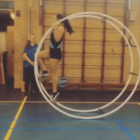
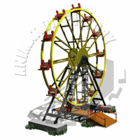
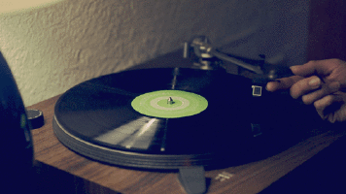
Circular Motion
Objects can be made to travel in a circle in many different ways e.g. electric motors, diesel engines, gravity
In this section we look at the maths that apply to anything travelling in a circle, regardless of why it is doing so…

Slide 2
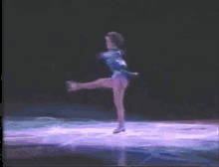
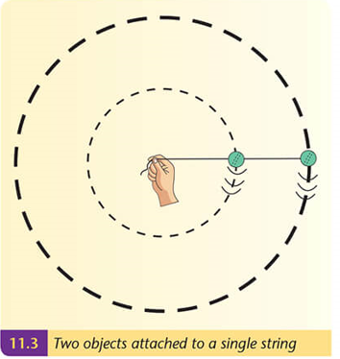
Circular Motion
When something is moving in a circle, we can measure its speed in 2 ways….
We can measure…
its linear speed – how fast a point moves in metres per second
(maybe how fast one of her fingers is moving)
2. its angular speed – what angle it moves through every second
These two objects would have the same angular speed, as they move through the same angle each second…
…but they would not have the same linear speed: the object on the outside is moving through a greater distance each second

Slide 3


Circular Motion
v represents the linear speed
It is measured in meters per second (ms⁻¹)
ω represents the angular speed
(ω is the Greek letter, pronounced omega)
l
θ
r
$$ω=\frac{θ}{t}$$
It is measured in radians per second (rad s⁻¹)
The two measurements are related by the equation…
$$v=rω$$

Slide 4
Circular Motion
Derivation:
l
θ
r

Slide 5


Circular Motion
Remember how waves have a frequency, f, and period, T.
Period (T) = time for one wave to pass
frequency (f) = no. of waves passing per second
measured in hertz (Hz)

Slide 6

Circular Motion
Remember how waves have a frequency, f, and period, T.
So, does circular motion.
Period (T) = time for one circle
Frequency (f) = no. of circles per second
$$T=\frac{1}{f}$$
l
θ
r

Slide 7
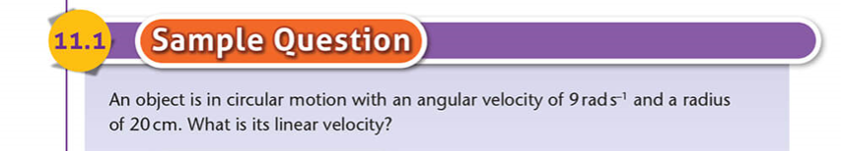
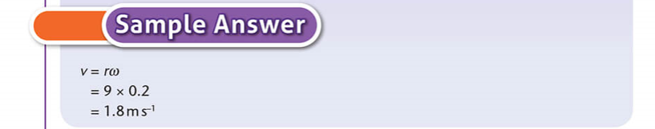
Circular Motion

Slide 8
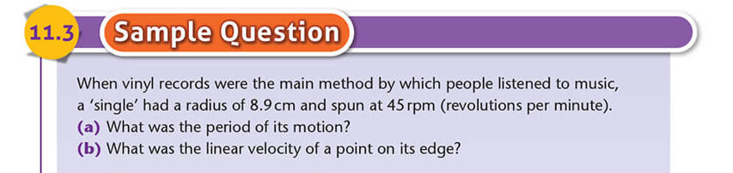
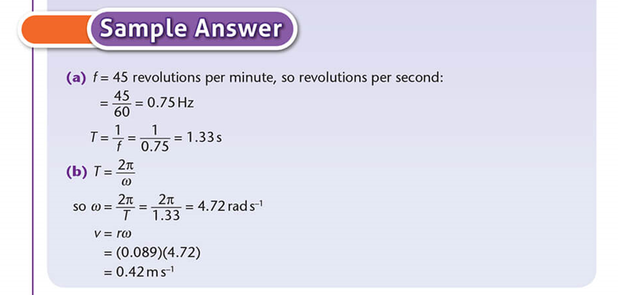
Circular Motion

