Slide 1
Electricity and Magnetism
Current in a Magnetic Field

Slide 2


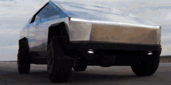
Electricity and Magnetism
Current in a Magnetic Field:
When an electric current flows through a magnetic field, a force is always created.
This is the basis of the electric motor, as used in washing machines, driers, power tools and increasingly in cars

Slide 3
Current in a Magnetic Field
When an electric current flows through a magnetic field, a force is always created.
Why does this happen?
because the electrons moving in an electric circuit behave like tiny magnets:
when one magnet (the electron) meets another, forces will always be created.

Slide 4
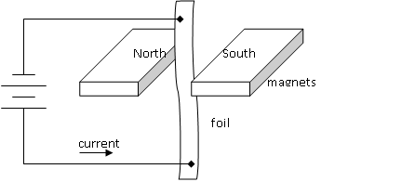
Current in a Magnetic Field: demonstration
When the current flows, the foil will move

Slide 5
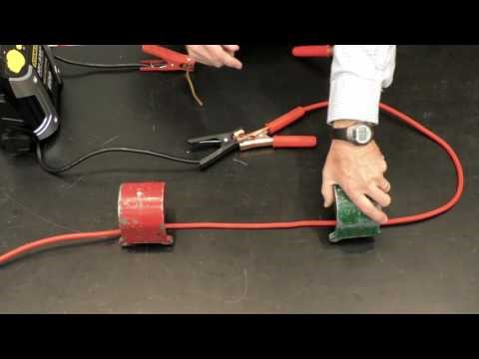
Current in a Magnetic Field: demonstration

Slide 6
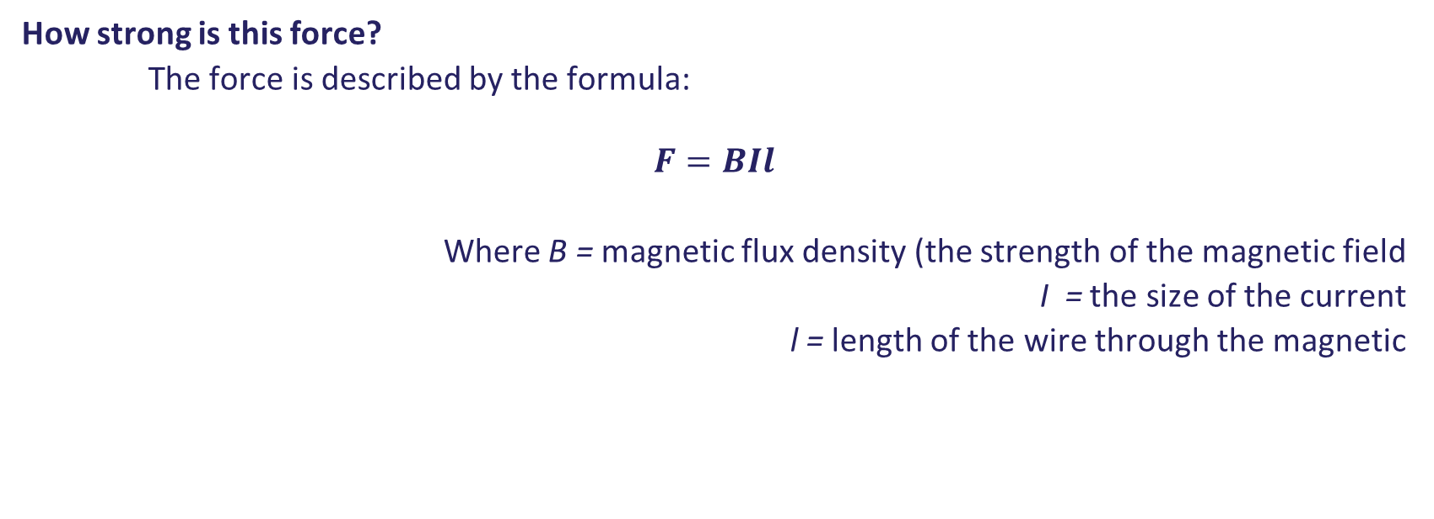
Current in a Magnetic Field: the maths
How strong is this force?
The force is described by the formula:
$$F=BIl$$
Where B = magnetic flux density (the strength of the magnetic field
I = the size of the current
l = length of the wire through the magnetic

Slide 7
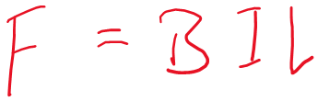
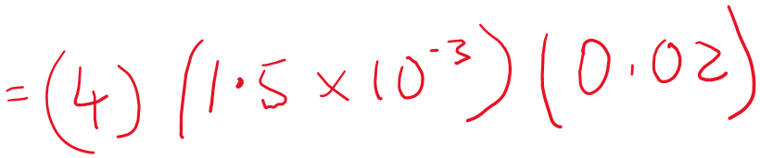

Current in a Magnetic Field: the maths
Sample Question:
An electrical wire carries a current of 1.5 mA and passes through a magnetic field pf length 2 cm and of magnetic flux density 4 T. What force does it experience?

Slide 8
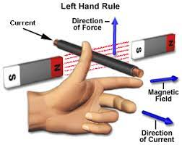
Current in a Magnetic Field: the left-hand rule
What is the direction of the force?
the direction of the force is described by the left hand rule:
hold you hand like the diagram shows…..
index finger shows the direction of the magnetic field
second finger shows the direction of the current
thumb shows the direction of the force created

Slide 9
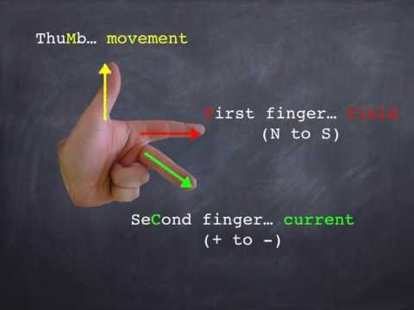
Current in a Magnetic Field: the left-hand rule
Have a look at this video….

Slide 10
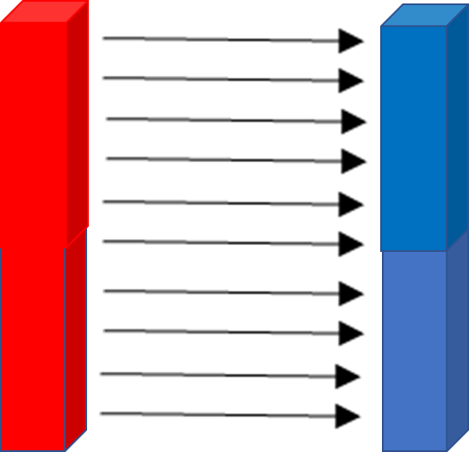
Current in a Magnetic Field: the left-hand rule
P⁺
The proton is entering a magnetic field as shown.
It will experience a force.
What is the direction of the force?
following the left hand rule, we can see the force would push the proton out of the screen.
This effect is used in particle accelerators to keep protons moving along a circular path

