Slide 1
Circular Motion
Satellite motion

Slide 2


Circular Motion:
what we know already…
v represents the linear speed
It is measured in meters per second (ms⁻¹)
ω represents the angular speed
(ω is the Greek letter, pronounced omega)
l
θ
r
$$ω=\frac{θ}{t}$$
It is measured in radians per second (rad s⁻¹)
The two measurements are related by the equation…
$$v=rω$$

Slide 3
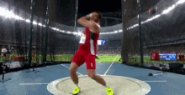

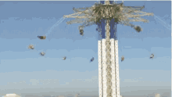
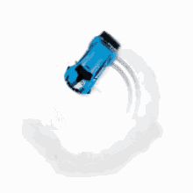
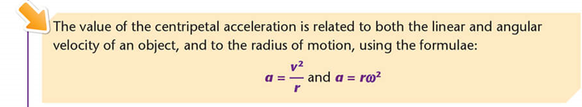

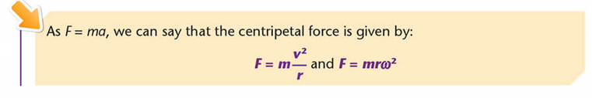
Circular Motion:
what we know already…

Slide 4
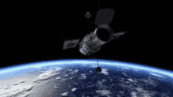
satellite motion
The centripetal force can be created in many ways: tension in a string, electric motors, friction…
When a satellite is in orbit the centripetal force is created by gravity
This allows us to develop our mathematical formulae further…..

Slide 5
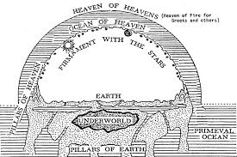
satellite motion: history
Ancient Greeks
Most believed the earth was the centre of the universe

Slide 6
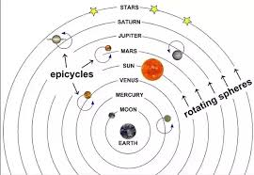
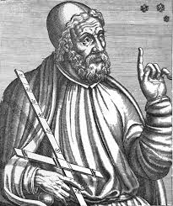
satellite motion: history
Ptolemy (from about 100 AD)
Tried to explain why the planets seem to move backwards and forwards across the night sky

Slide 7
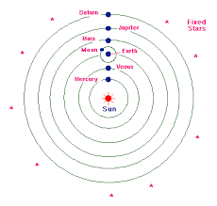
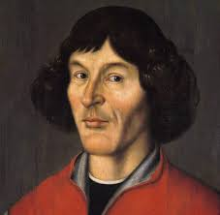
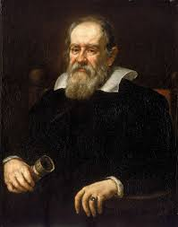
satellite motion: history
Copernicus (about 1500)
Put the sun at the centre of the motion
Supported by Galileo (about 1600)

Slide 8
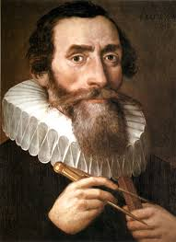
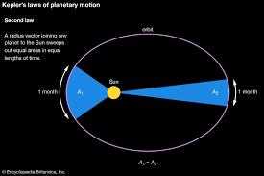
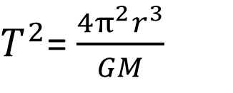
satellite motion: history
Kepler (about 1600)
Based on very accurate observations, devised the maths to describe the motion of the planets
$T^{2}$= $\frac{4π^{2}r^{3}}{GM}$
Observed that

Slide 9
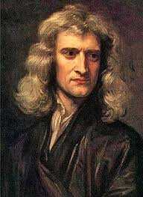
satellite motion: history
Newton (around 1700)
Based his work on theory and devised the maths to describe the motion of the planets
$T^{2}$= $\frac{4π^{2}r^{3}}{GM}$
Mathematically deduced that

Slide 10
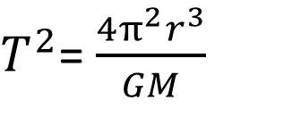
Observed that
$T^{2}$= $\frac{4π^{2}r^{3}}{GM}$
Mathematically deduced that
Theory and observations agreeing with each other, allowing us to believe in both

Slide 11
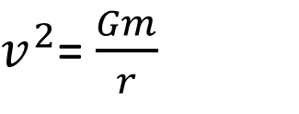
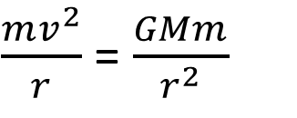
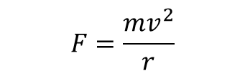
Velocity of a Satellite
Gravitation
Centripetal force
$$F=\frac{mv^{2}}{r}$$
M
m
$\frac{mv^{2}}{r}$ = $\frac{GMm}{r^{2}}$
$v^{2}$= $\frac{Gm}{r}$

Slide 12
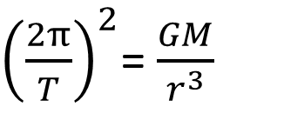
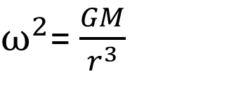
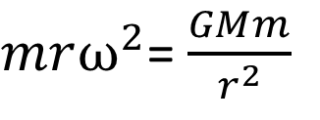

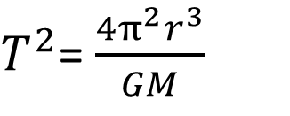
Period of a Satellite
Gravitation
Centripetal force
$$F=mrω^{2}$$
$mrω^{2}$= $\frac{GMm}{r^{2}}$
M
m
$ω^{2}$= $\frac{GM}{r^{3}}$
${\left(\frac{2π}{T}\right)}^{2}$= $\frac{GM}{r^{3}}$
$T^{2}$= $\frac{4π^{2}r^{3}}{GM}$

Slide 13
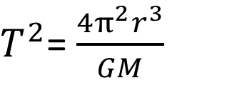
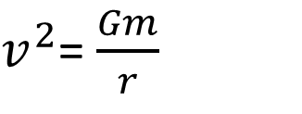
satellite motion: key formulae
$v^{2}$= $\frac{Gm}{r}$
M
m
$T^{2}$= $\frac{4π^{2}r^{3}}{GM}$

Slide 14
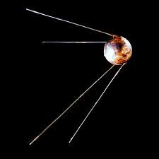
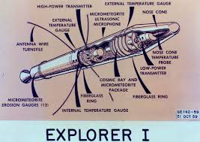
satellite motion: history
Sputnik
1st artificial satellite: 1957
Launched by the USSR
Explorer
1st US artificial satellite: 1958

Slide 15
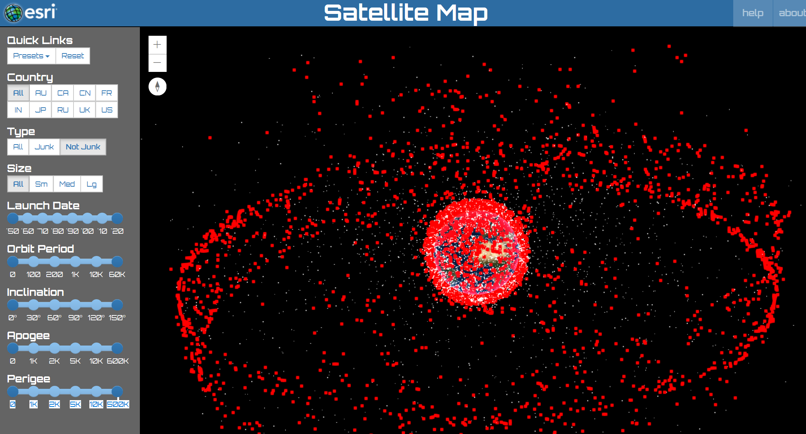
satellite motion: now…..

Slide 16
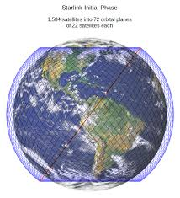
satellite motion: the future?…..

Slide 17
