Slide 1
Simple Harmonic Motion

Slide 2
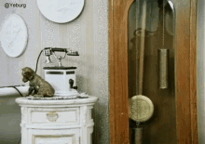



Simple Harmonic Motion
Any motion that is repeated over and over again is likely to be Simple Harmonic Motion….
…but to be considered SHM, this rule must be followed
$$a∝−s$$
Any motion in which the acceleration (a) of an object is proportional to its distance (s) from an equilibrium position and towards the position is simple harmonic motion (SHM)

Slide 3
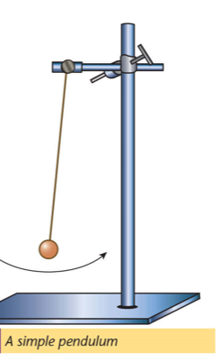
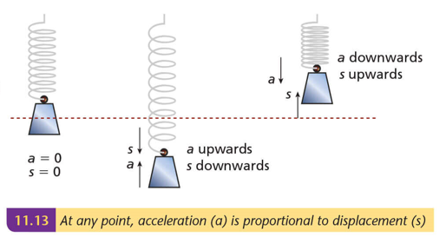


Simple Harmonic Motion
$$a∝−s$$
Any motion in which the acceleration (a) of an object is proportional to its distance (s) from an equilibrium position and towards the position is simple harmonic motion (SHM)
$$a∝−s$$
$$a∝−s$$
Or,
$$a=−ω^{2}s$$

Slide 4
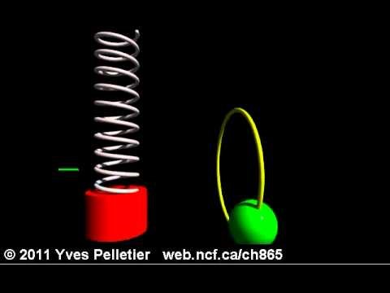

Simple Harmonic Motion
Connection with circular motion…..
$$T=\frac{2π}{ω}$$
Same ω
$$a=−ω^{2}s$$
The period of the circular motion matches that of the SHM

Slide 5
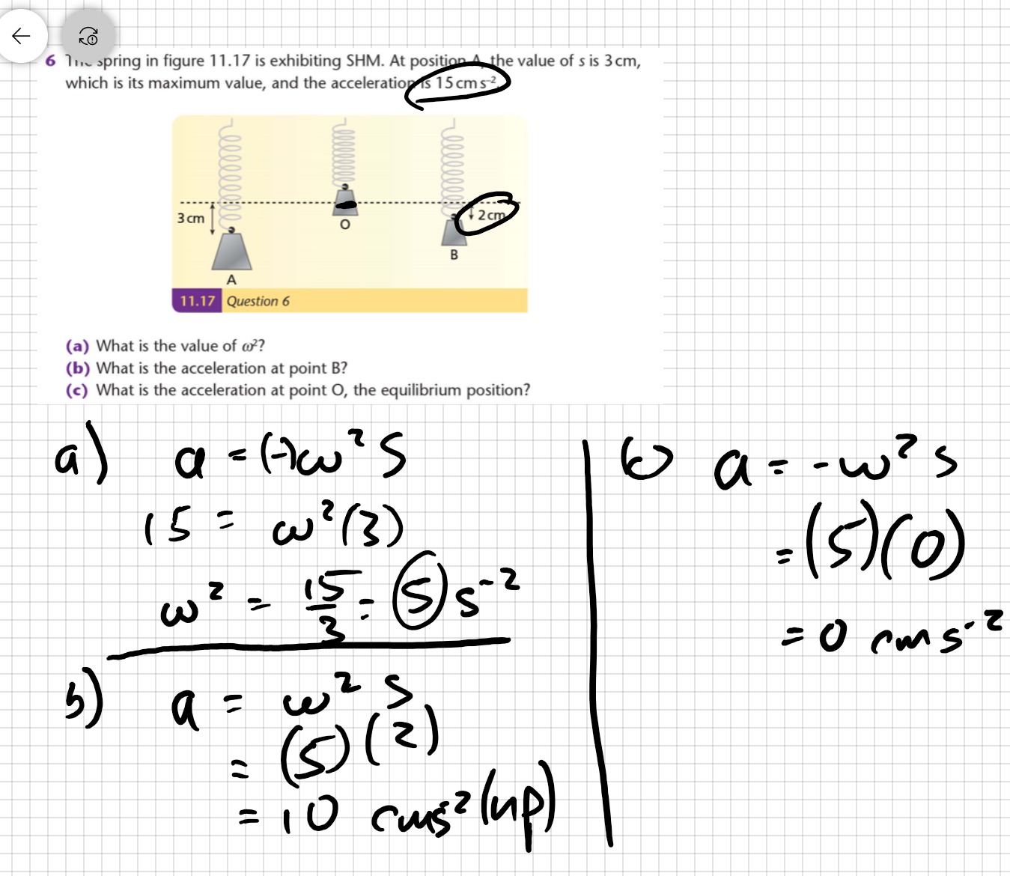
Simple Harmonic Motion:
sample question

