Slide 1
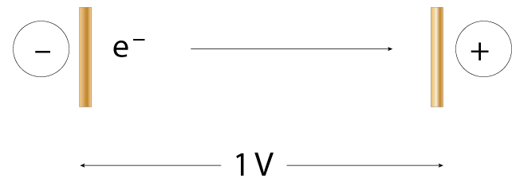

The electronvolt (eV)
The electronvolt is the amount of energy gained or lost by a single electron when it moves through a potential difference of one volt (1 V).
25.8 The energy gained by the electron is 1e V
1 eV = 1.6 × 10^{–19} J

Slide 2
Sample Question and Answer
An electron has a kinetic energy of 7 eV. What is that equal to in joules?
To change from electronvolts to joules, we multiply by the charge on the electron:
  7 eV = 7 × 1.602 × 10^{–19}
  = 1.12 × 10^{–18} J

Slide 3
Sample Question and Answer
If a voltage of 4000 V is applied to a cathode ray tube, how much energy does an electron gain as it moves from the cathode to the anode?
E = qV
= (1.602 × 10^{–19})(4000)
= 6.408 × 10^{–16} J

