Slide 1
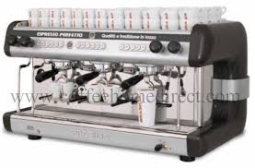
2011 q.7

Slide 2

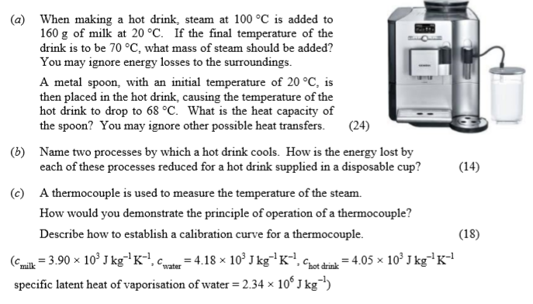

Slide 3
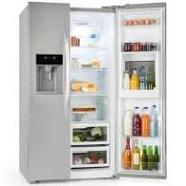
What is the typical temperature of a…..
…refrigerator?
0ºC -5ºC 4ºC 10ºC
(Some argue it should be lower)
…freezer?
0ºC -18ºC -42ºC -3ºC

Slide 4
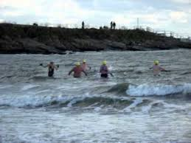
What is the typical temperature of …..
…the Irish Sea in July?
4ºC 14ºC 24ºC 34ºC
…the Irish Sea in January?
0ºC 3ºC 9ºC 14ºC

Slide 5
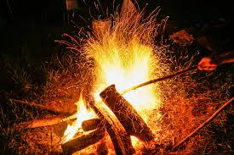
What is the typical temperature of …..
…a campfire?
200ºC 700ºC 900ºC 1100ºC

Slide 6
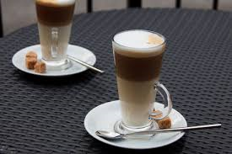
What is the typical temperature of …..
…a latte?
60ºC 70ºC 80ºC 90ºC

Slide 7
When making a hot drink, steam at 100 °C is added to 160 g of milk at 20 °C.
If the final temperature of the drink is to be 70°C, what mass of steam should be added? You may ignore energy losses to the surroundings.
X kg Steam
100ºC
0.16kg Milk
20ºC - 70ºC

Slide 8
X kg Steam
100ºC
0.16kg Milk
20ºC - 70ºC
Energy lost = Energy gained

Slide 9
A metal spoon, with an initial temperature of 20 °C, is then placed in the hot drink, causing the temperature of the hot drink to drop to 68 °C. What is the heat capacity of the spoon? You may ignore other possible heat transfers.

Slide 10
(b) Name two processes by which a hot drink cools. How is the energy lost by each of these processes reduced for a hot drink supplied in a disposable cup? (14)
A hot drink cools through convection, conduction and radiation.

Slide 11
convection

Slide 12
Conduction

Slide 13
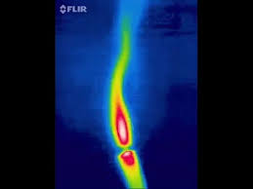
Radiation
Infra-red

Slide 14
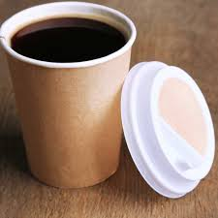
(b) Name two processes by which a hot drink cools. How is the energy lost by each of these processes reduced for a hot drink supplied in a disposable cup? (14)
A hot drink cools through convection, conduction and radiation.
Convection: The air above the drink is heated and then rises to be replaced by cooler air which in turn will heat and then rise. Heat is therefore constantly transferred away from the drink.
This process will be affected very little by using a
disposable cup, unless of course a lid is used -
which is often the case. The lid would trap a layer
of heated air above the drink and not allow it to
escape, thus limiting the creation of convection
currents.

Slide 15
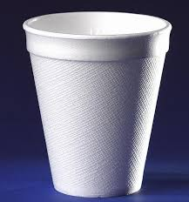
(b) Name two processes by which a hot drink cools. How is the energy lost by each of these processes reduced for a hot drink supplied in a disposable cup? (14)
A hot drink cools through convection, conduction and radiation.
Conduction: The container in which the drink is held will absorb some heat from the drink and transfer this drink from particle to particle within the cup. For this reason, most drink containers are poor conductors.
A polystyrene disposable cup is an excellent
insulator and therefore reduces this effect in
comparison with most other containers. A
standard ceramic cup, however, is probably a
better insulator than a paper disposable cup.

Slide 16
(b) Name two processes by which a hot drink cools. How is the energy lost by each of these processes reduced for a hot drink supplied in a disposable cup? (14)
A hot drink cools through convection, conduction and radiation.
Radiation: All warm bodies emit radiation into their surroundings.
A disposable cup would have little effect on this. But dark colours radiate more heat, so it would be better to use lighter colours.

Slide 17
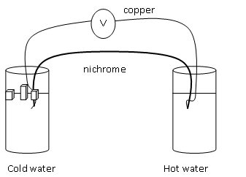
(c) A thermocouple is used to measure the temperature of the steam. How would you demonstrate the principle of operation of a thermocouple?
A thermocouple is made from a pair of metals connected as shown. When there a difference in temperature between the two junctions – as there is in the diagram, a voltage is created and a current will flow.
This is a thermometric property, which means that it can be used to measure the temperature.

Slide 18
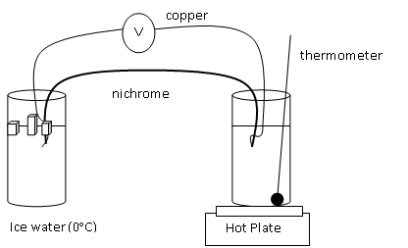
(c) A thermocouple is used to measure the temperature of the steam. How would you demonstrate the principle of operation of a thermocouple?
Set up apparatus as shown here
Begin with cold water in the beaker to the right.
Note the temperature of this water, and note the current flowing.
Slowly increase the temperature using the hot-plate.
Every 10ºC, note the current flowing.
Plot a graph of voltage against temperature

Slide 19
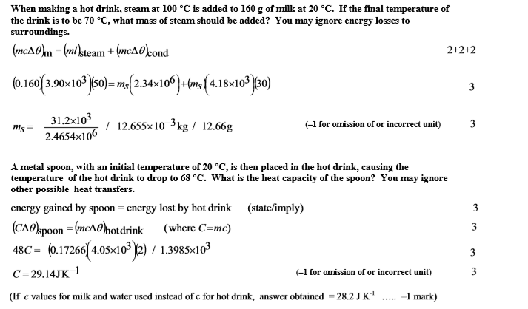
Marking Scheme

Slide 20
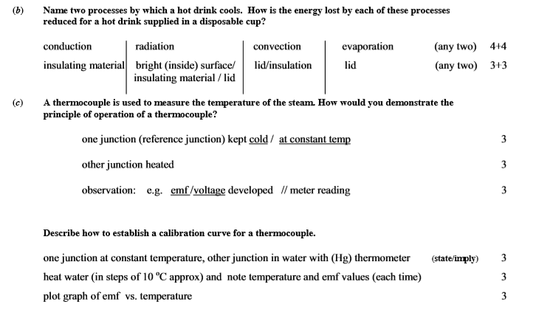
Marking Scheme

