Slide 1
Goldeneye
Specific heat capacity
Specific latent heat
Power

Slide 2

Goldeneye: train escape scene
The train escape scene
https://youtu.be/f0mjDbNmqdQ

Slide 3

Goldeneye: train escape scene
In the James Bond scene, a laser is used to cut through metal…
…the laser heats the metal beyond its melting point
…how powerful would this laser need to be?
…how much energy must the battery hold?
…and is that plausible?

Slide 4
Goldeneye: train escape scene
Assumptions…..
The floor is made of steel (and we’re told that its 1 inch thick)
That the room temperature is at 300 K (about 27 º C
That he cuts a square of side 0.5 m in the floor
That the laser beam is about 1 mm in width
That he cuts the floor in 2.5 minutes
Melting point of steel: T = 1800 K
Spec heat cap of steel: c = 490 J kg⁻¹ K⁻¹
Specific latent heat of steel: l = 2.7 x 10⁵ J kg⁻¹
Density of steel: d = 8000 kgm⁻³

Slide 5
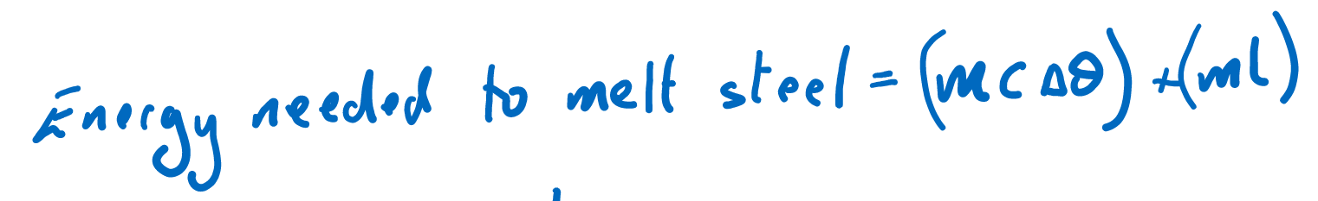
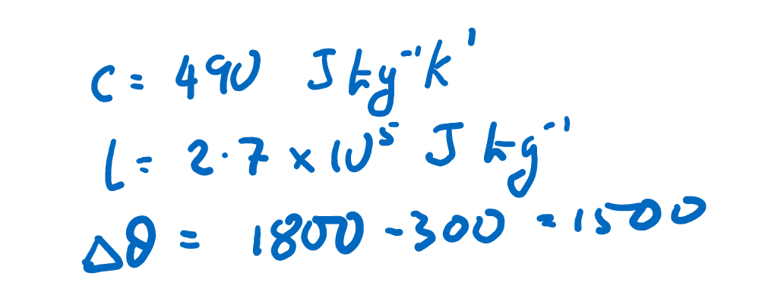

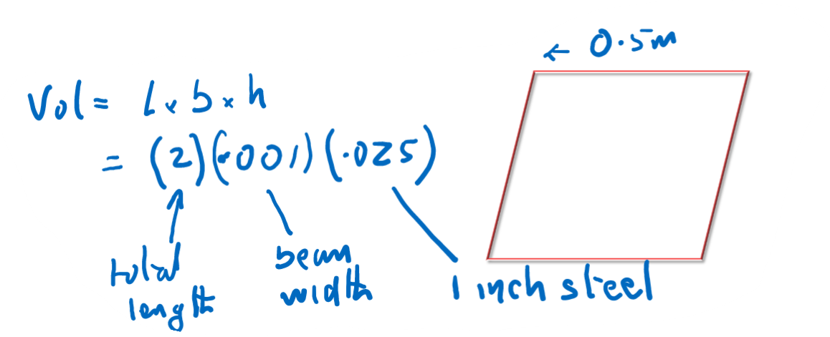

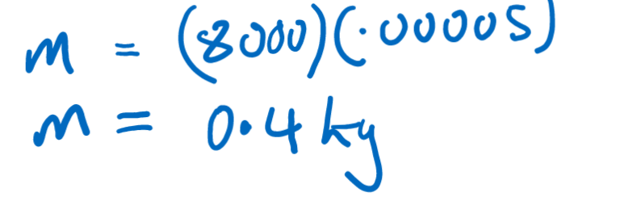

Energy required

Slide 6

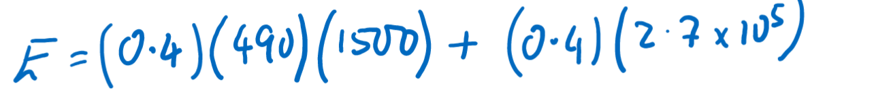

Energy required

Slide 7

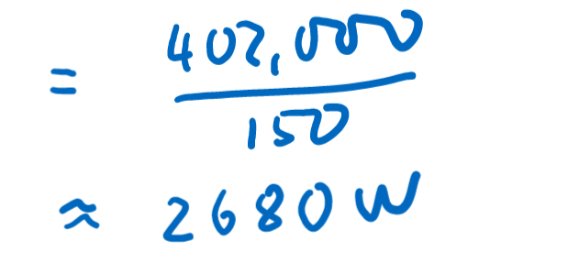
Power required
Typical power of a commercial laser: 2 – 3 kW
Typical power of a laser pointer: 5 mW

Slide 8
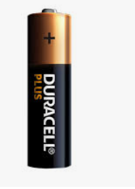
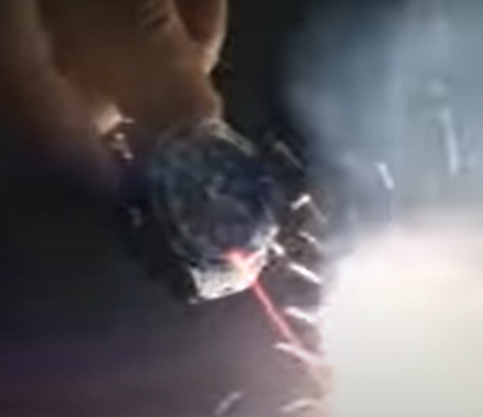
Could a watch produce this energy?
Typical energy content of a AA battery = 55 J
Energy required = 402, 000 J
Could this watch battery contain 402, 000 J?
implausible

