Slide 1

2014 q 12b

Slide 2
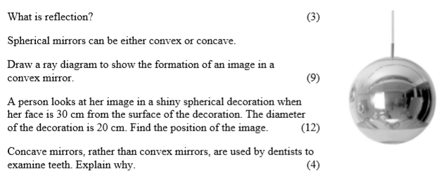
2014 q.12b

Slide 3
What is reflection? (3)
Reflection describes how a wave (notably a light wave) changes direction when incident upon a surface.

Slide 4
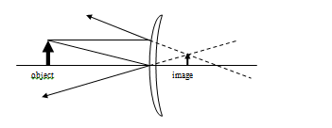
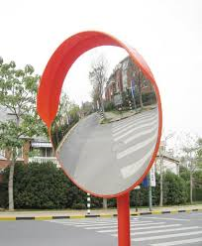
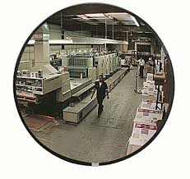
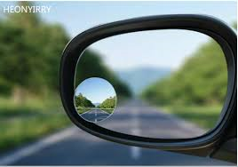
Spherical mirrors can be either convex or concave.
Draw a ray diagram to show the formation of an image in a convex mirror. (9)

Slide 5

A person looks at her image in a shiny spherical decoration when her face is 30 cm from the surface of the decoration.
The diameter of the decoration is 20 cm. Find the position of the image. (12)
For a convex mirror, v and f are negative:
d
f = 5 cm (½ the radius, or ¼ the diameter)
The image is formed 4.29 cm behind the surface of the decoration

Slide 6

Concave mirrors, rather than convex mirrors, are used by dentists to examine teeth. Explain why. (4)
Concave mirrors can produce magnified images for objects held close to the mirror.
Convex mirrors only produce diminished images.
Obviously the dentist would prefer a magnified image.

Slide 7
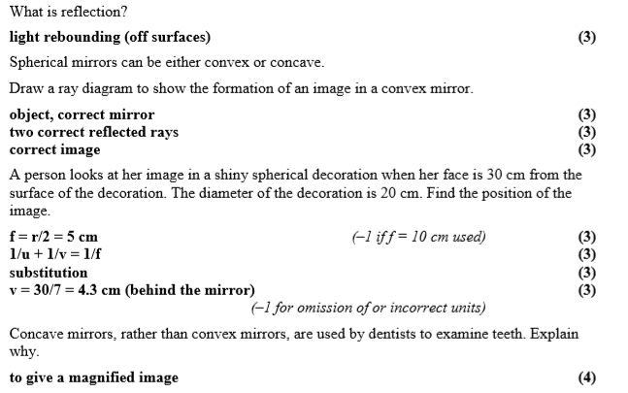
Marking scheme

