Slide 1
2013 q9
radioactivity

Slide 2
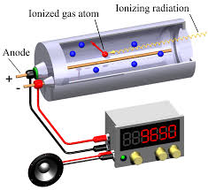
Define the becquerel.
The becquerel is defined as the decay of radioactive nucleus per second.
Name one device used to detect ionising radiations.
The Geiger-Müeller tube is used to detect radioactivity.

Slide 3
Compare alpha, beta, and gamma emissions using the following headings: (a) penetrating ability, (b) deflection in a magnetic field.
α-particles:
Their penetrating ability is the least of the radioactive emissions. They travel only about 2cm through air. They can be blocked by thin sheets of paper.
These are positively charged, so they are deflected by electric fields in the way predicted by the left hand rule.
β-particles:
Their penetrating ability is moderate. They travel about 30cm through air. They can be blocked by thin sheets of aluminium.
These are negatively charged, so they are deflected by electric fields but in the opposite direction to that predicted by the left hand rule.

Slide 4
Compare alpha, beta, and gamma emissions using the following headings: (a) penetrating ability, (b) deflection in a magnetic field.
β-particles:
Their penetrating ability is moderate. They travel about 30cm through air. They can be blocked by thin sheets of aluminium.
These are negatively charged, so they are deflected by electric fields but in the opposite direction to that predicted by the left hand rule.

Slide 5
Compare alpha, beta, and gamma emissions using the following headings: (a) penetrating ability, (b) deflection in a magnetic field.
γ-rays:
(a) Their penetrating ability is the greatest of the radioactive emissions. They can be blocked by thick sheets of lead or other dense materials.
(b) These are not electrically charged so they are not deflected by electric fields.

Slide 6
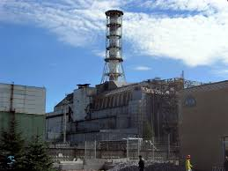
The photograph shows one of the nuclear reactors at Chernobyl, where there was a fire in April 1986 that released large quantities of radioactive contaminants. Among the contaminants were iodine-131 and caesium-137, which are two of the unstable isotopes formed by the fission of uranium-235.
Explain what happens during nuclear fission.
Nuclear fission is the breaking up of a large nucleus (3) into two smaller nuclei of similar size with the release of energy (3).
In the case of uranium-235, when bombarded with neutrons it splits in two to create barium and krypton, along with the release of 2 or 3 neutrons.

Slide 7

Iodine-131 decays with the emission of a beta-particle and has a half-life of 8 days.
Write an equation for the beta-decay of iodine-131.

Slide 8

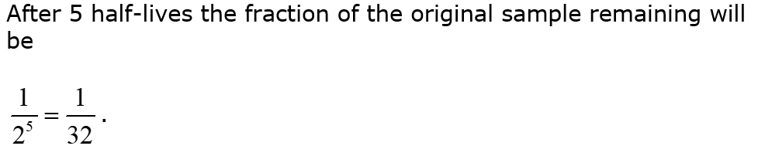
Iodine-131 decays with the emission of a beta-particle and has a half-life of 8 days.
Estimate the fraction of the iodine-131 that remained after 40 days.

Slide 9
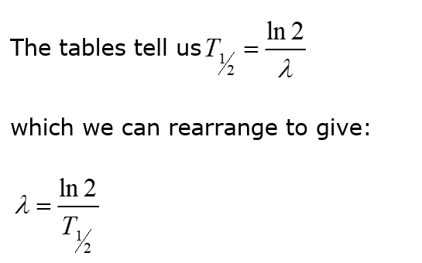
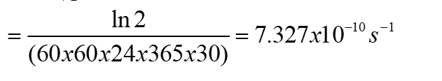


Caesium-137 has a half-life of 30 years and it remains a significant contaminant in the region around Chernobyl. It is easily absorbed into the tissues of plants as they grow. Scientists collected a sample of berries growing near the abandoned power station. The activity of the sample was measured at 5000 Bq.
Calculate the decay constant of caesium-137. Hence calculate the number of caesium-137 atoms present in the sample. (You may assume that all of the activity was caused by caesium-137.)

Slide 10

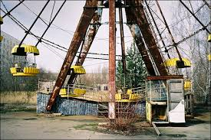

Chernobyl today…..

