Slide 1
Heat Transfer
conduction, convection, radiation
solar constant
u-values

Slide 2
Heat Transfer
Conduction
Convection
Radiation

Slide 3
Convection
Convection is …
…the transfer of heat within a body via the movement of the particles of that body

Slide 4
Conduction
Conduction is …
…the transfer of heat within a body without any net movement of the

Slide 5
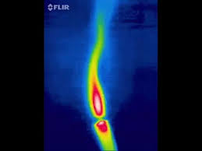
Radiation
Infra-Red Radiation
Radiation is …
…the transfer of energy across space, via electromagnetic radiation

Slide 6
Heat Pump

Slide 7
Heat Pump
In nature, heat moves from a hot region to a cold one
hot
cold
With a heat pump, heat moves from a cold region to a hot one
As used in…
…freezers / fridges
…air-conditioners
hot
cold
hotter
colder
…geo-thermal heating

Slide 8
Heat Pump
Water boils at…?
100 ºC
at standard atmospheric pressure
approx 60 ºC
on high mountains, at lower pressure
Boiling point is determined by both temperature and pressure
Phase diagrams show the connection between boiling point and pressure
Temp / ºC
boiling point
Vapour / steam
100
0
liquid / water
freezing point
ice
pressure
(Phase diagrams are not themselves on the syllabus – they are shown for background information)

Slide 9
Phase diagram for water
Temp / ºC
boiling point
Vapour / steam
100
0
liquid / water
freezing point
ice
pressure
To boil a liquid we usually think of increasing temperature…
…but we could also decrease pressure
Remember that for a liquid to change from liquid to gas, it must absorb heat from it’s surroundings (the latent heat of vaporisation)

Slide 10
How it works: freezer
A gas – liquid mix circulates as shown
Inside freezer is at low pressure
Outside freezer is at high pressure
Inside freezer, at low pressure, the liquid boils….
heat
heat
….absorbing latent heat from its surroundings
valve
Outside freezer, at high pressure, the gas condenses…
…releasing latent heat
Low pressure High pressure
The freezer becomes colder, the surroundings becomes warmer

Slide 11
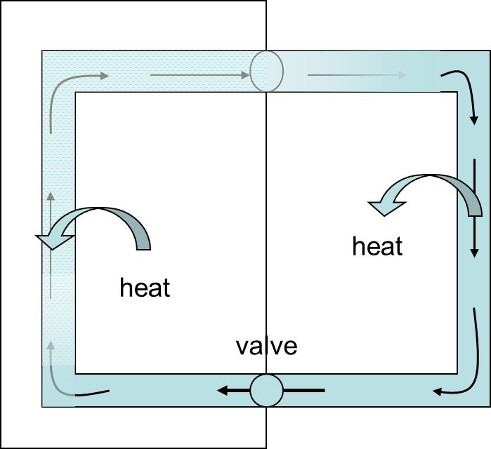
Heat Pump
The same technology is used in:
Freezers / Fridges
Air Conditioners
Geothermal Heating Systems

Slide 12
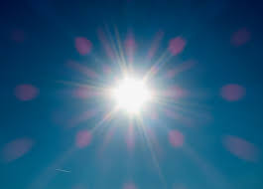
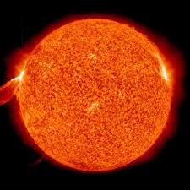

Solar Energy
The sun emits enormous quantities of radiation, used …
…in photosynthesis
…for hot water
…for electricity
…to separate salt from sea-water
…for drying clothes

Slide 13
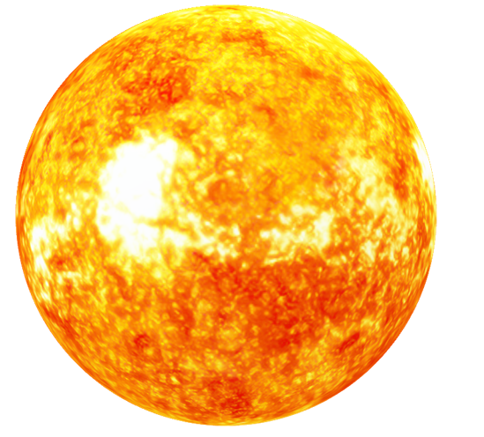

Solar Energy: the solar constant
The solar constant is the average amount of energy from the sun
falling per second perpendicularly on 1 m² of the earth’s atmosphere
The value of the solar constant is usually taken to be 1.37 kW/m²
energy
Energy
per m²
per second

Slide 14

Solar Energy: the solar constant
5 m²
5 min

Slide 15
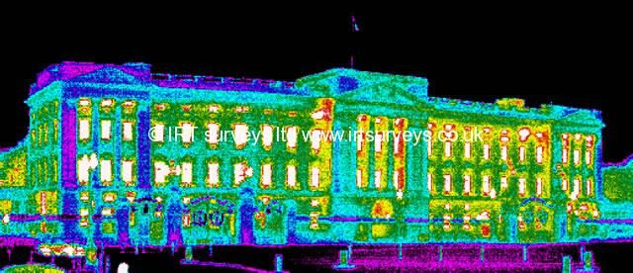
U Values
Heat loss from buildings is very wasteful
Infra-red image, showing escaping heat
The best way of measuring how good insulation is, is to measure the heat escaping…

Slide 16
U Values
the U-Value of a material is the heat energy conducted per second through 1 m² of that structure when a temperature difference of 1K is maintained between its ends

Slide 17
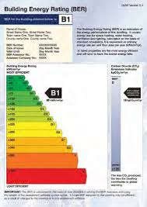

U-Values
Every material used in a building has its own U-value e.g.
  Concrete blocks: 2.3 Wm²K⁻¹
  Insulated cavity wall: 0.6 Wm²K⁻¹
  Single pane glass: 5.7 Wm²K⁻¹
  Double glazed window: 2.3 Wm²K⁻¹
Together, they contribute to a buildings BER score

Slide 18
