Slide 1
Circular Motion
Centripetal accelerations
Centripetal forces

Slide 2
Centripetal Acceleration
Remember that …..
  acceleration means the rate of change of velocity.
  velocity involves both speed and direction.
  An object travelling in a circle is always changing direction
  So, an object travelling in a circle is always accelerating
l
θ
r

Slide 3

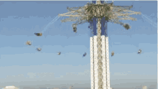


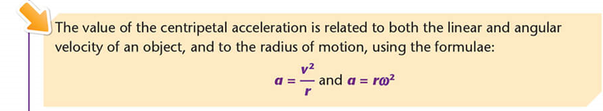
Centripetal Acceleration

Slide 4
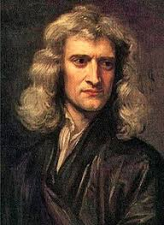

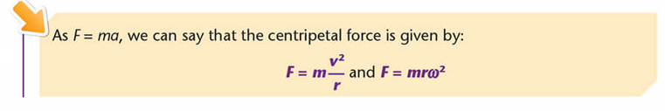
Centripetal Force
Remember Isaac Newton…..
First Law: an object will continue in a state of rest or uniform velocity in a straight line unless an unbalanced external force acts upon it
This means that if a body is travelling in a circle, there must always be a force acting in it.
This is known as the Centripetal force

Slide 5
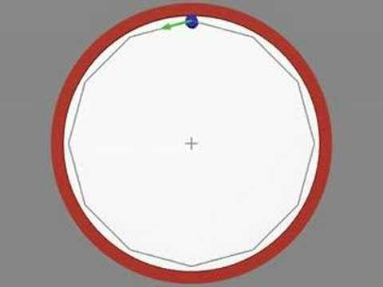
Centripetal Force
Why is the direction of a centripetal force always towards the centre?
This video helps us see why….

Slide 6

Centripetal Force
What creates the centripetal force
It can be created in many ways….

Slide 7
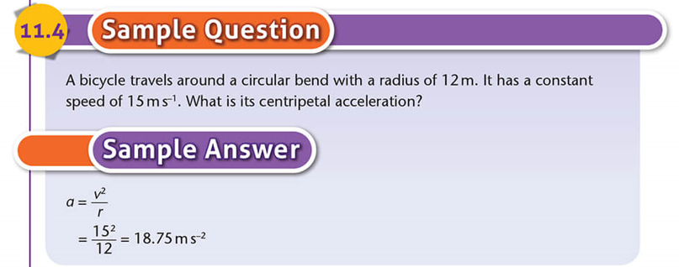
Sample questions…..

Slide 8
